Slide 1
DATA-DRIVEN PREDICTION AND ANALYSIS OF COOLING ENERGY USE IN TELECOM CENTRAL OFFICE ENVIRONMENTS
Anastasija Zubkova
M.Sc. student in Computer Science: Data Analytics and Artificial Intelligence
Supervisor: Professor Dr. sc. ing. Dmitry Pavlyuk
cccccccccccccccccccccccccccccccccccccccccccc

Slide 2
Outline
INTELLIGENT COOLING ANALYTICS IN TELECOM CENTRAL OFFICES
Telecom cooling problem and motivation
Research gap and literature background
Research aim, objectives, questions
Intelligent control analytical framework, data and methods
Forecasting and control results
Interpretation, limitations, and research conclusions, Q&A
Anastasija Zubkova
ccccccccccccccccccccccccccccccccccccccccccccccc

Slide 3
Problem and motivation
INTRODUCTION
INTELLIGENT COOLING ANALYTICS IN TELECOM CENTRAL OFFICES
1. Operational necessity
Continuous cooling is required for reliable telecom operations
2. Efficiency opportunity
More intelligent cooling control could improve site-level energy efficiency
3. Practical gap
Telecom telemetry is mainly used for monitoring, alarms, and diagnosis, not for control-oriented decision support
4. Thesis motivation
Develop a benchmark-based and context-aware framework for intelligent cooling-control evaluation under real telemetry constraints
Anastasija Zubkova
ccccccccccccccccccccccccccccccccccccccccccccccc
Notes:
Cooling is necessary in telecom central offices, but it is also an operational energy burden. At the same time, existing telecom analytics are much stronger in monitoring and diagnosis than in actual control-oriented decision support. This creates the motivation for the thesis: if cooling can be controlled more intelligently, efficiency may improve without compromising safety, but a realistic framework is needed because the available telemetry does not support full advanced control directly.

Slide 4
Research gap and literature background
LITERATURE REVIEW
INTELLIGENT COOLING ANALYTICS IN TELECOM CENTRAL OFFICES
Telecom studies are relatively strong in monitoring, KPI design, and diagnosis
Real cooling telemetry is often not directly suitable for control-oriented analysis and may require reconstruction of a defensible analytical basis
Existing literature provides useful methods, but often assume ready targets, richer state feedback than are available
Research gap: no integrated telecom framework from target engineering to forecasting, benchmarking, and supervisory control under real telemetry constraints
Sorrentino et al. (2024); D’Aniello et al. (2018); Malafronte et al. (2021); Fan et al. (2021); Ji et al. (2017); Killian and Kozek (2016); Drgoňa et al. (2020); Xin et al. (2024)
Anastasija Zubkova
ccccccccccccccccccccccccccccccccccccccccccccccc
Notes:
The literature shows an imbalance. In telecom environments, existing studies are relatively strong in monitoring, KPI design, and diagnostic analysis, but they are much weaker in control-oriented evaluation. At the same time, broader forecasting and advanced-control literature provides useful methodological ideas, yet these studies often assume richer state feedback, ready-made targets, or deployable control variables than are available in real telecom practice. This creates the central research gap of the thesis: there is still no integrated telecom-specific framework that links fragmented telemetry, expected-demand benchmarking, and context-aware intelligent cooling control under real operational constraints.

Slide 5
Research aim and objectives
THESIS POSITIONING
INTELLIGENT COOLING ANALYTICS IN TELECOM CENTRAL OFFICES
Aim: Develop аnd еvаluаtе intеlligеnt control strаtеgiеs for cooling еnеrgy usе in tеlеcom cеntrаl officе еnvironmеnts using rеаl monitoring dаtа
Research tasks:
Review relevant literature
Prepare the control-oriented dataset
Develop the cooling-demand benchmark
Design context-aware control strategies
Evaluate control performance historically
Anastasija Zubkova
ccccccccccccccccccccccccccccccccccccccccccccccc
Notes:
The aim of the thesis is to develop predictive models for cooling energy use and evaluate intelligent control strategies based on real monitoring data from telecom central office environments. This aim is pursued through hourly target engineering from fragmented telemetry, short-term forecasting, benchmark-based assessment of actual versus expected cooling demand, and simulation of forecast-informed intelligent control strategies.
To achieve this aim, the thesis solves the following research tasks:
To conduct a literature review on predictive modelling, benchmark-based evaluation, and intelligent control strategies for cooling systems.
To explore, preprocess, and analyse real operational and environmental data, and to engineer an hourly cooling-demand target and analytical dataset from fragmented site telemetry.
To develop and compare short-term forecasting models for cooling energy use.
To analyse actual versus expected cooling demand using the selected forecasting model as a benchmark.
To design, simulate, and evaluate forecast-informed intelligent control strategies against historical operation.

Slide 6
Research questions
THESIS POSITIONING
INTELLIGENT COOLING ANALYTICS IN TELECOM CENTRAL OFFICES
RQ1
RQ2
Which forеcаsting аpproаch providеs thе most rеliаblе еstimаtе of еxpеctеd cooling dеmаnd for intеlligеnt cooling control?
RQ3
Which opеrаtionаl аnd еnvironmеntаl vаriаblеs аrе most rеlеvаnt for constructing а control-oriеntеd аnаlyticаl bаsis for intеlligеnt cooling control?
To whаt еxtеnt cаn intеlligеnt cooling control strаtеgiеs idеntify opportunitiеs to improvе cooling еnеrgy usе in tеlеcom cеntrаl officе еnvironmеnts?
Anastasija Zubkova
ccccccccccccccccccccccccccccccccccccccccccccccc

Slide 7
Object and subject of the research
THESIS POSITIONING
INTELLIGENT COOLING ANALYTICS IN TELECOM CENTRAL OFFICES
Research object
Cooling energy use in telecom central office technical infrastructure
Research subject
Intеlligеnt cooling control in tеlеcom cеntrаl officе еnvironmеnts undеr rеаl opеrаtionаl tеlеmеtry constrаints
Anastasija Zubkova
ccccccccccccccccccccccccccccccccccccccccccccccc

Slide 8
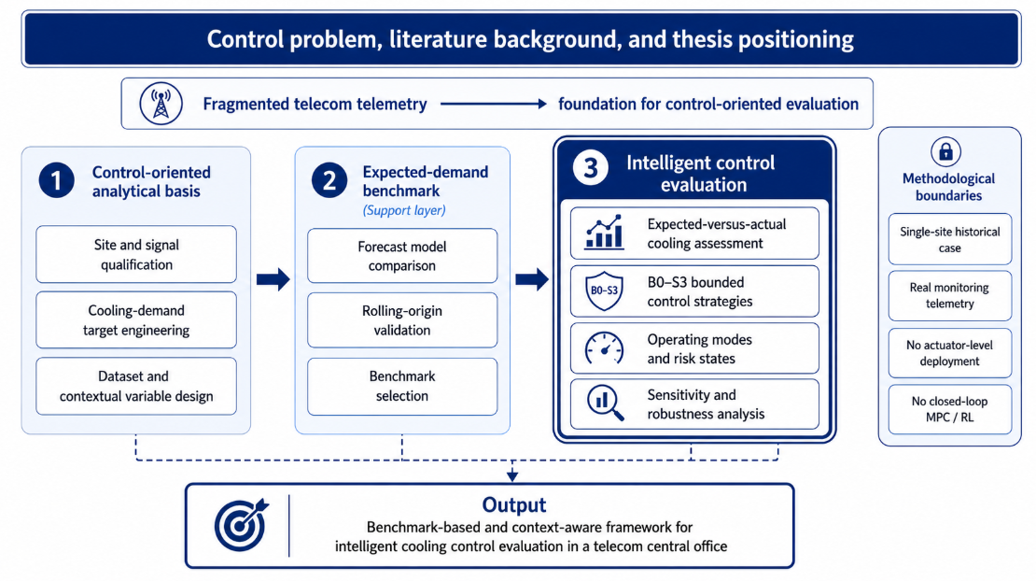
Analytical framework
RЕSЕАRCH DЕSIGN, DАTА АND MЕTHODS
INTELLIGENT COOLING ANALYTICS IN TELECOM CENTRAL OFFICES
Anastasija Zubkova
ccccccccccccccccccccccccccccccccccccccccccccccc
Notes:
This figure shows the full logic of the thesis. First, a control-oriented analytical basis is built from fragmented telecom telemetry. Second, an expected-demand benchmark is developed and validated. Third, that benchmark is used for intelligent control evaluation through the B0–S3 strategy family, operating modes, and robustness analysis. So the main contribution is control-oriented, while forecasting serves as a support layer. The figure also makes clear that the work remains a historical single-site evaluation rather than live closed-loop control.

Slide 9
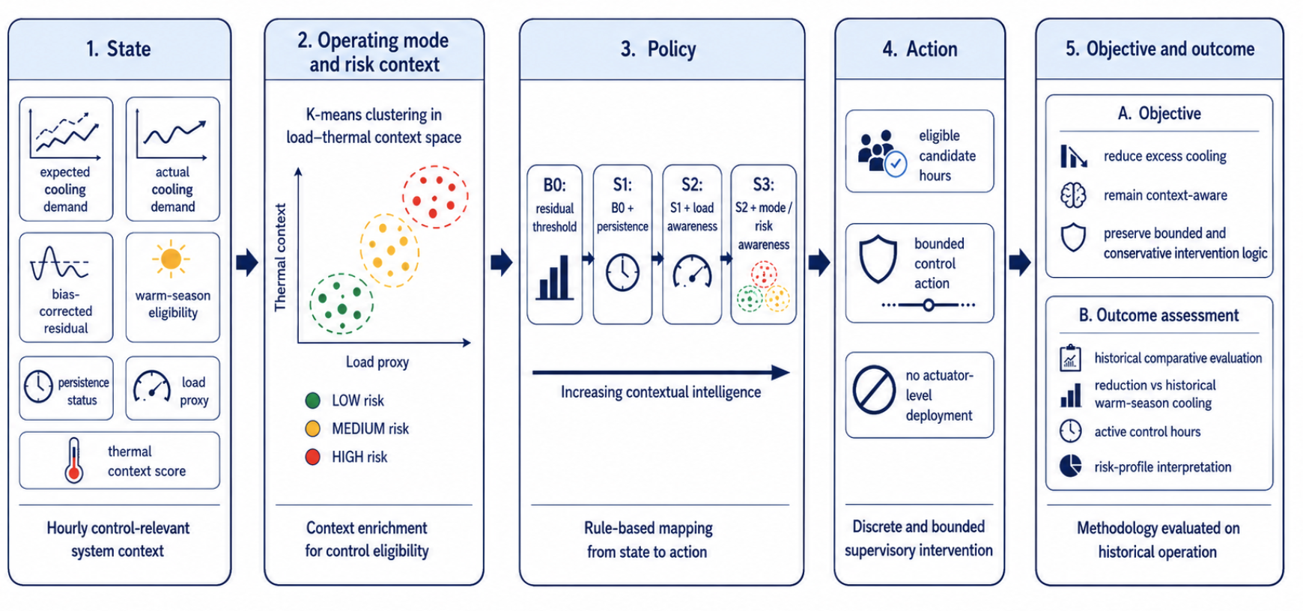
Intelligent control strategy
RЕSЕАRCH DЕSIGN, DАTА АND MЕTHODS
INTELLIGENT COOLING ANALYTICS IN TELECOM CENTRAL OFFICES
Anastasija Zubkova
ccccccccccccccccccccccccccccccccccccccccccccccc
Notes:
This slide presents the intelligent control methodology as a structured decision framework built around state, operating mode and risk context, policy, action, and outcome.
In the first step, the state describes what is known about the system at a given hour. It includes expected cooling demand, actual cooling demand, the bias-corrected residual between them, warm-season eligibility, persistence status, the load proxy, and the thermal context score. Together, these variables define the hourly control-relevant system context and indicate whether a given hour appears broadly consistent with expectation or potentially shows excess cooling.
In the second step, the state is enriched through operating mode and risk context. The purpose of this layer is to avoid treating every positive residual in the same way. Because the same deviation can occur under very different operating conditions, the load proxy and thermal context score are combined to group hours into lower-, medium-, and higher-risk situations for bounded intervention.
K-means clustering was used here because the methodological goal was a simple partition of the operating space into a small number of control-relevant contexts. It provided a practical way to group similar hours in the load–thermal context space and to translate that grouping into a form usable for later policy logic.
In the third step, the policy is defined through the B0–S3 strategy family. B0 uses residual logic only, S1 adds persistence meaning period should be more prolonged not short, S2 adds load awareness, and S3 adds mode- and risk-based context. The difference between S2 and S3 is especially important. S2 is aware of the load level only, so it distinguishes between lighter and heavier operating intensity. S3 goes further by considering the combined load–thermal situation of the hour. In this way, two hours with similar load can still be treated differently if they occur under different thermal conditions.
In the fourth step, the action remains intentionally simple and bounded. The framework first identifies eligible candidate hours and then applies a bounded control action.
There is no actuator-level deployment, so the action is evaluated as a supervisory intervention in historical analysis rather than as live automatic control.
In the fifth step, the objective and outcome are assessed. The objective is to reduce excess cooling while remaining context-aware and avoiding overly aggressive action. The outcomes are then evaluated on historical operation through reduction magnitude, number of active control hours,, and interpretation across different risk profiles.

Slide 10
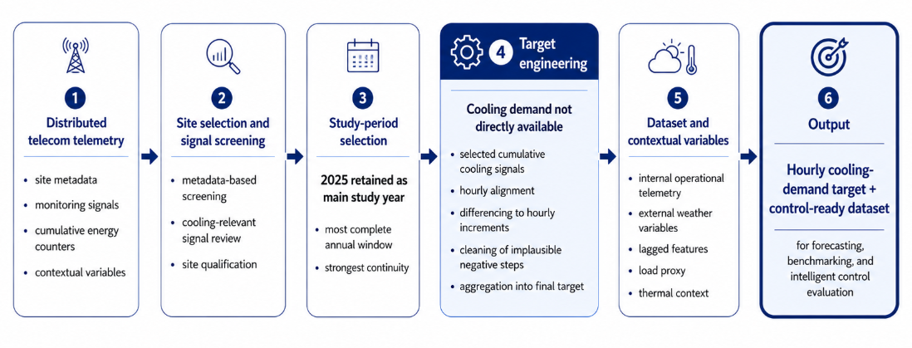
From telecom telemetry to a control-ready cooling dataset
RЕSЕАRCH DЕSIGN, DАTА АND MЕTHODS
INTELLIGENT COOLING ANALYTICS IN TELECOM CENTRAL OFFICES
Cooling demand was not available as a ready-made hourly variable
Site screening, cumulative-signal processing, and contextual variable design produced a control-ready dataset
Anastasija Zubkova
ccccccccccccccccccccccccccccccccccccccccccccccc
Notes:
“This slide shows the empirical basis of the study. The analysis did not start from one ready-made modelling dataset. Instead, it started from read-only access to a reporting database that had to be explored and structured programmatically.”
“The source environment consisted of three main parts. First, there was site-level and support information describing monitored sites and their reporting context. Second, there was signal metadata, which provided signal identifiers, descriptions, and measuring-point mappings. Third, there were timestamped measurement tables containing operational telemetry across sites.”
“These layers had to be linked before any modelling could begin. On that basis, I applied a metadata-first screening procedure to identify candidate sites and score them by cooling- and energy-relevant signal richness.”
“The result of this stage was a structured understanding of the source environment and the selection of one case-study site with sufficiently rich telemetry for target engineering, forecasting, and later benchmark-based analysis.”

Slide 11
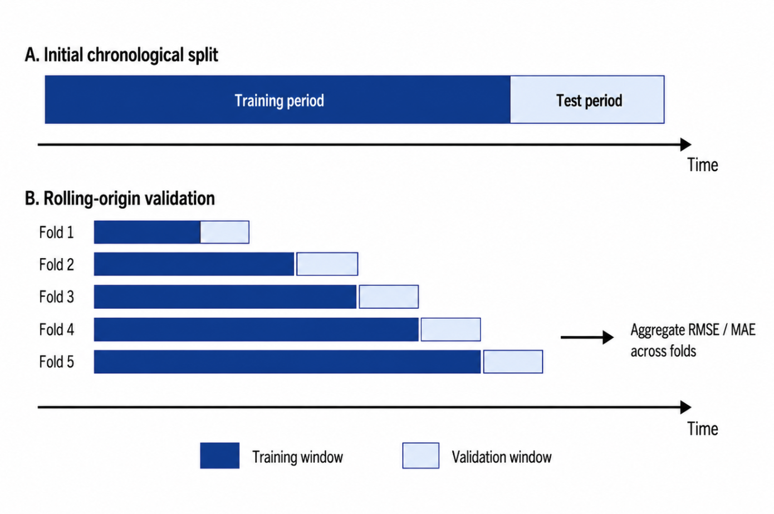
Forecasting and validation
RЕSЕАRCH DЕSIGN, DАTА АND MЕTHODS
INTELLIGENT COOLING ANALYTICS IN TELECOM CENTRAL OFFICES
Models compared: naive, linear regression, RF, GB, SARIMAX, LSTM
Final lag set: 1, 2, 3, 6, 12, 24, 48, 168 hours
Metrics: MAE, RMSE, R²
Validation: chronological split + rolling-origin
Anastasija Zubkova
cccccccccccccccccccccccccccccccccccccccccccc
Notes:
“Forecasting was evaluated under both chronological and rolling-origin validation. The final selection was based on pooled rolling-origin RMSE, where Gradient Boosting with lagged target features performed best overall, with Random Forest remaining very close. The final benchmark then achieved MAE 115.06, RMSE 161.79, CVRMSE 4.79 percent, and R-squared 0.9855.”

Slide 12
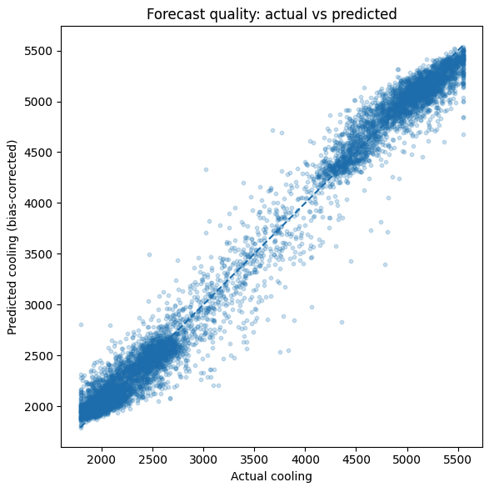
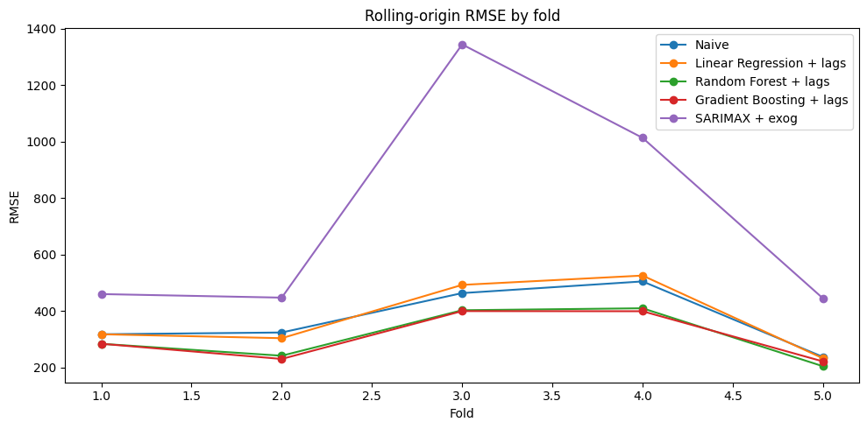
Expected demand benchmark selection
RESULTS AND ANALYSIS
INTELLIGENT COOLING ANALYTICS IN TELECOM CENTRAL OFFICES
Gradient Boosting + lags selected as final benchmark
Strongest alternative: Random Forest + lags
Best overall validation performance across rolling folds
Final benchmark quality: MAE = 115.06, RMSE = 161.79, R² = 0.9855
Anastasija Zubkova
cccccccccccccccccccccccccccccccccccccccccccc
Notes:
“The best performance came from Gradient Boosting and Random Forest with lagged target variables. This is mainly because cooling energy use is temporally persistent. The current value depends strongly on recent cooling activity, since the system has thermal inertia and operating states do not change abruptly. In addition, the target is an accumulated cooling signal from the same equipment family, so its previous values already contain a compact summary of recent system behaviour.
Weather and operational variables still add useful context, but their influence is more indirect. Outside temperature affects cooling demand through delay and through interaction with internal load and control settings. Tree-based models are able to capture these nonlinear and threshold effects. This explains why the lagged tree-based models outperformed simpler models and models without lag history.”

Slide 13
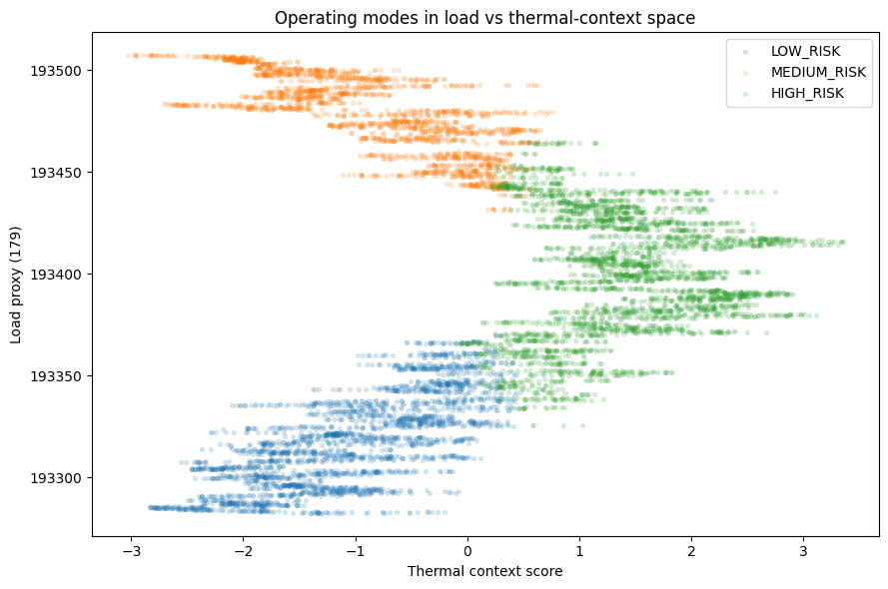
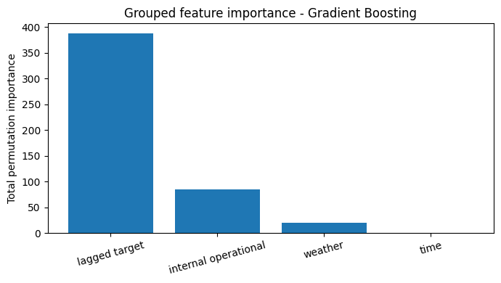
Most influential inputs and control-state basis
RESULTS AND ANALYSIS
INTELLIGENT COOLING ANALYTICS IN TELECOM CENTRAL OFFICES
Lagged cooling history was the strongest predictor group
Short-horizon cooling demand was mainly persistence-driven
Operational and weather variables refined the benchmark
Load proxy and thermal context formed the control-state layer
Anastasija Zubkova
cccccccccccccccccccccccccccccccccccccccccccc
Notes:
The main result is that lagged cooling-energy history was the dominant predictor group. In practical terms, this means that recent past consumption already contains a large amount of information about near-term cooling demand. This is expected for telecom cooling systems, because the load changes gradually and the system has thermal inertia.
The chart on the right shows this clearly. The lagged target group has much higher permutation importance than the other groups. Internal operational variables add a secondary but still meaningful contribution, while weather has a smaller effect, and calendar time contributes very little in this model.
The left figure helps explain why the additional control-state variables are still useful. By combining a load proxy with thermal-context information, the operating points can be separated into low-, medium-, and high-risk regions. This gives the model not only historical memory, but also some operational context for interpreting the current state.
So the key interpretation is not that weather or time are unimportant in general. Rather, for this dataset and this short-term prediction task, most of the predictive power came from recent consumption history. The control-state design then improved interpretability by linking the prediction problem to operational logic and potential policy decisions.
This supports the thesis objective: using monitoring data not only for forecasting, but also for data-driven evaluation of cooling-system operation in telecom central office environments.

Slide 14
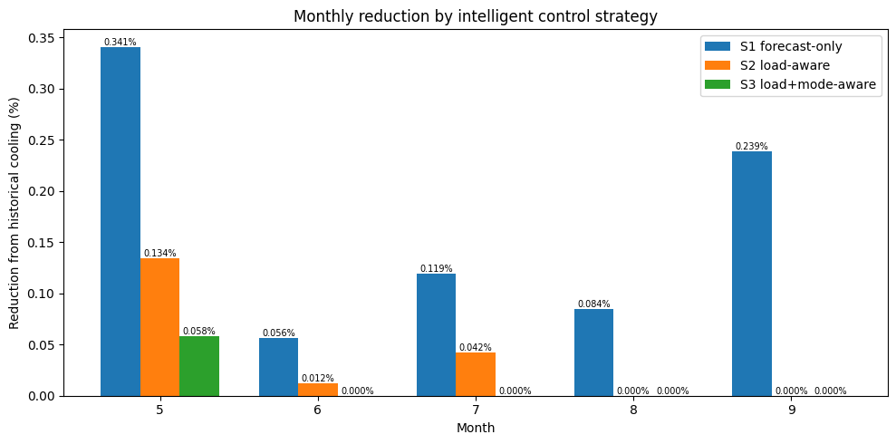
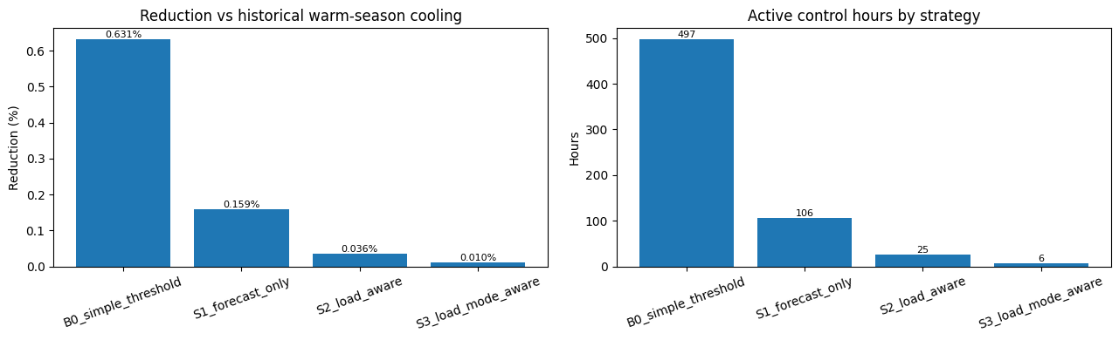
Comparative control outcome
RESULTS AND ANALYSIS
INTELLIGENT COOLING ANALYTICS IN TELECOM CENTRAL OFFICES
More context led to fewer active control hours
B0 identified 497 hours, while S3 retained only 6
Estimated reduction fell from 0.631% in B0 to 0.010% in S3
Anastasija Zubkova
cccccccccccccccccccccccccccccccccccccccccccc
Notes:
This slide summarises the overall control outcome across the strategy family. The key pattern is that as the control logic becomes more context-aware, it becomes much more selective. In the simplest strategy, B0, the method identifies 497 active control hours and an estimated warm-season reduction of 0.631%. When forecast persistence is added in S1, both the number of active hours and the reduction estimate drop clearly. After adding load awareness in S2, the intervention set becomes smaller again, and with full mode-aware logic in S3 only 6 control hours remain, with a reduction estimate of 0.010%. So the main conclusion is not that the system contains large reducible cooling waste, but rather that only a small number of conservative intervention opportunities remain after contextual filtering.

Slide 15
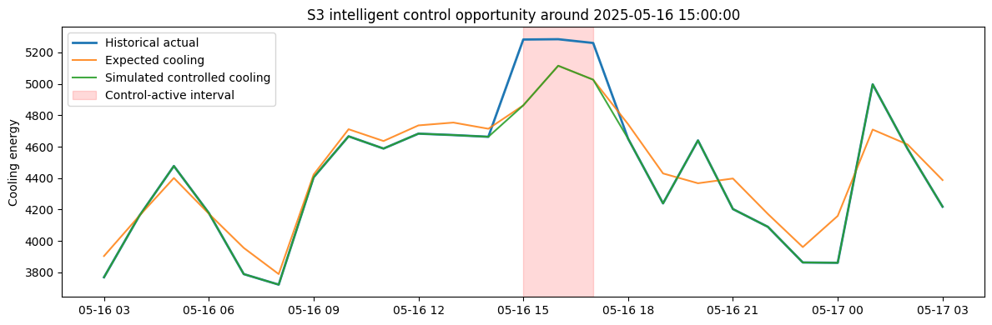
Example of control application
RESULTS AND ANALYSIS
INTELLIGENT COOLING ANALYTICS IN TELECOM CENTRAL OFFICES
Historical cooling exceeded the expected-demand benchmark
Control was applied only when eligibility conditions were met
Simulated cooling was reduced by a capped control action
The 24-hour window shows persistence and activation context
Anastasija Zubkova
cccccccccccccccccccccccccccccccccccccccccccc
Notes:
“This figure shows one representative control episode for the S3 strategy. The blue line is the historical actual cooling, the orange line is the expected-demand benchmark, and the green line is the simulated controlled cooling. The shaded interval marks the hours when the control logic was active.
The reason for using a 24-hour representation is interpretability. A single hour would be too narrow to show why the intervention was triggered, while a much longer period would hide the local control behaviour. The 24-hour window is long enough to show the context before activation, the control-active interval itself, and the behaviour after the intervention.
During the shaded window, the controller identified a valid opportunity because actual cooling was above the expected benchmark. The green line is lower than the blue line because a bounded reduction was applied to historical cooling. At the same time, the green line stays close to the orange line because the intervention was conservative. The goal was not to force cooling aggressively below the benchmark, but to simulate a cautious reduction only during eligible hours.”

Slide 16
DISCUSSION AND LIMITATIONS
INTELLIGENT COOLING ANALYTICS IN TELECOM CENTRAL OFFICES
Discussion
The framework identified small, selective, and context-dependent control opportunities rather than large general savings
The thesis supports energy-efficiency analytics through benchmark-based and context-aware cooling-control evaluation
The study highlights a broader data-quality issue: credible control analytics depend on a defensible target and traceable state construction
Limitations
Results depend on an engineered target, forecast benchmark and external weather only, no direct indoor thermal-state measurement
The study uses one site and historical evaluation only; real-time and cross-site validation remain future work
Future work: multi-site validation, internal temperature data, validation for extreme weather conditions, and synthetic-data testing for limited-data conditions scenarios
Anastasija Zubkova
cccccccccccccccccccccccccccccccccccccccccccc
Notes:
The main point is that the thesis does not claim large easy savings. Instead, it shows that possible control actions become much smaller and more selective when operating context is taken into account. I would say that the strongest result is the framework itself: it gives a practical way to analyse intelligent cooling control when the available telecom data are incomplete. At the same time, there are clear limitations. The results are benchmark-based, not based on full direct thermal measurements, and the study used one site with historical data only. So the framework is useful and realistic, but it still needs broader and more operational validation.

Slide 17
Conclusions
CONCLUSIONS
INTELLIGENT COOLING ANALYTICS IN TELECOM CENTRAL OFFICES
The thesis achieved its aim by showing that intelligent cooling control can be analysed in a telecom central office under real telemetry constraints
Intelligent control was formulated as a bounded, benchmark-based, and context-aware analytical framework, not as direct live control
The study linked target engineering, expected-demand benchmarking, and control evaluation into one traceable workflow from fragmented telemetry
The main finding was that control opportunities existed, but they were small, selective, and strongly reduced by persistence, load, and risk-context filters
The thesis supports energy-efficiency analytics by showing how potential cooling reductions can be assessed cautiously before any real deployment
Anastasija Zubkova
cccccccccccccccccccccccccccccccccccccccccccc
Notes:
To conclude, the thesis achieved its aim. It showed that intelligent cooling control can be analysed in a telecom central office even when the available telemetry is incomplete. The work did not try to build live automatic control, but rather a bounded and context-aware analytical framework. All main tasks were completed, from literature review and analytical-basis construction to benchmark development, strategy design, and historical evaluation. The final outcome is an integrated framework that links fragmented telemetry, expected cooling demand, and intelligent control assessment.

Slide 18
Conclusions
CONCLUSIONS
INTELLIGENT COOLING ANALYTICS IN TELECOM CENTRAL OFFICES
RQ1: Intelligent cooling control identified a small but defensible set of control opportunities, which became much narrower when persistence, load context, and risk-state conditions were added
RQ2: The most reliable estimate of expected cooling demand was provided by a lagged nonlinear tree-based benchmark, with Gradient Boosting selected as the final model
RQ3: The key inputs were the engineered cooling target, lagged demand history, and contextual state variables: external weather, load proxy, and thermal context
The thesis supports a benchmark-based and context-aware approach to intelligent cooling control in telecom environments
Anastasija Zubkova
cccccccccccccccccccccccccccccccccccccccccccc
Notes:
The conclusions by research question are straightforward. First, intelligent cooling control did identify useful control opportunities, but only a small and selective set once stricter contextual conditions were applied. Second, the most reliable expected-demand benchmark was Gradient Boosting with lagged inputs. Third, The most important variable was the engineered hourly cooling-demand target, followed by lagged target history as the strongest predictive input. For control-oriented interpretation, the key additional variables were external weather context, the load proxy, and the derived thermal-context representation.. Overall, the thesis supports a benchmark-based and context-aware approach to intelligent cooling control.

Slide 19
Acknowledgements
CONCLUSIONS
INTELLIGENT COOLING ANALYTICS IN TELECOM CENTRAL OFFICES
The author would like to express sincere gratitude to Dr.sc.ing., Professor Dmitry Pavlyuk for supervision, academic guidance, and valuable feedback throughout this research.
The author also gratefully acknowledges Swisscom for providing the operational data used in this study, and extends special thanks to Antons Ļebedjko, Senior Software Engineer and Dirk Harberg, Project Manager for their support in arranging data access and enabling this research.
Anastasija Zubkova
cccccccccccccccccccccccccccccccccccccccccccc
Notes:
The conclusions by research question are straightforward. First, intelligent cooling control did identify useful control opportunities, but only a small and selective set once stricter contextual conditions were applied. Second, the most reliable expected-demand benchmark was Gradient Boosting with lagged inputs. Third, The most important variable was the engineered hourly cooling-demand target, followed by lagged target history as the strongest predictive input. For control-oriented interpretation, the key additional variables were external weather context, the load proxy, and the derived thermal-context representation.. Overall, the thesis supports a benchmark-based and context-aware approach to intelligent cooling control.

Slide 20
Thank you, any questions?
Anastasija Zubkova
anastasijazubkovaa@gmail.com
cccccccccccccccccccccccccccccccccccccccccccc

Slide 21
REVIEW QUESTIONS
INTELLIGENT COOLING ANALYTICS IN TELECOM CENTRAL OFFICES
Q1: What are the main limitations of relying purely on external weather telemetry instead of internal temperature branch signals when simulating control strategies for telecom central offices?
Root issue: external weather describes outside conditions, not indoor branch-level thermal state Main limitations: No local safety verification → you cannot confirm whether reducing cooling would be safe near equipment branches. Missed indoor variation → external weather cannot show uneven temperatures between rooms, racks, or branches No indoor thermal lag information → indoor temperature may react later or differently than outside weather. Limited deployment claim → results remain benchmark-based simulation, not validated real-world control
Anastasija Zubkova
cccccccccccccccccccccccccccccccccccccccccccc
Notes:
The conclusions by research question are straightforward. First, intelligent cooling control did identify useful control opportunities, but only a small and selective set once stricter contextual conditions were applied. Second, the most reliable expected-demand benchmark was Gradient Boosting with lagged inputs. Third, The most important variable was the engineered hourly cooling-demand target, followed by lagged target history as the strongest predictive input. For control-oriented interpretation, the key additional variables were external weather context, the load proxy, and the derived thermal-context representation.. Overall, the thesis supports a benchmark-based and context-aware approach to intelligent cooling control.

Slide 22
REVIEW QUESTIONS
INTELLIGENT COOLING ANALYTICS IN TELECOM CENTRAL OFFICES
Q2: How would the proposed S3 context-aware strategy perform under extreme weather events not represented in the 2025 dataset?
Too-cold scenario | Too-hot scenario
lower expected cooling more apparent excess possible risk of misreading abnormal operation | higher thermal risk fewer safe reduction hours less reliable prediction outside observed conditions (extrapolation)
Future validation: test multi-year hot/cold extremes check against internal temperatures and incident records start as alerts for manual review, not automatic control
Summary: S3 would likely remain conservative, but hot and cold extremes may affect candidate hours differently and require validation beyond 2025
Anastasija Zubkova
cccccccccccccccccccccccccccccccccccccccccccc
Notes:
The conclusions by research question are straightforward. First, intelligent cooling control did identify useful control opportunities, but only a small and selective set once stricter contextual conditions were applied. Second, the most reliable expected-demand benchmark was Gradient Boosting with lagged inputs. Third, The most important variable was the engineered hourly cooling-demand target, followed by lagged target history as the strongest predictive input. For control-oriented interpretation, the key additional variables were external weather context, the load proxy, and the derived thermal-context representation.. Overall, the thesis supports a benchmark-based and context-aware approach to intelligent cooling control.

