Slide 1
DATA-DRIVEN PREDICTION AND ANALYSIS OF COOLING ENERGY USE IN TELECOM CENTRAL OFFICE ENVIRONMENTS
Anastasija Zubkova
M.Sc. student in Computer Science: Data Analytics and Artificial Intelligence
Supervisor: Dr.sc.ing., Professor Dmitry Pavlyuk
cccccccccccccccccccccccccccccccccccccccccccc

Slide 2
Outline
Research motivation and gap in telecom cooling analytics
Target engineering from fragmented operational telemetry
Forecasting methodology and expected-demand benchmarking
Forecast-informed supervisory control simulation and results
Conclusions, contribution, novelty
Anastasija Zubkova
ccccccccccccccccccccccccccccccccccccccccccccccc

Slide 3
Problem and motivation
INTRODUCTION
Telecom central offices require continuous cooling for reliable operation of sensitive equipment
Existing telecom analytics are stronger in monitoring and diagnosis than in control-oriented decision support
More intelligent cooling control could improve efficiency without compromising operational safety, but full advanced control is difficult under available telemetry constraints
The thesis therefore develops an intelligent, control-oriented framework for real telecom operating conditions.
Anastasija Zubkova
ccccccccccccccccccccccccccccccccccccccccccccccc
Notes:
Cooling is necessary in telecom central offices, but it is also an operational energy burden. At the same time, existing telecom analytics are much stronger in monitoring and diagnosis than in actual control-oriented decision support. This creates the motivation for the thesis: if cooling can be controlled more intelligently, efficiency may improve without compromising safety, but a realistic framework is needed because the available telemetry does not support full advanced control directly.

Slide 4
Research gap and literature background
INTRODUCTION
Telecom studies are relatively strong in monitoring, KPI design, and diagnosis
Real cooling telemetry is often not directly suitable for control-oriented analysis and may require reconstruction of a defensible analytical basis
Literature provide useful methods, but often assume ready targets, richer state feedback than are available
Research gap: no integrated telecom framework from target engineering to forecasting, benchmarking, and supervisory control under real telemetry constraints
Sorrentino et al. (2024); D’Aniello et al. (2018); Malafronte et al. (2021); Fan et al. (2021); Ji et al. (2017); Killian and Kozek (2016); Drgoňa et al. (2020); Xin et al. (2024)
Anastasija Zubkova
ccccccccccccccccccccccccccccccccccccccccccccccc
Notes:
The literature shows an imbalance. In telecom environments, existing studies are relatively strong in monitoring, KPI design, and diagnostic analysis, but they are much weaker in control-oriented evaluation. At the same time, broader forecasting and advanced-control literature provides useful methodological ideas, yet these studies often assume richer state feedback, ready-made targets, or deployable control variables than are available in real telecom practice. This creates the central research gap of the thesis: there is still no integrated telecom-specific framework that links fragmented telemetry, expected-demand benchmarking, and context-aware intelligent cooling control under real operational constraints.

Slide 5
Research aim and objectives
INTRODUCTION
Aim: Develop аnd еvаluаtе intеlligеnt control strаtеgiеs for cooling еnеrgy usе in tеlеcom cеntrаl officе еnvironmеnts using rеаl monitoring dаtа
Research tasks:
Review relevant literature
Prepare the control-oriented dataset
Develop the cooling-demand benchmark
Design context-aware control strategies
Evaluate control performance historically
Anastasija Zubkova
ccccccccccccccccccccccccccccccccccccccccccccccc
Notes:
The aim of the thesis is to develop predictive models for cooling energy use and evaluate intelligent control strategies based on real monitoring data from telecom central office environments. This aim is pursued through hourly target engineering from fragmented telemetry, short-term forecasting, benchmark-based assessment of actual versus expected cooling demand, and simulation of forecast-informed intelligent control strategies.
To achieve this aim, the thesis solves the following research tasks:
To conduct a literature review on predictive modelling, benchmark-based evaluation, and intelligent control strategies for cooling systems.
To explore, preprocess, and analyse real operational and environmental data, and to engineer an hourly cooling-demand target and analytical dataset from fragmented site telemetry.
To develop and compare short-term forecasting models for cooling energy use.
To analyse actual versus expected cooling demand using the selected forecasting model as a benchmark.
To design, simulate, and evaluate forecast-informed intelligent control strategies against historical operation.

Slide 6
Research questions
INTRODUCTION
To whаt еxtеnt cаn intеlligеnt cooling control strаtеgiеs idеntify opportunitiеs to improvе cooling еnеrgy usе in tеlеcom cеntrаl officе еnvironmеnts?
Which forеcаsting аpproаch providеs thе most rеliаblе еstimаtе of еxpеctеd cooling dеmаnd for intеlligеnt cooling control?
Which opеrаtionаl аnd еnvironmеntаl vаriаblеs аrе most rеlеvаnt for constructing а control-oriеntеd аnаlyticаl bаsis for intеlligеnt cooling control?
Anastasija Zubkova
ccccccccccccccccccccccccccccccccccccccccccccccc

Slide 7
Object and subject of research
INTRODUCTION
The object of the research is cooling energy use in telecom central office technical infrastructure.
The subject of the research is intеlligеnt cooling control in tеlеcom cеntrаl officе еnvironmеnts undеr rеаl opеrаtionаl tеlеmеtry constrаints
Anastasija Zubkova
ccccccccccccccccccccccccccccccccccccccccccccccc

Slide 8
Analytical framework
INTRODUCTION
The object of the research is cooling energy use in telecom central office technical infrastructure.
The subject of the research is intеlligеnt cooling control in tеlеcom cеntrаl officе еnvironmеnts undеr rеаl opеrаtionаl tеlеmеtry constrаints
Anastasija Zubkova
ccccccccccccccccccccccccccccccccccccccccccccccc

Slide 9
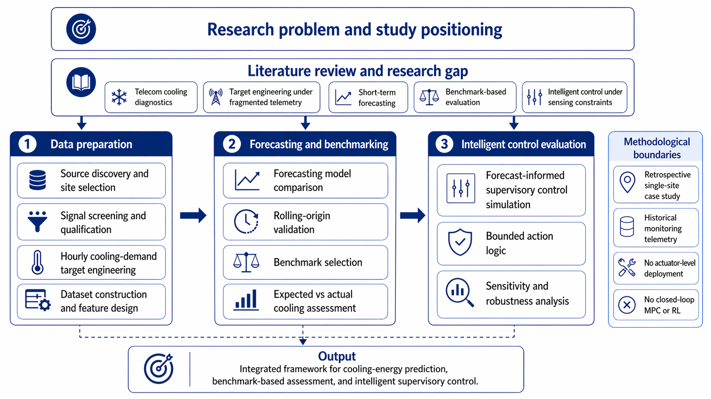
RЕSЕАRCH DЕSIGN, DАTА АND MЕTHODS
Analytical framework
Anastasija Zubkova
ccccccccccccccccccccccccccccccccccccccccccccccc
Notes:
This figure shows the overall logic of the thesis. Starting from the research problem and literature review, the study moves through three linked phases. First, I prepare the data by selecting the site, screening the signals, and engineering an hourly cooling-demand target from fragmented telemetry. Second, I compare forecasting models and select a defensible expected-demand benchmark. Third, I use that benchmark for expected-versus-actual assessment and for forecast-informed supervisory control simulation. The study remains methodologically bounded: it is retrospective, single-site, and based on historical telemetry, without actuator-level deployment or full MPC. The main contribution is therefore not one model in isolation, but an integrated analytical framework for telecom cooling analytics.

Slide 10
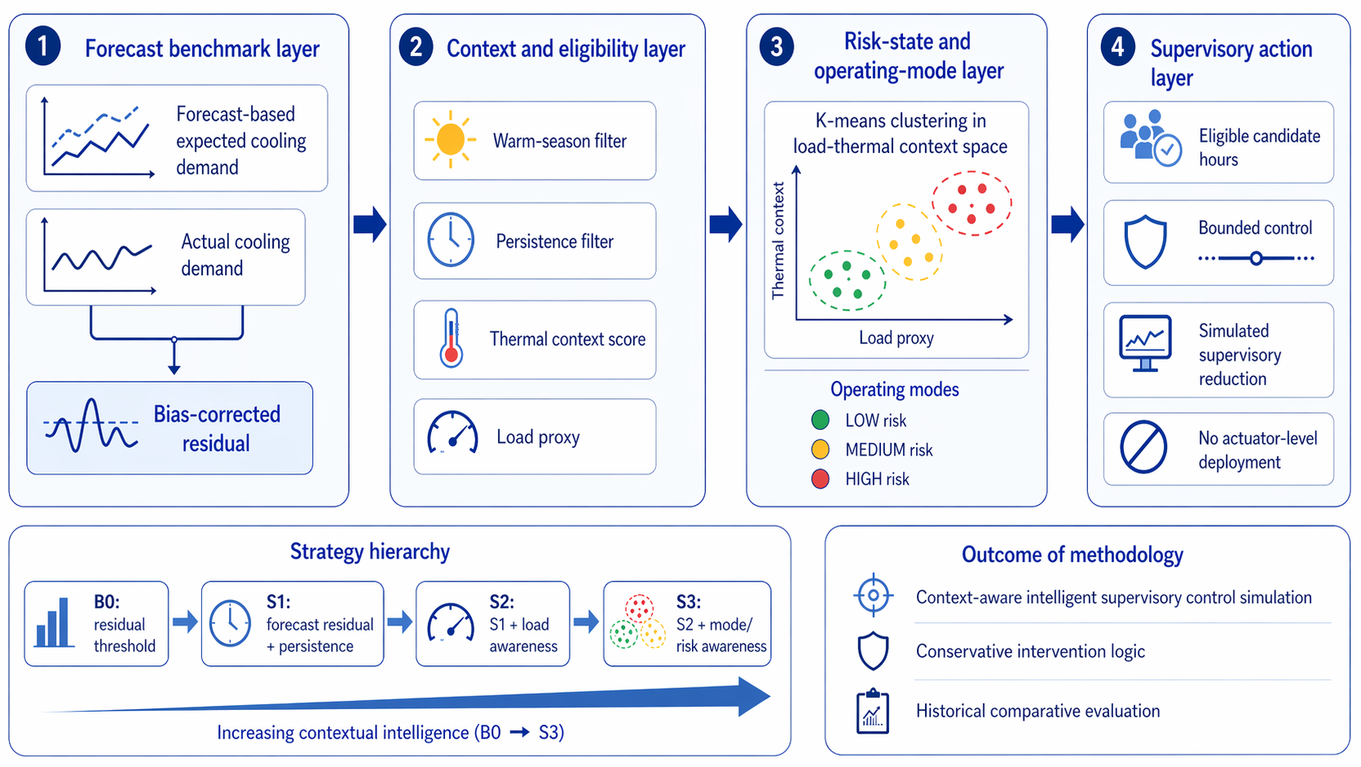
Intelligent control strategy
RЕSЕАRCH DЕSIGN, DАTА АND MЕTHODS
Anastasija Zubkova
ccccccccccccccccccccccccccccccccccccccccccccccc
Notes:
“This slide summarizes how supervisory control was designed in the study. First, I defined the control context using load proxy 179 and a thermal-context score, and then applied K-means clustering to identify recurring operating modes, which were interpreted as low-, medium-, and high-risk contexts. Second, these operating states were embedded into a rule-based supervisory workflow, where forecast residuals were filtered by season, persistence, and risk eligibility before any bounded control action was simulated.”

Slide 11
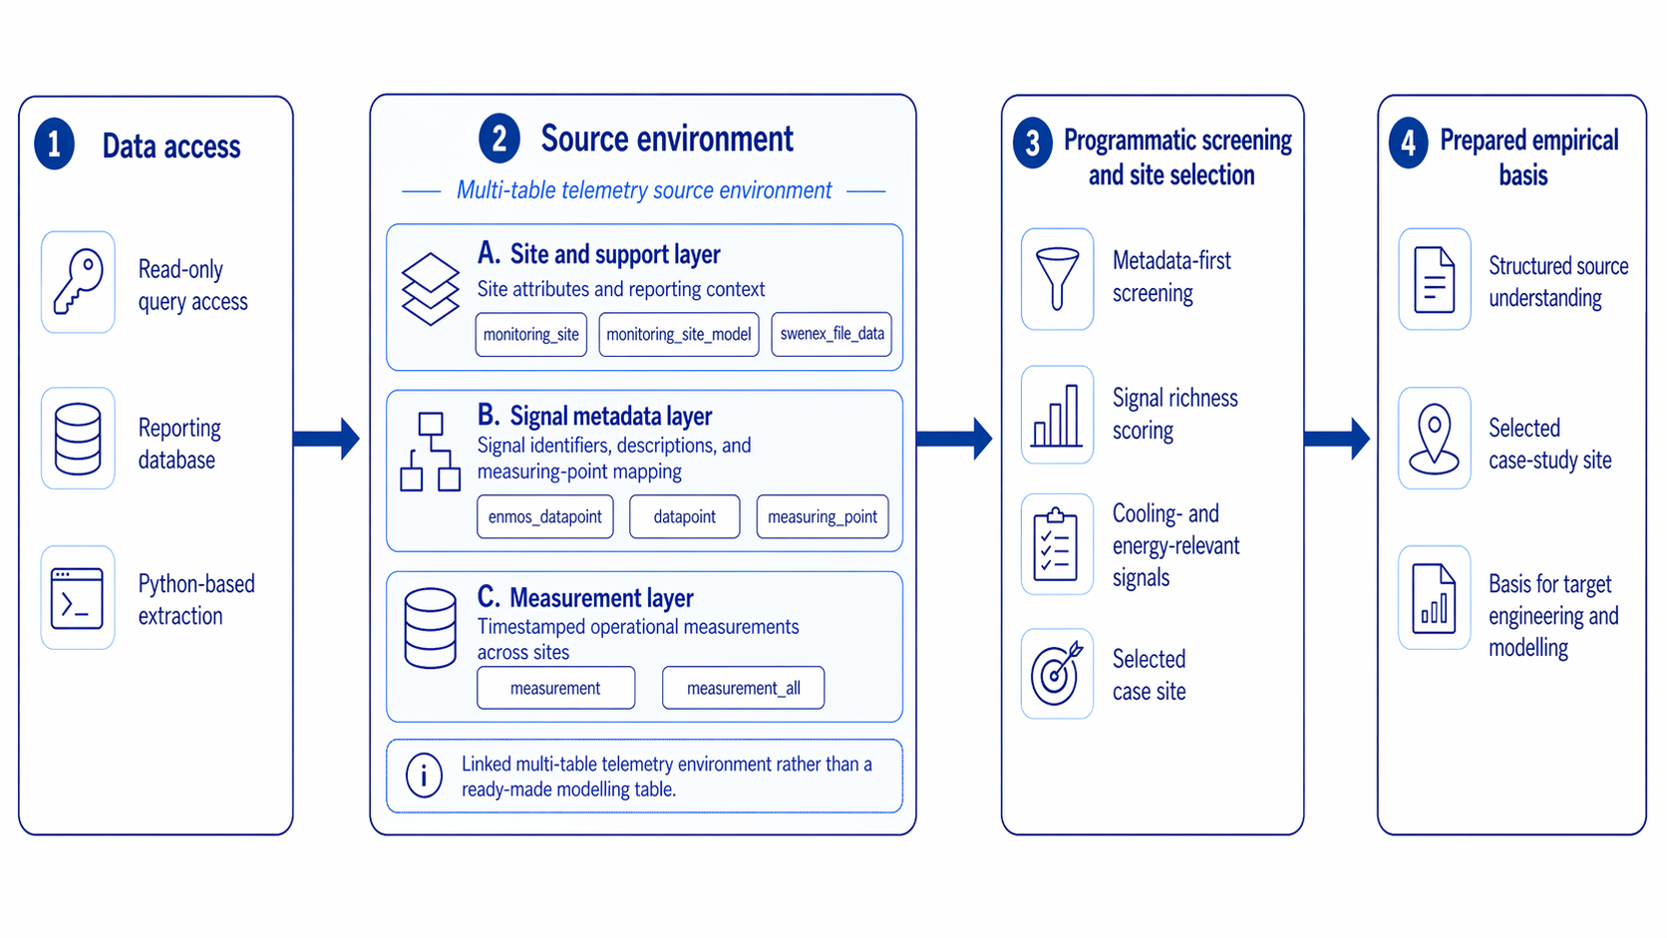
7. Data and case-study context: Data access and source environment
RЕSЕАRCH DЕSIGN, DАTА АND MЕTHODS
Anastasija Zubkova
ccccccccccccccccccccccccccccccccccccccccccccccc
Notes:
“This slide shows the empirical basis of the study. The analysis did not start from one ready-made modelling dataset. Instead, it started from read-only access to a reporting database that had to be explored and structured programmatically.”
“The source environment consisted of three main parts. First, there was site-level and support information describing monitored sites and their reporting context. Second, there was signal metadata, which provided signal identifiers, descriptions, and measuring-point mappings. Third, there were timestamped measurement tables containing operational telemetry across sites.”
“These layers had to be linked before any modelling could begin. On that basis, I applied a metadata-first screening procedure to identify candidate sites and score them by cooling- and energy-relevant signal richness.”
“The result of this stage was a structured understanding of the source environment and the selection of one case-study site with sufficiently rich telemetry for target engineering, forecasting, and later benchmark-based analysis.”

Slide 12
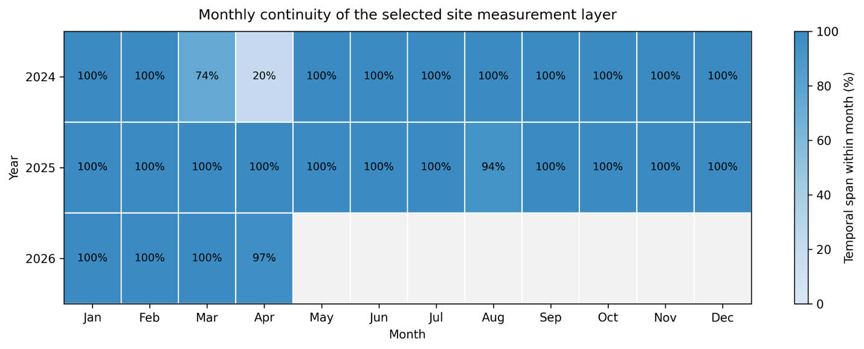
7. Data and case-study context: Study period and temporal continuity
RЕSЕАRCH DЕSIGN, DАTА АND MЕTHODS
The data covered more than one year, but the analysis was restricted to year 2025
2025 is complete and internally coherent annual window
Monthly continuity in 2025 remained effectively complete, only one dip to 94% in August
Anastasija Zubkova
ccccccccccccccccccccccccccccccccccccccccccccccc
Notes:
“I restricted the analysis to calendar year 2025 because it provided the most complete and internally coherent annual window. The heatmap shows that 2025 was effectively complete, with only one moderate dip to 94 percent in August, whereas 2024 had clear disruptions and 2026 was still partial. This made 2025 the strongest basis for target engineering, forecasting validation, and benchmark-based analysis.”

Slide 13
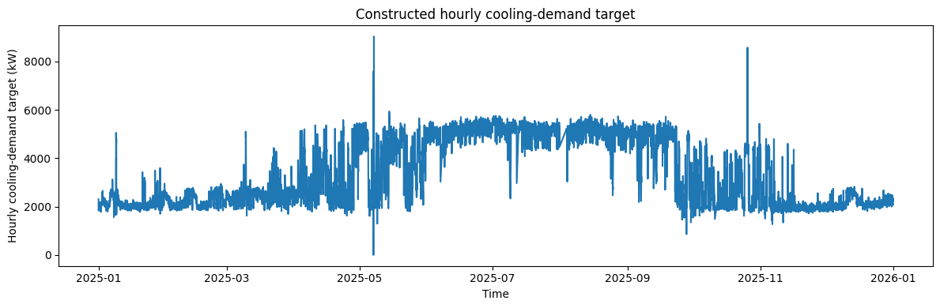
8. Methodology: Target engineering
RЕSЕАRCH DЕSIGN, DАTА АND MЕTHODS
Cooling demand was not available as a ready hourly target
Candidate cumulative cooling signals were screened
Hourly target built by alignment, differencing, clipping, and aggregation
Anastasija Zubkova
Notes:
“First, I had to engineer the target, because cooling demand was not directly available as a ready hourly variable. I shortlisted plausible cumulative cooling-related signals and retained 120, 230, 46, 49, and 78 because they jointly showed clear cooling semantics, strong hourly usability, non-trivial variability, coherent co-movement, and the most interpretable core cooling-distribution role.”

Slide 14
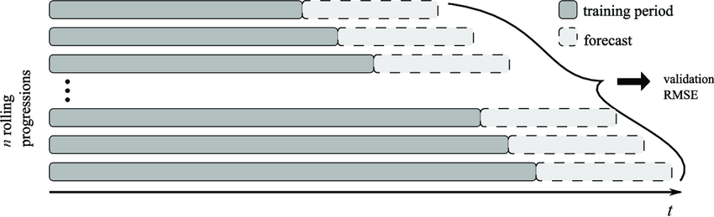
8. Methodology: Forecasting and validation
Models compared: naive, linear regression, RF, GB, SARIMAX, LSTM
Final lag set: 1, 2, 3, 6, 12, 24, 48, 168 hours
Metrics: MAE, RMSE, R²
Validation: chronological split + rolling-origin
Rolling origin forecast cross-validation principle. Figure adopted from Oliveira and Ramos (2019)
Anastasija Zubkova
Notes:
“Forecasting was evaluated under both chronological and rolling-origin validation. The final selection was based on pooled rolling-origin RMSE, where Gradient Boosting with lagged target features performed best overall, with Random Forest remaining very close. The final benchmark then achieved MAE 115.06, RMSE 161.79, CVRMSE 4.79 percent, and R-squared 0.9855.”

Slide 15
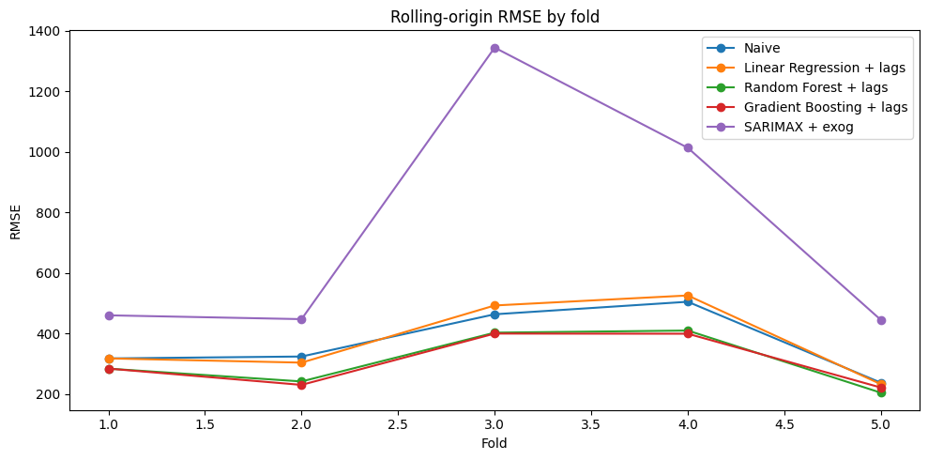
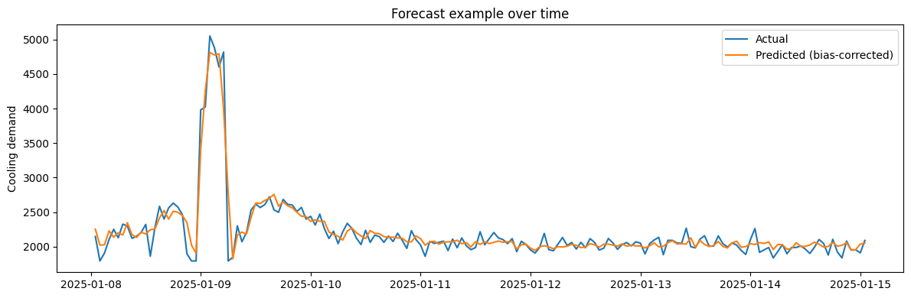
9. Results: Forecasting performance and final model selection
Best model: Gradient Boosting + lags
Strong secondary benchmark: Random Forest + lags
Final benchmark quality: MAE 115.06, RMSE 161.79, R² 0.9855
Anastasija Zubkova
Notes:
“This slide presents the main forecasting result. Under rolling-origin validation, Gradient Boosting with lagged target features achieved the best overall RMSE and was therefore selected as the final benchmark model. Random Forest remained very close, while naive persistence was still a strong baseline, which confirms that the process is strongly persistence-driven. The final selected benchmark then achieved MAE 115.06, RMSE 161.79, and R-squared 0.9855, which is strong enough to support expected-demand benchmarking rather than prediction alone.”

Slide 16
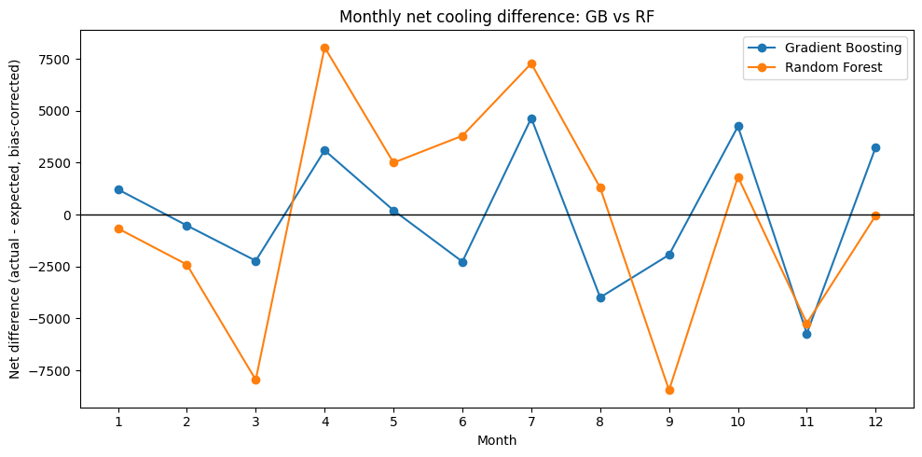
9. Results: Benchmarking actual vs expected cooling
Full-year net difference ≈ 0 after bias correction
Warm season: excess 1.34%, reduced 1.36%, net -0.02%
No evidence of large-scale systematic annual overcooling
Anastasija Zubkova
Notes:
“This slide presents the main forecasting result. Under rolling-origin validation, Gradient Boosting with lagged target features achieved the best overall RMSE and was therefore selected as the final benchmark model. Random Forest remained very close, while naive persistence was still a strong baseline, which confirms that the process is strongly persistence-driven. The final selected benchmark then achieved MAE 115.06, RMSE 161.79, and R-squared 0.9855, which is strong enough to support expected-demand benchmarking rather than prediction alone.”

Slide 17
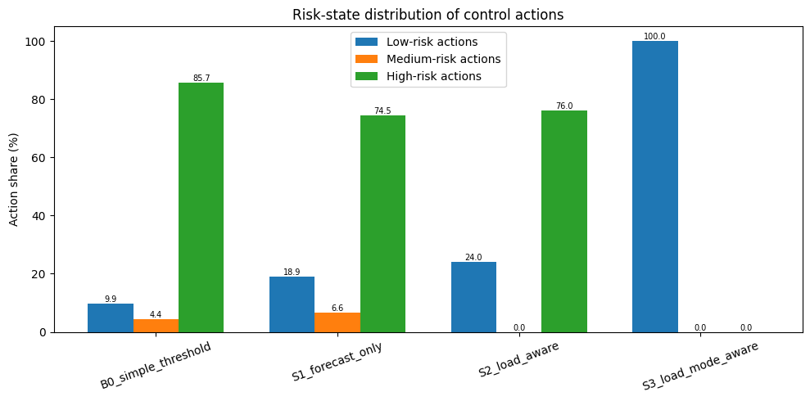
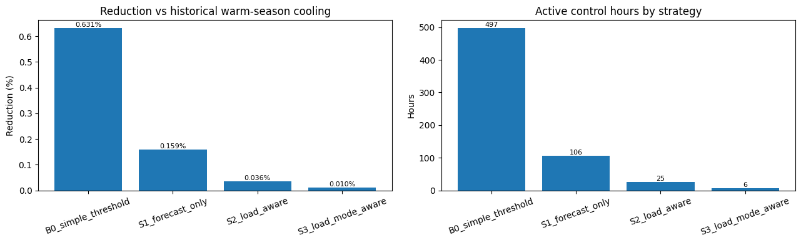
9. Results: Control outcome
Increasing supervisory context yields fewer active hours and smaller reduction estimates
Stricter strategies also shift actions toward safer operating
Anastasija Zubkova
Notes:
“The final result concerns forecast-informed control simulation. Once the benchmark residuals are filtered through conservative supervisory rules, the candidate set shrinks sharply from all warm-season hours to only 38 control-eligible hours. The strategy hierarchy is also clear: S1 is broader, S2 is stricter, and S3 is the most selective and context-aware. So the thesis does identify intervention opportunities, but they are small, bounded, and operationally conservative rather than large reducible waste.”

Slide 18
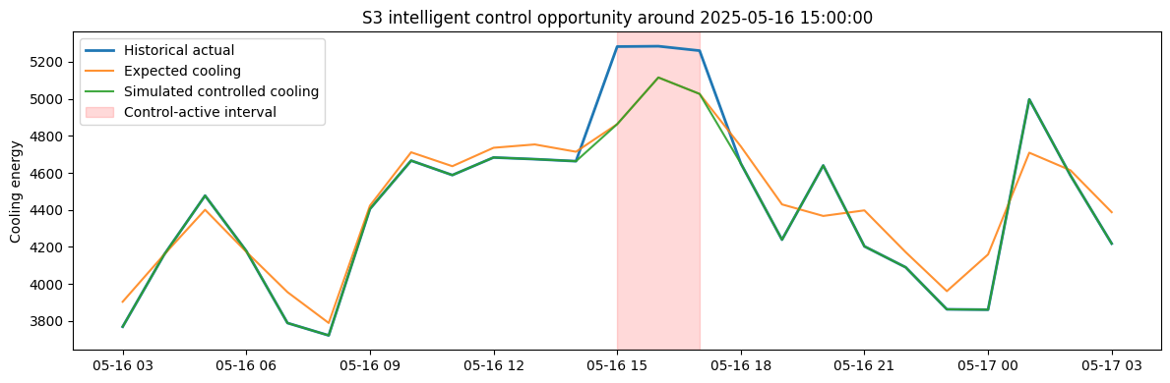
9. Results: Example of simulated control intervention
Actual cooling exceeded the expected-demand benchmark
Simulated control reduced cooling only during the eligible interval
Intervention remained conservative and time-local
Anastasija Zubkova
Notes:
“This slide shows why the stricter strategies are not just smaller, but safer. The control logic increasingly suppresses actions in riskier operating contexts. In the final validated version, S3 acts only in low-risk conditions, which is a strong supervisory result. So the main contribution is not aggressive reduction, but selective and risk-aware intervention logic.”

Slide 19
10. Discussion and limitations
The method found small and selective control opportunities, not large general savings
The main value of the thesis is the framework which shows how control can be analysed with limited telecom data
The results are based on a benchmark model, not on direct measurement of full indoor thermal conditions
The study used one site and historical data only, so real-time testing is still needed
Anastasija Zubkova
Notes:
The main point is that the thesis does not claim large easy savings. Instead, it shows that possible control actions become much smaller and more selective when operating context is taken into account. I would say that the strongest result is the framework itself: it gives a practical way to analyse intelligent cooling control when the available telecom data are incomplete. At the same time, there are clear limitations. The results are benchmark-based, not based on full direct thermal measurements, and the study used one site with historical data only. So the framework is useful and realistic, but it still needs broader and more operational validation.

Slide 20
Conclusions
The thesis achieved its aim by showing that intelligent cooling control can be analysed in a telecom central office under real telemetry constraints
In the present case, intelligent control was formulated as a bounded and context-aware analytical framework rather than as direct live control
All main tasks were completed: literature review, construction of the analytical basis, expected-demand benchmark development, control-strategy design, and historical evaluation
The study produced a framework linking fragmented telemetry, expected-demand benchmarking, and context-aware intelligent control assessment
Notes:
To conclude, the thesis achieved its aim. It showed that intelligent cooling control can be analysed in a telecom central office even when the available telemetry is incomplete. The work did not try to build live automatic control, but rather a bounded and context-aware analytical framework. All main tasks were completed, from literature review and analytical-basis construction to benchmark development, strategy design, and historical evaluation. The final outcome is an integrated framework that links fragmented telemetry, expected cooling demand, and intelligent control assessment.

Slide 21
Conclusions
RQ1: Intelligent cooling control identified a small but defensible set of control opportunities, which became much narrower when persistence, load context, and risk-state conditions were added
RQ2: The most reliable estimate of expected cooling demand was provided by a lagged nonlinear tree-based benchmark, with Gradient Boosting selected as the final model
RQ3: A control-oriented analytical basis could be built from fragmented telecom telemetry through target engineering, signal qualification, and contextual state design
The thesis supports a benchmark-based and context-aware approach to intelligent cooling control in telecom environments
Anastasija Zubkova
Notes:
The conclusions by research question are straightforward. First, intelligent cooling control did identify useful control opportunities, but only a small and selective set once stricter contextual conditions were applied. Second, the most reliable expected-demand benchmark was Gradient Boosting with lagged inputs. Third, fragmented telecom telemetry could still support control-oriented analysis, but only after explicit engineering of the target and the control state. Overall, the thesis supports a benchmark-based and context-aware approach to intelligent cooling control.

Slide 22
Thank you, any questions?
Anastasija Zubkova
anastasijazubkovaa@gmail.com

