Slide 1
Software Barrier Algorithms
INCOMPLETE
Shows Progress

Slide 2
Outline
Hardware Background
Software Barrier Algorithms Implemented
Intel Sandy Bridge Architecture
Experiments and Results
Conclusions

Slide 3
Hardware Background (1/3)
Correctness Related
  Read/Write/Full fences required for correct execution
  Used C/C++11 memory model to abstract the underlying hardware machine memory model
    Portability: all compilers support the C/C++11 memory model (at least in their newest versions)
    DETAILS FOR THE MEMORY MODEL OMITTED

Slide 4
Hardware Background (2/3)
Performance Related
  Atomic Primitives Used
    Instead of locks I used the atomics.
    std::atomic<int> i, declares an atomic integer variable i.
      i.load(memory_order)/i.store(v,memory_order)/i.exchange(v,memory_order)
      i.compare_exchange_weak(vold,vnew,memory_order)/...
  False-Sharing
    Even if threads use different data variables, the cache ping-pong effect can still arise if those variables lie inside the same cache-line.
    HARDWARE PREFETCHING NOT YET DEALT WITH
  Relaxed Model
    The implementations use the Relaxed Ordering offered by the C/C++ memory model which map efficiently to the underlying memory model by providing fine-grained control over the amount of ordering and synchronization required around the memory accesses of different threads
    What does this mean for performance?
      See next slide

Slide 5
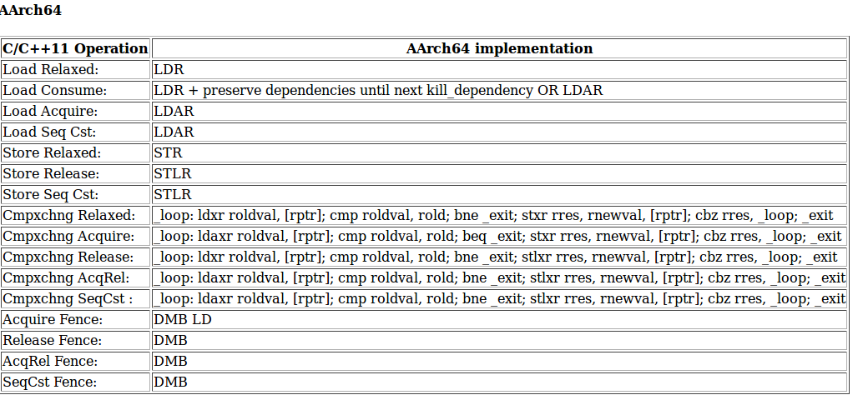
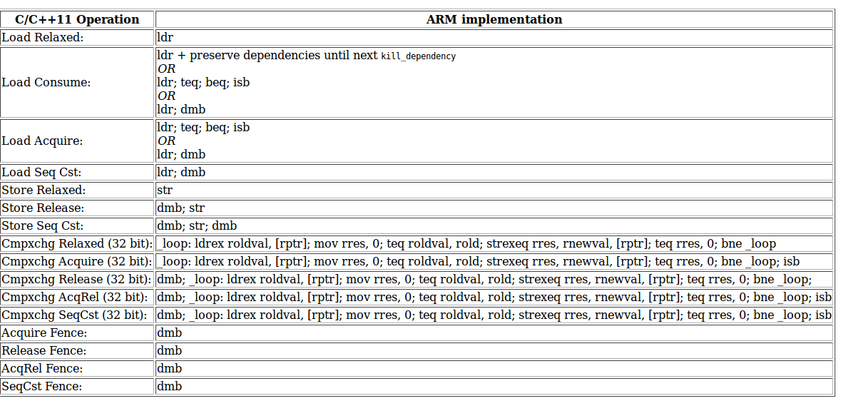
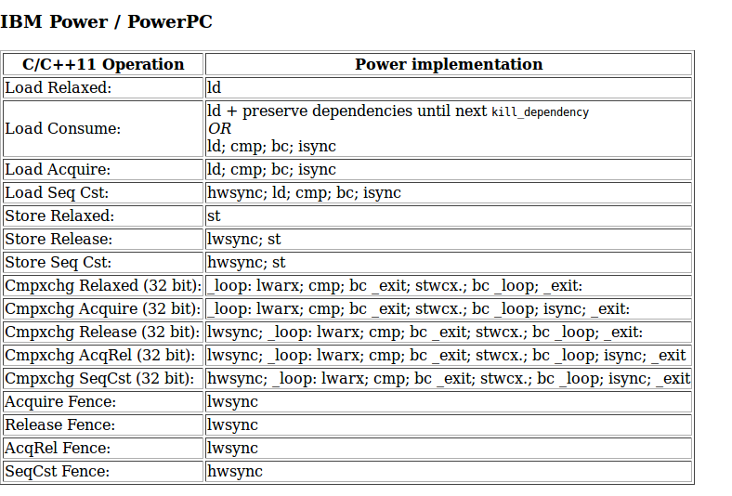
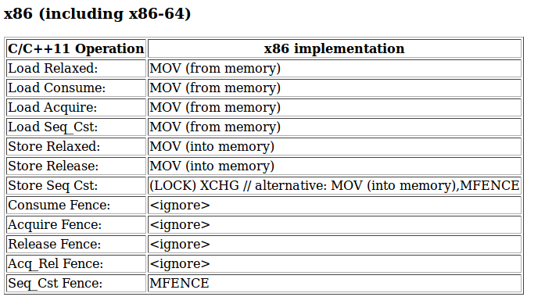
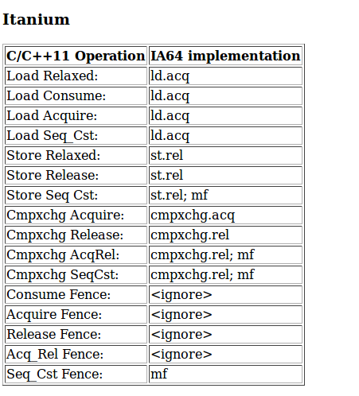
Hardware Background (3/3)

Slide 6
Software Barrier Algorithms Implemented
Centralized Sense Reversing Barrier
Static Tree Barrier
  Arrival Tree
  Departure Tree
Static Tree Barrier with Global Departure
  Arrival Tree
  Global atomic boolean flag for departure
    Like the departure phase of the centralized sense-reversing barrier algorithm
Dissemination Barrier
  NOT YET

Slide 7
Intel Sandy Bridge Architecture
OMITTED

Slide 8
Experiments and Results (1/5)
Thread mapping:
  First fill first thread inside each core from left to right
  Then fill the second thread inside each core from left to right
Experimental Process:
  10.000 barrier episodes. Each thread makes a random workload of 100 counter increments between episodes.
  Repeat 30 times and measure (lower,mean,upper) latency with a confidence level of 99.9%

Slide 9
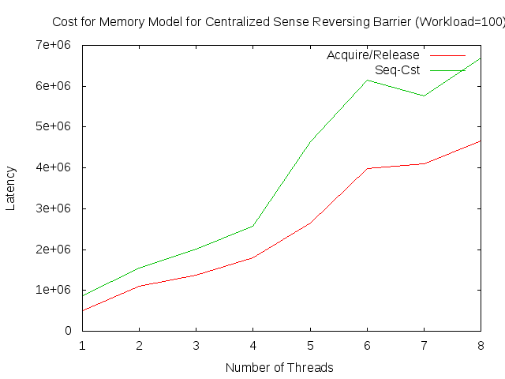
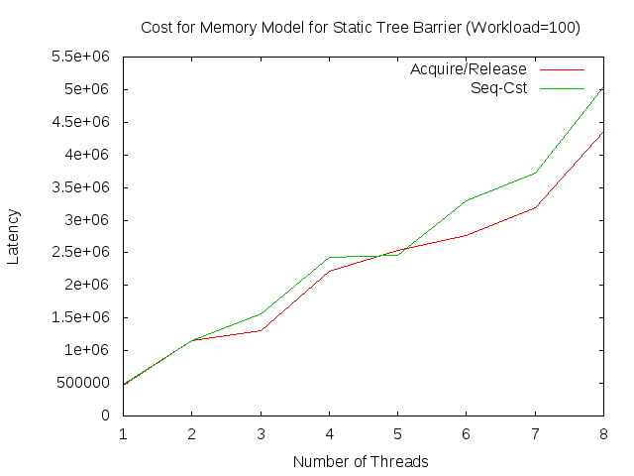
Experiments and Results (2/5)
I first studied the effect of the relaxed memory model over the sequentially consistent one.
  The cost of mfence for Intel
  Relaxed is better!

Slide 10
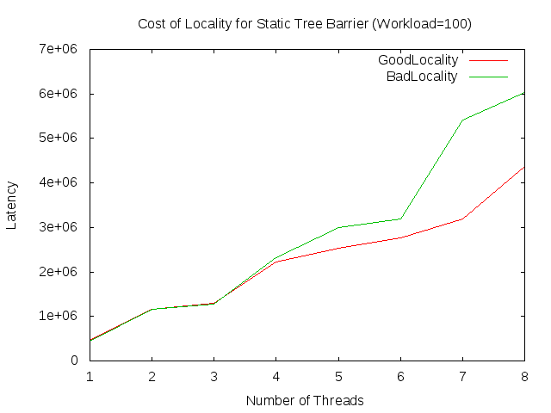
Experiments and Results (3/5)
Then I studied the effect of locality for the static tree barrier
  Locality matters!

Slide 11
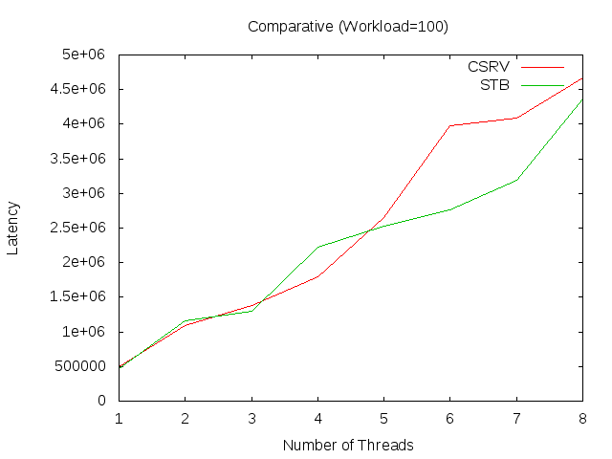
Experiments and Results (4/5)
How do the Centralized Sense Reversing Barrier and Static Tree Barrier compare against?
  Best versions
    Relaxed+good-locality
    Static Tree Barrier is better!

Slide 12
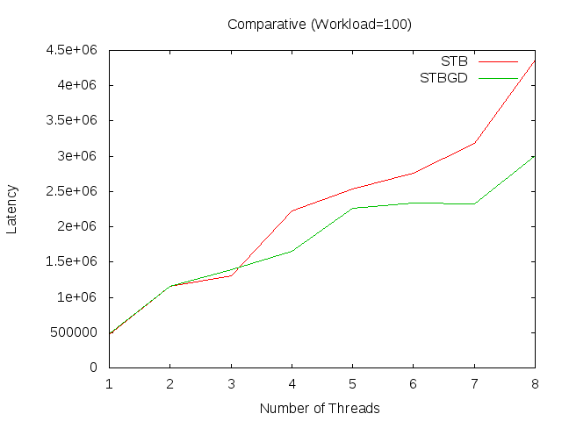
Experiments and Results (5/5)
Surely the static tree barrier benefits from the parallel arrival phase versus the sequential bottleneck of the shared counter in the centralized sense reversing tree.
But what about the departure phase?
  I compare the previous static tree barrier with a static tree barrier whose global departure phase is implemented using a global sense flag
  The version with the global departure flag is better.
    The ring interconnect has to do something with it?
  Further improvement over the centralized sense reversing barrier!

Slide 13
Conclusions
OMITTED

