Slide 1
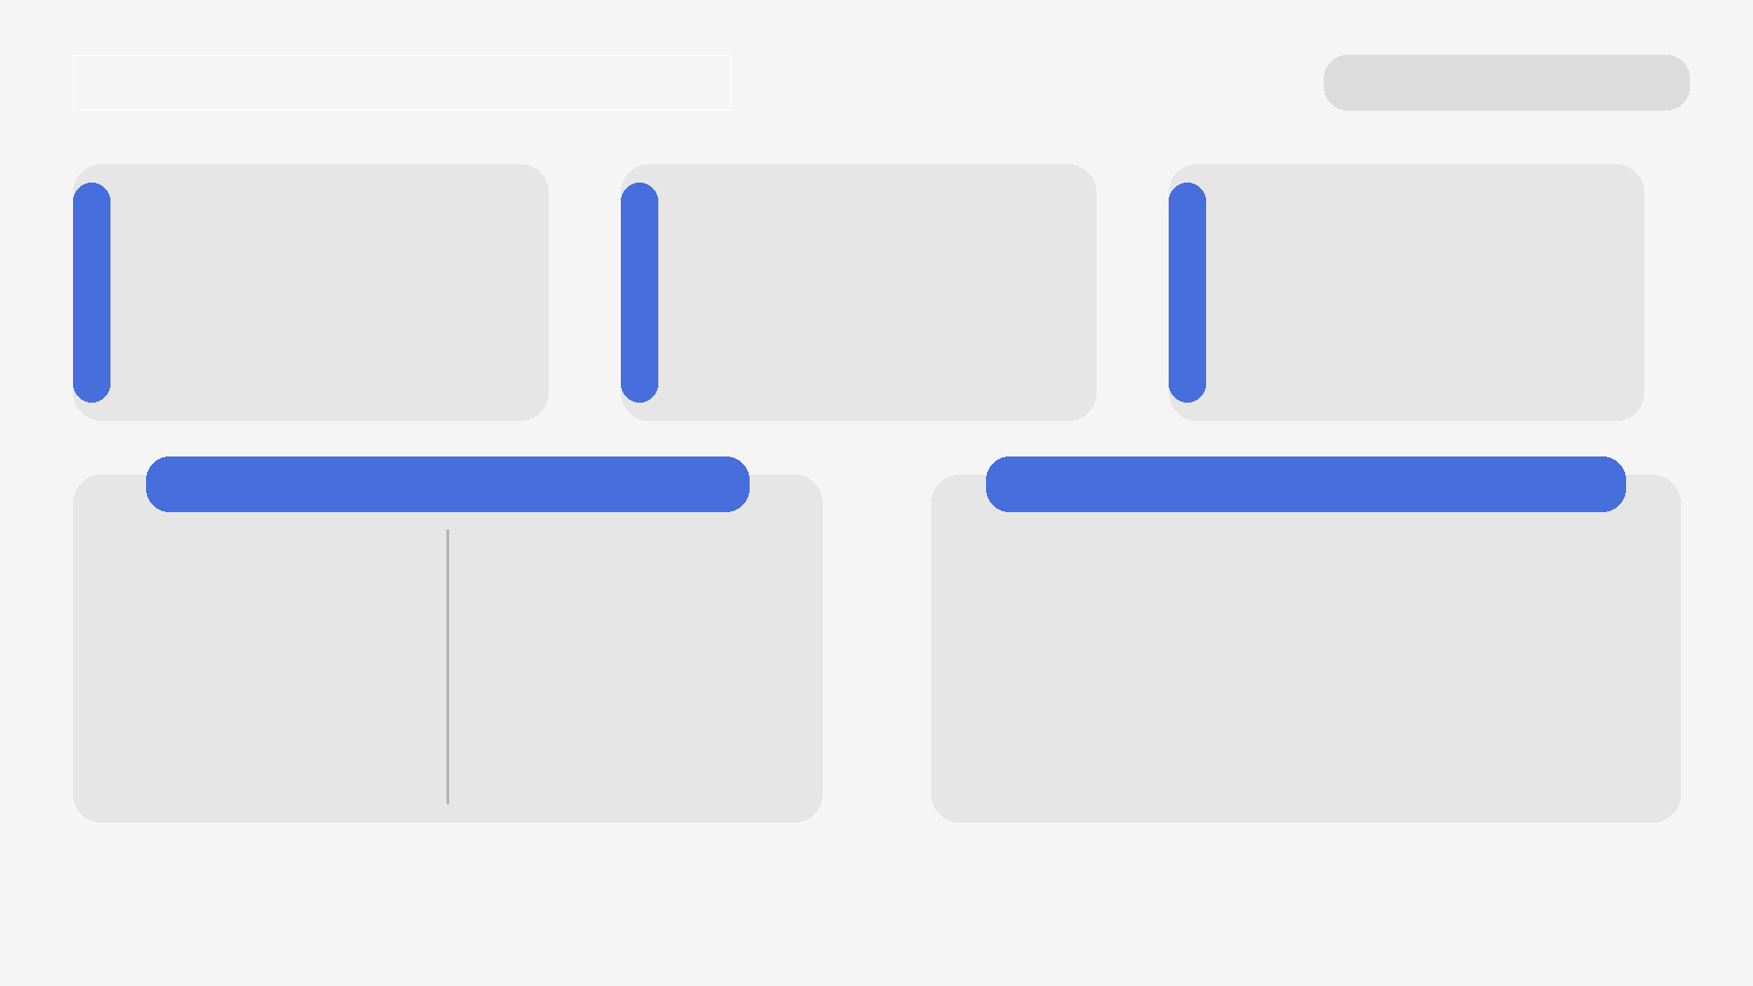
Renomia Hackathon — Challenge 2
Saiton
Manual CRM retyping from OCR
Amendments silently override values
No clear change trace across documents
Python · FastAPI · Gemini (Pro + Flash)
PostgreSQL cache · Pydantic validation
Docker · Google Cloud Run
Manual extraction of insurance contract data from OCR bundles into CRM systems.
Challenge
Problems
Technology
Approach
Architecture
Extract fields from each document using LLM
Merge contract + amendments by priority
Refine ambiguous fields with second LLM pass
Return validated CRM JSON
OCR Documents → API → LLM Extraction → Amendment Resolver
→ Dual-LLM Refinement → Cache → CRM JSON

