Slide 1
FraudLens
An anomaly detection framework for fraudulent credit card transactions
The complete data science lifecycle on an open-source data platform
Notes:
Welcome. FraudLens is our end-to-end anomaly detection framework for card fraud. In the next ten minutes we walk through all eight stages of the data science lifecycle, show the open-source platform it runs on, demonstrate the deployed system, and finish with monitoring and how the project was managed.

Slide 2
Catch fraud without flooding the review queue
Every alert costs an analyst $15; every missed fraud costs its amount. Four success criteria were set before modelling; all four are met on the untouched test period (Jun-Dec 2020).
96.2%
72.4%
14.7
251×
recall · target ≥ 90%
precision · target ≥ 50%
alerts/day · target ≤ 20
PR-AUC lift · target ≥ 50×
≈ $964,182 estimated net benefit on the test period (98.7% of fraud value caught), assuming $15 per review and 90% recovery: an estimate on simulated data, not demonstrated savings. All 56 verification checks pass.
Data: Sparkov simulated card transactions (Kaggle, CC0), 1.85 M transactions, 2019-2020, 0.52% fraud.
Notes:
The business problem is a trade-off: catch fraud, but keep the analysts' queue small and trustworthy. We wrote four success criteria into the configuration before any model was trained. On the six months of test data the champion catches 96.2% of fraud with 72.4% precision at 14.7 alerts a day. In money terms that is an estimated $964,182 net benefit, but note the word estimated: it assumes a review costs fifteen dollars and that ninety percent of caught fraud value is recovered, on simulated data. It ranks operating points; real savings would have to be measured in a trial. Accuracy is not on the slide on purpose: never alerting would be 99.6% accurate.

Slide 3
Eight lifecycle stages, end to end
1
Problem
2
Acquisition
3
Preparation
4
EDA
criteria, cost model, hypotheses
Kaggle API, NiFi, checksums
contract, privacy, leakage-safe
Seaborn, Plotly, hypotheses
5
Modelling
6
Evaluation
7
Deployment
8
Monitoring
6 models, time-series CV
CIs, cost, SHAP, fairness
FastAPI, Streamlit, Docker
Evidently, Prometheus, retrain
python -m fraudlens.run_all reproduces every stage; 8 executed notebooks document them.
Notes:
The project follows the eight-stage lifecycle. Each stage has a module in the package and an executed notebook. One command reproduces everything from the raw files, and a verification stage checks that the stages agree with each other.

Slide 4
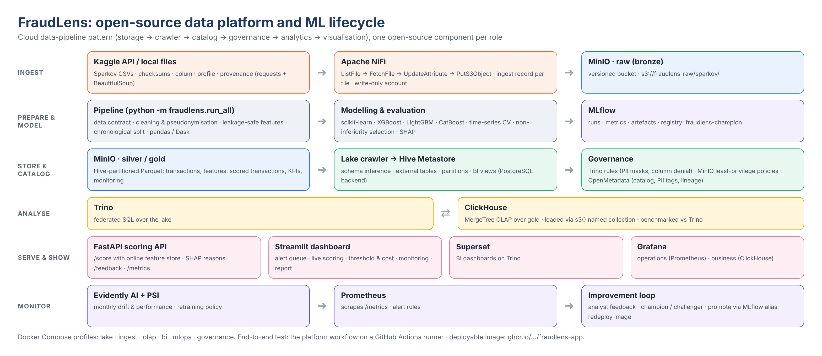
An open-source version of the cloud data pipeline
Notes:
Every role in a modern cloud data pipeline has an open-source component here. MinIO is the S3-compatible lake with raw, silver and gold buckets. NiFi ingests the files; a Python crawler infers schemas and registers tables in the Hive Metastore. Governance is enforced by Trino access rules and least-privilege MinIO accounts and documented in OpenMetadata. Trino and ClickHouse serve analytics; Superset, Grafana and our Streamlit dashboard visualise. MLflow, FastAPI, Evidently and Prometheus cover machine-learning operations.

Slide 5
Provenance in, leakage out
Acquisition and preparation
Chronological split
Kaggle API or local copy; SHA-256 manifest re-verified every run
NiFi lands files in a versioned raw bucket with a write-only account
12-check data contract; no duplicates or invalid rows found
Names and streets dropped, card numbers salted-hashed
Features use only each card's earlier transactions (proved by brute-force check)
Train 2019-01-01 → 2020-05-10 · validation 6 weeks · test = Kaggle's later file. Fraud rate 0.58% → 0.39%.
Notes:
Acquisition records checksums, sizes and a column profile, and on the platform NiFi writes the files into an immutable raw bucket. Preparation validates a data contract, removes personal identifiers and builds behavioural features from each card's history, using only earlier transactions; we proved that with a brute-force recomputation. The split is chronological, because a fraud model is always deployed forward in time.

Slide 6
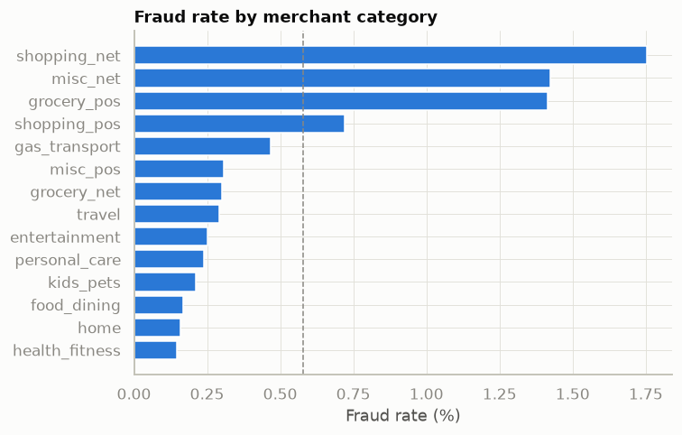
What the data says about fraud
$387
85%
28%
10
median fraud amount vs $47 legitimate
of fraud happens 22:00-03:59
fraud rate when amount > 10× the card's usual
frauds per compromised card, within ~45 h
Hypotheses confirmed
H1 large amounts relative to the card: strongly
H2 night-time: strongly
H3 bursts on a compromised card: yes; 24 h spend is the top single feature
H4 online and grocery-POS categories: 2-3× base rate
H5 demographics: weak, kept but checked for fairness
Notes:
EDA on the training period confirmed the hypotheses from stage one. Fraud is large compared with the card's own history, concentrated at night, arrives in bursts on compromised cards, and is two to three times more common in online shopping and grocery point-of-sale. Demographics carry little signal, so we kept them but check fairness later.

Slide 7
Six candidates, one pre-registered selection rule
Simplest non-inferior model wins
Time-series CV tuning inside train; class weights, no SMOTE
Four boosted models within noise of each other
Rule: pick the simplest whose PR-AUC gap to the best has a 95% CI upper bound < 0.01
HistGB (scikit-learn): gap CI [0.0032, 0.0084]
Tracked and registered in MLflow
Notes:
We compared logistic regression, three gradient-boosting libraries, an unsupervised Isolation Forest and a hybrid. The boosted models are all around 0.98 PR-AUC on validation, logistic regression 0.68, and the anomaly detector alone only 0.36. Rather than pick the top number, we registered a rule in advance: choose the simplest model that is statistically non-inferior to the best. That is HistGB, which needs only scikit-learn and is the smallest and fastest to serve.

Slide 8
On unseen months: high recall, tight intervals
96.2%
recall (95% CI 95.3%-96.9%)
72.4%
precision (95% CI 70.8%-73.9%)
14.7
Threshold chosen on validation by maximising net benefit, applied once to test. 98.7% of fraud value caught; missed fraud is mostly low-value.
alerts per day at threshold 0.740
Notes:
The threshold was chosen on validation to maximise net benefit and then applied once to the test period. Recall is 96.2% and precision 72.4%, with bootstrap intervals of about plus or minus one percentage point, and the monthly lines are stable from June to December. The fraud it misses is mostly small transactions, where an alert would cost more than it recovers.

Slide 9
Every alert explains itself
Reasons an analyst can act on
Top-3 SHAP contributions on every alert, plus plain rules: "Amount is 7× this card's usual spend; 5 transactions in 24 h; 3 min since the last one".
Fairness, reported honestly
Recall 0.947 for women vs 0.981 for men; false alarms 15.67 vs 12.45 per 10k. Next step on real data: retrain without gender and compare.
Notes:
Explanations come from SHAP. Amount, category, the last 24 hours of spend, night-time and velocity drive the score, which matches the EDA. Every alert carries its top three reasons, so the analyst sees why. We also report performance by group: recall is high for everyone, but slightly lower for women than for men, so before any real deployment we would retrain without gender and compare.

Slide 10
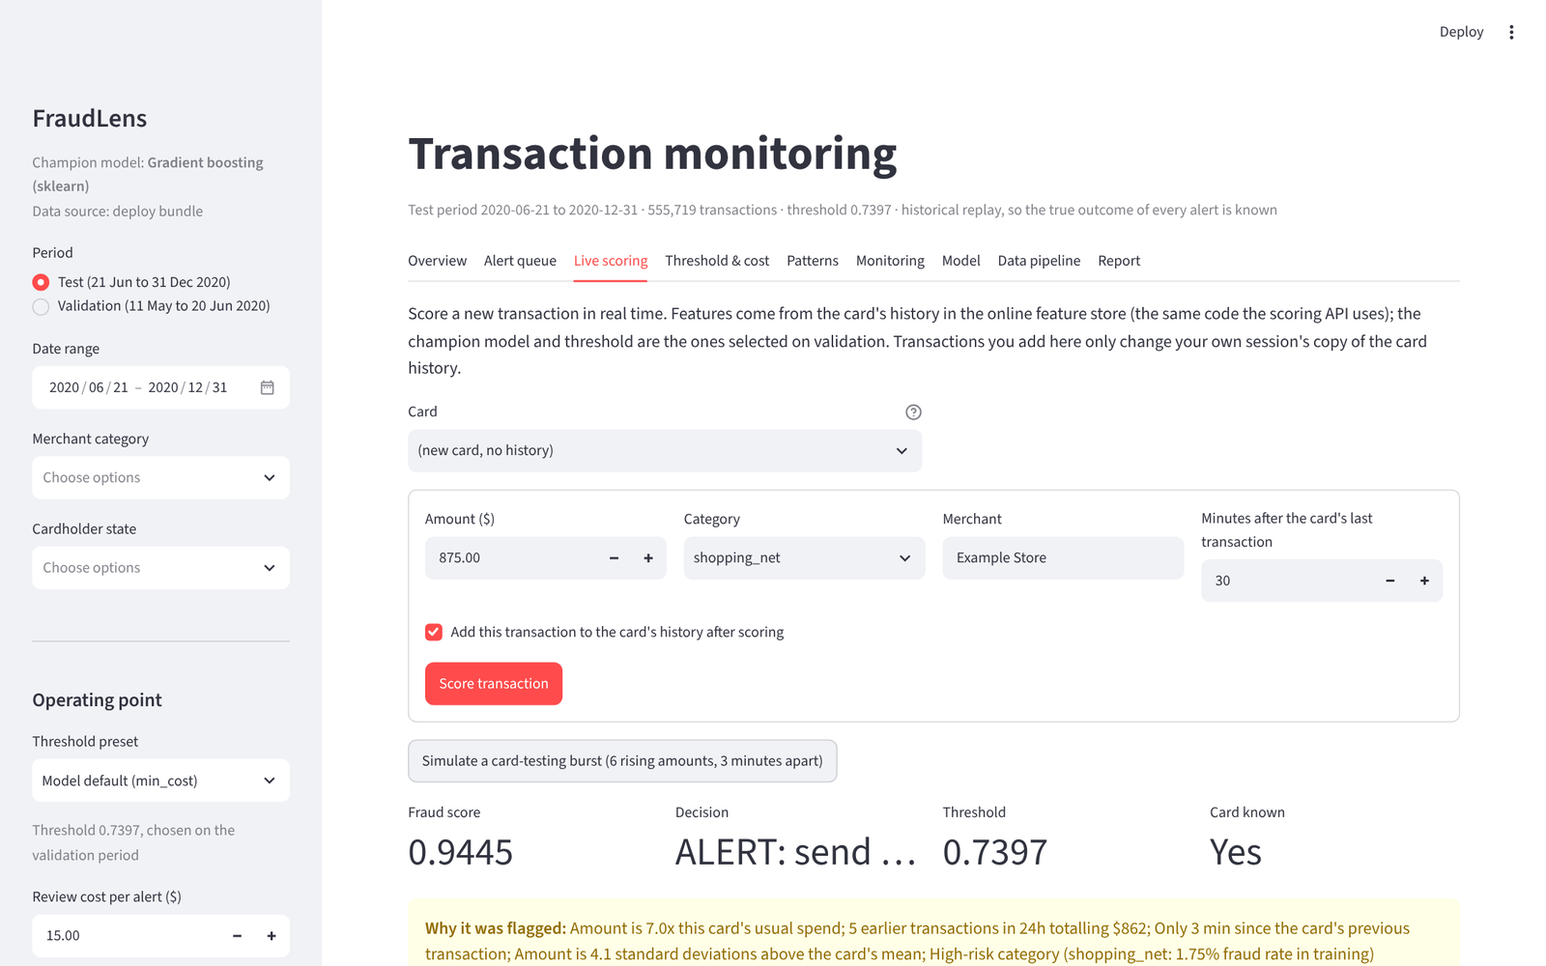
Deployed: scoring API and analyst dashboard
FastAPI /score: online feature store computes card history in real time; SHAP reasons and a counterfactual
Review queue: /alerts and /alerts/{id}/decision; the dashboard's Case review tab
Access control: role-based API keys (scorer, analyst, admin); dashboard sign-in (analyst, viewer); audit log
One 40 MB bundle; container image ghcr.io/…/fraudlens-app; public links with access control on
Notes:
Deployment has two faces. The FastAPI service scores a raw transaction in real time: the online feature store keeps every card's running history, the model scores, and SHAP gives the reasons. The Streamlit dashboard is for analysts and managers. Here you see live scoring: a simulated card-testing burst of six rising amounts three minutes apart is flagged at 0.94 with readable reasons. Both run from one 40-megabyte bundle and are packaged as a container image. [Switch to the live demo here.]

Slide 11
A new transaction, from features to an analyst decision
1 Received
2 Features
3 Inference
4 Routed
5 Decision
POST /score or the dashboard's Live transaction tab
online feature store: card history, velocity 1 h / 24 h / 7 d
score vs threshold, SHAP reasons, counterfactual amount
alert → case opened in the review queue; else approved
analyst: fraud / legitimate + note; audit log
How decisions inform monitoring
Live precision (confirmed ÷ reviewed alerts) with a 95% interval vs the 40% floor → threshold/model review, Prometheus alert
Fraud reported on approved transactions = live misses; backlog and time to decision = workload
Every decided case keeps its exact model inputs → labelled examples for the next champion/challenger
Notes:
This answers the main question from the last review: what happens to a transaction we have never seen. It arrives at the scoring API, or here in the dashboard, which runs the same code. The online feature store computes its card-history features from the card's earlier transactions. The champion scores it, SHAP explains the score, and for an alert we also show the amount at which it would have been approved. An alert opens a case in the review queue; the analyst sees exactly what the model saw and records fraud or legitimate, with their name in the audit log. Those decisions are labels: live precision is tracked against the policy floor and alerts in Prometheus if it drops, disputes on approved transactions count as misses, and every decided case becomes a training example for the next model. Access is controlled throughout: API keys by role and a dashboard sign-in where only analysts can decide.

Slide 12
Monitoring closes the loop
Improvement loop
Evidently drift + PSI and performance each month
Prometheus alert rules; Grafana operations and business dashboards
Analyst feedback via /feedback
Challenger retrained on train + val: PR-AUC 0.9741 vs 0.9698 → promote via MLflow alias
Flagged 2020-08 and 2020-12 (seasonal spending); recall stayed ≥ 94.4%.
Notes:
Monitoring replays the scored months as if the model were live. Evidently measures drift against the training data; performance is measured at the fixed threshold. The policy flagged August and December, driven by seasonal spending, while recall stayed above the floor, so a person reviews the recommendation. A challenger retrained on more recent data scores slightly higher and would be promoted through the MLflow registry alias. In operation, Prometheus and Grafana watch the API and analyst feedback provides new labels.

Slide 13
Managed and verified like a product
GitHub Project
CI/CD
Quality
Board generated from project_plan.yaml
4 milestones, one issue per task with acceptance checklist
Lifecycle-stage field tracks progress stage by stage
ci: full lifecycle on sample data + dashboard render
platform: Docker stack end to end, 14/14 smoke checks pass
deploy: build, test, publish the image
56/56 verification checks pass
Train/serve parity test (caught a real bug)
Pinned versions, one-command rebuild
Notes:
The project is run like a product. The GitHub Project board is generated from a plan file, with milestones and an issue per task, and a lifecycle-stage field so progress is visible stage by stage. Three workflows test the lifecycle, the whole Docker platform, and the deployable image. On the runner every platform service starts, the sample lifecycle flows from NiFi through the lake, Trino and ClickHouse, and 14 of 14 smoke checks pass; OpenMetadata catalogues 13 tables with 29 PII-tagged columns and lineage. Fifty-six verification checks pass, including a train-to-serve parity test that caught a real precision bug during the final run.

Slide 14
From data collection to a monitored deployment
96.2% of fraud caught at 14.7 alerts/day, 72.4% precision, every alert explained
Open-source platform: MinIO, NiFi, Hive Metastore, Trino, ClickHouse, Superset, Grafana, MLflow
Next: real transaction data, calibrated probabilities, scheduled retraining
Notes:
To conclude: FraudLens meets all five objectives, from data collection to a monitored deployment, on open-source tools. The limitation to keep in mind is that the data are simulated, so the numbers validate the method rather than predict production accuracy. Next steps are real data, calibrated probabilities and a scheduled retraining loop. Thank you; we are happy to take questions.

