Slide 1
FRAUDLENS
An Anomaly Detection Framework for Identifying Fraudulent Credit Card Transactions
ASSESSMENT 2
Current project
foundation
PRT661 – Data Science Practice

Slide 2
Why FraudLens?
INTRODUCTION
A focused data-science response to suspicious credit-card transaction behaviour.
Theme 3
Anomaly Detection and Intelligent Monitoring
01
Core challenge
Fraudulent transactions are rare compared with legitimate activity.
02
Project direction
Use machine learning to identify unusual transaction behaviour and support investigation.
03

Slide 3
What FraudLens Covers
PROJECT OVERVIEW
1,852,394
9,651
0.521%
Transactions
Confirmed fraud
Overall fraud rate
Assessment 2 project flow
1
2
3
4
5
DATA
PREPARE
MODEL
EVALUATE
MONITOR
Sparkov fraudTrain.csv + fraudTest.csv
Validation • cleaning • feature engineering
LR • HGB • Isolation Forest • Hybrid
Chronological split • metrics • threshold analysis
Dashboard-ready outputs for analyst investigation

Slide 4
Five Objectives of FraudLens
PROJECT OBJECTIVES
01
Fraud Detection
02
Reliable Evaluation
03
Model Comparison
Identify potentially fraudulent transactions using machine-learning techniques.
Use measures suited to highly imbalanced fraud data.
Compare different approaches and examine detection performance.
04
Reproducibility
05
Decision Support
Maintain a structured workflow so results can be regenerated and checked.
Present outputs in a monitoring format that supports analyst investigation.

Slide 5
From Proposal to Developed Solution
HANDOVER
ASSESSMENT 1
ASSESSMENT 2
Established the problem
Refined the solution
Fraud-detection focus
Stronger data pipeline
Initial objectives
Chronological evaluation
Proposed workflow
Reproducibility & monitoring
Next: technical development, data engineering, modelling and evaluation.

Slide 6
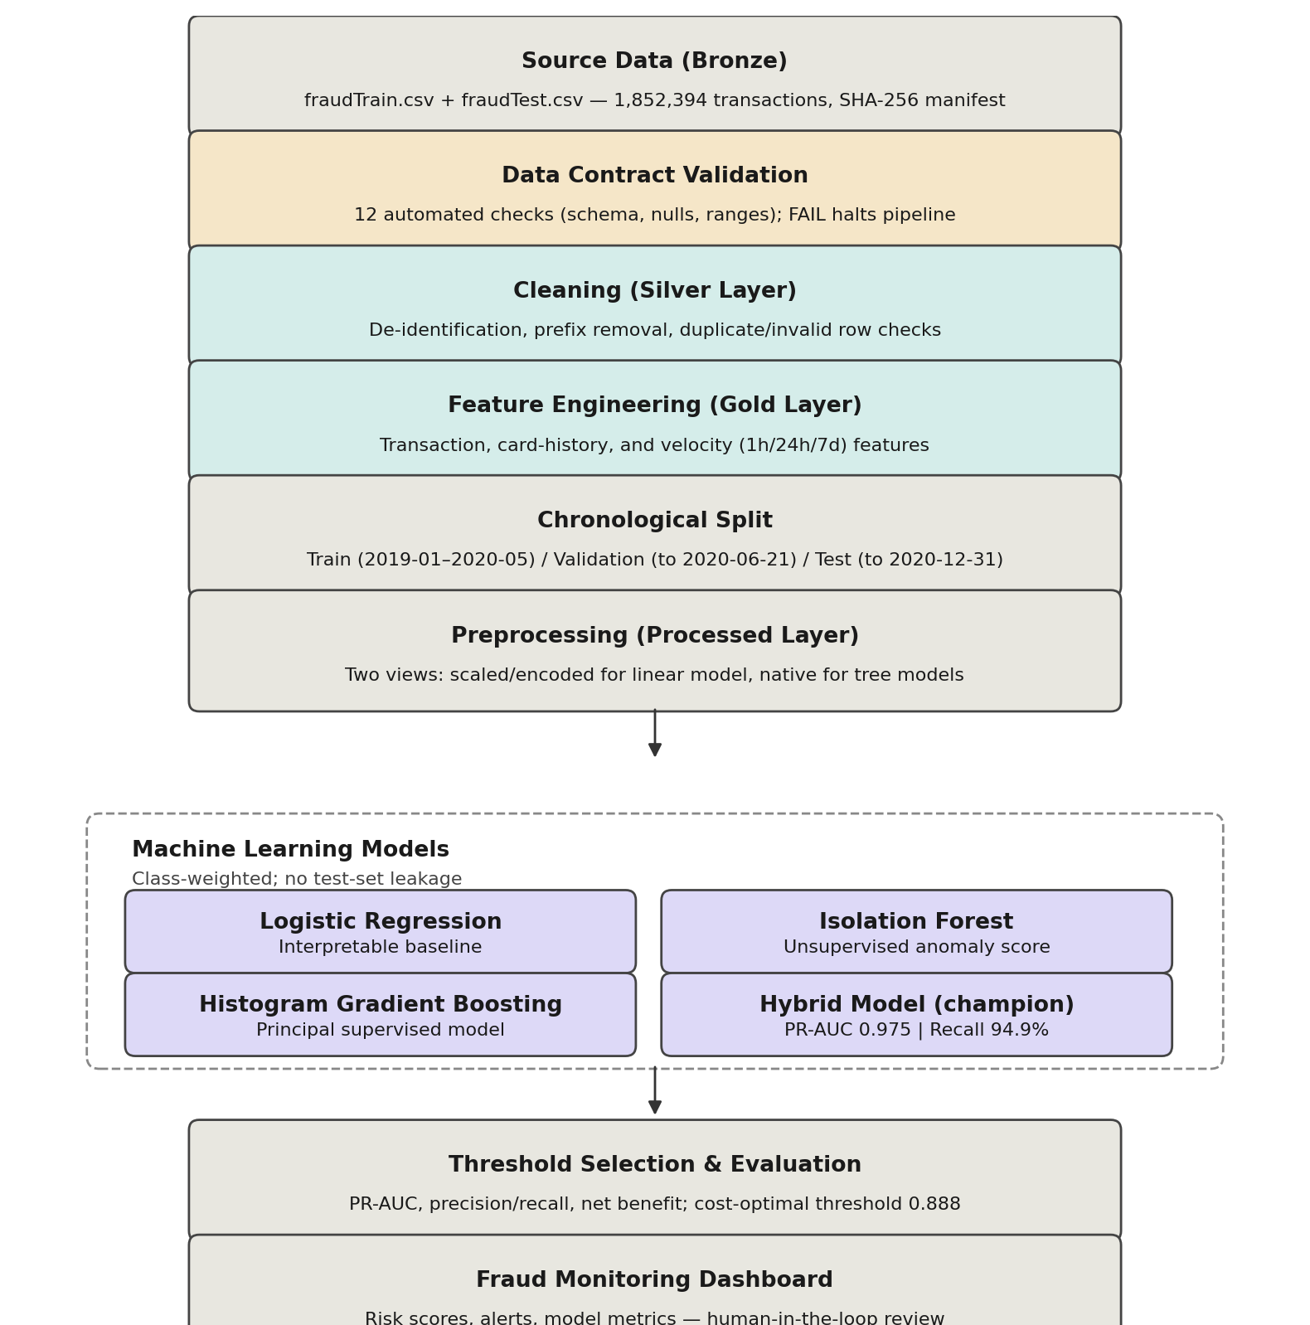
Updated System Architecture
SYSTEM ARCHITECTURE
A layered, file-based pipeline replacing the earlier single-database design

Slide 7
Why a Layered Architecture
SYSTEM ARCHITECTURE
Bronze
raw transaction files are ingested as-is, each run stamped with a SHA-256 checksum manifest for traceability.
Validation
a 12-point data contract checks schema, nulls, value ranges, label validity and referential integrity before anything moves forward.
Silver
cleaned, de-duplicated, type-corrected data that has passed validation.
Gold
feature-engineered data (time features, distance, velocity/behavioural signals).
Processed
two model-ready views — a linear view for Logistic Regression/Isolation Forest, and a tree view for Histogram Gradient Boosting/Hybrid GB.

Slide 8
Workflow
WORKFLOW
End-to-end sequence from raw data to a reviewable fraud alert
Ingest → Validate → Clean → Engineer features → produces the bronze/silver/gold layers above, each step auditable on its own.
1–5
Chronological split, not random — train/validation/test are cut by date, so the model is always evaluated on transactions it could not have seen in training. This avoids the optimistic bias a random split would give for a time-ordered fraud problem.
6
Class-weighting, not SMOTE — imbalance (~1 fraud per 172 legitimate transactions) is handled inside training via class weights on the training split only, avoiding synthetic data that could leak across the chronological boundary.
7
Train & evaluate four candidate models, each scored on PR-AUC (not accuracy/ROC-AUC) because of the extreme class imbalance.
8–9
Threshold selection, net-benefit calculation and dashboard delivery — turning model scores into a business decision a reviewer can act on.
10–12

Slide 9
Implementation Progress — Model Lineup
IMPLEMENTATION PROGRESS
Four models trained on the processed layer; evaluated on the held-out chronological test set
Model | Val PR-AUC | Test PR-AUC | Precision | Recall | Net benefit
Hybrid gradient boosting | 0.9841 | 0.9753 | 89.9% | 94.9% | $966,349
Gradient boosting | 0.9840 | 0.9749 | 89.0% | 94.7% | $967,019
Logistic regression | 0.6839 | 0.5900 | 20.3% | 83.1% | $822,772
Isolation Forest | 0.3556 | 0.2662 | 7.1% | 57.2% | $518,304
Champion model: Hybrid gradient boosting (Histogram Gradient Boosting + Isolation Forest anomaly score as an input feature).

Slide 10
Where We Stand
IMPLEMENTATION PROGRESS
2,035 / 2,145
229
$966,349
frauds correctly flagged in the test period
false alerts raised alongside them
estimated net benefit (recovered fraud value minus review cost)
Pipeline, validation, and modeling layers are built and reproducible end-to-end on the real dataset (1,852,394 transactions).
Threshold is a business decision, tuned against net benefit rather than a fixed statistical cut-off.

Slide 11








One command, raw data to dashboard
SYSTEM DEMO
Ingest
Quality
Explore
Preprocess
Train
Score
Verify
Dashboard
python -m fraud_pipeline.run_all
1,852,394
48 / 48
Exact
transactions processed
verification checks pass
match on re-scoring
Validated against a 12-check data contract; zero rows lost
Every stage cross-checked against every other, end to end
Saved model re-scored independently: every reported metric matched

Slide 12
Fraud follows learnable patterns
ANALYTICS & ML
84.8%
27.6%
of fraud happens between 22:00 and 04:00
fraud rate when the amount is >10× the card's usual (vs 0.58% overall)
45 h
76%
median window holding all fraud on a card
of fraud sits in amount outliers, so we kept them

Slide 13

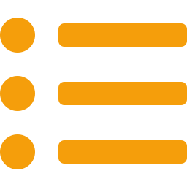

The dashboard turns scores into decisions
SYSTEM DEMO
● LIVE DEMO
1 Overview
2 Alert queue
3 Threshold & cost
2,282
By card
$2.65
alerts over 6 months (11.8 a day)
fraud arrives in ~45-hour bursts
break-even cost per review
89.0% precision
Amount far above usual
Move the threshold and watch precision, recall and net benefit update for any filter.
94.7% recall
Night-time
$967K net benefit
High-risk category
Burst of activity
more fraud caught
fewer alerts

Slide 14



Four models, one honest test
ANALYTICS & ML
Fit
Report once
Train: Jan 2019 – May 2020
Test: Jun – Dec 2020
Select on 6 weeks of validation
Class weights only
Fraud weighted ~172×. No SMOTE, no resampling of any split.
PR-AUC, not accuracy
Guessing “legitimate” every time already scores 99.4% accuracy.
Test touched once
Model and threshold were fixed on validation first.

Slide 15
The simpler model won on evidence
ANALYTICS & ML
Gradient boosting
CHAMPION
Hybrid gradient boosting
NOT SELECTED
Validation PR-AUC
0.9840
Validation PR-AUC
0.9841
Frauds caught (validation)
646
Frauds caught (validation)
647
Alerts raised
701
Alerts raised
701
Components to run
1 model
Components to run
2 models
Rule: choose the simplest model whose PR-AUC gap to the best is provably below 0.01
95% interval of the gap: −0.0010 to +0.0012
margin 0.01
0
0.005
0.010
Logistic regression: gap +0.270 to +0.331, excluded

Slide 16
95% of fraud caught at 12 alerts a day
ANALYTICS & ML
94.7%
89.0%
recall
precision
2,031 of 2,145 test frauds
1 false alarm per 8 frauds caught
11.8
$967K
alerts per day
net benefit
a workable review queue
recovered fraud minus review cost
Break-even: $2.65 per review. The wider net catches 99.3%, but at $15 a review it nets $82K less.

Slide 17



Key takeaways
Reproducible and verified
One command rebuilds everything; 48 of 48 end-to-end checks pass.
Behaviour beats raw data
Card-relative features and a non-linear model: 0.975 PR-AUC versus 0.590 for a linear one.
Decisions, not just scores
Alerts grouped by card, with reasons and a cost-aware threshold.
Caveat: the data is simulated. The method transfers to real transactions; the absolute scores will not.

Slide 18
Four challenges shaped the build
TECHNICAL CHALLENGES
01
Extreme class imbalance
02
Leakage across time
About 1 fraud per 172 transactions, so guessing “legitimate” already scores 99.4% accuracy.
A random split or synthetic oversampling lets the model see the future and inflates results.
Fix: Class weights on the training split only, and PR-AUC instead of accuracy.
Fix: Chronological train, validation and test split; no SMOTE; test set touched once.
03
Two models almost tied
04
Too many alerts to review
Gradient boosting and the hybrid differ by only 0.0001 validation PR-AUC.
Catching 99.3% of fraud needs 46.2 alerts a day, and every review costs money.
Fix: A pre-set rule: compare the gap using a 95% interval and a 0.01 margin.
Fix: A cost-aware threshold: about 95% recall at roughly 12 alerts a day.
Still open: the data is simulated, so the method transfers to real transactions but the absolute scores will not.

Slide 19
What we finish before Assessment 4
FUTURE WORK
1
2
3
4
Lock the model
Stress-test over time
Finish the dashboard
Document and package
Confirm the final champion and threshold on validation, with no further tuning on the test set.
Check performance month by month across the test period to see whether it drifts.
Move from demo to analyst-ready: alert reasons, filters and the threshold control.
Final report, run guide and reproducibility evidence for the Assessment 4 submission.

Slide 20
Conclusion
1
A working, reproducible pipeline
1,852,394 transactions go from raw files to a dashboard in one command.
2
Clear progress beyond Assessment 2
A layered architecture, four models compared and a cost-aware alert threshold.
3
Results an analyst can act on
About 95% of fraud caught at roughly 12 alerts a day.
Thank you. Questions?

