Slide 1

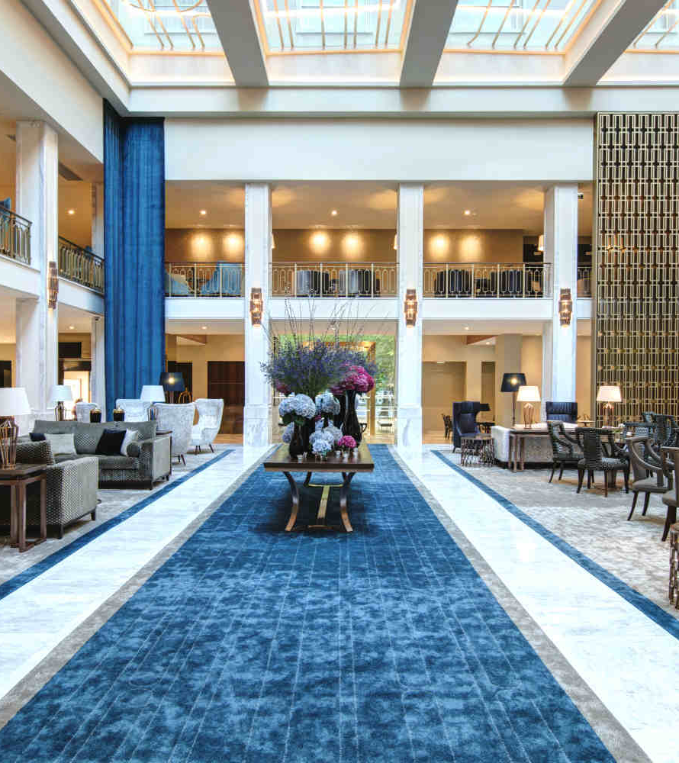
Business Cases with Data Science
c
Business Case #2
Hotel Dataset
Group A
Notes:
Introduction: - Miguel
(Presentation/ Theme / Group)
We carry out predictive analysis using the CRISP-DM framework.
The objectives of this Project are:
Use algorithms in solving prediction problems in hotel booking cancellations
Understand what are most valuable variables in our case study and how to deal and prevent Money losses with cancellations.
This presentations will be described in five parts:
The first part for the Business and Data Mining goals.
The second and third part describes what were our findings and most importante insights and variables.
The fourth part describes how the results were found.
And at the end, the conclusing and suggestions.

Slide 2
Business Goals
Data Mining Goals
Allow the hotel to act prevently against cancellations
Good prediction model – Predict Cancellations to a rate of 80%
Cancelling bookings by not confirming from forecast cancelled bookings
Data Understanding and Data Cleaning
Data visualizations to find hidden information about the data
Deployment and Evaluation of Machine Learning Algorithms
Notes:
Business Goals: - Shahin
Implement a prediction model to allow the hotel to forecast net demand based on reservations on-the-books – Cancellatios prediction
Better pricing and overbooking policies;
Allow the hotel to act prevently with a good prediction model - Our initial goal was to predict cancellations at a rate of 80%.
With this approach, the hotel management can cancel the reservations according to the predicted cancellations bookings.
Data Mining Goals:
The Data Mining goals were based on the CRISP-DM methodology and were:
1. Data understanding and data cleaning
2. There will be some data visualizations to help the team to understand and extract important insights of the business.
3. The deployment of Machine Learning algorithms.

Slide 3
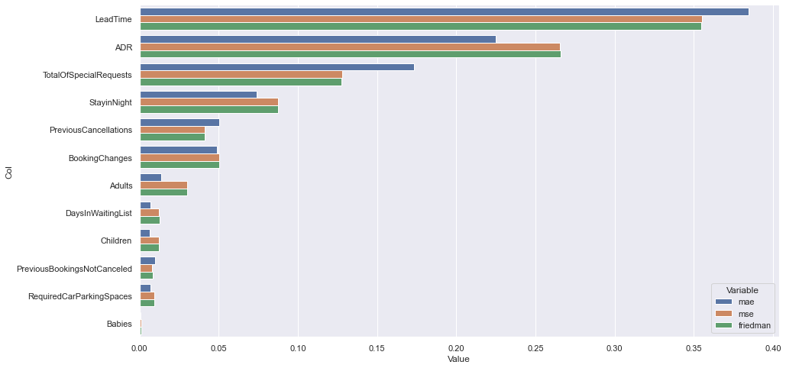
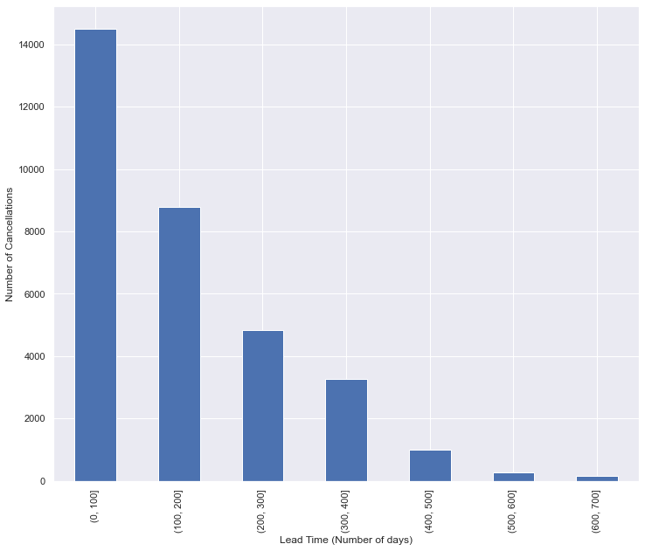
Relevant Results
The most influential Feature
Predictions Results
No. | Modelling Result
 | Model | Accuracy
1 | Logistic Regression | 0.73
2 | Decision Tree | 0.79
3 | Random Forest | 0.83
We have a total of 12 most important variables.
Lead Time is the most importante variable for our model
With this prediction we are capable to predict cancellations to a rate of 83%
Booking reservations with a shorter Lead time are most probable to got cancelled than one year before reservations
Notes:
Sofia
Prediction Results
It was used a total of 3 models and the better result was with Random Forest with an accuracy of 83%.
Cancellation prediction of hotel rooms reservations is important to minimize the loss of income to the company - by not confirming bookings from customers who are predicted to cancel the booking.
Variable Importance
By using CRISP-DM the most appropriate features for the machine learning model are built and this will give importante insights for business strategy – For our data science team, Lead Time should have the most importante role in the model implementation.
1. We also got the most influential features when predicting the booking cancellation, we found that number of days between when a booking is made by the customer and the date when the customer arrives at the hotel is the most important variable.
It can be seen in the right image that according to decision tree classificator LeadTime was the most importante variable.
2. Also according to this visualization can be seen that with a short lead time is very rare to cancel, while bookings made more than one year before are very often canceled.

Slide 4
How did we find these results?
Business Understanding
Data Understanding
Correlations
Data Preparation and Modelling
Features Transformations
Feature Selection with LASSO, RIDGE and Decision Tree
Evaluation
1. Logistic Regression
2. Decision Tree
3. Random Forest
Based on accuracy
Deployment
Outliers
Suggestions:
Integration of the machine learning models into the hotel room reservation system
Notes:
Francisco
Our Team used CRISP-DM Framework to develop the business case and these are some useful informations to take into account.
After the definition of the Business Understanding – the visualizations of correlations and outliers were done
In the Data preparation and Modelling the most appropriate features for the machine learning model are built with LASSO, RIDGE and Decision Tree methods.
For Evaluation, three machine learning models were:
1. Logistic Regression
2. Decision Tree
3. Random Forest
And the model selection was made based on the accuracy measure.
As suggestions, our team suggest the integration of these machine learnings techniques to minimize the loss of income to the company, also further dataset preprocessing in other ways or hyperparameter tuning technique to get better accuracy.

Slide 5
Conclusions
With accuracy score of 0.834, random forest outperformed other algorithm on predicting hotel booking cancellation
Orders that have a short lead time have the higher number of cancellations. The contrary happens for more than one year bookings
Reduces losses by cancelling bookings from customers who are predicted to cancel the booking
Notes:
Acabar - Miguel
The hotel management can reduce losses caused by canceling bookings by not confirming bookings from customers who are predicted to cancel the booking. - confusão....
We also got the most influential features when predicting the booking cancellation, we found that number of days between when a booking is made by the customer and the date when the customer arrives at the hotel is the most important variables.

