Slide 1
Phishing Awareness Training
Learn to Detect, Prevent, and Report Phishing Attacks

Slide 2
Learning Objectives
Recognize what phishing is and why it matters
Identify common phishing attack types
Spot red flags in emails, texts, and calls
Understand social engineering tactics
Know how to report and respond safely

Slide 3
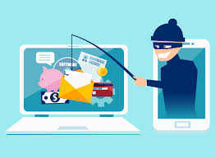
What is phishing ?
Phishing is a common cyber-attack that targets individuals through email, text messages, phone calls, and other forms of communication.
A phishing attack aims to trick the recipient into falling for the attacker’s desired action, such as revealing financial information, system login credentials, or other sensitive information. Fundamentally, these threats exploit human psychology rather than technical vulnerabilities.
90% of breaches start with phishing” (Verizon DBIR)

Slide 4
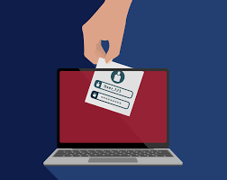
Why Phishing Is Dangerous
Phishing tricks users into giving away passwords, financial info, or downloading malware, leading to data breaches, financial loss, and reputational damage.
Who Is Targeted?
Everyone.
Staff - fake emails or links
Students - scams like fake scholarships
CEOs - high-level attacks (“whaling”)
If you use email, you're a target.

Slide 5
Types of Phishing Attacks
1. Email Phishing
What it is: Mass emails sent to trick users into clicking malicious links or giving up sensitive information.
Visual idea: 📧 Screenshot of a fake "Password Expired – Reset Now" email.
2. Spear Phishing
What it is: Highly targeted emails aimed at a specific individual, using personal details to build trust.
Visual idea: 🎯 Email that looks like it’s from a supervisor, using your name and department.
3. Whaling
What it is: Phishing aimed at top executives, often using legal or financial pretexts to gain high-level access.
Visual idea: 🐋 Fake urgent email to a CEO requesting a wire transfer, appearing to be from the CFO or legal team.

Slide 6
4. Smishing (SMS Phishing)
What it is: Text messages that appear to be from a trusted source (bank, delivery service, etc.) urging you to tap a link or share personal details.
Visual idea: 📱 Screenshot of a fake courier SMS: “Your package is heldverify payment here: bit.ly/…”.
5. Vishing (Voice Phishing)
What it is: Phone calls or voice‑mails pretending to be from tech support, banks, or government agencies, pressuring you to reveal credentials or transfer money.
Visual idea: ☎️ Image of a caller ID spoofed as “Bank Support” with a scripted scam prompt on‑screen.
6. Pharming
What it is: Attackers redirect you from a legitimate website to a fake one (via poisoned DNS or local malware) to steal logins or payment info—no click required.
Visual idea: 🌐 Split screen: real bank URL vs. look‑alike fraudulent site, highlighting the subtle URL change.

Slide 7
Real world case studies
phishing emails to steal over $100 million from Google and Facebook :
https://www.cnbc.com/2019/03/27/phishing-email-scam-stole-100-million-from-facebook-and-google.html
Famous phishing incidents:
https://www.hempsteadny.gov/635/Famous-Phishing-Incidents-from-History

Slide 8
Anatomy of a Phishing Email
1. Suspicious Email Address
From: support@paypal-security.com.fake-domain.info➡ Looks similar to PayPal but has a strange domain structure.
✅ Red Flag: Legit companies don’t use long or odd domains.
2. Generic Greeting
“Dear valued customer,”
➡ Not personalized.
✅ Red Flag: Legitimate emails usually address you by name.
3. Urgent Message Subject:
"Unauthorized login attempt – Immediate Action Required!"➡ Threatens account lockout if you don’t act quickly.
✅ Red Flag: Creates fear to force a quick response.
4. Misleading Link Text
www.paypal.comHover shows: http://secure-login.pay-pal-account-reset.com
✅ Red Flag: The link doesn’t go where it says it will. Always hover to check.
5. Poor Grammar/Spelling
Example line: “We have detect an problem with you’re account activity.”
✅ Red Flag: Grammar errors suggest the message isn’t official.
6. Unnecessary Attachment or Button
Includes “Reactivate Account Now” button➡ Might lead to a phishing site or malware.
✅ Red Flag: Never click buttons or attachments from unexpected emails.

Slide 9
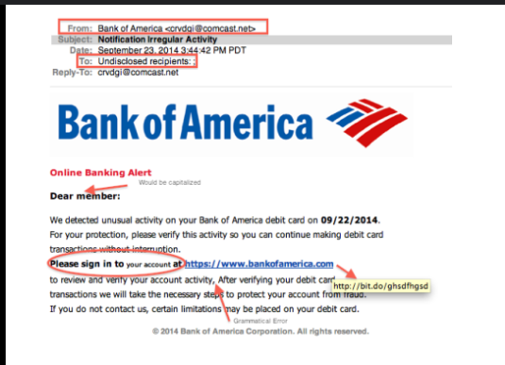
Spot the Phish!
Can you spot the red flags?
🖼️ [Use the provided screenshot] Add red circles, arrows, or highlight boxes on the image to point out each of the following:
Suspicious Email Address
Generic Greeting: Dear member
Urgent Language
“Unusual activity”, “verify this activity”, “limitations may be placed”
4. Fake Link Hidden Behind Text
5. Unnecessary Attachment or Link
📎 In this case, the suspicious shortened link is enough links without a clear explanation are dangerous.
Tip for the audience: Always hover to check links, look for odd email addresses, and never click on urgent-sounding prompts without verifying.

Slide 10
Social Engineering Tricks
⚠️ Urgency
🕒 “Act now or lose access!”
They pressure you to respond quickly, so you don’t think clearly.
👔 Authority
🧑‍💼 “CEO approval needed.”
They pretend to be someone important like your boss or HR, so you obey without question.
💰 Greed
🎉 “You’ve won something!”
Offers of money, prizes, or rewards to tempt you into clicking
🕵️ Curiosity
📎 “Unpaid invoice attached.”
They make you curious or concerned enough to open a link or attachment.

Slide 11
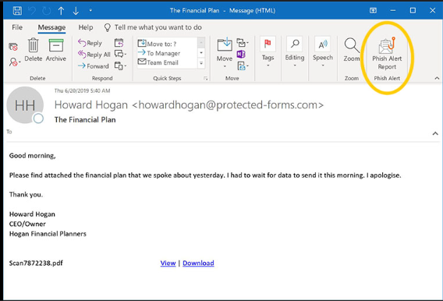
What To Do If You Suspect Phishing
🚫 1. Don’t Click!
Avoid clicking links or downloading attachments.
🛠️ 2. Report It Immediately
Use built-in tools:
Outlook: Report Message button
Gmail: Report phishing option
👨‍💻 3. Notify IT or the Security Team
Forward the email to your organization’s cybersecurity team.
⚠️ 4. If You Clicked:
Disconnect from the internet
Inform IT/security immediately
Do not delete the email, they’ll need it for investigation

Slide 12
Mini Quiz
1. Open the Form: Click me, Quiz!
Click the link
Takes 2 minutes, 5 rapid‑fire questions.
What to Expect
4 multiple‑choice questions on today’s red‑flag tips.
1 short case scenario: decide if an email is safe or a phish.
How to Answer
Trust your instincts: look for the address, urgency, link mismatch, & attachments.
Submit when finished; you’ll see your score instantly.
Why It Matters
A quick self‑check now = safer clicks later.
Top scorers get a shout‑out at the end!
Ready? Grab your phone or laptop, open the form, and let’s see who can spot the phish in record time.

Slide 13
Bonus tips
Bookmark Official Websites
Always bookmark and access important sites (like banking, university, or government portals) directly.
🚫 Don’t search on Google attackers create fake sites that look real.
Enable Two-Factor Authentication (2FA)
Even if your password is stolen, 2FA adds an extra layer of protection. ✅ Use apps like Google Authenticator, Microsoft Authenticator, or SMS codes.
Keep Systems Updated
Update your devices and apps regularly — many phishing emails try to install malware that exploits known vulnerabilities. 💡 Patches = protection
“The more layers of security you add, the harder you make it for attackers.”

Slide 14
Summary
What is Phishing?
A cyberattack that tricks you into giving away sensitive info by pretending to be something or someone you trust.
Common Types
Email Phishing
Spear Phishing
Whaling
Smishing, Vishing, and Pharming
How to Spot It
Suspicious sender address
Urgent or threatening tone
Link doesn’t match
Grammar mistakes
Unexpected attachments
🛡️ What to Do
Don’t click anything
Report using Outlook/Gmail tools
Notify IT/Security
If clicked: disconnect and report immediately
💡 Remember:
“Awareness is your strongest defense.”

Slide 15

Thank you
“Stay alert. Stay secure.”
Made By Anasullah sharief

