Slide 1
Data Engineering
Instructor: Dr. Ibrahim Al-Haol
Student: Anas Obeidat
Subject: AirFlow to convert CSV to JSON and Save it on Mongo DB

Slide 2
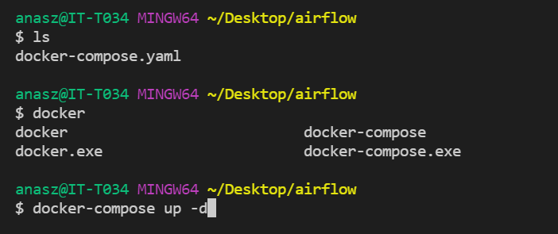
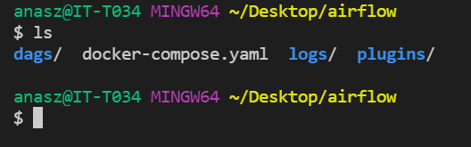
Install Docker-Compose

Slide 3
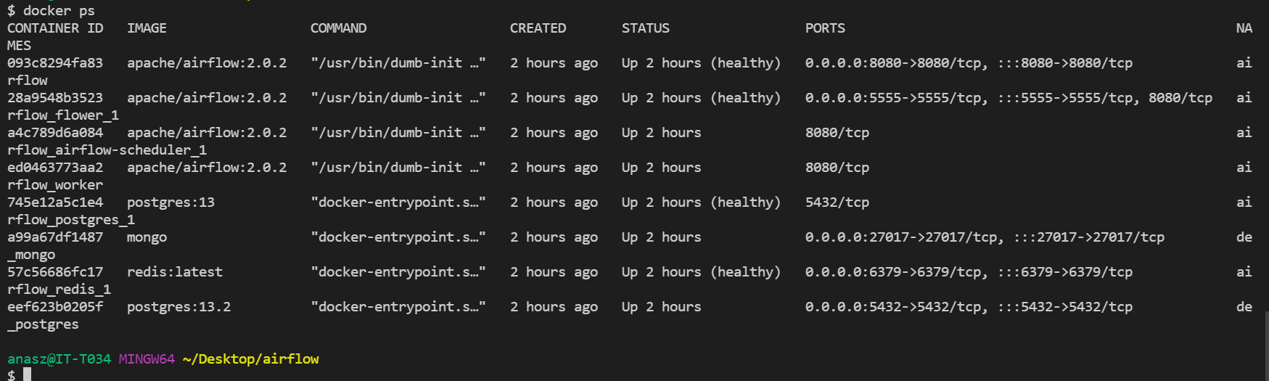
Docker Compose Installed Successfully

Slide 4
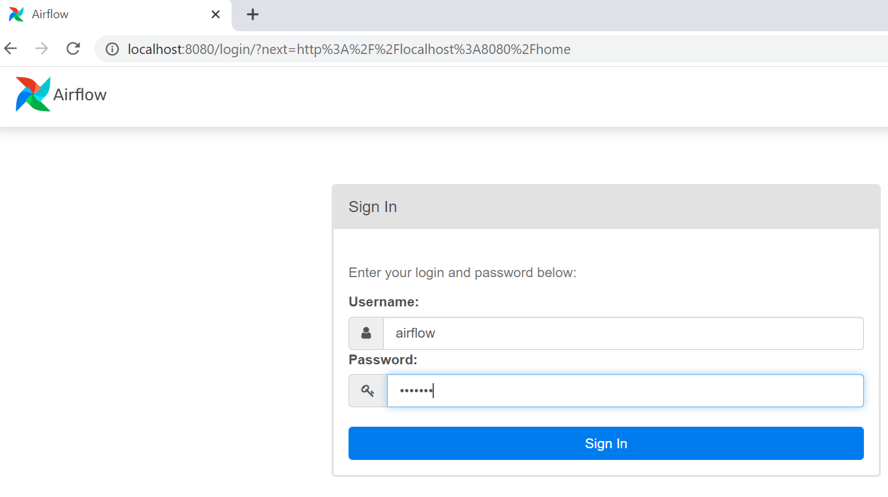
AirFlow Web Working

Slide 5
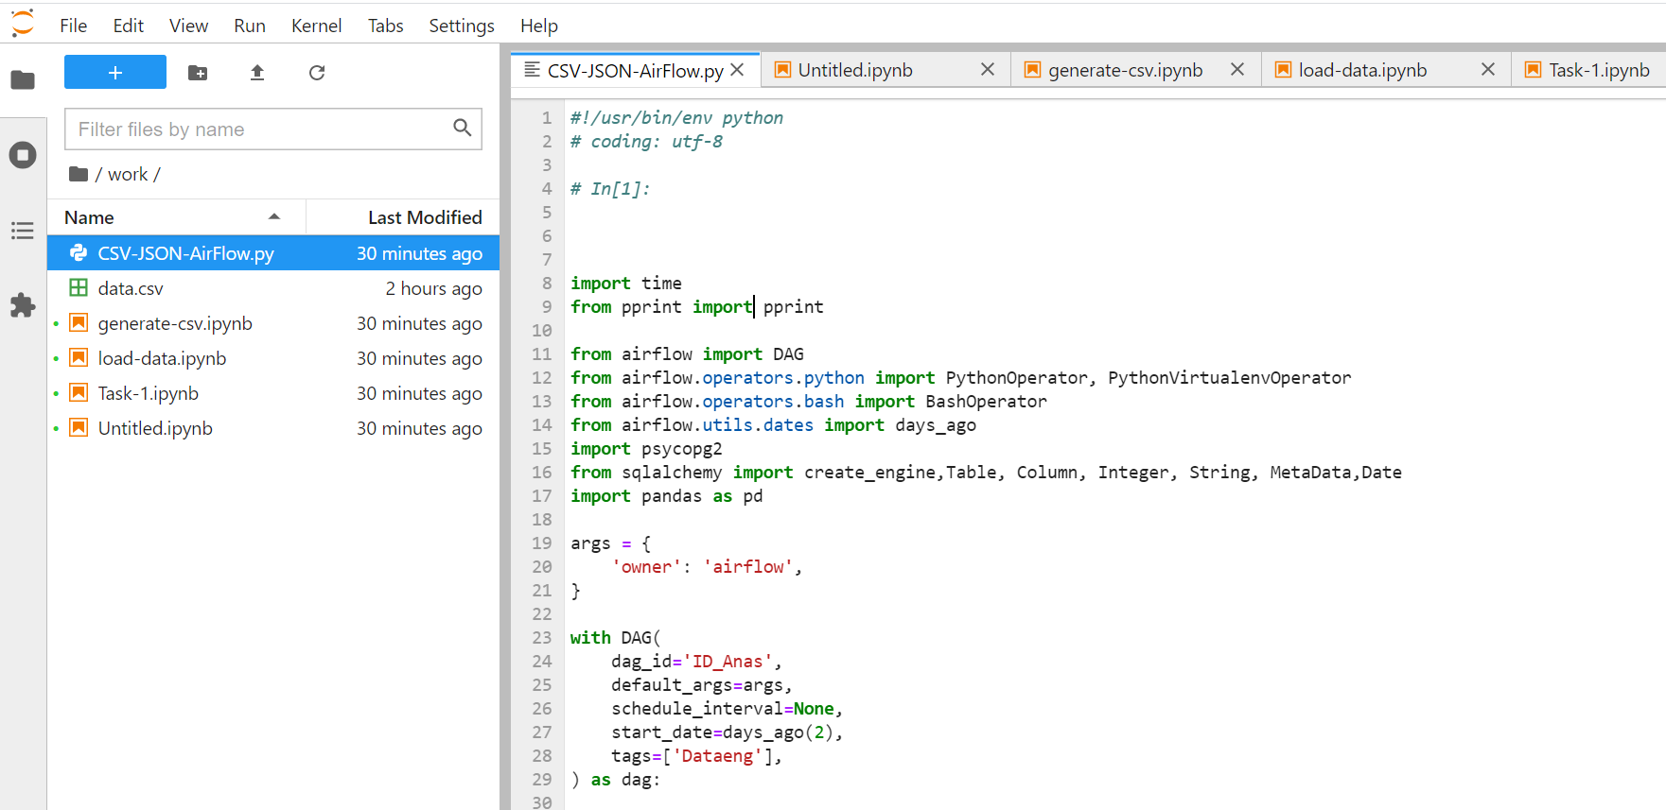
Upload the Code to Generate the Data and Load it

Slide 6
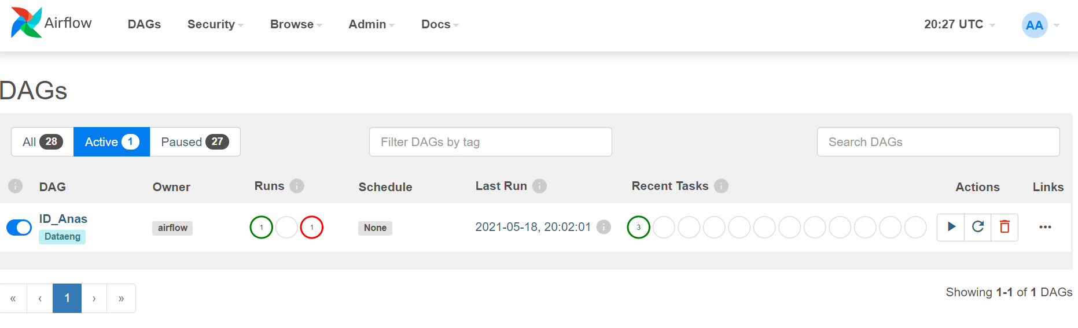
DAG Enabled Successfully

Slide 7
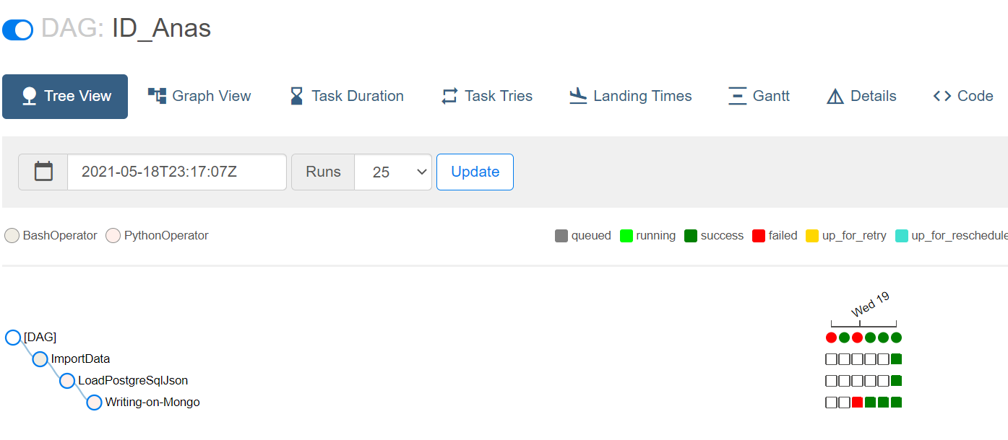
DAG Run Successfully

Slide 8
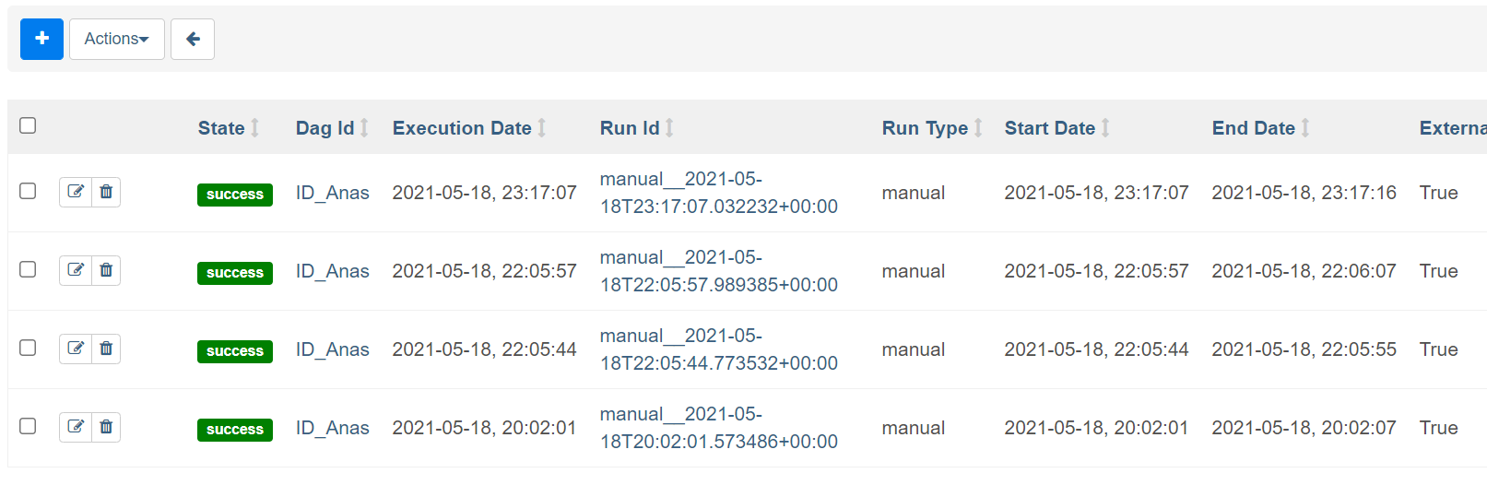
Creating DB (Postgresql) Generating the Data (CSV File) Convert the Data from CSV to JSON

Slide 9
Repo. Link: https://github.com/anaszobeidat/DE-Assig-Que-2.git

