Slide 1
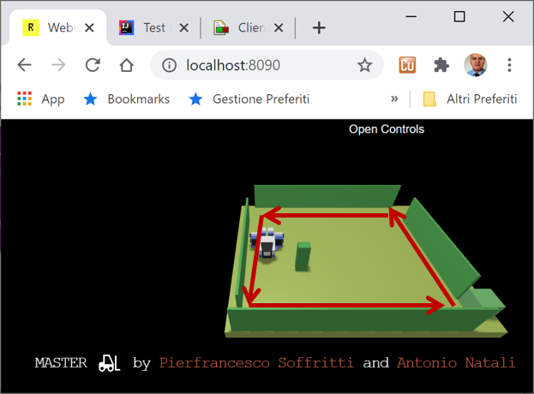

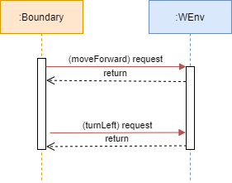
…

Slide 2
Generic Entity
Data base
Function
Procedure Call
Object
Object with
internal Tread)
Dispatch
Actor
Request
Reply
Service
Event
ANatali - DISI - University of Bologna

Slide 3
HTTP POST (request)
boundaryWalk
8090
WEnv
8091
socket
Request – Reply (dispatch)
send
(dispatch)
HTTP POST (request)
8090
WEnv
8091
socket
Request – Reply (dispatch)
boundaryWalk
command (request)
answer (reply)
WEnv
sonardata (dispatch)
boundaryWalk

Slide 4
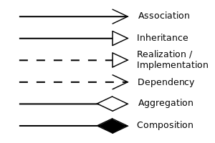
UML symbols
IssHttpSupport
IssWsSupport
IssOperations interface
IssCommsFactory
public static IssOperations create( Object obj ){ ProtocolInfo protocolInfo = IssAnnotationUtil.getProtocol(obj);
…
}
UseRobotApp
UseRobotAril
application-level
requestSynch / request / forward
IssAppOperations interface
IssAppRobotSupport
IssOperations interface
aril-level
Payload: w | s | h | l | r
IssArilRobotSupport
IssOperations interface
IssOperations interface
cril-level
Payload: cril sentence
IssArilRobotSupport
commsSupport
IssOperations interface
commsSupport

Slide 5
UML symbols
IssHttpSupport
IssWsSupport
IssOperations interface
IssHttpSupport
IssWsSupport
UseRobotAril
application-level
IssOperations interface
RobotControllerBoundary
1
IssCommSupport interface
IssVirtualRobotSupport
aril-level
IssObserver interface
IssOperations interface
IssOperations interface
cril-level
commsSupport
IssCommsFactory
public static IssOperations create( Object obj ){ ProtocolInfo protocolInfo = IssAnnotationUtil.getProtocol(obj);
…
}
Application Layer
RobotSupport Layer
WEnv
Communication Layer
HTTP POST (request)
8090
8091
Request – Reply (dispatch)
boundaryWalk

Slide 6
Application Layer
command (request)
IssObserver
RobotControllerBoundary
WEnv
answer (reply)
1
updateObserver
dispatch
IssCommSupport
IssOperations
IssHttpSupport
IssWsSupport
0
nc-1
0
ClientBoundaryWebsockBasicAsynch
0
nc-1
0
nc-1
0
home
0
nr-1
nr-1
nr-1

Slide 7
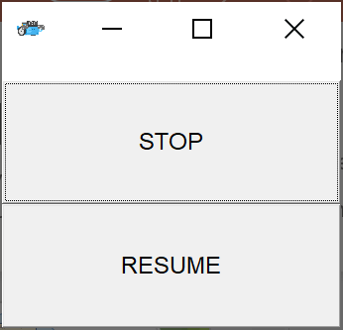
Application Layer
ConsoleGui
RobotMovesInfo
creates
IssObserver
ResumableBoundaryLogic
RobotApplInputController
command (request)
1
WEnv
request
IssCommSupport
answer (reply)
updateObserver
IssOperations
dispatch
IssHttpSupport
IssWsSupport
ResumableRobotBoundary

Slide 8
emptyMove
start
Transitions fired by messages
endmove && stepNum <= 4 /
doStep
/ doStep
walking
endmove && stepNum < 4 /
doStep
not endmove /
turnLeft
resume
obstacle
endmove && step=4
end
stopped
stop
Within a state,
events not shown are ignored
The stop event is handled
before endmove

Slide 9
emptyMove
start
Transitions fired by messages
forward-endmove / doStep
/ doStep
walking
turnLeft-endmove && stepNum < 4 / stepNum++, doStep
not (forward-endmove) /
turnLeft
resume
obstacle
turnLeft-endmove && step=4 / turnLeft
turnLeft-endmove /
turnRight
end
stopped
stop

Slide 10
start
forward-endmove &&
! tripStopped || resume / doStep
/ doStep
walking
turnLeft-endmove &&
stepNum < 4 && ! tripStopped || resume /
stepNum++, doStep
not (forward-endmove) /
turnLeft
obstacle
turnLeft-endmove && step=4 / turnLeft
turnLeft-endmove /
turnRight
end
stop /
halted
resume / halted=false
stop

Slide 11
emptyMove
start
step
Transitions fired by messages
endmove is true && step<4 / step
step
resume
walking
step
stopped
endmove is true
&& step=4
stop
endmove is true
endmove is false
end
obstacle
turnLeft
step++; turnLeft
https://en.wikipedia.org/wiki/Mealy_machine
Within a state,
events not shown are ignored
The stop event is handled
before endmove

Slide 12
ActorBasicJava
IJavaActor : IssObservable
ActorBasic
prod
cons
kaq
kactor
abstract actorBody
prodObserver

Slide 13
testObservers
NaiveActorObserver
RobotActorController
send
forward
IssCommActorSupport
command (request)
IssOperations
WEnv
IssWsHttpJavaSupport
answer (reply)
send
dispatch

Slide 14
NaiveObserverActor
send
send (to observer)
BoundaryWalkerActor
consoleGuiActor
forward
IssCommActorSupport
command (request)
IssOperations
IssWsHttpJavaSupport
WEnv
send (to observer)
answer (reply)
dispatch

Slide 15
send (robotCmd to observer)
ResumableBoundaryWalkerActor
consoleGuiActor
forward
(doStep, turnLeft)
send
WEnv
send (to observer)
endmove
sonarData
IssWshttpJavaSupport

Slide 16
ActorBasicContextKb
ActorContextTcpServer
8010
TCPSupprt
{"step":"350" }
IssWsHttpKotlinSupport
StepRobotService
StepRobotActor
BasicRobotCaller (observer of BasicRobotActor)
BasicRobotActor
msg(robotmove,dispatch,caller,basicRobot,{"robotmove": "turnLeft"@ "time": 300 },1)
IssWsHttpKotlinSupport
msg(endmove,dispatch,basicRobot,support,turnRight,2)

Slide 17
BasicStepRobotActor
ActorBasicContextKb
ActorContextTcpServer
{"step":"350" }
8010
{"robotmove": “…“, "time": … },
IssWsHttpKotlinSupport
TCPSupprt
StepRobotActor
{"step":"350" }
StepRobotService
{"robotmove": “…“, "time": … },
IssWsHttpKotlinSupport
BasicRobotActor
StepRobotActor
BasicRobotActor
{"step":"350" }
{"robotmove": “…“, "time": … },
IssWsHttpKotlinSupport
{"robotmove": “…“, "time": … },
StepRobotActor
BasicRobotActor
{"step":"350" }
{"robotmove": “…“, "time": … },
{"robotmovecmd": “…“, "time": … },
IssWsHttpKotlinSupport

Slide 18
BasicStepRobotActor
{"step":"350" }
{"robotmove": “…“, "time": … },
IssWsHttpKotlinSupport
StepRobotActor
{"step":"350" }
{"robotmove": “…“, "time": … },
IssWsHttpKotlinSupport
BasicRobotActor
StepRobotActor
BasicRobotActor
{"step":"350" }
{"robotmove": “…“, "time": … },
IssWsHttpKotlinSupport
{"robotmove": “…“, "time": … },
StepRobotActor
BasicRobotActor
{"step":"350" }
{"robotmove": “…“, "time": … },
{"robotmovecmd": “…“, "time": … },
IssWsHttpKotlinSupport

Slide 19
{"step":"350" }
8010
StepRobotActor
{"step":"350"}
StepRobotService
Application
Application
{"stepDone":"ok"} or {"stepFail":DT } since observed
ActorBasicContextKb
ActorContextTcpServer
8010
TCPSupprt
{"step":"350" }
IssWsHttpKotlinSupport
StepRobotService
StepRobotActor
WalkerPath
msg(step,dispatch,walker,stepRobot,{"step":"350" },1)
8010
msg(stepAnswer,dispatch,stepRobot,ctxServer,{"stepDone":"ok" },5)
msg(stepAnswer,dispatch,stepRobot,ctxServer,{"stepFail":"115" },13) l
StepRobotService
ConnectionReader
(observer)
WalkerStrategyActor
WalkerStrategyActor
PathExecutorActor
PathExecutorActor
StepRobotActor
StepRobotActor

Slide 20
msg(move, //msgID
dispatch, //msgType
actortry, //msgSender
stepRobot, //msgReceiver
{“robotmove”:“turnLeft“ , “time”:350 }, //msgContent (move)
INT //msgNum)
robotActorTry
{“move”:”w|r|…”}
{“cmd”:“init”}
msg(step,dispatch,actortry,stepRobot,{"step":"350" },INT)
{“cmd” : “end”}
8010
RobotService
InputReader
msg(stepAnswer,dispatch,stepRobot,X,{"stepDone":“ok" },INT)
msg(stepAnswer,dispatch,support,X,{"stepFail":“TIME" },INT)
msg(endmove,dispatch,support,X,{“endmove":“…“, “move”:”…” },INT)
{ “endmove” : “…” , “move” : “… “ }
{ "sonarName": “…", "distance": INT, "axis": “…" }
{ "collision" : “…", "move": “…"}
msg(move, //msgID
dispatch, //msgType
…, //msgSender
stepRobot, //msgReceiver
{“robotmove”:“turnLeft“ , “time”:350 }, //msgContent (move)
INT //msgNum)
msg(step,dispatch,…,stepRobot,{"step":"350" },INT)
IssWsHttpKotlinSupport
msg(stepAnswer,dispatch,stepRobot,X,{"stepDone":“ok" },INT)
msg(stepAnswer,dispatch,support,X,{"stepFail":“TIME" },INT)
msg(endmove,dispatch,support,X,{“endmove":“…“, “move”:”…” },INT)
BasicStepRobotActor

Slide 21
robotUsage
IssWsHttpKotlinSupport
{“move”:”w|r|…”}
{"robotmove": “…“, "time": … },
{“cmd”:“init”}
{“cmd” : “end”}
WEnvSupportObserver
(ActorBasicKotlin)
BasicRobotActor
{ “endmove” : “…” , “move” : “… “ }
{ “endmove” : “…” , “move” : “… “ }
{ "sonarName": “…", "distance": INT, "axis": “…" }
{ "collision" : “…", "move": “…"}
{ "sonarName": “…", "distance": INT, "axis": “…" }
{ "collision" : “…", "move": “…"}
{“stepDone”:”ok”}
{“stepFail”:”TIME”}
msg(stepAnswer,dispatch,stepRobot,X,{"stepDone":“ok" },INT)
msg(stepAnswer,dispatch,support,X,{"stepFail":“TIME" },INT)
msg(endmove,dispatch,support,X,{“endmove":“…“, “move”:”…” },INT)

Slide 22
robotUsage
StepRobotActor
{“move”:”w|r|…”}
{"step":"350" }
{“cmd”:“init”}
{“cmd” : “end”}
{"robotmove": “…“, "time": … },
{ “endmove” : “…” , “move” : “… “ }
IssWsHttpKotlinSupport
{ "sonarName": “…", "distance": INT, "axis": “…" }
{ "collision" : “…", "move": “…"}
BasicRobotActor
{“stepDone”:”ok”}
{“stepFail”:”TIME”}
msg(stepAnswer,dispatch,stepRobot,X,{"stepDone":“ok" },INT)
msg(stepAnswer,dispatch,support,X,{"stepFail":“TIME" },INT)
msg(endmove,dispatch,support,X,{“endmove":“…“, “move”:”…” },INT)
interface IssActorObservable { fun registerActor(obs: IUniboActor) fun removeActor(obs: IUniboActor) }
IUniboActor
IActorObservable
Provides:
forward
request
autoMsg
sendToYourself
sendToActor
interface IUniboActor : IssActorObservable { fun myname() : String fun send(msg: String ) }
kactor
ActorBasicKotlin
msg(step,dispatch,…,stepRobot,{"step":"350" },INT)
msg(move,dispatch,…,stepRobot,{“robotmove":“…“,”time”:…. },INT)
PathExecutor
IssWsHttpKotlinSupport
BasicStepRobotActor

Slide 23
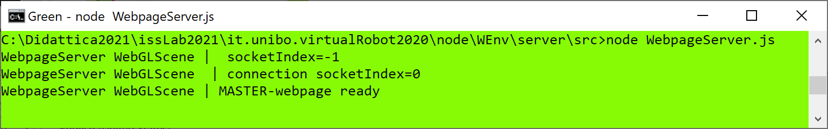
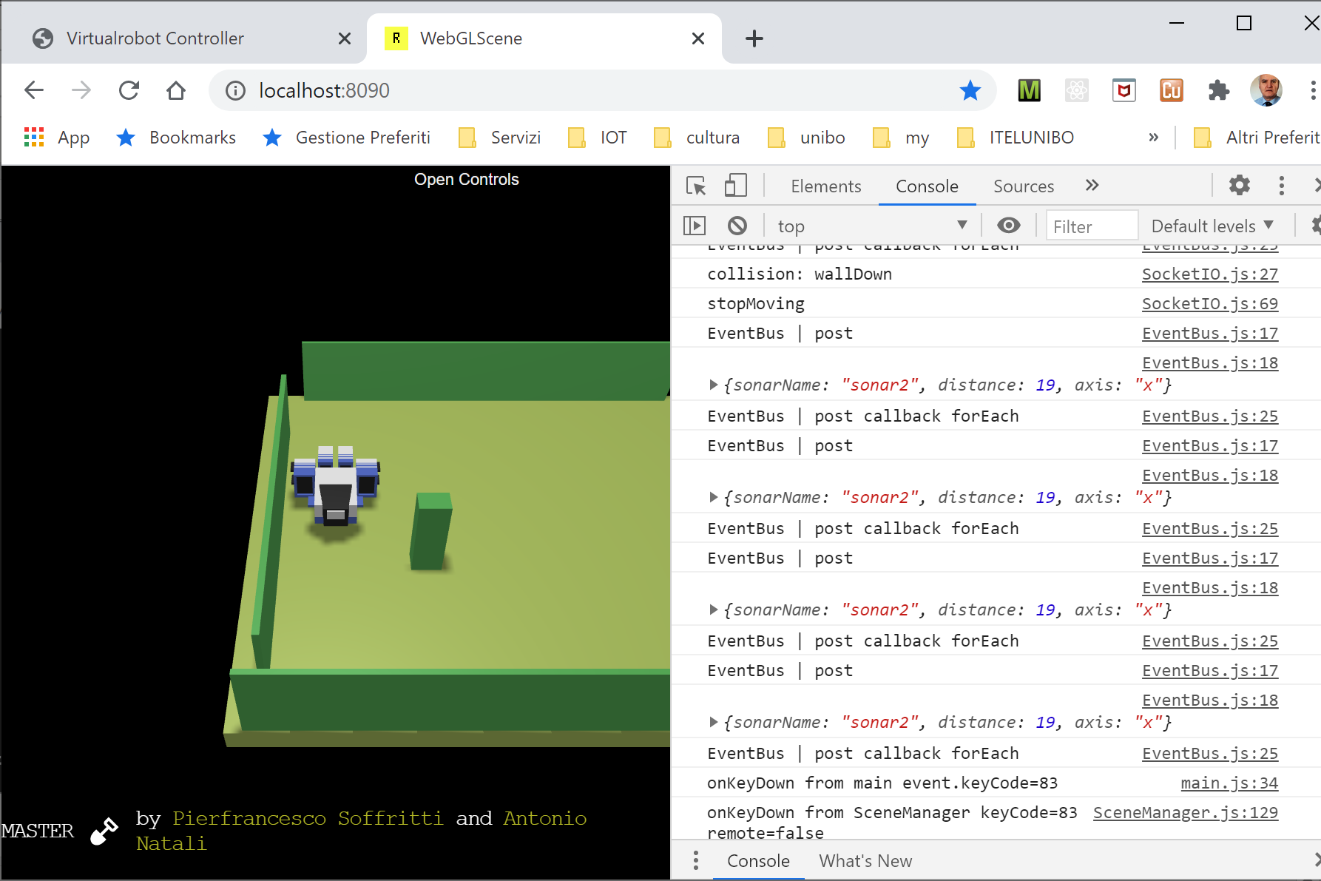
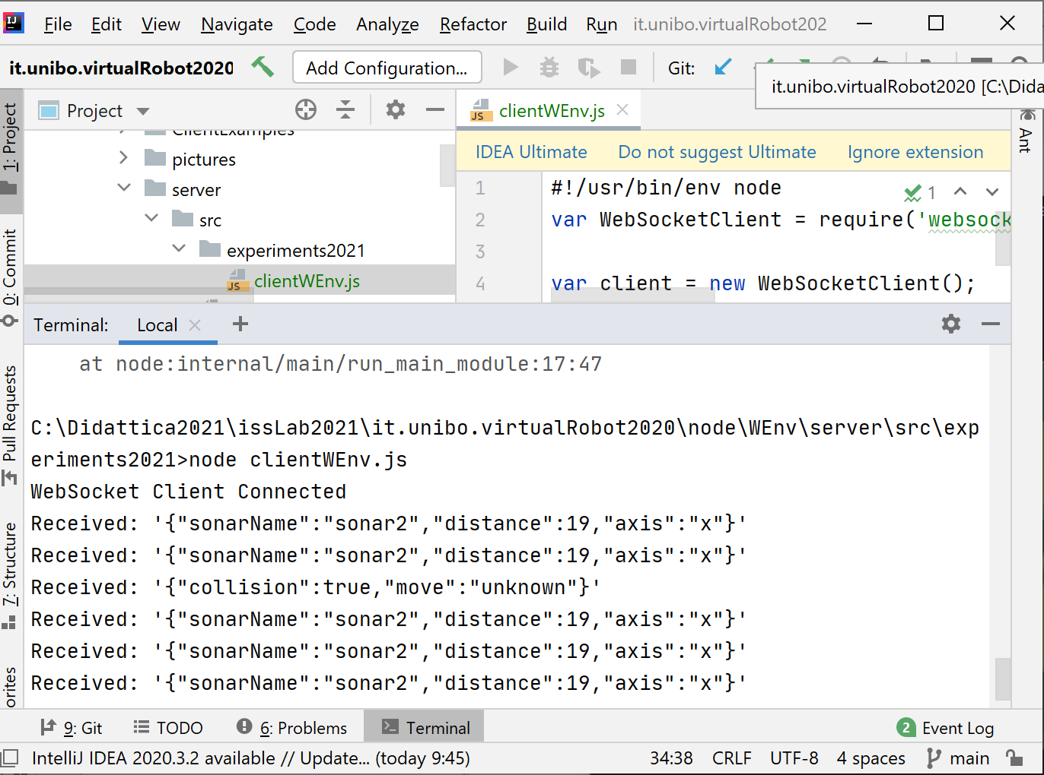
Console updated
by WebpageServer
WebpageServer updates the scene by using websocket-8090
Console updated
by scripts loaded in
the HTML file
Console updated
by a client (js) that handles messages sent by WEnv over websocket-8091
Wenv (scene)

Slide 24
Console updated
by scripts loaded in
the HTML file
Console updated
by WebpageServer

Slide 25
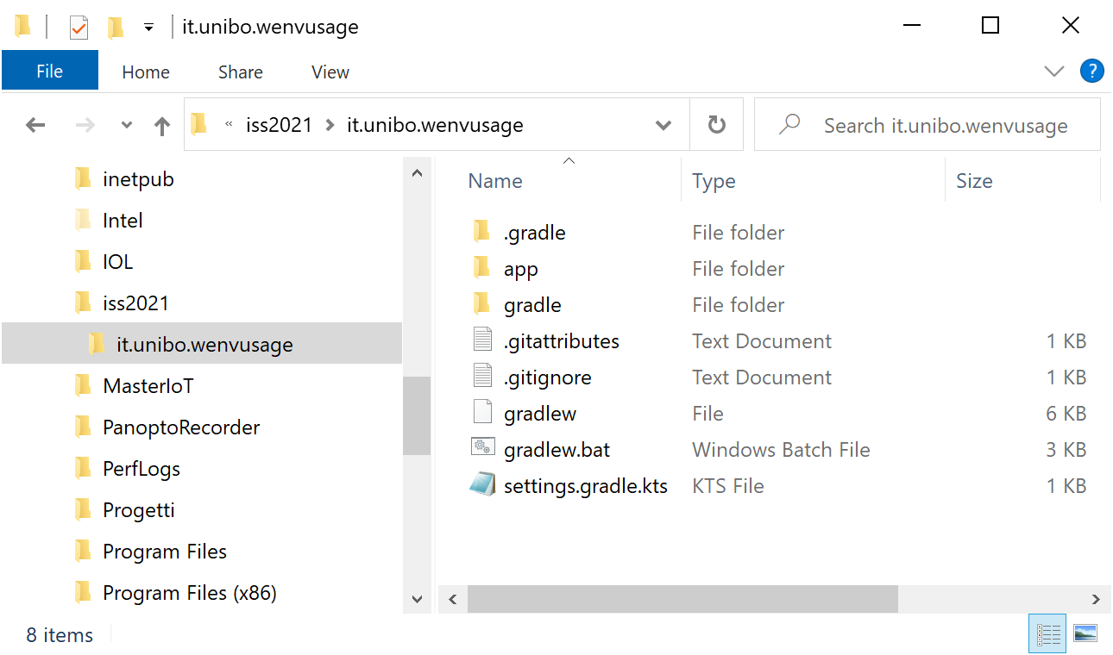
Create a project with gradle
C:\...\issLab2021>mkdir it.unibo.wenvusage
C:\...\issLab2021>gradle init (select 2, 3, 1, 2, 1, -, -)

Slide 26
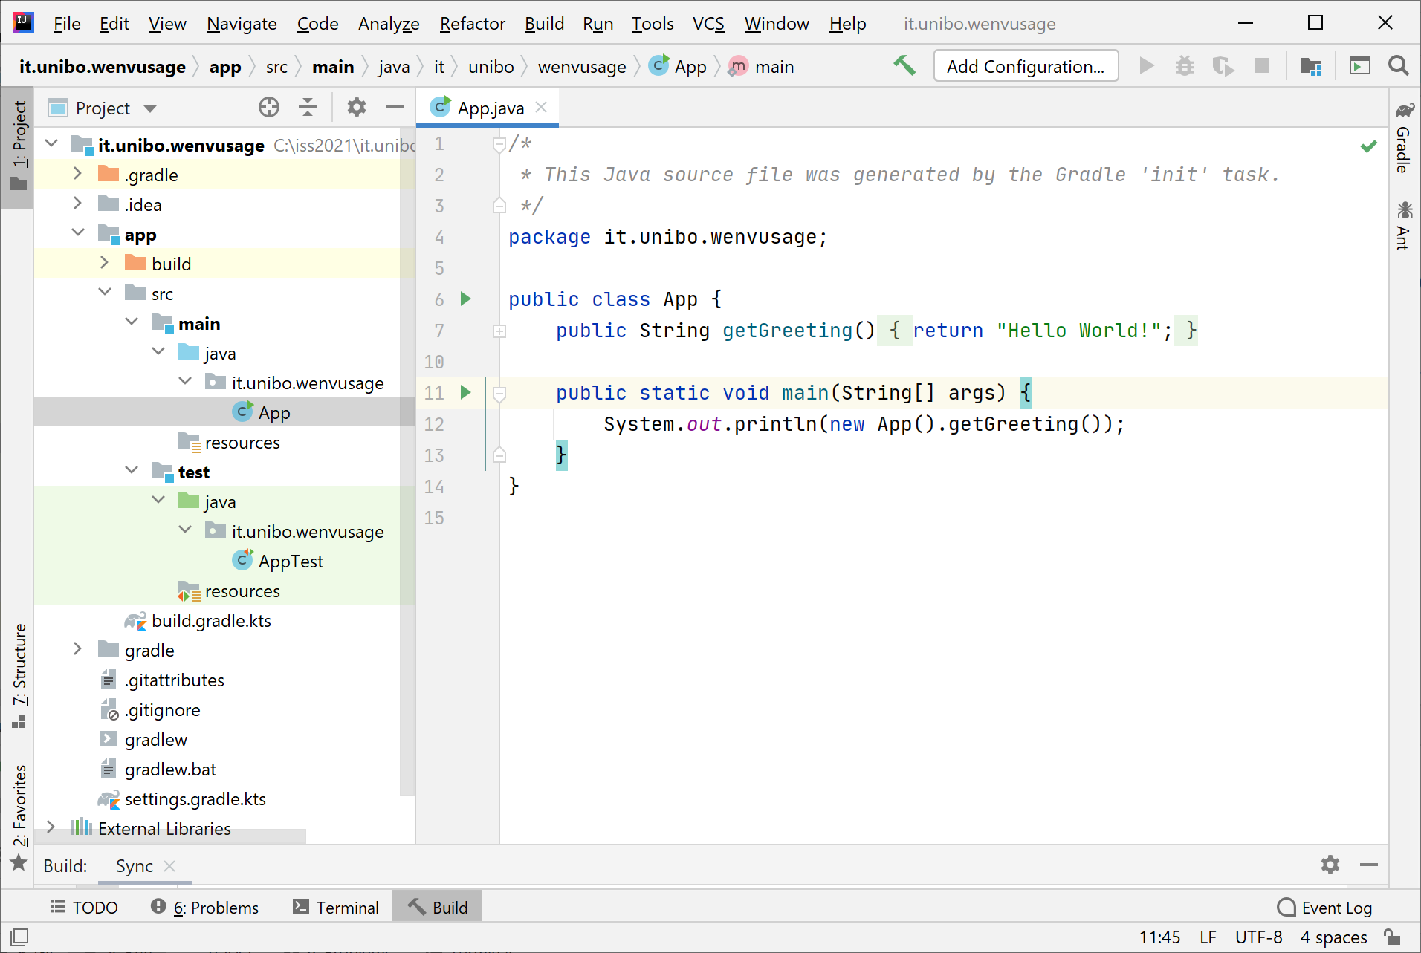
The project it.unibo.wenvusage
gradlew build
gradlew run
> Task :app:run
Hello World!
BUILD SUCCESSFUL in 2s
2 actionable tasks: 1 executed, 1 up-to-date

Slide 27
Define our app and modify build
application { // Define the main class for the application. //mainClass.set("it.unibo.wenvusage.App") //ORIGINAL mainClass.set("it.unibo.wenvusage.MoveVirtualRobot")
}
Create the userDocs folder
Formally define the Test (in JUnit)

Slide 28
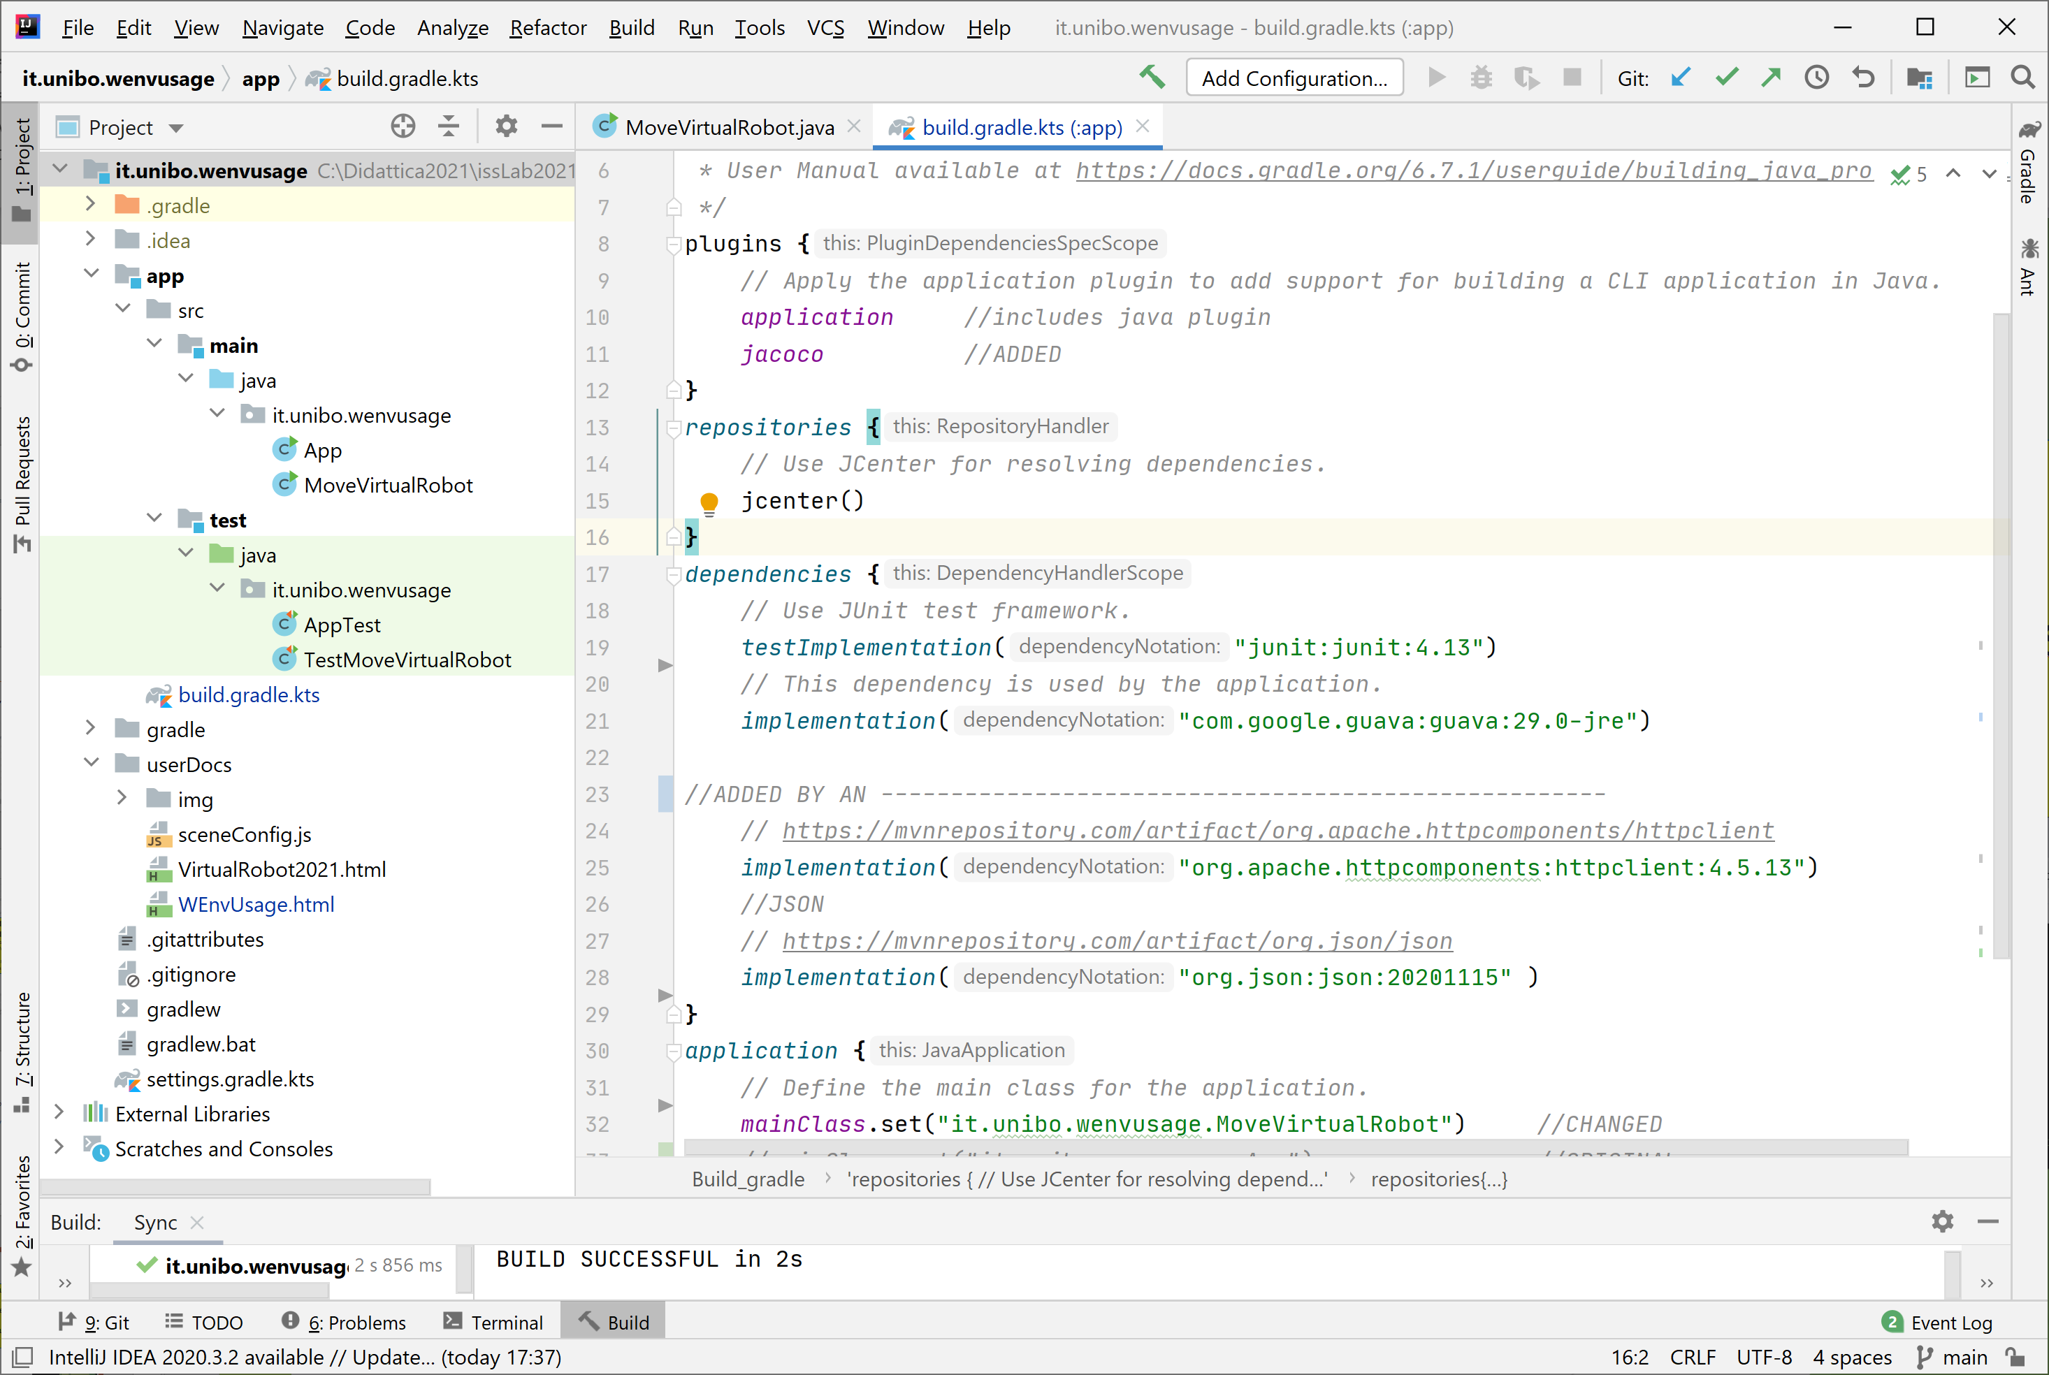
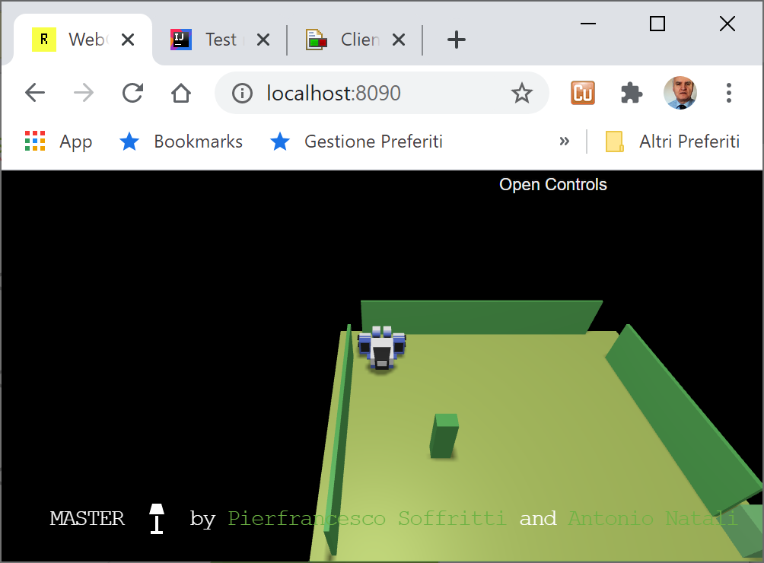
The project it.unibo.wenvusage
gradlew build -x test
gradlew test jacocoTestReport
gradlew run

