Slide 1
Generic Entity
Data base
Function
Procedure Call
Object
sender
receiver
Object with
internal Tread)
Dispatch
Actor
Request
Reply
server
Service
Event

Slide 2
Dispatch
Actor
Request
QActor
Reply
Service
Event
CounterMsg
senderActor
receiverActor
counterActor

Slide 3
High-level
application code
(model)
instanceof
qa metamodel
Defined in project
it.unibo.Qactork
SoftwareFactory
(Eclipse Pluigins)
generates
Kotlin code
Inherits from
Runs over
it.unibo.Qactork_1.2.3.jar
it.unibo.Qactork.ide_1.2.3.jar
it.unibo.Qactork.ui_1.2.3.jar
Qak Infrastructure
it.unibo.qakactor-2.3.jar

Slide 4
ctxSender
% SYSTEM DESCRIPTION
context( ctxSender, "192.168.43.229","TCP", "8010" ).
context( ctxReceiver, "192.168.43.229","TCP","8020").
qactor( qasender, ctx1, ‘QActorSender’ ).
qactor( qareceiver, ctx2, ‘QActorReceiver’).
PORT
A message sent by a qactor
to another qactor
is inserted in the message queue
of the destination actor
NodeProxy
ctxReceiver
ReceiverCoroutine
creates
PORT
CtxSeerverAgent
CtxServerAgent : created at start-up
SenderAgent : created a start-up
ReceiverAgent : created at each conn request

Slide 5
ctxSender
ctx…
NodeProxy
TCP
PORT
TCP
PORT
sender
NodeProxy
NodeProxy
NodeProxy
ctxReceiver
ReceiverCoroutine
creates
TCP
PORT
receiver

Slide 6
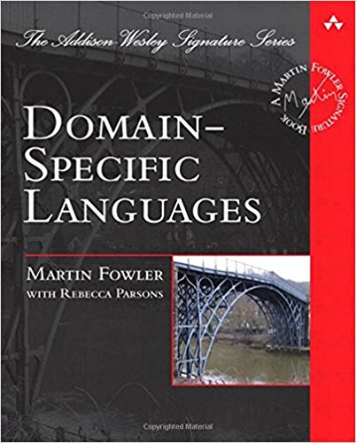
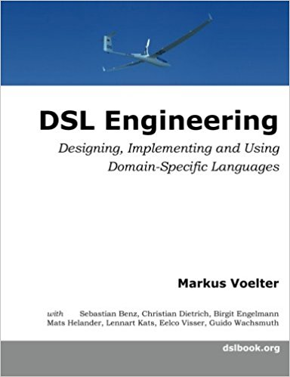
DSL
Domain-Specific Languages
Fowler presents effective techniques for building DSL, and guides software engineers in choosing the right approaches for their applications. This book's techniques may be utilized with most modern object-oriented languages; the author provides numerous examples in Java and C#, as well as selected examples in Ruby
This book provides a thorough introduction to DSL, relying on today’s state of the art language workbenches.
The book provides details about the implementation of DSLs with lots of code. It uses three state-of-the-art but quite different language workbenches: JetBrains MPS, Eclipse Xtext and TU Delft’s Spoofax.
2010
2013
ISBN-10: 0321712943
ISBN-13: 978-0321712943
ISBN-10: 1481218581
ISBN-13: 978-1481218580

Slide 7
VISION
S
architectural
dimensions
B
I
BUSINESS LOGIC
DOMAIN-RELATED TERMINOLOGY
WHAT
APPLICATION LEVEL
Logical Architecture
HOW
HIGH
( MODEL – CONTROL - VIEW )
MAPPING LEVEL
SoftwareFactory
LOW
PLATFORM LEVEL
EDGE
FOG
CLOUD
CONCRETE (IOT) WORLD

Slide 8
ActorBasic
kaq
kactor
abstract actorBody
Message-driven
ApplQActor
override
actorBody
ActorBasic
inherits
kaq
abstract actorBody

Slide 9
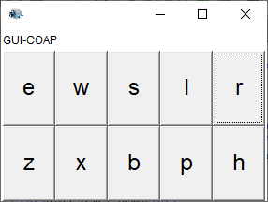
inherits
Message-based (fsm)
ApplFsmQActor
body
ActorBasic
ActorBasicFsm
fsmwork
kaq
abstract actorBody
override actorBody

Slide 10
sonarsimulator
datalogger
datacleaner
distanceFilter
sonarsimulator
datalogger
datacleaner
distanceFilter
qasink
sonarHCSR04SupportActor
robotDataSourceArduino
virtualrobotSonarSupportActor
datacleaner
distanceFilter
sonarRobot
obstacle
sonar

Slide 11
Domande (su un sistema)
Cosa deve fare → committente
Cosa deve essere → analista
Quale struttura-interazione-comportamento sono necessari tenendo conto dei vincoli che sorgono dai requisiti e dal problema in sè
Cosa è opportuno che sia → analista
Tenendo conto delle tecnologie, dell’andamento del mercato, delle risorse umane, economiche, temporali, etc.
Come è fatto → progettista
Quale struttura-interazione-comportamento ha il sistema finale tenendo conto dei vincoli dall’analisi e dei criteri (pattern) usati per risolvere le forze (anche contrastanti) in gioco

Slide 12
Specifica della grammatica
grammar it.unibo.xtext.Entities with org.eclipse.xtext.common.Terminals
generate entities "http://www.unibo.it/xtext/Entities"
Model : (imports+=Import)*
(types+=Type)* ;
Import : 'import' importURI = STRING;
Type: SimpleType | Entity;
SimpleType: 'type' name = ID;
Entity : 'entity' name=ID ('extends' extends= [ Entity ] )? '{'
properties+=Property*
'}';
Property: 'property' name=ID ':' type= [ Type ] ( many ?= '[]')?;
EBNF notation
The grammar is a collection of Rules.
Rules start with their name followed by : and ending with ;
The editor provides code completion and constraint checking for the grammars themselves

Slide 13
a:Int, b:Int
Int
Unit
k:Int
Int
sendMsg(
jsonString: String)
socket
clientWenvTcpObj
(starts a coroutine to read sonar data)
ctx1
ctx2

Slide 14
init ….
end …
move …
domove( cmd: String )
socket
robotActorTry
virtualRobotSupport
(starts a sensorObserver coroutine that
sends messages to robotActorTry)
sensor ….
collision …
ε-move
{“cmd”:”init”}
doInit
{“cmd”:”end”}
doEnd
working
{“move”:”w”}
doMove
{"sonarName":“…","distance":INT,"axis":"x"}
doSonar
ε-move
{"collision":true,"move":"unknown"}
doCollision

Slide 15
collision
doCollision
start
doInit
end
doEnd
receive
stop
doStop
resume
ε-move
doResume
sensor
elabSensor

Slide 16
Dispatch
Request
Reply
Event
msg(move, dispatch, main, robotactor, w, 1)
domove( cmd: String )
socket
robotActor
virtualRobotSupport
(starts a sensorObserver coroutine that
sends messages to robotActor)
msg(sensor,dispatch,vr,robotactor, collision-bottle2, 6)

Slide 17
Init
explore
Explore
Explore ( an empty room )
stepdone
explore
Step
ε-m
Rotate
Robot
Init
stepfail
stepdone
Rotate
ε-m
Step
stepfail
Stopped
stop
stop
Direction DOWN : Rotate 90 Left
Direction UP : Rotate 90 Right

Slide 18
R
start
collision
left
down
Init
collision
up
right
collision
collision
goon
init
start
working
sensor
endOfStep
stop
end
resume
stop
stopped
end
[ nStep < 4 ] collision

Slide 19
ε-m
Dt=2sec
init
activateR
stopR
stop
start
Dt=1sec
resume
resumeR
robotboundary
user
robotboundary
virtualRobotSupport
socket
start
stop
resume
sensor (collision)

Slide 20
ε-m
endtime
stepOk
init
ε-m
work
step
doStep
sensor
stepKo
gauge
timeractor
endtime
init
ε-m
waitcmd
timer
waitcmd
ε-m

Slide 21
msg1
s2
s0
ε-m
s1
endtime
msg2
msg2
s3
ε-m
reply
ε-m
sensor
stepKo
discard
gauge
init
ε-m
waitcmd
step
doStep
checkStep
(delay stepTime)
sensor
gauge
endtime
timeractor
[ else ]
sendDone
reply

Slide 22
s0
forward cmd to itself
ε-m
s1
ε-m
s2
cmd
tout
s3

Slide 23
init
init
request r1
r1
ε-m
ε-m
work
ε-m
replyTo r1
handleRequest
a1
handleReply

Slide 24
init
init
request r1
r1
ε-m
work
ε-m
r2
handleRequest
askFor r2
handleAskFromCaller
ε-m
a1
replyTo r2
a1
answerAfterAsk
replyTo r1
handleReply

Slide 25
publish
MQTT broker
BROWSER
xxxx
subscribe
yyyy
publish

Slide 26
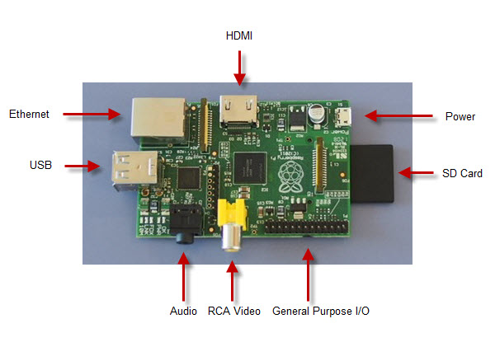
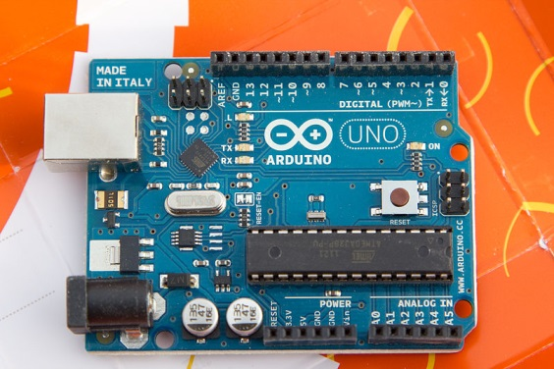

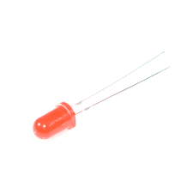
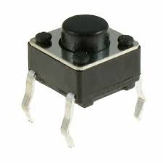

click
led is listener
of button?
button
led
button
led
???
Polling:
led calls button
click

Slide 27
button
led
Polling:
led calls button
button
led
Mazzuca
button
led
led is called
by button
button
led
led perceives
button events
button
control
led
(3)
socket

Slide 28
button
control
led
button
control
led
button
control
led
control
led
???
button
click
(2)
(3)
(3)
socket

Slide 29
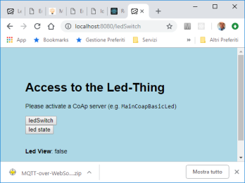
browser
frontend
control
led
???

Slide 30
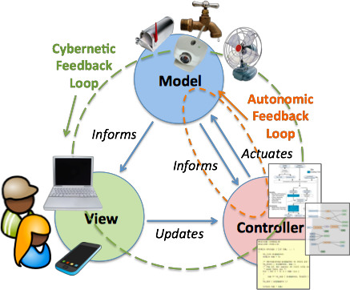
MVC
The Model-VIew-Controller macro pattern provides a framework for the structured division of responsibility between people and software in IoT applications. It also provides a framework for high level interoperability between data sources, control elements, and UI elements.
The Model is a representation or an abstraction of the physical things and their attributes, which informs a Controller.
The Controller is software which makes actuation decisions based on the information, and sends actuation commands to the thing using it’s modeled affordances.
The software goal is to maintain a desired state of the thing through it’s model.

Slide 31
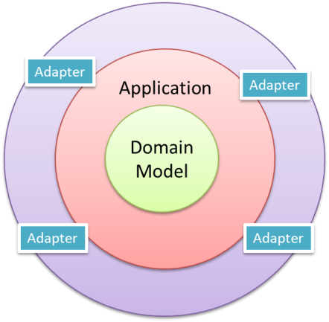
SISTEMI: una visione ‘olistica’
VISTE DI UN SISTEMA
Dal di fuori (cosa fa)
Dal di dentro (come è fatto)
ARCHITETTURA ESAGONALE
The connection between the inside and the outside part of the system is realized via abstractions called ports and their implementation counterparts called adapters.

Slide 32
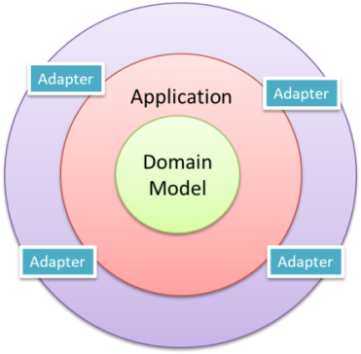
Hexagonal Architecture (Port-Adapter)
Alistair Cockburn
Allow an application to equally be driven by users, programs, automated test or batch scripts, and to be developed and tested in isolation from its eventual run-time devices and databases.
As events arrive from the outside world at a port, a technology-specific adapter converts it into a usable procedure call or message and passes it to the application. The application is blissfully ignorant of the nature of the input device.
When the application has something to send out, it sends it out through a port to an adapter, which creates the appropriate signals needed by the receiving technology (human or automated).
The application has a semantically sound interaction with the adapters on all sides of it, without actually knowing the nature of the things on the other side of the adapters.

Slide 33


persistence
Input
handling
Application
service
Domain
model
Output
adapter
Security
GUI
Security
Transactions
Task coordination
Entities
Business Logic
Domain events
Repositories
Documents
Cache
Inherits or use? → The resource USES the model

Slide 34
R
R
step
Matrice n x m
0
1
nc-1
0
R
1
nr-1

Slide 35
R
step
Matrice n x m
nc-1
0
R
1
0
1
nr-1

Slide 36
user
robotboundary
start
stop
resume
step
Application Logic
sensor/collision
Reusable Logic
stepper
stepOk
stepKo
Reusable worker (no policy)
w | s | h …
basicrobot
virtualRobotSupportApp
Virtual / Concrete robot
R

Slide 37
sensor/collision
w | s | h …
alien
basicrobot
virtualRobotSupportApp
collisionEvent
R

Slide 38
"unibo/qak/xxx"
Fsm
subscribed
MQTT
broker
is_a
publish
"unibo/qak/events"
xxx
publish
alien
Ref to the owner

Slide 39
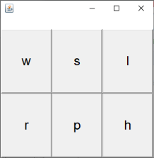
Ref to the owner
"unibo/qak/basicrobot"
Fsm
MQTT
broker
is_a
publish
subscribed
w | s | h …
basicrobot
alien
sensorData
virtualRobotSupportApp
R
endwork
end
ε-m
init
waitcmd
sensor
handlesensor
ε-m
w | s | h …
cmd
execcmd
ε-m

Slide 40
localController
(owner)
"unibo/qak/basicrobot"
sensorData
propagated
MQTT
broker
publish
‘alien’ entity
basicrobot
publish
(a command)
command
dispacth
mqttSupport
sensorData
virtualRobotSupportApp
remoteController
R

Slide 41
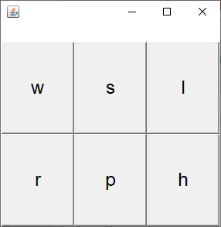
Gui
publish cmd dispatch
"unibo/qak/basicrobot"
MQTT
broker
"unibo/qak/events"
sensorObserver
publish sensor event
basicrobot
collision
robotboundary
virtualRobotSupport
start
stop
resume
socket
robotboundary
start
stop
resume
sensor (collision)

Slide 42
resume
s0
start
work
stop
stopped
collision
endWork
[ NumStep<4 ]
wall
[ NumStep==4 ]
obstacle
cmd( M )
start
stop
resume
basicrobot
robotboundary
step
stepDone
stepFail
robotSupport
virtualRobotSupportQak
mbotSupport
robotDataSourceArduino
collision
TCP socket
Serial

Slide 43
ctxrobotboundary
ctxbasicrobot
obstacle
start
stop
resume
step
cmd
8018
robotboundary
8020
basicrobot
resume
s0
start
work
stop
stopped
collision
endWork
[ NumStep<4 ]
wall
[ NumStep==4 ]

Slide 44
[ NumStep<4 ]
basicrobot
stepDone
stepdone
ε-m
init
start
working
stepfail
stepFail
[ NumStep==4 ]
resume
stop
stopped
end

Slide 45
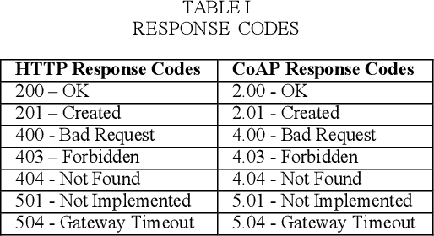
ε-m
Timeout
counter++
[ counter==0 ]
watch
s0
handleAlarm
[ counter==0 ] alarm
ε-m
end
[ counter !=0 ]

Slide 46
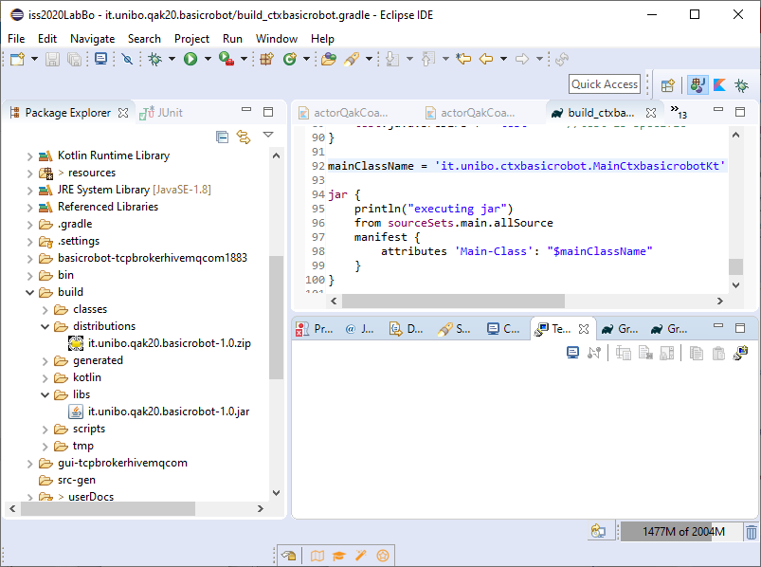

Slide 48
Nuovo progetto
it.unibo.bls20
Note: If the run fails with Error: Could not find or load main class it may mean that the IDE can't find the *Kt Kotlin file related to the main class. To fix this, edit the corresponding Run Configuration in the Dependencies tab (or the Classpath tab, depending on the Eclipse version), choose Advanced and enter the folder containing the kotlin generated .class files (for example: build/classes/kotlin/main).

Slide 49
Disponibile
Versione 1.2.4
it.unibo.Qactork.ide_1.2.4.jar
it.unibo.Qactork.ui_1.2.4.jar
it.unibo.Qactork_1.2.4.jar
Aggiornare Qak runtime versione
it.unibo.qakactor-2.4.jar

Slide 50
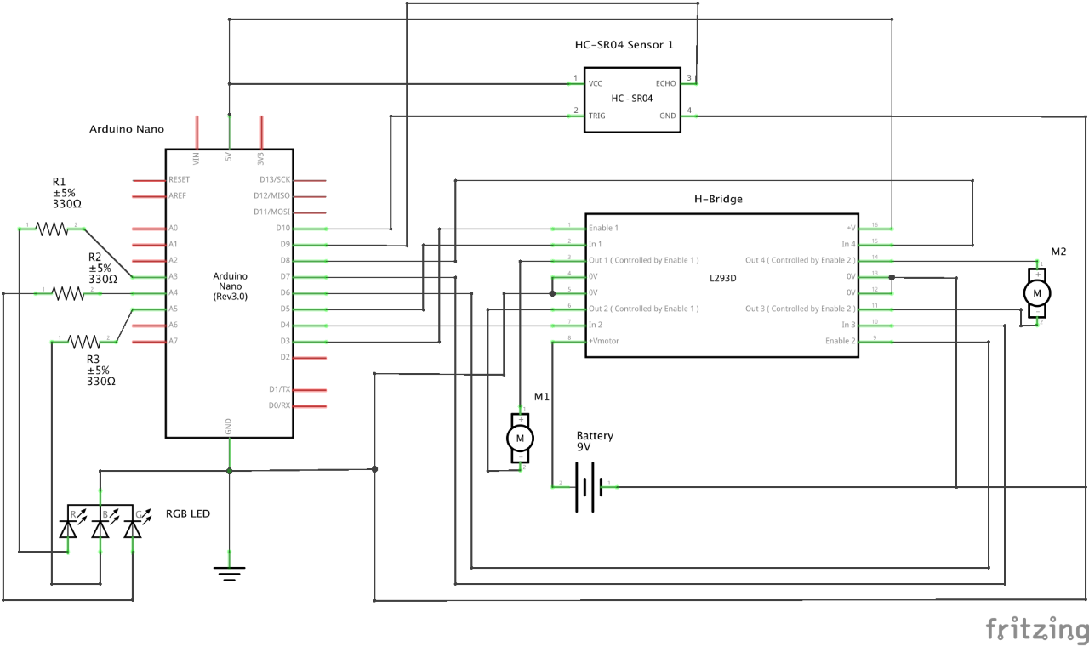
Ugo Cavalcanti (ugoleone.cavalcanti@studio.unibo.it) : schema connessioni Arduino

Slide 51
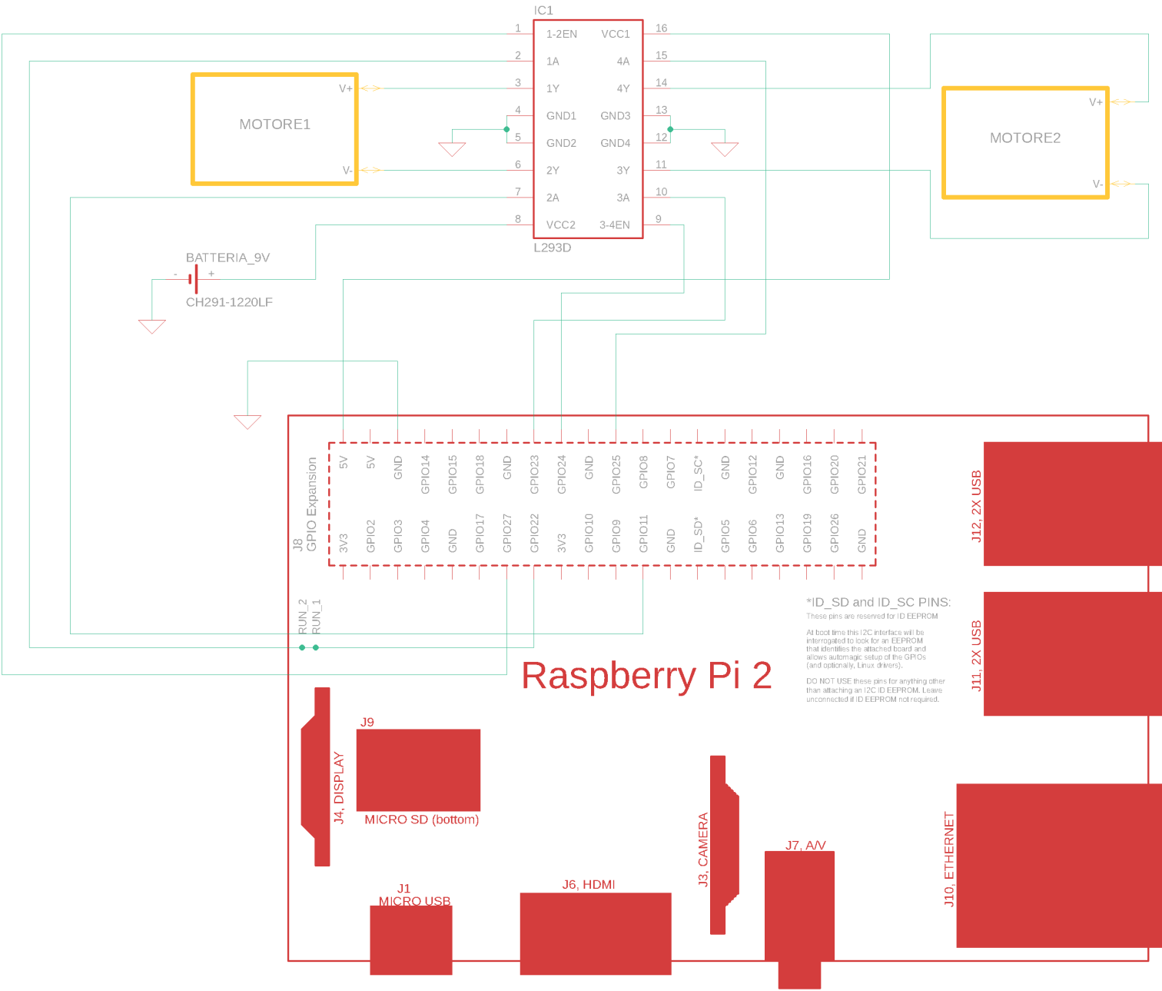
Ugo Cavalcanti (ugoleone.cavalcanti@studio.unibo.it) : schema connessioni l293d per Rasp

Slide 52
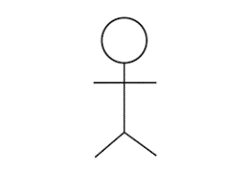
walk
<<uses>>
Start-work
<<include>>
Detect-obstacle
<<extend>>
Stop-work
walk
<<include>>
init
walk
<<include>>
init
<<include>>
stop
resume
stop
<<include>>
resume

Slide 53
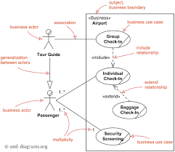

Slide 54
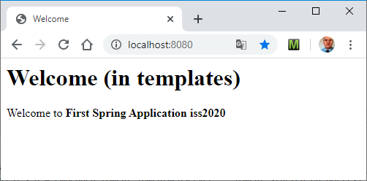
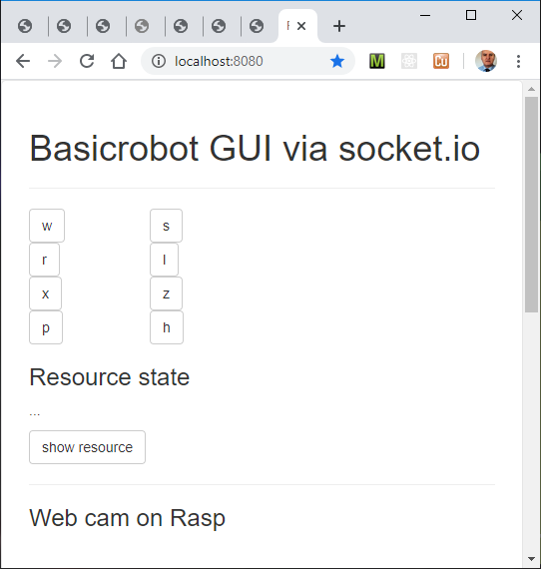
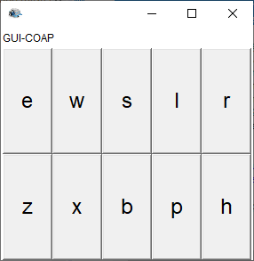

Slide 55
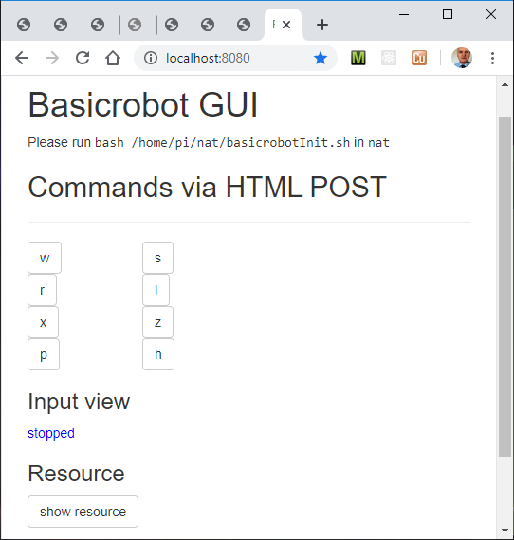

Slide 56
Giovedi 21 Maggio
it.unibo.qak20.boudaryrobot.analysis
it.unibo.qak20.basicrobot
robotWeb2020
it.unibo.frontend20
it.unibo.qak20.robotboundary

Slide 57
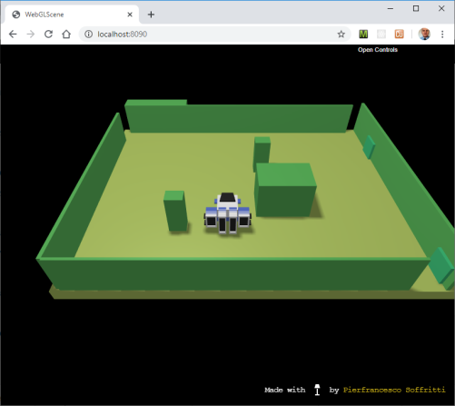


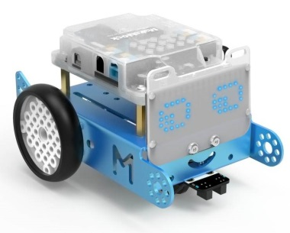
obstacle
ctxbasicrobot
8020
basicrobot

Slide 58
Martedi 26 Maggio
obstacle
ctxbasicrobot
8020
basicrobot
it.unibo.planner20
it.unibo.qak20.robotroommap (TODO)

Slide 59
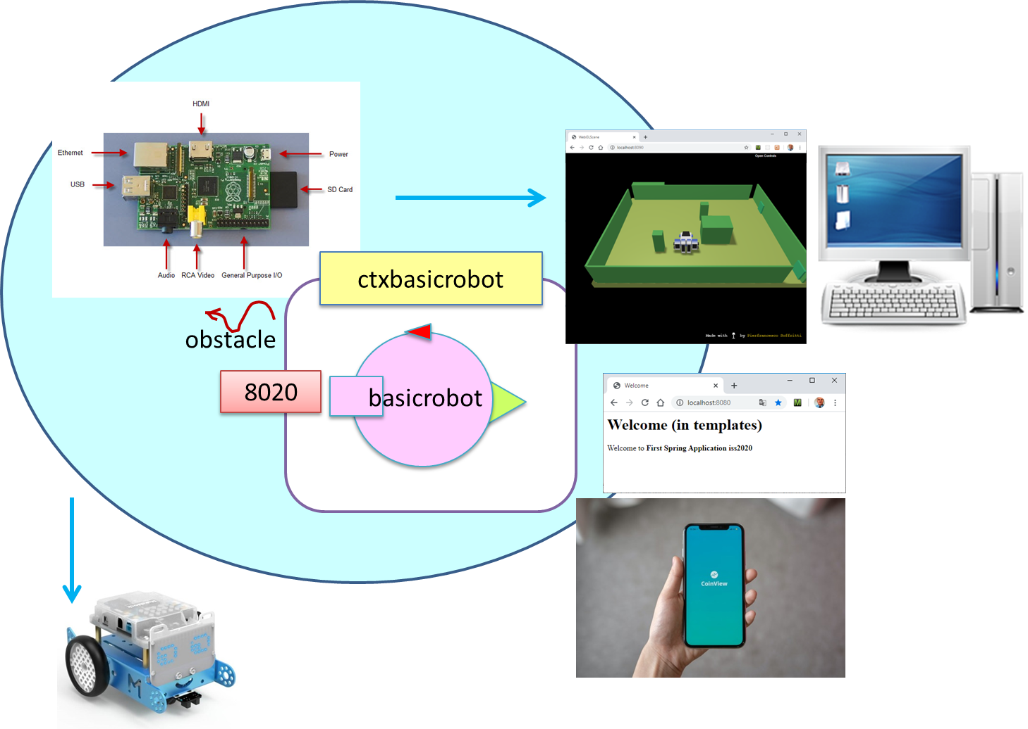

Slide 60
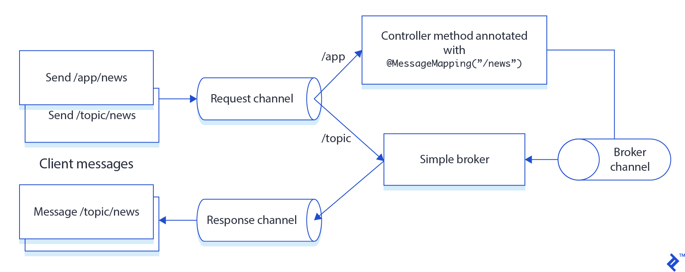

Slide 61
Virtual robot on PC (192.168.1.22)
Basicrobot in \it.unibo.qak20.basicrobot
Create distribution for the basicrobot
ConsoleGui & Coap observer
------------------
Basicrobot su Rasp (192.168.1.5) & VR su PC
Webrobot
Configuration su resources/connQak /ConnConfig
e RobotController htmlPage
& coapobs
---------------------------
Real robot
---------------------------
Boundary planner

Slide 62
WebSocketConfig
r
app.js
sendTheMove → /app/move
RobotController
BusinessLogic
/topic
Html page

Slide 63
Se avete tempo portate il robotweb su Rasp
Robot boundary problem
Inviare via web il comando START e
vedere la mappa costruita
Dal boundaryrobot sulla pagina web.
Forse non è bene modificare il codice del basicrobot
Ma più opportunamente introdurre un altro
‘layer’ nella business logic.

Slide 64
Pull. Nuovi progetti
it.unibo.qak.radar2020
it.unibo.radarusage
it.unibo.qak20.robotroommap
Towards the final application
robotWeb2020/userdocs/RobotWebonSpring.html

Slide 65
TODO
Create un nuovo progetto Java it.unibo.radar.demo
Create il ‘modello’ demoradar.qak
System demoradar
Context ctxdemoradar ip [ host= "localhost" port= 8039 ]
QActor demoradargui context ctxdemoradar{
State s0 initial{
run radarPojo.radarSupport.setUpRadarGui()
}
}
Compilare ed eseguire …
SISTEMA SOFTWARE layered / esagonali
«Mente-corpo»
Dati generati da sensori
Robot boundary problem

Slide 66
it.unibo.radarusage
Struttura
Interazione
Comportamento
radarPojo
radargui
basicrobot
perceiver
roomboundaryexplorer

Slide 67
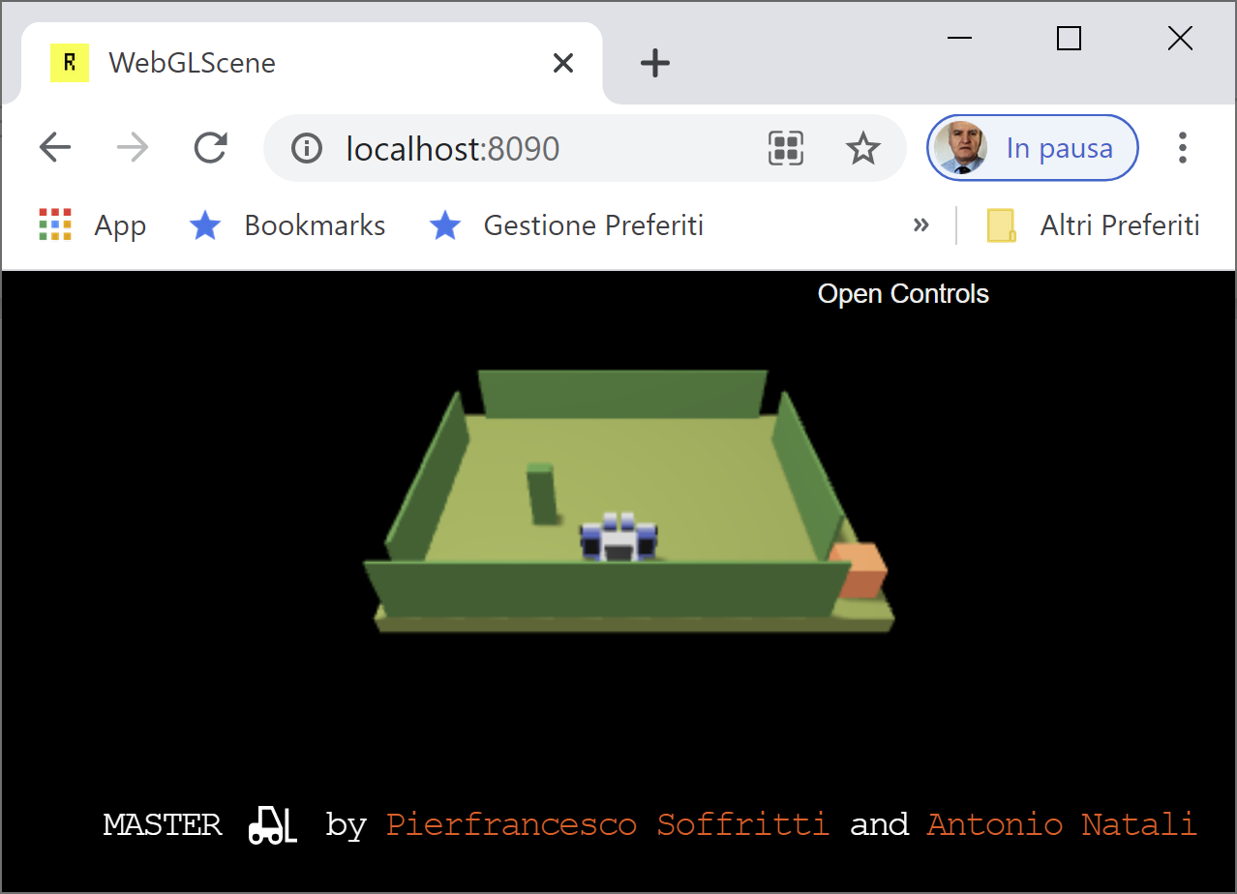

den

Slide 68
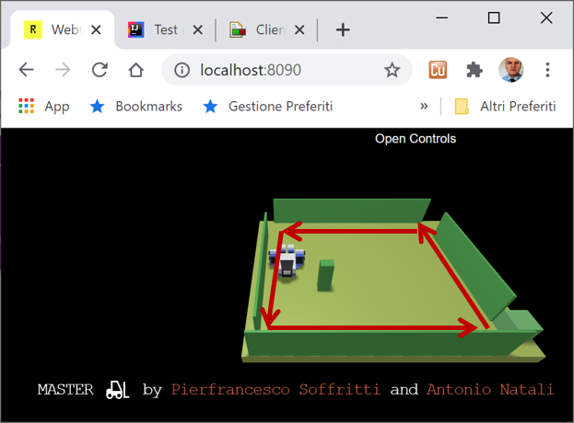

HOME

Slide 69
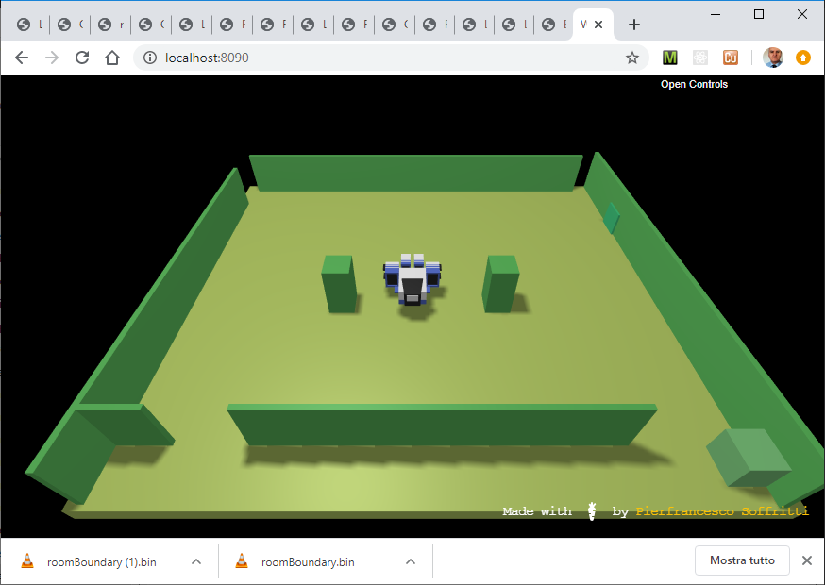
teatable1
teatable2
entrancedoor

Slide 70
home
servicedesk
service area
teatable1
waiter
teatable2
entrancedoor
exitdoor
smartbell
hall
presencedetector

Slide 71
project
it.unibo.qak20.robotroommap
sceneBottlesWithSonarsConfig.js
8068
|r, 1, 1, 1, 1, 1, X,
|1, 0, 0, 0, 0, 1, X,
|1, 0, 0, 0, 0, 1, X,
|1, 1, 1, 1, 1, 1, X,
|X, X, X, X, X, X, X,
boundarywalker
trustingwalker
mappingwalker
ctxrobotboundary
obstacle
8020
cmd( M )
basicrobot
stepDone
stepFail
robotSupport
project
it.unibo.qak20.basicrobot
virtualRobotSupportQak
mbotSupport
robotDataSourceArduino
TCP socket
Serial
ctxbasicrobot

Slide 72
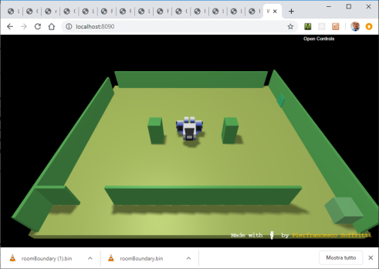
project
it.unibo.qak20.robotroommap
tearoomSceneConfig.js
|r, 1, 1, 1, 1, 1, 1, X,
|1, 1, 1, 1, 1, 1, 1, X,
|1, 1, 1, 1, 1, 1, 1, X,
|1, 1, X, 1, X, 1, 1, X,
|1, 1, 1, 1, 1, 1, 1, X,
|X, X, X, X, X, X, X, X,
8050
waiter
waiterwalker
tearoomkb.pl
obstacle
8020
cmd( M )
ctxdomains
basicrobot
step
stepDone
stepFail
robotSupport
virtualRobotSupportQak
mbotSupport
robotDataSourceArduino
TCP socket
Serial
ctxbasicrobot

Slide 73
