Slide 1
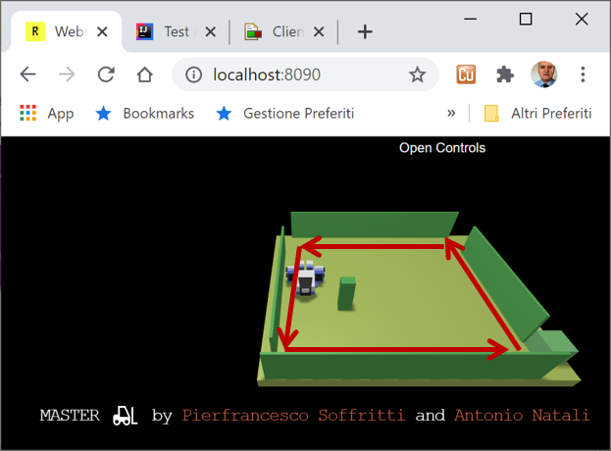

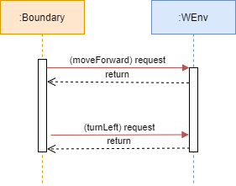
…

Slide 2
Generic Entity
Procedure Call
Data base
Dispatch
Request
Function
Reply
Procedure Call
Object
Event
Object with
internal Tread)
Dispatch
Actor
Request
Reply
Service
Event
ANatali - DISI - University of Bologna

Slide 3
HTTP POST (request)
boundaryWalk
8090
WEnv
8091
socket
Request – Reply (dispatch)
send
(dispatch)
HTTP POST (request)
8090
WEnv
8091
socket
Request – Reply (dispatch)
boundaryWalk

Slide 4
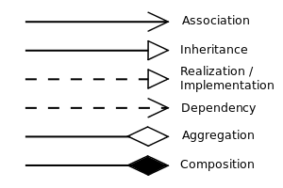
UML symbols
IssHttpSupport
IssWsSupport
IssOperations interface
UseRobotAril
application-level
public static IssOperations create( Object obj ){ ProtocolInfo protocolInfo = IssAnnotationUtil.getProtocol(obj);
…
}
IssOperations interface
IssCommsFactory
IssVirtualRobotSupport
aril-level
IssOperations interface
cril-level
commsSupport
Application Layer
RobotSupport Layer
WEnv
Communication Layer
HTTP POST (request)
8090
8091
Request – Reply (dispatch)
boundaryWalk

Slide 5
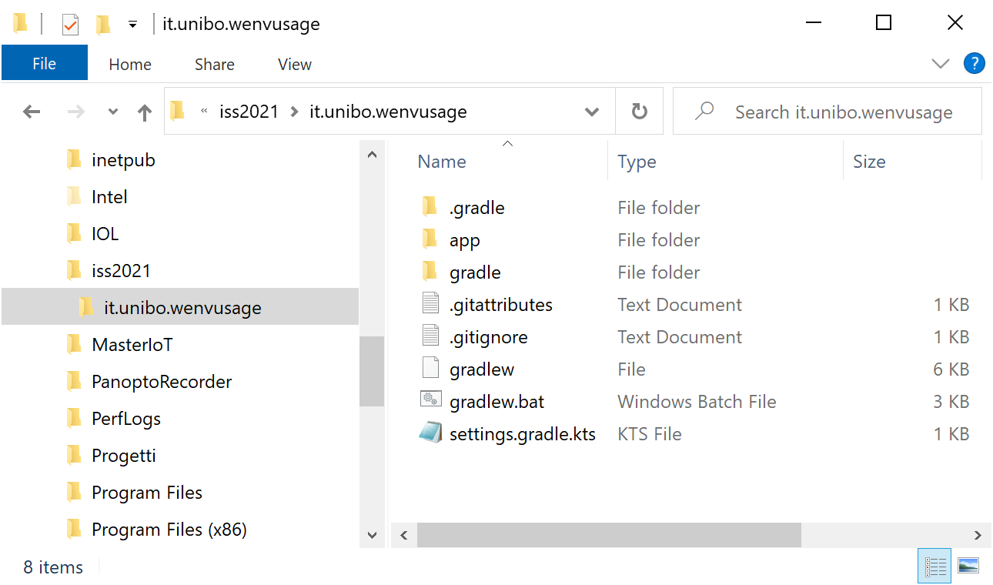
Create a project with gradle
C:\...\issLab2021>mkdir it.unibo.wenvusage
C:\...\issLab2021>gradle init (select 2, 3, 1, 2, 1, -, -)

Slide 6
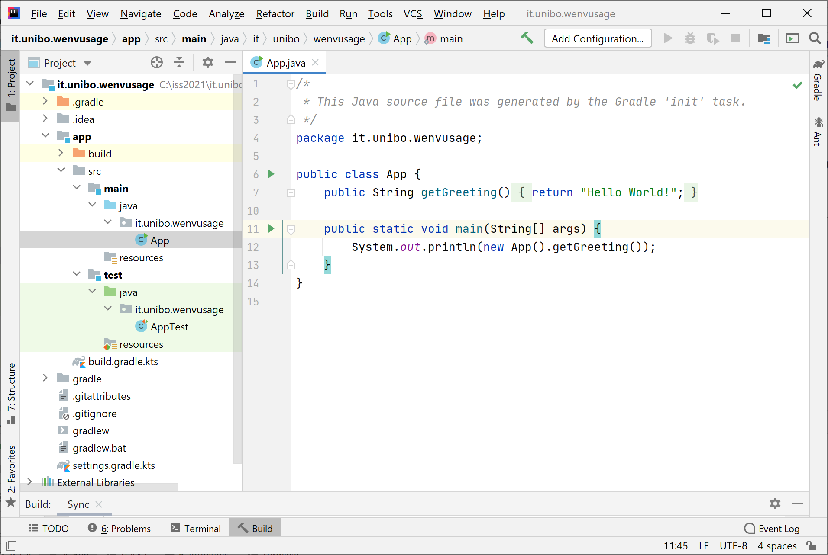
The project it.unibo.wenvusage
gradlew build
gradlew run
> Task :app:run
Hello World!
BUILD SUCCESSFUL in 2s
2 actionable tasks: 1 executed, 1 up-to-date

Slide 7
Define our app and modify build
application { // Define the main class for the application. //mainClass.set("it.unibo.wenvusage.App") //ORIGINAL mainClass.set("it.unibo.wenvusage.MoveVirtualRobot")
}
Create the userDocs folder
Formally define the Test (in JUnit)

Slide 8
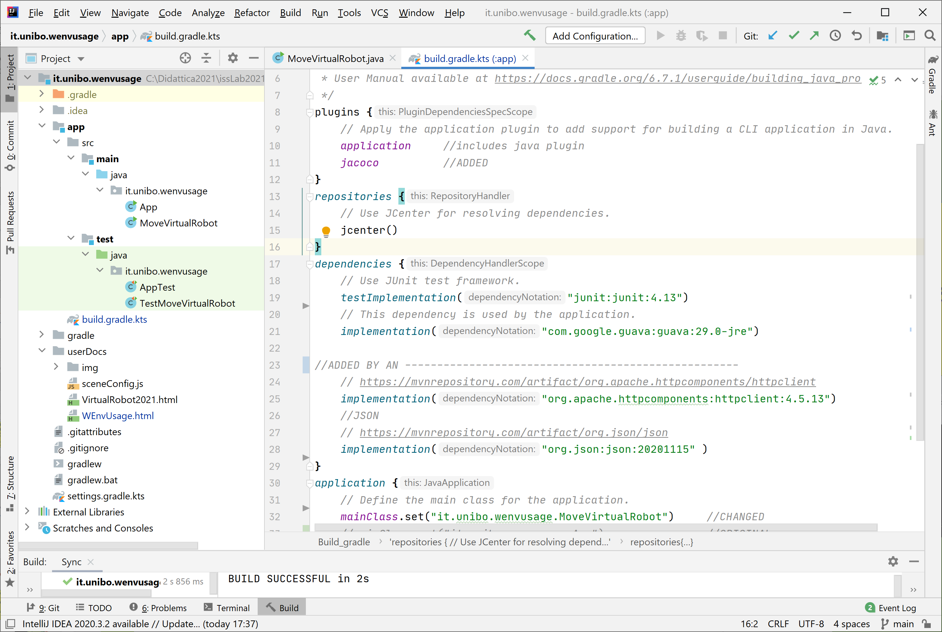
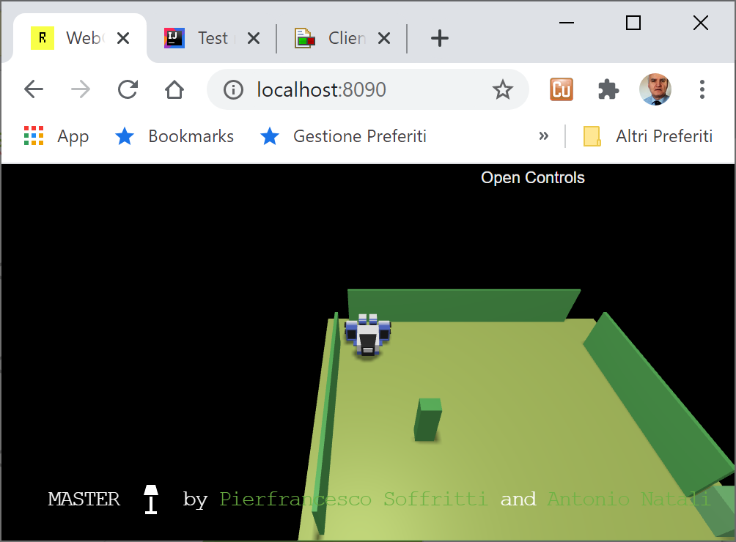
The project it.unibo.wenvusage
gradlew build -x test
gradlew test jacocoTestReport
gradlew run

