Slide 1
72939 - INGEGNERIA DEI SISTEMI SOFTWARE M
INGEGNERIA: enfasi sulla costruzione consapevole e motivata di artefatti (prodotti) basata su analisi, progettazione, sviluppo, distribuzione e manutenzione di prodotti.
SISTEMI: enfasi sulla organizzazione di parti (componenti) che svolgono 'operazioni utili' e presentano proprietà non tutte riconducibili a quelle dei singoli component.
SOFTWARE: istruzioni (definite da esseri umani o da altri sistemi software) e dati che 'istruiscono' elaboratori elettronici 'classici' (computer di Von Neumann).
… atomi … transistor … NOR … Hardware (interpreter) … Counter (Minsky) machine
… componenti software interagenti (Funzioni, Oggetti,Processi, Attori, Agenti …)
… architetture … Internet … sistemi distribuiti… sistemi auto-organizzati …. organismi (!?)
M: corso di laurea magistrale con finalità diverse da quelle di un corso di laurea triennale: la acquisizione di consoscenze e pratiche è rivolta principalmente alla formazione specialistica, alla progettazione e alla innovazione.

Slide 2
72939 - MATERIALE
Sito Web di Ateneo:
https://www.unibo.it/it/didattica/insegnamenti/insegnamento/2020/385373
GITHUB del corso
https://github.com/anatali/issLab2021
Una panoramica introduttiva
72939LabISSIntro.html Tema finale 2020
Un template di riferimento
issLab2021/it.unibo.issLabStart/userDocs/template2021.html
Panopto
Video tema finale studenti

Slide 3
72939 – Lab tools (start)
Installare GIT
Clonare https://github.com/anatali/issLab2021 in una directory vuota (e.g. C:/.../iss2021)
Installare Docker
Installare Gradle
Installare IntelliJ
Installare Eclipse IDE for Java and DSL Developers 2020-06 (Avoid more recent versions)
Installare Node.js
Installare ngrok

Slide 4
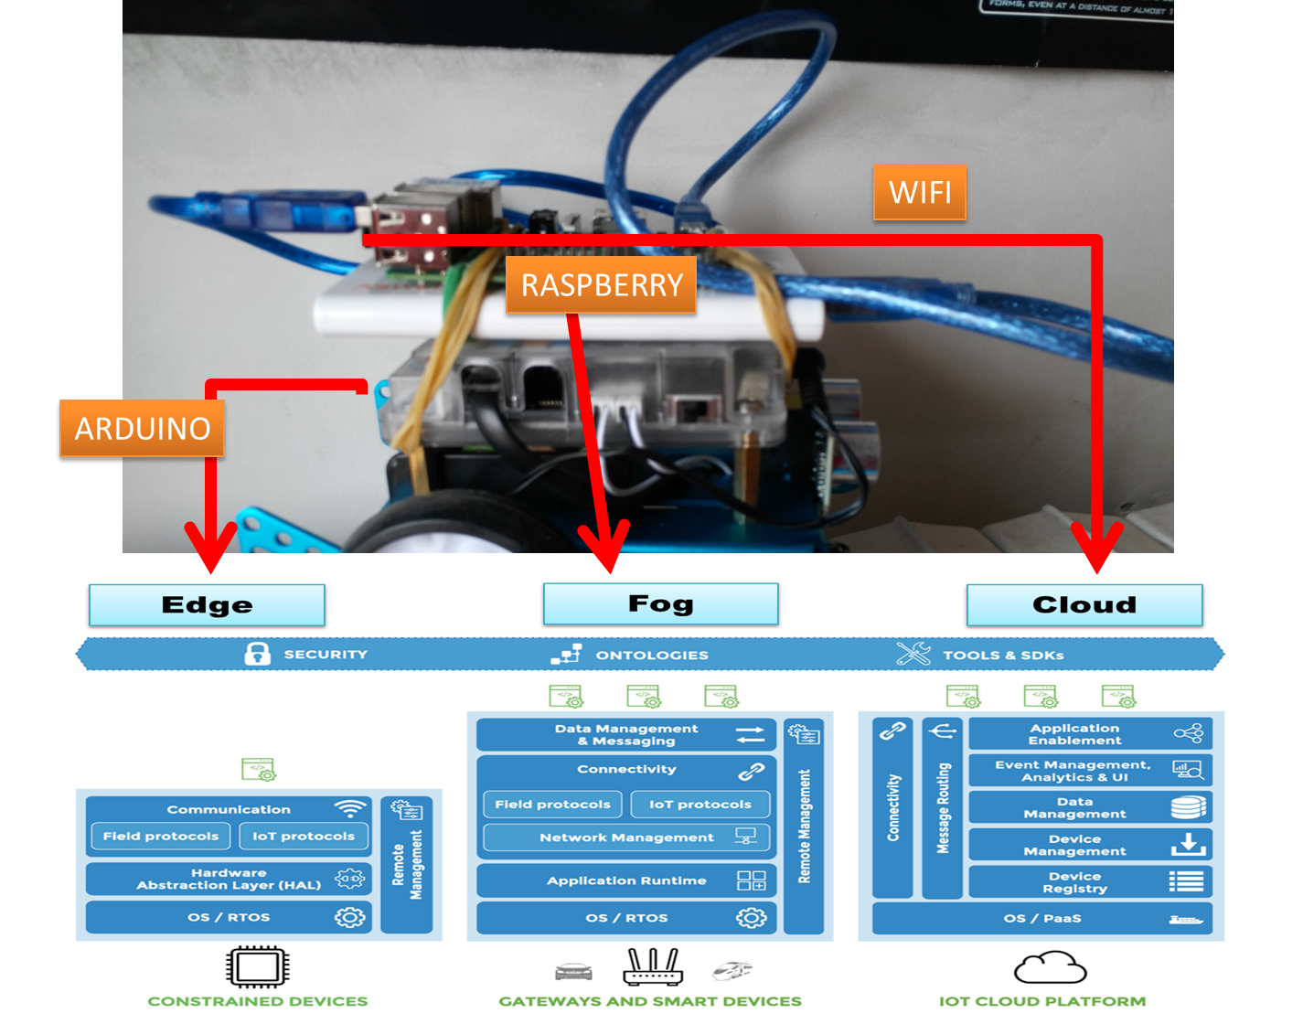
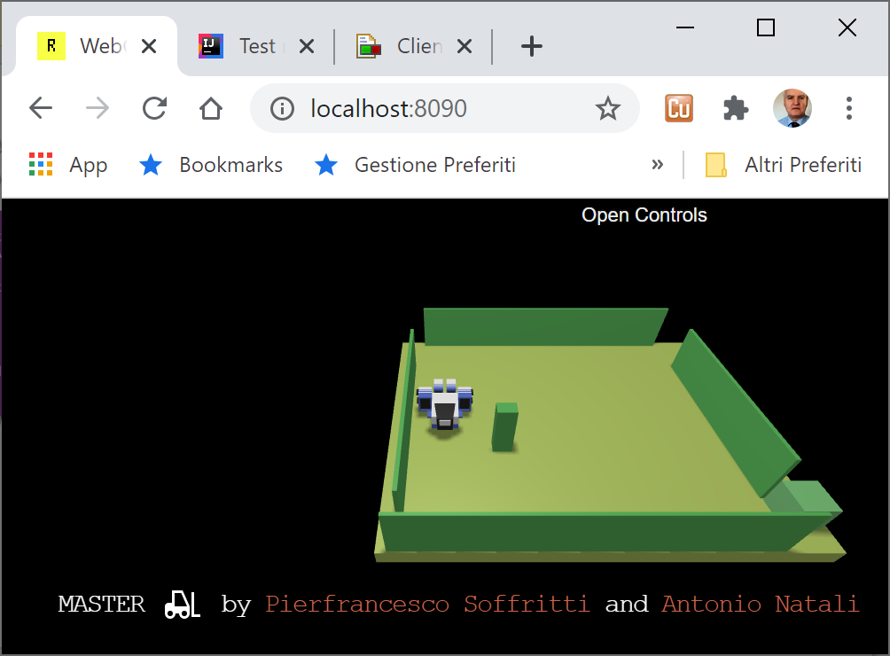
Il dominio IOT
Real worlds : devsDdr.html
Virtual worlds

Slide 5
Prime sperimentazioni
Iniziamo usando software già sviluppato e deployed su
https://hub.docker.com/repositories

Slide 6
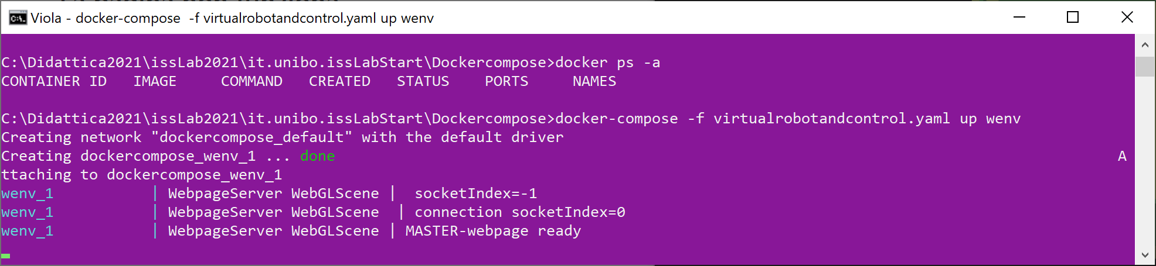
Run the WEnv
docker-compose -f virtualrobotandcontrol.yaml up wenv
Localhost:8090
docker-compose -f virtualrobotandcontrol.yaml down

Slide 7
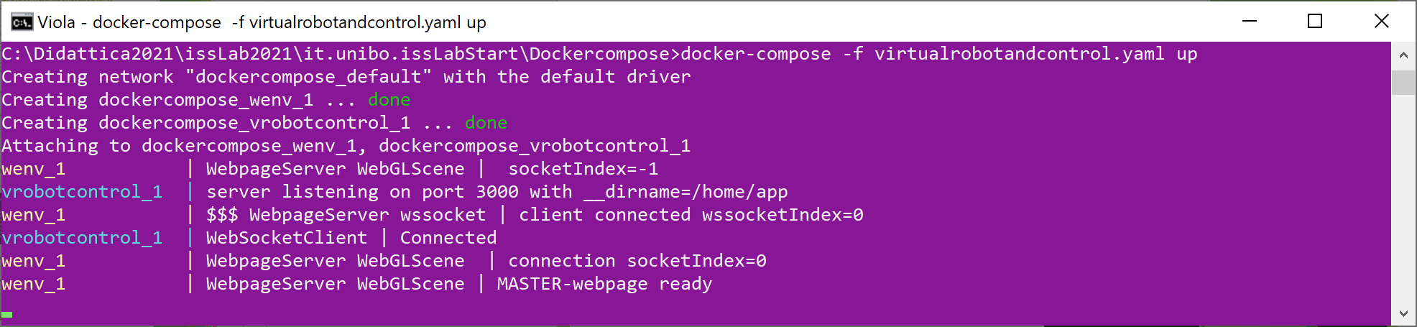
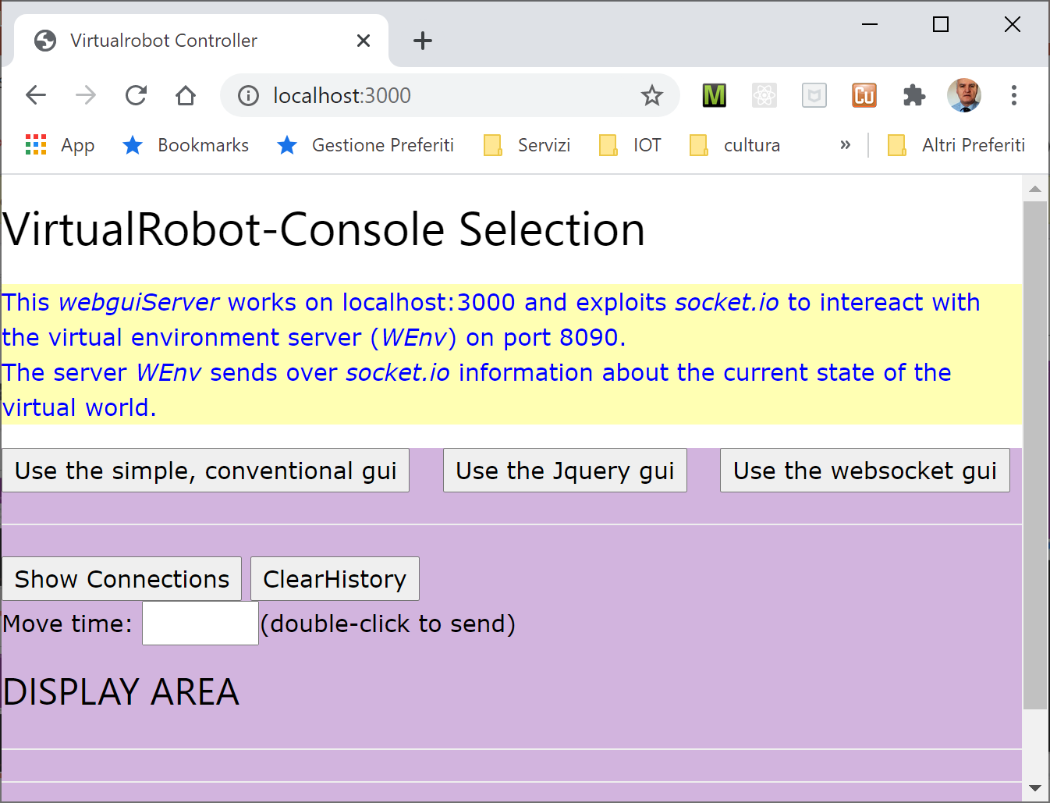
Run the WEnv + Control
docker-compose -f virtualrobotandcontrol.yaml up
Localhost:8090
Localhost:3000

Slide 8
Un primo sistema da sviluppare
Requirement
Design and build a software system that leads a robot to walk along the boundary of a empty, rectangular room.

Slide 9
HOME WORK
Deliverable : Si compili il template di riferimento (con foto)
issLab2021/it.unibo.issLabStart/userDocs/template2021.html
e si invii un file pdf (<cognome_nome>_iss0.pdf) a antonio.natali@unibo.it
TestPlan
TODO: (HINT: as an user, I expect that …)
Analysis
TODO: (HINT: the relevant aspects are …
the suited technologies are …
the expected costs are …. )
Main goal: superare indicazioni vaghe e imprecise cercando di definire specifiche formali (cioè ‘comprensibili a un computer’)

Slide 10
Books

Slide 11

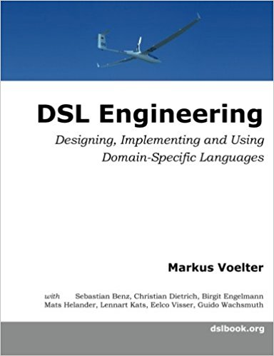
DSL
Domain-Specific Languages
Fowler presents effective techniques for building DSL, and guides software engineers in choosing the right approaches for their applications. This book's techniques may be utilized with most modern object-oriented languages; the author provides numerous examples in Java and C#, as well as selected examples in Ruby
This book provides a thorough introduction to DSL, relying on today’s state of the art language workbenches.
The book provides details about the implementation of DSLs with lots of code. It uses three state-of-the-art but quite different language workbenches: JetBrains MPS, Eclipse Xtext and TU Delft’s Spoofax.
2010
2013
ISBN-10: 0321712943
ISBN-13: 978-0321712943
ISBN-10: 1481218581
ISBN-13: 978-1481218580

Slide 12
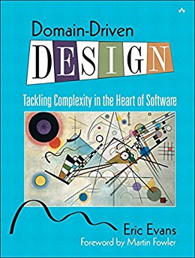
DDD
Software
developer
Designer
Domain
expert
Developers are insulated from the domain experts. If a developer does not understand a concept, it is likely the implementation will not accurately reflect the domain.
Developers without solid design principles will produce a code that is hard to understand or change – the oppostive of agility. (pg. xxiij)
2004
Domain model: a rigorously organized and selective abstraction of the knowledge in a domain’s expert head (pg. 3).
One model should underlie implementation, design and team communications (pg. 41)
The model is the backbone of a language used by all team members (pg.4, 26).
iterate a single model to reflect a shared understanding across domain experts, designers and developers
establisha common language, i.e. a UBIQUITOUS LANGUAGE (pg. 24)
Code as a design document does have its limits (pg. 38). A document should explain the concepts of the model and must be involved in project activities (pg.39)
Effective domain modelers are knowledge crunchers. Continuous learning takes place between domain experts, designers and developers (pg. 15)
(OO) MODEL-DRIVEN DESIGN pg. 47

Slide 13
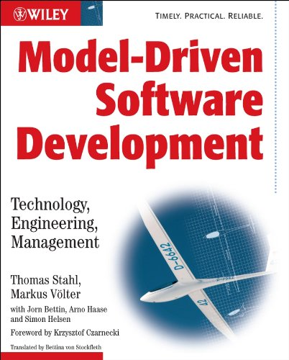
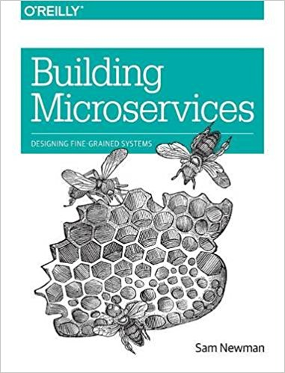
Model-Driven Software Development (MDSD) puts analysis and design models on par with code.
Models do not constitute documentation, but are considered equal to code, as their implementation is automated.
The goal of the book is to convince you, the reader, that MDSD is a practicable method today, and that it is superior to conventional development methods in many cases.
Distributed systems have become more fine-grained in the past 10 years, shifting from code-heavy monolithic applications to smaller, self-contained microservices.
With lots of examples and practical advice, this book takes a holistic view of the topics that system architects and administrators must consider when building, managing, and evolving microservice architectures.
2015

Slide 14
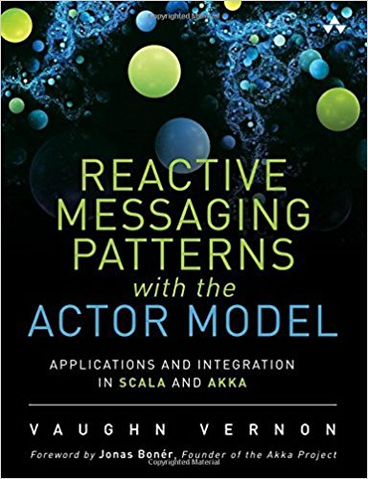
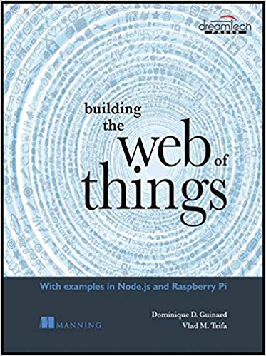
The Actor model allows us to design software models that are:
responsive, resilient, elastic,message-driven
more understandable
able to employ both sequential and functional programming techniques in a highly dynamic environemt
able to abstractely increase the distributiviy of computation as it evolves, by dynamically creating new actors
integrable with existing systems

Slide 15
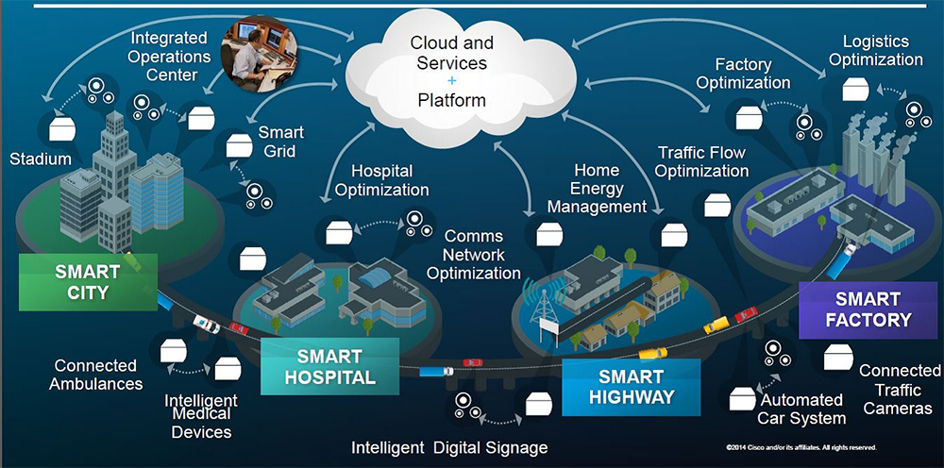
The Internet of (Every)Thing (IoT, IoE)
Capturing the real value of Internet-connected devices goes much further than providing connectivity, a transport scheme and databasing.

