Slide 1
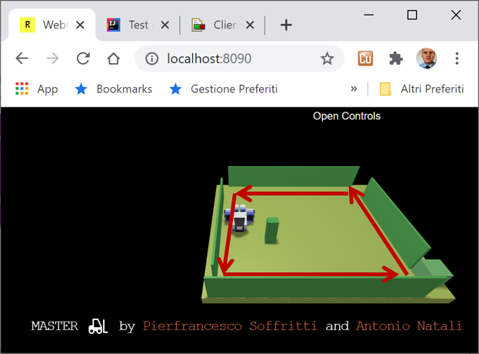

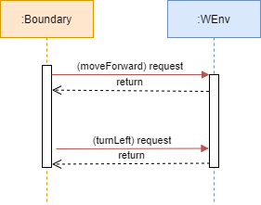
…

Slide 2
Generic Entity
Data base
Function
Procedure Call
Object
Object with
internal Tread)
Dispatch
Actor
Request
Reply
Service
Event
ANatali - DISI - University of Bologna

Slide 3
HTTP POST (request)
boundaryWalk
8090
WEnv
8091
socket
Request – Reply (dispatch)
send
(dispatch)
HTTP POST (request)
8090
WEnv
8091
socket
Request – Reply (dispatch)
boundaryWalk
command (request)
answer (reply)
WEnv
sonardata (dispatch)
boundaryWalk

Slide 4
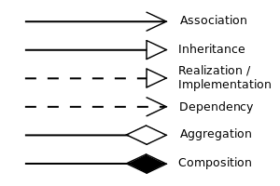
UML symbols
IssHttpSupport
IssWsSupport
IssOperations interface
IssCommsFactory
public static IssOperations create( Object obj ){ ProtocolInfo protocolInfo = IssAnnotationUtil.getProtocol(obj);
…
}
UseRobotApp
UseRobotAril
application-level
requestSynch / request / forward
IssAppOperations interface
IssAppRobotSupport
IssOperations interface
aril-level
Payload: w | s | h | l | r
IssArilRobotSupport
IssOperations interface
IssOperations interface
cril-level
Payload: cril sentence
IssArilRobotSupport
commsSupport
IssOperations interface
commsSupport

Slide 5
UML symbols
IssHttpSupport
IssWsSupport
IssOperations interface
IssHttpSupport
IssWsSupport
UseRobotAril
application-level
IssOperations interface
RobotControllerBoundary
1
IssCommSupport interface
IssVirtualRobotSupport
aril-level
IssObserver interface
IssOperations interface
IssOperations interface
cril-level
commsSupport
IssCommsFactory
public static IssOperations create( Object obj ){ ProtocolInfo protocolInfo = IssAnnotationUtil.getProtocol(obj);
…
}
Application Layer
RobotSupport Layer
WEnv
Communication Layer
HTTP POST (request)
8090
8091
Request – Reply (dispatch)
boundaryWalk

Slide 6
Application Layer
command (request)
IssObserver
RobotControllerBoundary
WEnv
answer (reply)
1
updateObserver
dispatch
IssCommSupport
IssOperations
IssHttpSupport
IssWsSupport
0
nc-1
0
ClientBoundaryWebsockBasicAsynch
0
nc-1
0
nc-1
0
home
0
nr-1
nr-1
nr-1

Slide 7
Application Layer
RobotMovesInfo
creates
command (request)
IssObserver
WEnv
RobotBoundaryLogic
RobotInputController
answer (reply)
forward
1
dispatch
IssCommSupport
updateObserver
IssOperations
IssWsHttpJavaSupport
ClientBoundaryWebsockArilAsynch

Slide 8
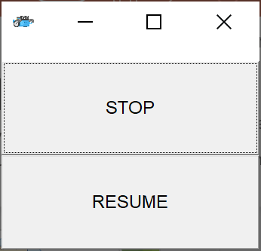
Application Layer
ConsoleGui
RobotMovesInfo
creates
IssObserver
ResumableBoundaryLogic
RobotApplInputController
command (request)
1
WEnv
request
IssCommSupport
answer (reply)
updateObserver
IssOperations
dispatch
IssHttpSupport
IssWsSupport
ResumableRobotBoundary

Slide 9
init
Transitions fired by messages
endmove is true
&& step<4
emptyMove
resume
walk
step
stopped
endmove is true
&& step=4
stop
endmove is true
endmove is false
end
obstacle
turnLeft
step++; turnLeft
Within a state,
events not shown are ignored
The stop event is handled
before endmove

Slide 10
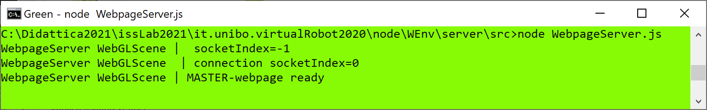
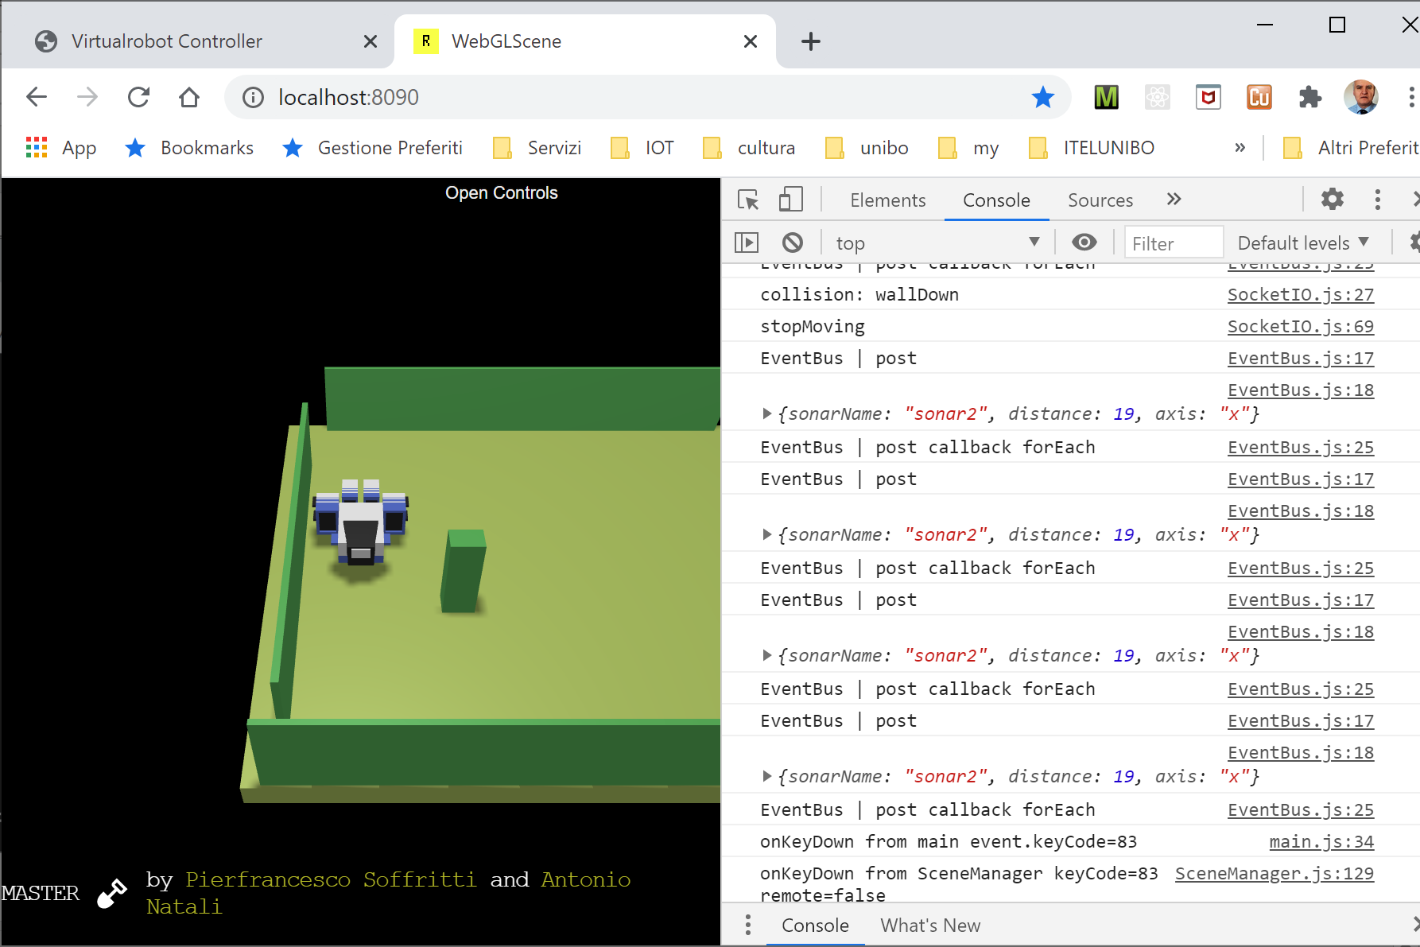
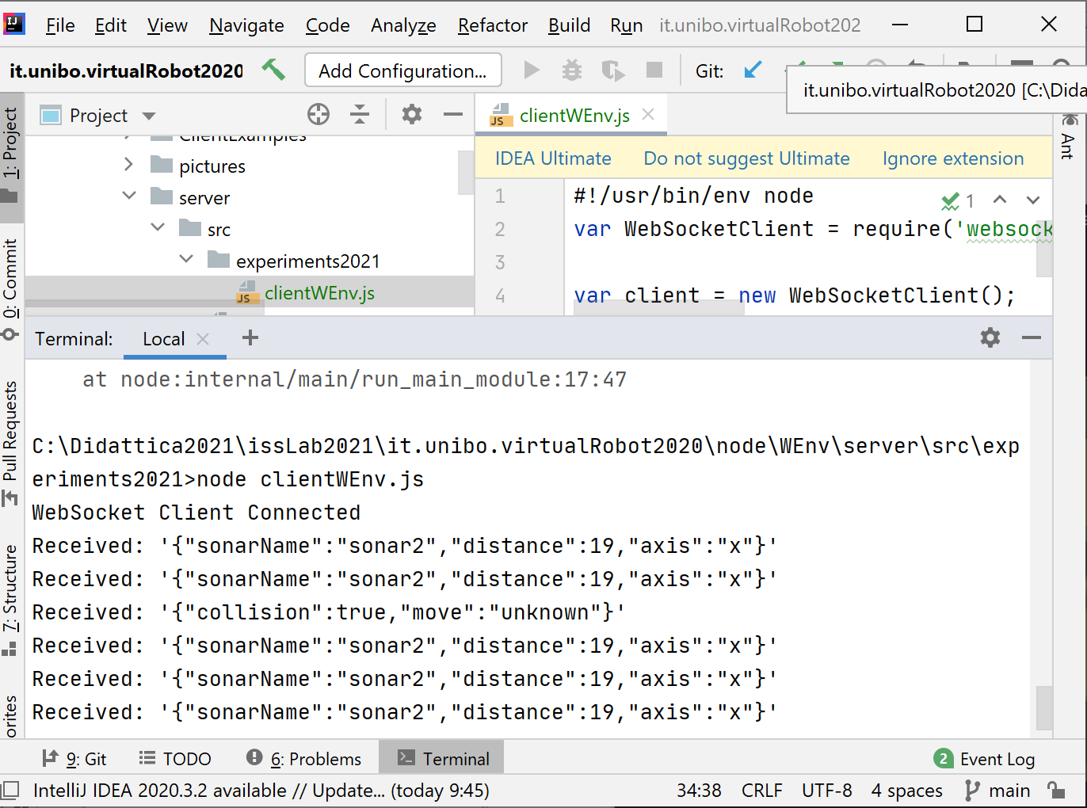
Console updated
by WebpageServer
WebpageServer updates the scene by using websocket-8090
Console updated
by scripts loaded in
the HTML file
Console updated
by a client (js) that handles messages sent by WEnv over websocket-8091
Wenv (scene)

Slide 11
Console updated
by scripts loaded in
the HTML file
Console updated
by WebpageServer

Slide 12
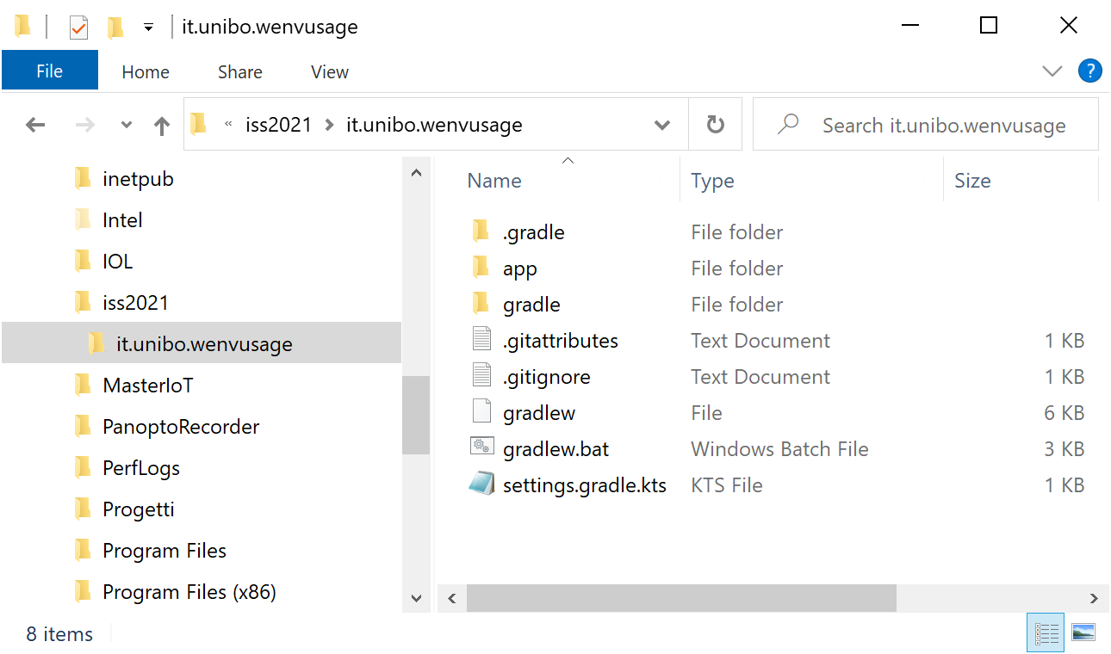
Create a project with gradle
C:\...\issLab2021>mkdir it.unibo.wenvusage
C:\...\issLab2021>gradle init (select 2, 3, 1, 2, 1, -, -)

Slide 13
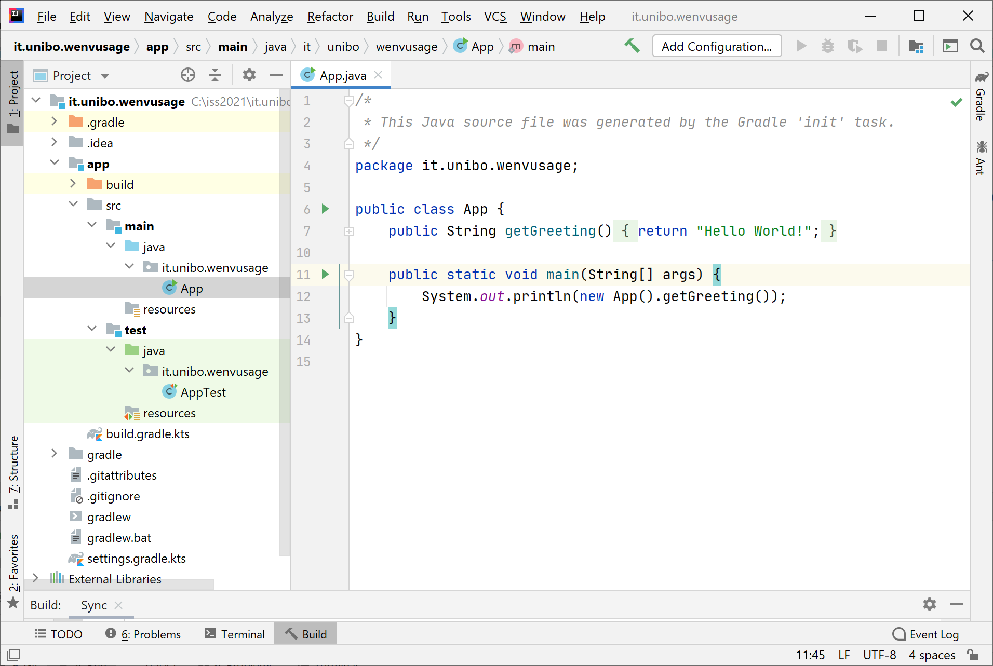
The project it.unibo.wenvusage
gradlew build
gradlew run
> Task :app:run
Hello World!
BUILD SUCCESSFUL in 2s
2 actionable tasks: 1 executed, 1 up-to-date

Slide 14
Define our app and modify build
application { // Define the main class for the application. //mainClass.set("it.unibo.wenvusage.App") //ORIGINAL mainClass.set("it.unibo.wenvusage.MoveVirtualRobot")
}
Create the userDocs folder
Formally define the Test (in JUnit)

Slide 15
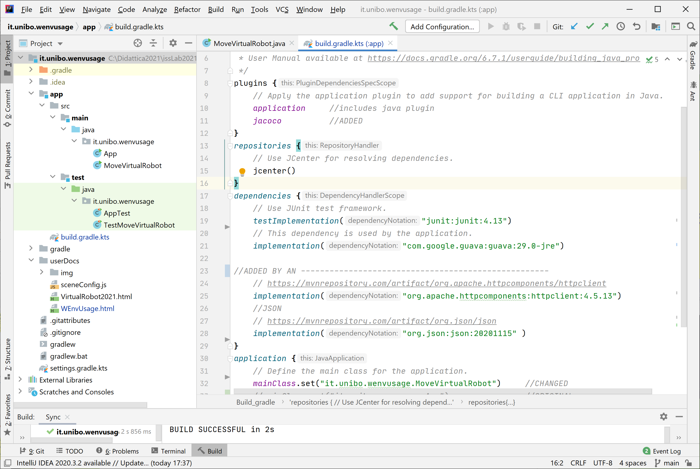
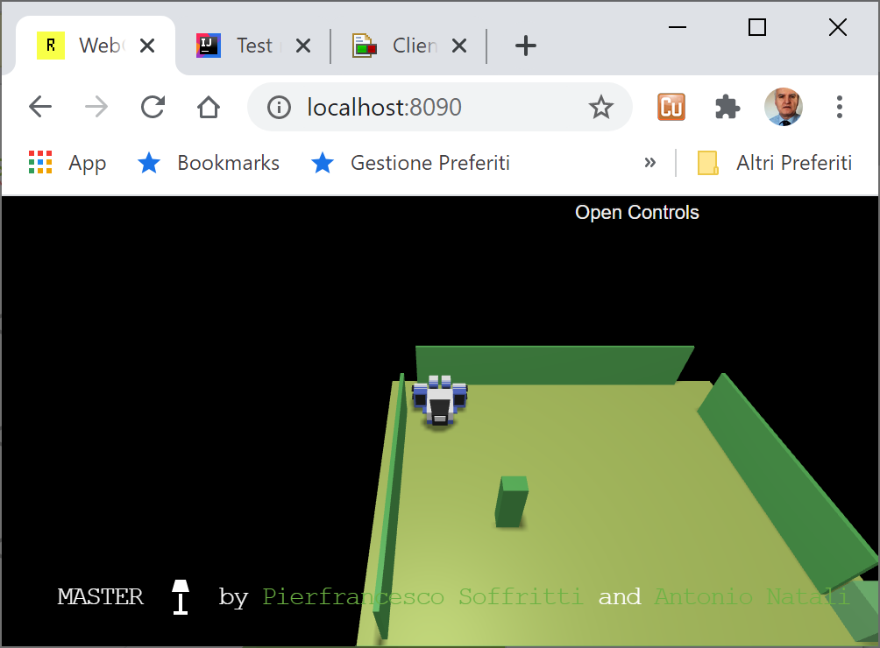
The project it.unibo.wenvusage
gradlew build -x test
gradlew test jacocoTestReport
gradlew run

