Slide 1
Generic Entity
Data base
Function
Procedure Call
Object
Object with
internal Tread)
Dispatch
Actor
Request
Reply
Service
Event
ANatali - DISI - University of Bologna

Slide 2
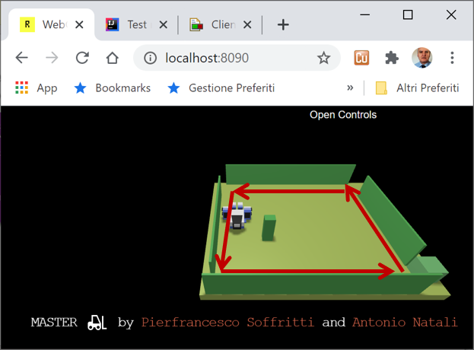

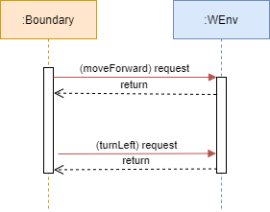
…
ANatali - DISI - ISSM2020 Univeristy of Bologna
1

Slide 3
HTTP POST
(request)
boundaryWalk
8090
WEnv
8091
socket
send
(dispatch)

