Slide 1
Generic Entity
Data base
called
caller
Function
Procedure Call
Object
sender
receiver
Object with
internal Tread)
Dispatch
Actor
Request
Reply
server
Service
Event

Slide 2
Itel-post
Itel-pre
Adapter
?
?
Other

Slide 3
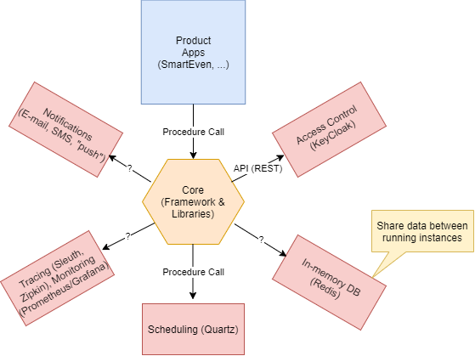
ITEL-BASIC SUPPORTS
That live into ‘some’ infrastructure (Docker, …)
Shared by all the applications

Slide 4
Infrastructure-related adapters
<event>
License
synchronizer
Infrastructure
Adapter
US1
Licence update
Infrastructure (CLI)
(docker, swarm, kubernetes)
<event>
Metrics
Adapter
Infrastructure
Adapter
US2 (MA)
monitor
Infrastructure (CLI)
Infrastructure
Adapter
Operator
US3
install
Infrastructure (CLI)

Slide 5
Application-related adapters
Health Data
Provider
Health Data
Adapter
US4 ( HDA )
Health data
Health service
Sensor Data
Provider
Sensor Data
Adapter
US5 ( IOTA )
Domotic
Domotic system
WebRTC
Adapter
Developer
US6 ( WA )
WebRTC
Web RTC

Slide 6
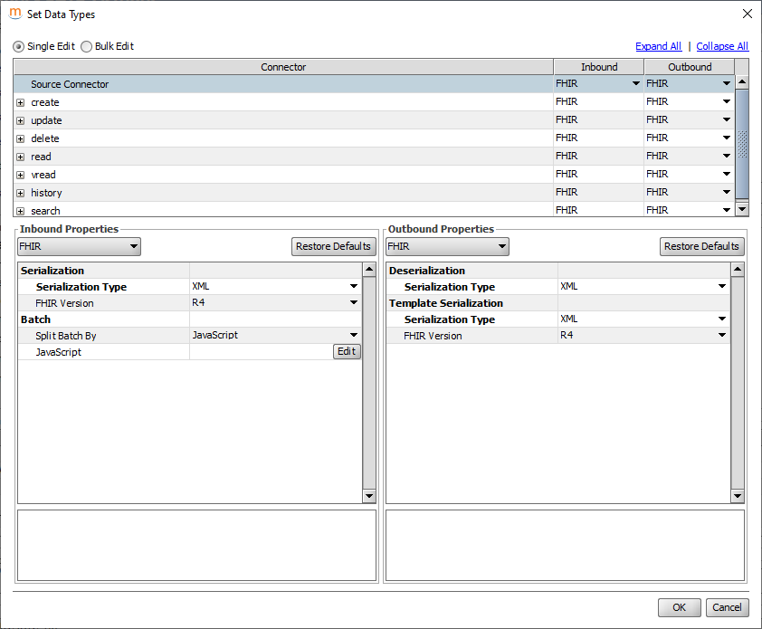

Slide 7
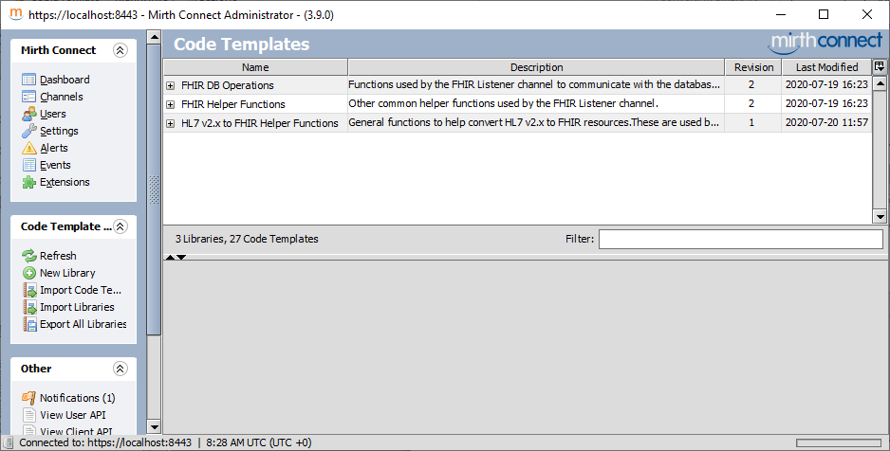

Slide 8
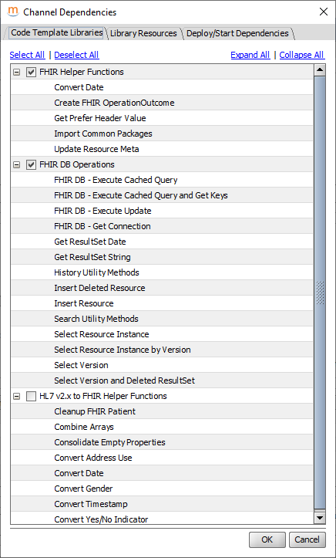

Slide 9
