Slide 1
Parsley
A keyword-driven test framework for Protractor

Slide 2
Parsley A Test Framework for Protractor
What is it?
For testing AngularJS web applications
Uses Protractor to run the tests
But Protractor is a framework already – isn’t it?

Slide 3
Parsley A Test Framework for Protractor
But why?
No need to write Jasmine “describe” and “it” program code
A test is a sequence of actions (keywords) and data
Keywords are reusable (like a set of building-blocks)
Excel is used for productivity during test design and assembly
JavaScript files are generated for run-time execution

Slide 4
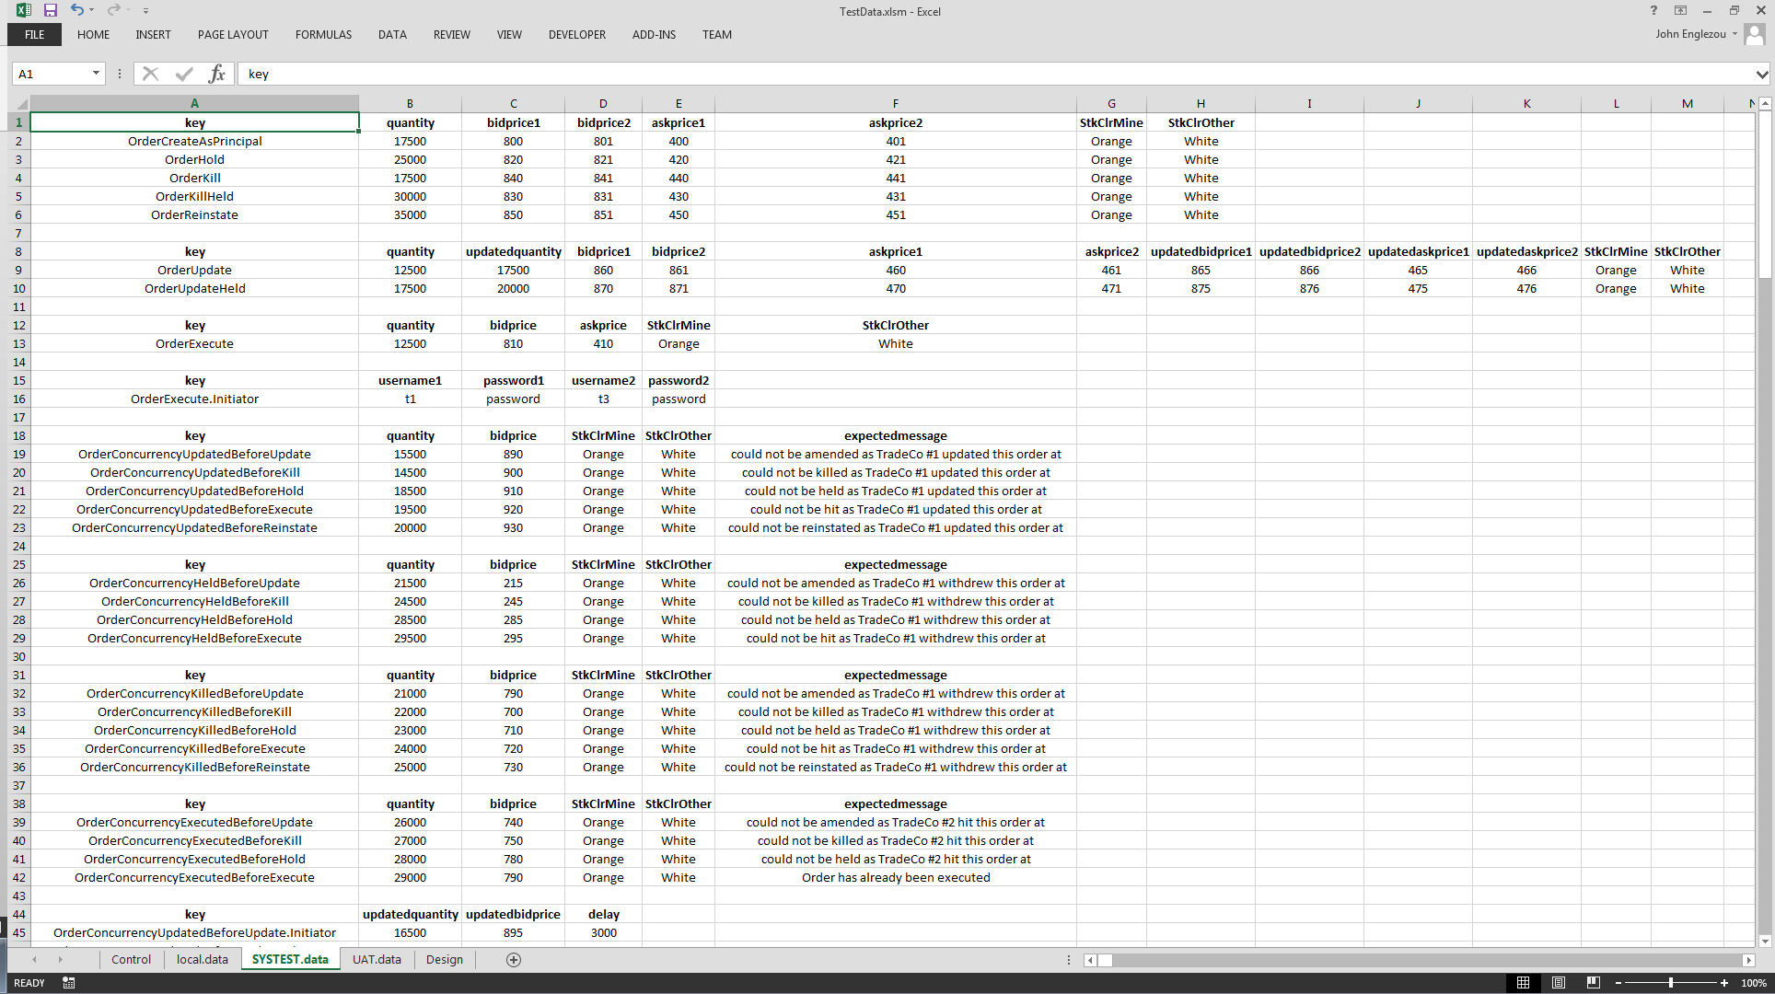
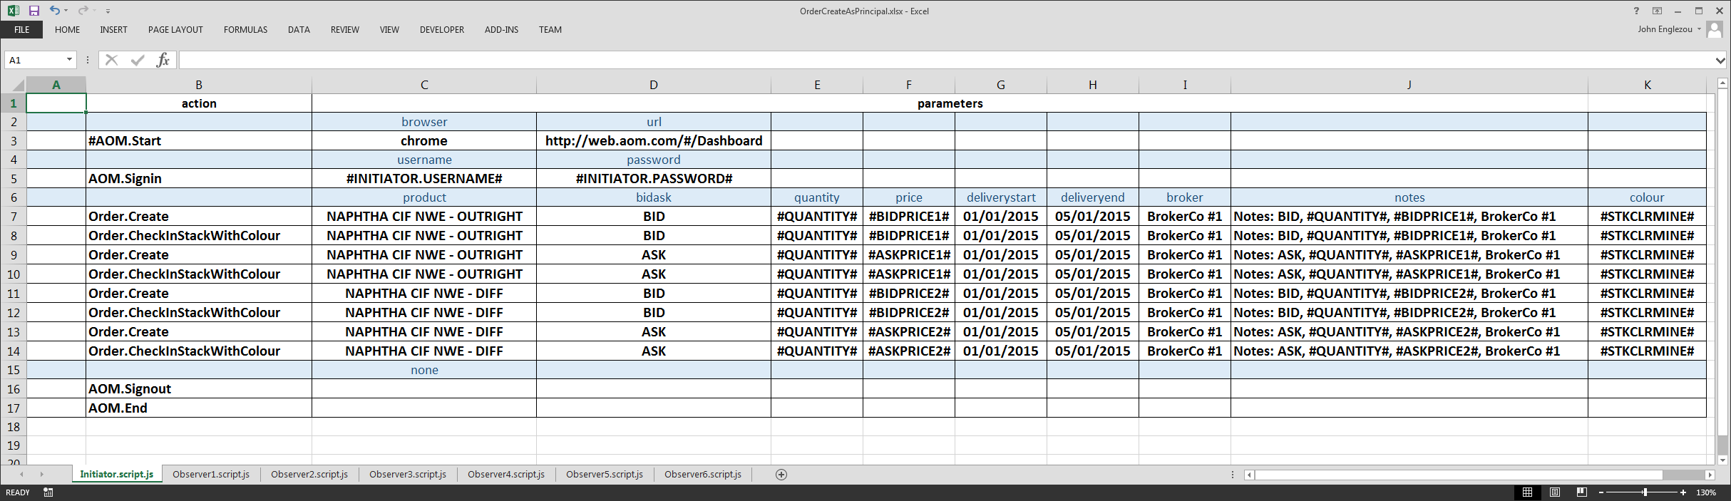
Parsley A Test Framework for Protractor
Overall view of all the parts
TestData.xlsm
OrderCreateAsPrincipal.xlsx
DESIGN
DESIGN
1. Create/Edit
1. Create/Edit
2. Generate
GENERATE
2. Generate
.pro.js
files
.script.js
files
.data.js
files
3. Push
GitHub
Not really as complicated as it looks
TeamCity Server
TeamCity Agent
4. Run
RUN
Protractor

Slide 5

Parsley A Test Framework for Protractor
OrderCreateAsPrincipal.xlsx
Initiator.pro.js
describe('Initiator', function () {
automation.using("running Initiator test script", require('./Initiator.script.js'),
function (step) {
var sObject = step.action.substring(0, step.action.indexOf('.'));
for (var property in (step.params)[0]) {
if ((step.params)[0].hasOwnProperty(property)) {
(step.params)[0][property] = automation.resolveParams(dictData, (step.params)[0][property]);
}
}
try { key(require('../../keywords/' + sObject + '.keywords.js')); } catch(err) { }
it("Step " + iStep++ + ": Keyword=" + step.action + ", Data=[" + step.params + "]", function () {
if (step.action.slice(0,1) != '#') {
key.run(step.action, step.params).then(function () { });
}
}, 600000);
});
}, 600000);
Initiator.pro.js
describe('Initiator', function () {
automation.using("running Initiator test script", require('./Initiator.script.js'),
function (step) {
var sObject = step.action.substring(0, step.action.indexOf('.'));
for (var property in (step.params)[0]) {
if ((step.params)[0].hasOwnProperty(property)) {
(step.params)[0][property] = automation.resolveParams(dictData, (step.params)[0][property]);
}
}
try { key(require('../../keywords/' + sObject + '.keywords.js')); } catch(err) { }
it("Step " + iStep++ + ": Keyword=" + step.action + ", Data=[" + step.params + "]", function () {
if (step.action.slice(0,1) != '#') {
key.run(step.action, step.params).then(function () { });
}
}, 600000);
});
}, 600000);
.pro.js
files
.script.js
files
Generates JavaScript
Initiator.script.js
var Initiator = [
[{action:'#AOM.Start', params:[{browser:'chrome',url:'http://web.aom.com/#/Dashboard'}]}],
[{action:'AOM.Signin', params:[{username:'#INITIATOR.USERNAME#', password:'#INITIATOR.PASSWORD#'}]}],
[{action:'Order.Create', params:[{product:'NAPHTHA CIF NWE - OUTRIGHT',bidask:'BID',quantity:'#QUANTITY#', price:'#BIDPRICE1#',deliverystart:'01/01/2015',deliveryend:'05/01/2015',broker:'BrokerCo #1',notes:'Notes: BID, #QUANTITY#, #BIDPRICE1#, BrokerCo #1',colour:'#STKCLRMINE#'}]}],
[{action:'Order.CheckInStackWithColour', params:[{product:'NAPHTHA CIF NWE - OUTRIGHT',bidask:'BID',quantity:'#QUANTITY#', price:'#BIDPRICE1#',deliverystart:'01/01/2015',deliveryend:'05/01/2015',broker:'BrokerCo #1',notes:'Notes: BID, #QUANTITY#, #BIDPRICE1#, BrokerCo #1',colour:'#STKCLRMINE#'}]}],
[{action:'Order.Create', params:[{product:'NAPHTHA CIF NWE - OUTRIGHT',bidask:'ASK',quantity:'#QUANTITY#', price:'#ASKPRICE1#',deliverystart:'01/01/2015',deliveryend:'05/01/2015',broker:'BrokerCo #1',notes:'Notes: ASK, #QUANTITY#, #ASKPRICE1#, BrokerCo #1',colour:'#STKCLRMINE#'}]}],
[{action:'Order.CheckInStackWithColour', params:[{product:'NAPHTHA CIF NWE - OUTRIGHT',bidask:'ASK',quantity:'#QUANTITY#', price:'#ASKPRICE1#',deliverystart:'01/01/2015',deliveryend:'05/01/2015',broker:'BrokerCo #1',notes:'Notes: ASK, #QUANTITY#, #ASKPRICE1#, BrokerCo #1',colour:'#STKCLRMINE#'}]}],
[{action:'Order.Create', params:[{product:'NAPHTHA CIF NWE - DIFF',bidask:'BID',quantity:'#QUANTITY#', price:'#BIDPRICE2#',deliverystart:'01/01/2015',deliveryend:'05/01/2015',broker:'BrokerCo #1',notes:'Notes: BID, #QUANTITY#, #BIDPRICE2#, BrokerCo #1',colour:'#STKCLRMINE#'}]}],
[{action:'Order.CheckInStackWithColour', params:[{product:'NAPHTHA CIF NWE - DIFF',bidask:'BID',quantity:'#QUANTITY#', price:'#BIDPRICE2#',deliverystart:'01/01/2015',deliveryend:'05/01/2015',broker:'BrokerCo #1',notes:'Notes: BID, #QUANTITY#, #BIDPRICE2#, BrokerCo #1',colour:'#STKCLRMINE#'}]}],
[{action:'Order.Create', params:[{product:'NAPHTHA CIF NWE - DIFF',bidask:'ASK',quantity:'#QUANTITY#', price:'#ASKPRICE2#',deliverystart:'01/01/2015',deliveryend:'05/01/2015',broker:'BrokerCo #1',notes:'Notes: ASK, #QUANTITY#, #ASKPRICE2#, BrokerCo #1',colour:'#STKCLRMINE#'}]}],
[{action:'Order.CheckInStackWithColour', params:[{product:'NAPHTHA CIF NWE - DIFF',bidask:'ASK',quantity:'#QUANTITY#', price:'#ASKPRICE2#',deliverystart:'01/01/2015',deliveryend:'05/01/2015',broker:'BrokerCo #1',notes:'Notes: ASK, #QUANTITY#, #ASKPRICE2#, BrokerCo #1',colour:'#STKCLRMINE#'}]}],
[{action:'AOM.Signout', params:[{none:''}]}],
[{action:'AOM.End', params:[{none:''}]}]
];
module.exports = Initiator;
Initiator.script.js
var Initiator = [
[{action:'#AOM.Start', params:[{browser:'chrome',url:'http://web.aom.com/#/Dashboard'}]}],
[{action:'AOM.Signin', params:[{username:'#INITIATOR.USERNAME#', password:'#INITIATOR.PASSWORD#'}]}],
[{action:'Order.Create', params:[{product:'NAPHTHA CIF NWE - OUTRIGHT',bidask:'BID',quantity:'#QUANTITY#', price:'#BIDPRICE1#',deliverystart:'01/01/2015',deliveryend:'05/01/2015',broker:'BrokerCo #1',notes:'Notes: BID, #QUANTITY#, #BIDPRICE1#, BrokerCo #1',colour:'#STKCLRMINE#'}]}],
[{action:'Order.CheckInStackWithColour', params:[{product:'NAPHTHA CIF NWE - OUTRIGHT',bidask:'BID',quantity:'#QUANTITY#', price:'#BIDPRICE1#',deliverystart:'01/01/2015',deliveryend:'05/01/2015',broker:'BrokerCo #1',notes:'Notes: BID, #QUANTITY#, #BIDPRICE1#, BrokerCo #1',colour:'#STKCLRMINE#'}]}],
[{action:'Order.Create', params:[{product:'NAPHTHA CIF NWE - OUTRIGHT',bidask:'ASK',quantity:'#QUANTITY#', price:'#ASKPRICE1#',deliverystart:'01/01/2015',deliveryend:'05/01/2015',broker:'BrokerCo #1',notes:'Notes: ASK, #QUANTITY#, #ASKPRICE1#, BrokerCo #1',colour:'#STKCLRMINE#'}]}],
[{action:'Order.CheckInStackWithColour', params:[{product:'NAPHTHA CIF NWE - OUTRIGHT',bidask:'ASK',quantity:'#QUANTITY#', price:'#ASKPRICE1#',deliverystart:'01/01/2015',deliveryend:'05/01/2015',broker:'BrokerCo #1',notes:'Notes: ASK, #QUANTITY#, #ASKPRICE1#, BrokerCo #1',colour:'#STKCLRMINE#'}]}],
[{action:'Order.Create', params:[{product:'NAPHTHA CIF NWE - DIFF',bidask:'BID',quantity:'#QUANTITY#', price:'#BIDPRICE2#',deliverystart:'01/01/2015',deliveryend:'05/01/2015',broker:'BrokerCo #1',notes:'Notes: BID, #QUANTITY#, #BIDPRICE2#, BrokerCo #1',colour:'#STKCLRMINE#'}]}],
[{action:'Order.CheckInStackWithColour', params:[{product:'NAPHTHA CIF NWE - DIFF',bidask:'BID',quantity:'#QUANTITY#', price:'#BIDPRICE2#',deliverystart:'01/01/2015',deliveryend:'05/01/2015',broker:'BrokerCo #1',notes:'Notes: BID, #QUANTITY#, #BIDPRICE2#, BrokerCo #1',colour:'#STKCLRMINE#'}]}],
[{action:'Order.Create', params:[{product:'NAPHTHA CIF NWE - DIFF',bidask:'ASK',quantity:'#QUANTITY#', price:'#ASKPRICE2#',deliverystart:'01/01/2015',deliveryend:'05/01/2015',broker:'BrokerCo #1',notes:'Notes: ASK, #QUANTITY#, #ASKPRICE2#, BrokerCo #1',colour:'#STKCLRMINE#'}]}],
[{action:'Order.CheckInStackWithColour', params:[{product:'NAPHTHA CIF NWE - DIFF',bidask:'ASK',quantity:'#QUANTITY#', price:'#ASKPRICE2#',deliverystart:'01/01/2015',deliveryend:'05/01/2015',broker:'BrokerCo #1',notes:'Notes: ASK, #QUANTITY#, #ASKPRICE2#, BrokerCo #1',colour:'#STKCLRMINE#'}]}],
[{action:'AOM.Signout', params:[{none:''}]}],
[{action:'AOM.End', params:[{none:''}]}]
];
module.exports = Initiator;

Slide 6

Parsley A Test Framework for Protractor
Still generating JavaScript
TestData.xlsm
SYSTEST.OrderCreateAsPrincipal.data.js
var TestData = (function () {
function TestData() {}
TestData.prototype.load = function (dictData) {
dictData.set('#QUANTITY#', '17500');
dictData.set('#BIDPRICE1#', '800');
dictData.set('#BIDPRICE2#', '801');
dictData.set('#ASKPRICE1#', '400');
dictData.set('#ASKPRICE2#', '401');
dictData.set('#STKCLRMINE#', 'Orange');
dictData.set('#STKCLROTHER#', 'White');
dictData.set('#INITIATOR.USERNAME#', 't1');
dictData.set('#INITIATOR.PASSWORD#', 'password');
dictData.set('#OBSERVER1.USERNAME#', 't2');
dictData.set('#OBSERVER1.PASSWORD#', 'password');
dictData.set('#OBSERVER2.USERNAME#', 't3');
dictData.set('#OBSERVER2.PASSWORD#', 'password');
dictData.set('#OBSERVER3.USERNAME#', 't4');
dictData.set('#OBSERVER3.PASSWORD#', 'password');
dictData.set('#OBSERVER4.USERNAME#', 'b1');
dictData.set('#OBSERVER4.PASSWORD#', 'password');
dictData.set('#OBSERVER5.USERNAME#', 'b3');
dictData.set('#OBSERVER5.PASSWORD#', 'password');
dictData.set('#OBSERVER6.USERNAME#', 'ae1');
dictData.set('#OBSERVER6.PASSWORD#', 'password');
};
return TestData;
})();
module.exports = TestData;
var TestData = (function () {
function TestData() {}
TestData.prototype.load = function (dictData) {
dictData.set('#QUANTITY#', '17500');
dictData.set('#BIDPRICE1#', '800');
dictData.set('#BIDPRICE2#', '801');
dictData.set('#ASKPRICE1#', '400');
dictData.set('#ASKPRICE2#', '401');
dictData.set('#STKCLRMINE#', 'Orange');
dictData.set('#STKCLROTHER#', 'White');
dictData.set('#INITIATOR.USERNAME#', 't1');
dictData.set('#INITIATOR.PASSWORD#', 'password');
dictData.set('#OBSERVER1.USERNAME#', 't2');
dictData.set('#OBSERVER1.PASSWORD#', 'password');
dictData.set('#OBSERVER2.USERNAME#', 't3');
dictData.set('#OBSERVER2.PASSWORD#', 'password');
dictData.set('#OBSERVER3.USERNAME#', 't4');
dictData.set('#OBSERVER3.PASSWORD#', 'password');
dictData.set('#OBSERVER4.USERNAME#', 'b1');
dictData.set('#OBSERVER4.PASSWORD#', 'password');
dictData.set('#OBSERVER5.USERNAME#', 'b3');
dictData.set('#OBSERVER5.PASSWORD#', 'password');
dictData.set('#OBSERVER6.USERNAME#', 'ae1');
dictData.set('#OBSERVER6.PASSWORD#', 'password');
};
return TestData;
})();
module.exports = TestData;

Slide 7
Parsley A Test Framework for Protractor
Files and Folders
automated_tests/
tests/
AOM.keywords.js
keywords/
GenerateScriptnPro.hta
ATest/
pages/
protractorConfig.js
TestData/
initiator.pro.js
SYSTEST.ATest.data.js
helpers/
documentation/
Automation.js
LoginPage.js
Vanilla.pro.js
TestData.xlsm
ATest.xlsx
initiator.script.js
UAT.ATest.data.js
Test data
by environment,
by test, by sheet
Protractor/Jasmine test specifications
Test scripts with keywords and data

Slide 8
Parsley A Test Framework for Protractor
A developer’s view of a test
// ---------------------------------------------------
// ---------------------------------------------------
describe('template test scenario', function () {
// ---------------------------------------------------
// ---------------------------------------------------
it("DoSomething A", function () {
var dataItem1='DataItem';
// code for functionality goes here
// can use expect().toEqual() for assertions
},120000);
// ---------------------------------------------------
// ---------------------------------------------------
it("DoSomething B", function () {
var dataItem1='DataItem';
// code for functionality goes here
// can use expect().toEqual() for assertions
},120000);
// ---------------------------------------------------
// ---------------------------------------------------
it("DoSomething C", function () {
var dataItem1='DataItem';
// code for functionality goes here
// can use expect().toEqual() for assertions
},120000);
// ---------------------------------------------------
// ---------------------------------------------------
it("DoSomething D", function () {
var dataItem1='DataItem';
// code for functionality goes here
// can use expect().toEqual() for assertions
},120000);
// ---------------------------------------------------
// ---------------------------------------------------
it("DoSomething E", function () {
// code for functionality goes here
// can use expect().toEqual() for assertions
},120000);
}, 60000);
The usual structure of a Jasmine test is a describe() with a sequence of it()s.

Slide 9
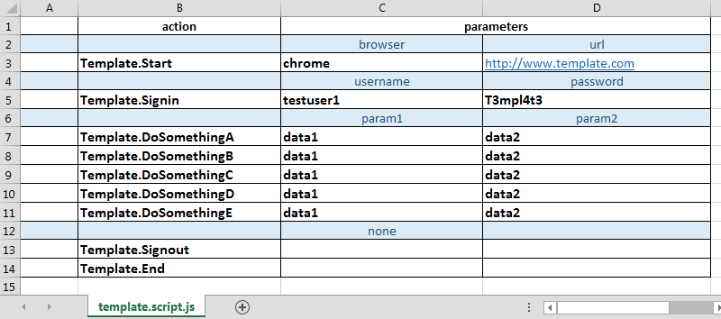
Parsley A Test Framework for Protractor
A tester’s view of a test?

Slide 10
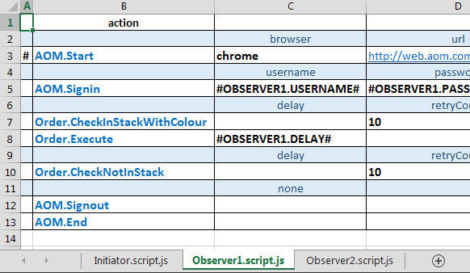
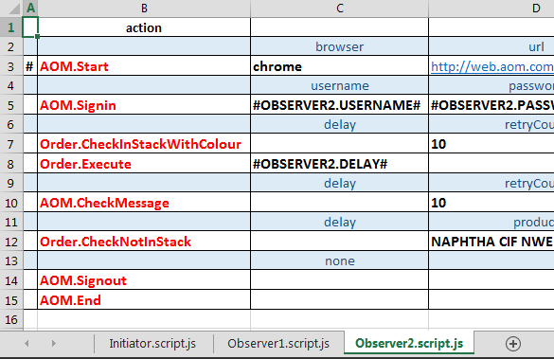
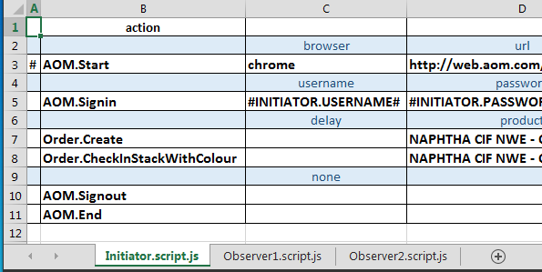
Parsley A Test Framework for Protractor
A more complex test
This AOM test involves interaction between three users (Participants)
An initiator and two aggressors

Slide 11
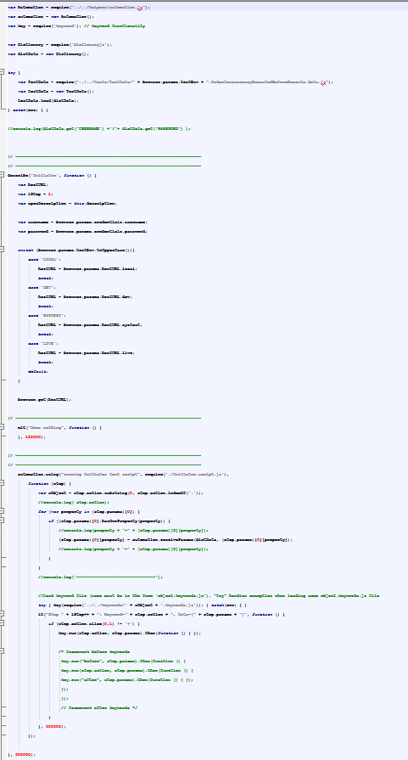
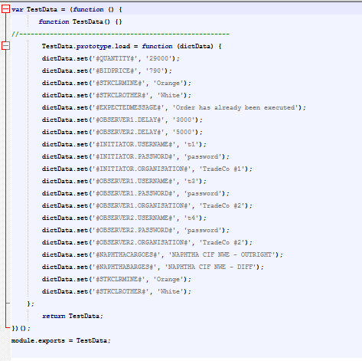
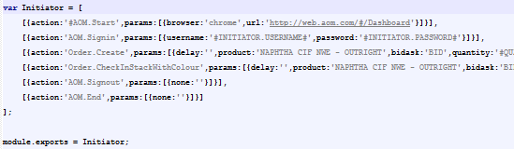
Parsley A Test Framework for Protractor
The test as Javascript

Slide 12
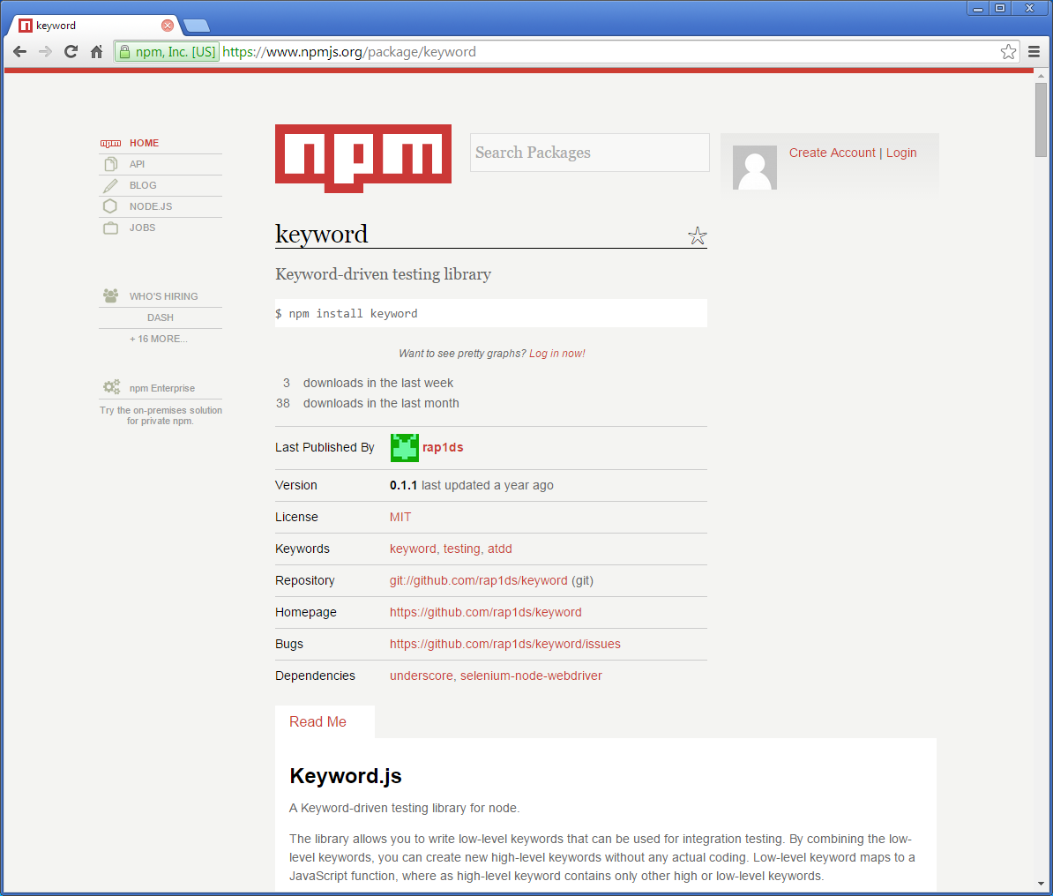
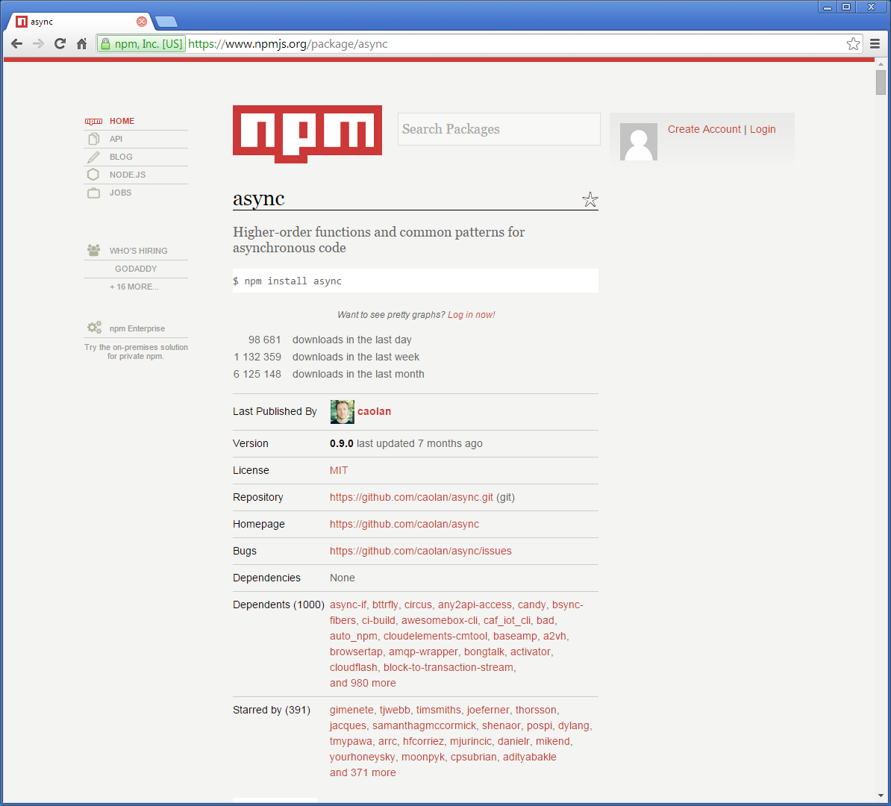
Parsley A Test Framework for Protractor
Use keyword and async from npm

Slide 13
Parsley A Test Framework for Protractor
Vanilla test specification
.\tests\vanilla.pro.js
var Automation = require("../../helpers/automation.js");
var automation = new Automation();
var key = require('keyword'); // keyword functionality
var Dictionary = require('dictionaryjs');
var dictData = new Dictionary();
try {
var TestData = require("../../tests/TestData/" + browser.params.testEnv + ".vanillaTestName.data.js");
var testData = new TestData();
testData.load(dictData);
} catch(err) { }
// -------------------------------------------------------------------------
// -------------------------------------------------------------------------
describe('vanillaScriptName', function () {
automation.using("running vanillaScriptName test script", require('./vanillaScriptName.script.js'),
function (step) {
var sObject = step.action.substring(0, step.action.indexOf('.'));
for (var property in (step.params)[0]) {
if ((step.params)[0].hasOwnProperty(property)) {
(step.params)[0][property] = automation.resolveParams(dictData, (step.params)[0][property]);
}
}
//Load keyword file (name must be in the form 'object.keywords.js'). "try" handles exception when loading same object.keywords.js file
try { key(require('../../keywords/' + sObject + '.keywords.js')); } catch(err) { }
it("Step " + iStep++ + ": Keyword=" + step.action + ", Data=[" + step.params + "]", function () {
if (step.action.slice(0,1) != '#') {
key.run(step.action, step.params).then(function () { });
}
}, 600000);
});
}, 600000);
The data for this test
The test specification is generated by replacing “vanilla…” with the test name.
The test keywords

Slide 14
Parsley A Test Framework for Protractor
Generated test specification
.\tests\OrderCreateAsPrincipal\Intiator.pro.js
var Automation = require("../../helpers/automation.js");
var automation = new Automation();
var key = require('keyword'); // keyword functionality
var Dictionary = require('dictionaryjs');
var dictData = new Dictionary();
try {
var TestData = require("../../tests/TestData/" + browser.params.testEnv + ".OrderCreateAsPrincipal.data.js");
var testData = new TestData();
testData.load(dictData);
} catch(err) { }
// -------------------------------------------------------------------------
// -------------------------------------------------------------------------
describe('Initiator', function () {
automation.using("running Initiator test script", require('./Initiator.script.js'),
function (step) {
var sObject = step.action.substring(0, step.action.indexOf('.'));
for (var property in (step.params)[0]) {
if ((step.params)[0].hasOwnProperty(property)) {
(step.params)[0][property] = automation.resolveParams(dictData, (step.params)[0][property]);
}
}
//Load keyword file (name must be in the form 'object.keywords.js'). "try" handles exception when loading same object.keywords.js file
try { key(require('../../keywords/' + sObject + '.keywords.js')); } catch(err) { }
it("Step " + iStep++ + ": Keyword=" + step.action + ", Data=[" + step.params + "]", function () {
if (step.action.slice(0,1) != '#') {
key.run(step.action, step.params).then(function () { });
}
}, 600000);
});
}, 600000);
The data for this test
The test keywords

Slide 15
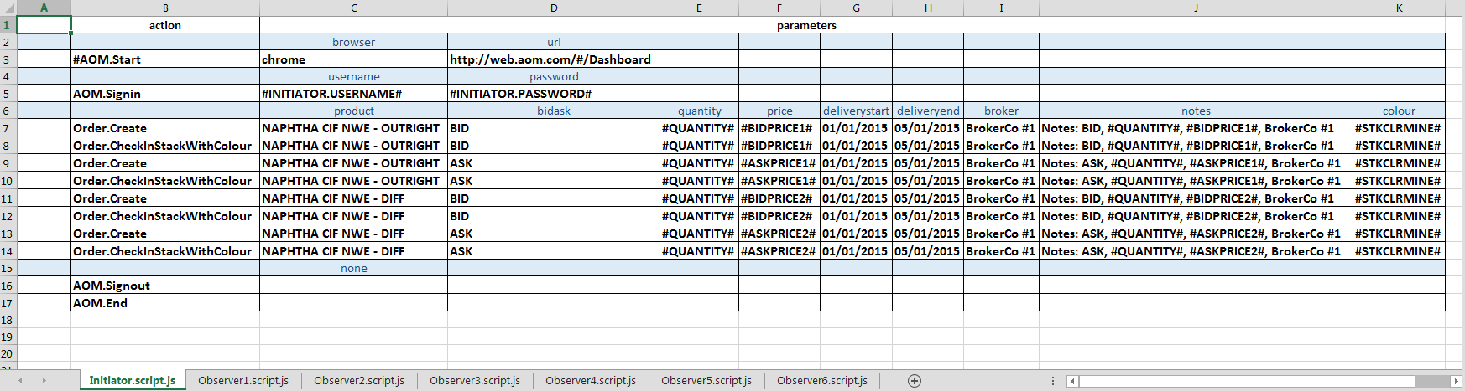
Parsley A Test Framework for Protractor
Test script spreadsheet OrderCreateAsPrincipal.xlsx

Slide 16
Parsley A Test Framework for Protractor
Generated test specification
.\tests\OrderCreateAsPrincipal\Intiator.script.js
var Initiator = [
[{action:'#AOM.Start', params:[{browser:'chrome',url:'http://web.aom.com/#/Dashboard'}]}],
[{action:'AOM.Signin', params:[{username:'#INITIATOR.USERNAME#', password:'#INITIATOR.PASSWORD#'}]}],
[{action:'Order.Create', params:[{product:'NAPHTHA CIF NWE - OUTRIGHT',bidask:'BID',quantity:'#QUANTITY#', price:'#BIDPRICE1#',deliverystart:'01/01/2015',deliveryend:'05/01/2015',broker:'BrokerCo #1',notes:'Notes: BID, #QUANTITY#, #BIDPRICE1#, BrokerCo #1',colour:'#STKCLRMINE#'}]}],
[{action:'Order.CheckInStackWithColour', params:[{product:'NAPHTHA CIF NWE - OUTRIGHT',bidask:'BID',quantity:'#QUANTITY#', price:'#BIDPRICE1#',deliverystart:'01/01/2015',deliveryend:'05/01/2015',broker:'BrokerCo #1',notes:'Notes: BID, #QUANTITY#, #BIDPRICE1#, BrokerCo #1',colour:'#STKCLRMINE#'}]}],
[{action:'Order.Create', params:[{product:'NAPHTHA CIF NWE - OUTRIGHT',bidask:'ASK',quantity:'#QUANTITY#', price:'#ASKPRICE1#',deliverystart:'01/01/2015',deliveryend:'05/01/2015',broker:'BrokerCo #1',notes:'Notes: ASK, #QUANTITY#, #ASKPRICE1#, BrokerCo #1',colour:'#STKCLRMINE#'}]}],
[{action:'Order.CheckInStackWithColour', params:[{product:'NAPHTHA CIF NWE - OUTRIGHT',bidask:'ASK',quantity:'#QUANTITY#', price:'#ASKPRICE1#',deliverystart:'01/01/2015',deliveryend:'05/01/2015',broker:'BrokerCo #1',notes:'Notes: ASK, #QUANTITY#, #ASKPRICE1#, BrokerCo #1',colour:'#STKCLRMINE#'}]}],
[{action:'Order.Create', params:[{product:'NAPHTHA CIF NWE - DIFF',bidask:'BID',quantity:'#QUANTITY#', price:'#BIDPRICE2#',deliverystart:'01/01/2015',deliveryend:'05/01/2015',broker:'BrokerCo #1',notes:'Notes: BID, #QUANTITY#, #BIDPRICE2#, BrokerCo #1',colour:'#STKCLRMINE#'}]}],
[{action:'Order.CheckInStackWithColour', params:[{product:'NAPHTHA CIF NWE - DIFF',bidask:'BID',quantity:'#QUANTITY#', price:'#BIDPRICE2#',deliverystart:'01/01/2015',deliveryend:'05/01/2015',broker:'BrokerCo #1',notes:'Notes: BID, #QUANTITY#, #BIDPRICE2#, BrokerCo #1',colour:'#STKCLRMINE#'}]}],
[{action:'Order.Create', params:[{product:'NAPHTHA CIF NWE - DIFF',bidask:'ASK',quantity:'#QUANTITY#', price:'#ASKPRICE2#',deliverystart:'01/01/2015',deliveryend:'05/01/2015',broker:'BrokerCo #1',notes:'Notes: ASK, #QUANTITY#, #ASKPRICE2#, BrokerCo #1',colour:'#STKCLRMINE#'}]}],
[{action:'Order.CheckInStackWithColour', params:[{product:'NAPHTHA CIF NWE - DIFF',bidask:'ASK',quantity:'#QUANTITY#', price:'#ASKPRICE2#',deliverystart:'01/01/2015',deliveryend:'05/01/2015',broker:'BrokerCo #1',notes:'Notes: ASK, #QUANTITY#, #ASKPRICE2#, BrokerCo #1',colour:'#STKCLRMINE#'}]}],
[{action:'AOM.Signout', params:[{none:''}]}],
[{action:'AOM.End', params:[{none:''}]}]
];
module.exports = Initiator;
var Initiator = [
[{action:'#AOM.Start', params:[{browser:'chrome', url:'http://web.aom.com/#/Dashboard'}]}],
[{action:'AOM.Signin', params:[{username:'#INITIATOR.USERNAME#', password:'#INITIATOR.PASSWORD#'}]}],
[{action:'Order.Create', params:[{product:'NAPHTHA CIF NWE - OUTRIGHT', bidask:'BID', quantity:'#QUANTITY#', price:'#BIDPRICE#',
[{action:'Order.CheckInStackWithColour', params:[{product:'NAPHTHA CIF NWE - OUTRIGHT', bidask:'BID', quantity:'#QUANTITY#',
[{action:'Order.Create', params:[{product:'NAPHTHA CIF NWE - OUTRIGHT', bidask:'ASK', quantity:'#QUANTITY#',
[{action:'Order.CheckInStackWithColour', params:[{product:'NAPHTHA CIF NWE - OUTRIGHT', bidask:'ASK', quantity:'#QUANTITY#' [{action:'Order.Create', params:[{product:'NAPHTHA CIF NWE - DIFF', bidask:'BID', quantity:'#QUANTITY#', price:'#BIDPRICE2#'
[{action:'Order.CheckInStackWithColour', params:[{product:'NAPHTHA CIF NWE - DIFF', bidask:'BID', quantity:'#QUANTITY#', [{action:'Order.Create', params:[{product:'NAPHTHA CIF NWE - DIFF', bidask:'ASK', quantity:'#QUANTITY#',
[{action:'Order.CheckInStackWithColour', params:[{product:'NAPHTHA CIF NWE - DIFF', bidask:'ASK', quantity:'#QUANTITY#',
[{action:'AOM.Signout', params:[{none:''}]}],
[{action:'AOM.End', params:[{none:''}]}]
];
module.exports = Initiator;

Slide 17
Parsley A Test Framework for Protractor
End

