Slide 1
Parsley
A keyword-driven test framework for Protractor

Slide 2
Parsley A Test Framework for Protractor
Demo scenario
Concurrency test scenario – “Order executed before execute”
A trader attempts to execute an order but it fails because the order is executed by another trader.
A trader (the initiator) creates an order
Two other traders (aggressors) see it and decide to execute the order
One of them succeeds and the other one gets an error message

Slide 3
Parsley A Test Framework for Protractor
Validation
The order appears in orange for the initiator
The order appears in white for both of the aggressors
The order disappears for the successful aggressor
An error message is displayed to the unsuccessful aggressor
The error message contains the expected text
The order disappears for the unsuccessful aggressor

Slide 4
Parsley A Test Framework for Protractor
Demo

Slide 5
Parsley A Test Framework for Protractor
Demo
Explained

Slide 6
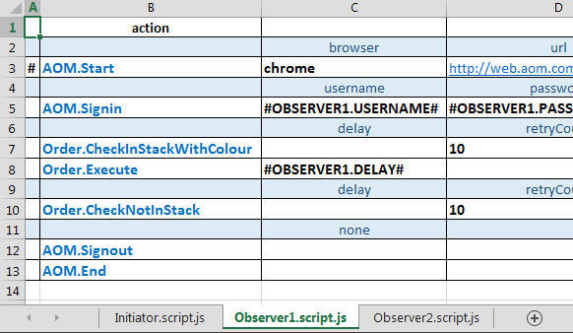
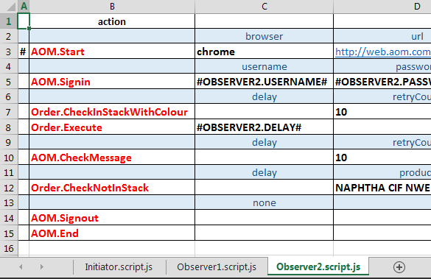
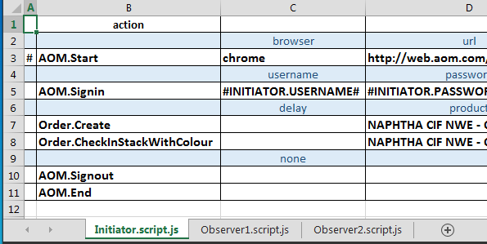
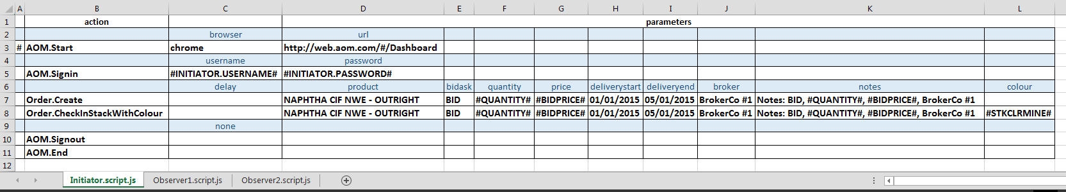
Parsley A Test Framework for Protractor
Design
concurrent sessions

Slide 7
Parsley A Test Framework for Protractor
Run
concurrent sessions
> protractor protractorConfig.js
--params.testEnv=systest
--capabilities.browserName=chrome
--capabilities.shardTestFiles=true
--capabilities.maxInstances=3
--specs=".\tests\OrderConcurrencyExecutedBeforeExecute\*.pro.js"
Observer1.pro.js
Observer1.script.js
Observer2.pro.js
Observer2.script.js
Initiator.pro.js
Initiator.script.js
each of these runs in a separate browser, and they all run concurrently
systest environment
chrome browser
3 concurrent instances
test specs

