Slide 1


Natesan A
28/10/2026

Slide 2

Outline
Executive Summary
Introduction
Methodology
Results
EDA Visualization Results
SQL Analysis Results
Folium Map Results
Plotly Dash Dashboard
Machine Learning Results
Data Collection & Web Scraping
Data Wrangling
EDA & SQL Analysis
Interactive Visual Analytics
Predictive Analysis
Conclusion
Appendix

Slide 3
Executive Summary
Objective
Predict the landing success of SpaceX Falcon 9's first stage to understand rocket reusability and launch costs.
Methodology
Collected data using the SpaceX API and web scraping.
Performed data cleaning, data wrangling, EDA, and SQL analysis.
Created interactive maps using Folium and dashboards using Plotly Dash.
Built and evaluated Logistic Regression, SVM, Decision Tree, and KNN models.
Key Results
Analyzed launch success patterns across launch sites, orbit types, payloads, and years.
Used interactive visualizations to explore launch outcomes.
Evaluated classification models using accuracy and confusion matrices.
Conclusion
Data analytics and machine learning can help predict first-stage landing outcomes and support decisions about booster reusability and launch-cost estimation.

Slide 4
Introduction
Project Background
SpaceX operates the Falcon 9 rocket, which is designed to recover and reuse its first stage.
Reusing the first stage can reduce launch costs compared with expendable rockets.
Space Y aims to compete in the commercial space-launch industry by understanding the factors affecting launch success.
Problem Statement
Determine whether the Falcon 9 first stage will land successfully.
Identify relationships between launch sites, payload mass, orbit type, and landing outcomes.
Use historical launch data and machine learning to predict landing success.
Project Objective
Collect and Analyze SpaceX launch data.
Build interactive visualizations and dashboards.
Compare classification models and identify the best-performing model for predicting landing outcomes.

Slide 5

Section 1

Slide 6
Methodology
1. Data Collection
SpaceX API: Retrieved launch records and mission details in JSON format.
Web Scraping: Extracted supplementary launch information from web pages using Python libraries such as Pandas and BeautifulSoup.
2. Data Wrangling
Cleaned the collected data and handled missing values.
Selected relevant features for analysis.
Applied one-hot encoding to categorical variables to prepare data for machine learning.
3. Exploratory Data Analysis (EDA)
Used Python, Pandas, Matplotlib, and Seaborn to visualize launch outcomes and identify patterns.
Used SQL queries to analyze launch sites, payloads, success rates, rankings, and launch trends over time.
4. Interactive Visual Analytics
Folium: Created an interactive map showing launch sites and launch outcomes, with markers and proximity analysis.
Plotly Dash: Developed an interactive dashboard with dropdown filters, a payload range slider, a success pie chart, and a scatter plot.
5. Predictive Analysis
Defined landing outcome (Class) as the target variable. Split the dataset into training and testing sets.
Trained and tuned Logistic Regression, Support Vector Machine (SVM), Decision Tree, and K-Nearest Neighbors (KNN) models.
Evaluated model performance using accuracy scores and confusion matrices to identify the best-performing model.

Slide 7
Data Collection
Data Sources
SpaceX REST API: Collected historical Falcon 9 launch records and mission details in JSON format.
Web Scraping: Extracted supplementary launch information from web pages using Python.
Data Storage: Converted the collected information into Pandas DataFrames for analysis.
Tools Used
Pandas
Python
Requests
BeautifulSoup
JSON
Information Collected
Flight number and launch date
Booster version and launch site
Payload mass and orbit type
Landing outcome and booster reuse information

Slide 8
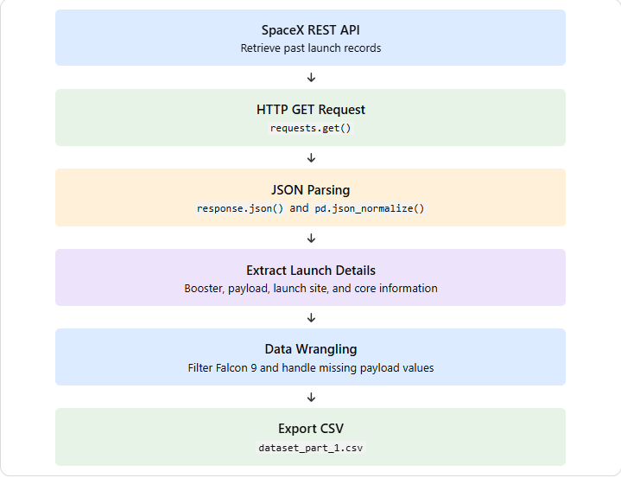
Data Collection – SpaceX API
Used the public SpaceX API to retrieve Falcon 9 launch data.
Sent HTTP GET requests to API endpoints using Python's requests library.
Received launch information in JSON format.
Extracted relevant details such as flight number, launch date, launch site, payload, orbit, and landing outcome.
Converted the collected data into a Pandas DataFrame for further analysis.
Tools: Python, Requests, JSON, Pandas
GitHub Repository:
[Insert your GitHub repository URL here]
Place your flowchart of SpaceX API calls here

Slide 9
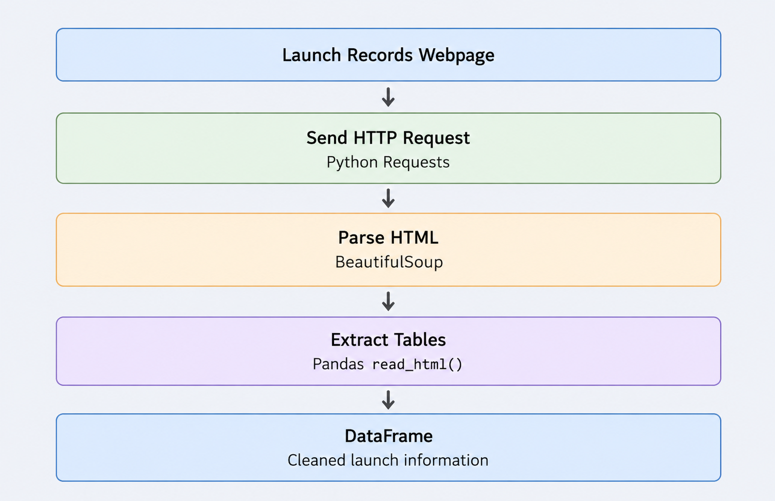
Data Collection - Scraping
Objective
Extract historical Falcon 9 launch information from web pages.
Methodology
Accessed the SpaceX launch records webpage.
Retrieved HTML content using Python's requests library.
Parsed HTML using BeautifulSoup.
Located HTML tables containing launch information.
Converted the extracted table into a Pandas DataFrame using pd.read_html().
Cleaned and prepared the data for further analysis.
Tools Used
Python, Requests, BeautifulSoup, Pandas
GitHub : https://github.com/anatesan-01/Data-Science-Capstone--IBM/blob/main/jupyter-labs-spacex-data-collection-api-v2.ipynb

Slide 10
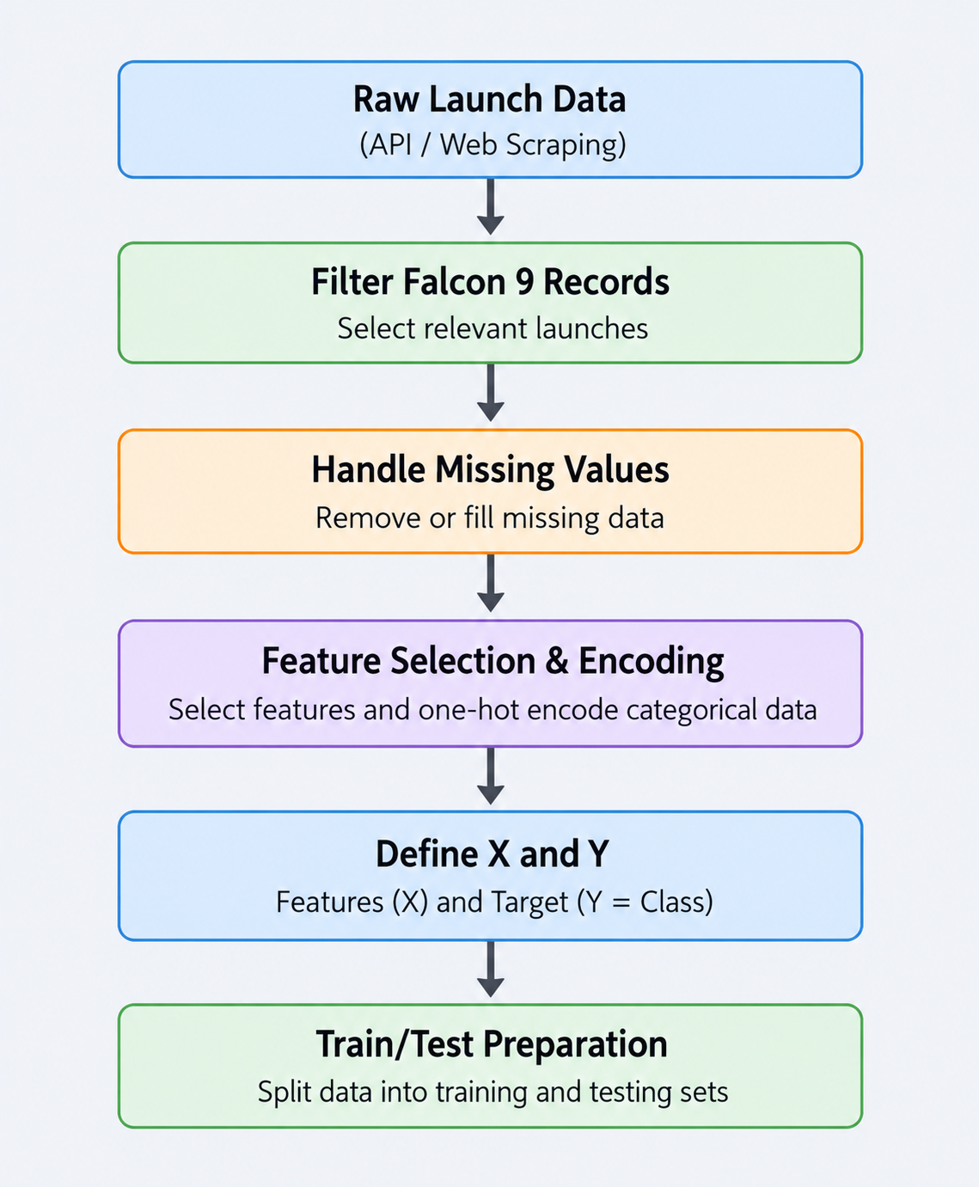
Data Wrangling
Data Wrangling Methodology
Data Filtering: Selected Falcon 9 launch records.
Missing Values: Identified and handled missing payload values.
Feature Extraction: Selected relevant launch features, including payload mass, orbit, launch site, and landing outcome.
Feature Encoding: Applied one-hot encoding to categorical variables.
Feature and Target Definition: Defined input features (X) and target variable (Y = Class).
Data Splitting: Prepared training and testing datasets for machine learning.
Tools
Python, Pandas, NumPy, Scikit-learn
GitHub : https://github.com/anatesan-01/Data-Science-Capstone--IBM/blob/main/labs-jupyter-spacex-Data%20wrangling-v2.ipynb

Slide 11
EDA with Data Visualization
Charts Used and Their Purpose
Scatter Plot: Examined the relationship between payload mass and launch outcomes at different launch sites.
Bar Chart: Compared the mean of the Class variable across different orbit types, including ES-L1, GEO, GTO, HEO, ISS, LEO, MEO, PO, SO, SSO, and VLEO.
Line Chart: Analyzed yearly trends in the Class variable from 2010 to 2020, showing an overall upward trend with some fluctuations.
Orbit Analysis: Compared landing outcomes across different orbit types using flight number and payload mass.
Flight Number Analysis: Investigated successful and unsuccessful landing outcomes across different launch sites and flight numbers.
Key Objective
Identify factors associated with successful Falcon 9 first-stage landings.
Discover patterns in launch performance based on payload mass, launch site, orbit type, flight number, and yearly trends.
Tools Used
Python, Pandas, Matplotlib, Seaborn
GitHub Repository:https://github.com/anatesan-01/Data-Science-Capstone--IBM/blob/main/jupyter-labs-eda-dataviz-v2.ipynb

Slide 12
EDA with SQL
SQL Queries Performed and Their Purpose
Launch Site Analysis: Identified unique launch sites and filtered CCA sites.
Payload Analysis: Calculated total and average payload mass.
Landing Outcome Analysis: Found the earliest successful landing and qualifying drone-ship landings.
Mission Success and Failure: Counted successful and unsuccessful outcomes.
Maximum Payload: Identified boosters carrying the maximum payload.
Monthly Analysis: Retrieved failed drone-ship landings from 2015.
Time-Based Ranking: Ranked landing outcomes by count within the specified date range.
Key Objective
Analyze launch sites, payloads, and landing outcomes.
Identify success patterns and historical trends.
Support Falcon 9 landing-success analysis.
Tools Used
SQL, SQLite, Python, Pandas
GitHub : https://github.com/anatesan-01/Data-Science-Capstone--IBM/blob/main/jupyter-labs-eda-sql-coursera_sqllite.ipynb

Slide 13
Build an Interactive Map with Folium
Map Objects Used and Their Purpose
Markers: Identified SpaceX launch sites, including CCAFS SLC-40, KSC LC-39A, and VAFB SLC-4E.
Pop-ups: Displayed launch site details when users clicked on the markers.
Circles: Highlighted launch site locations to make them easier to identify.
Interactive Features: Enabled users to zoom in, zoom out, and explore the geographical locations on the map.
Why These Objects Were Added
To visualize the geographical distribution of SpaceX launch sites.
To compare launch site locations and explore their positions.
To support the analysis of launch sites and Falcon 9 landing performance.
Key Objective
Create an interactive map of SpaceX launch sites.
Explore launch locations and their geographical distribution.
Understand the role of launch sites in Falcon 9 mission analysis.
Tools Used
Python, Folium, Pandas, Jupyter Notebook
GitHub : https://github.com/anatesan-01/Data-Science-Capstone--IBM/blob/main/lab-jupyter-launch-site-location-v2.ipynb

Slide 14
Build a Dashboard with Plotly Dash
Plots and Interactions Used
Scatter Plot: Compared payload mass with launch outcomes to identify performance patterns.
Bar Chart: Displayed launch success rates across different launch sites.
Pie Chart: Showed the proportion of successful and unsuccessful first-stage landings.
Interactive Filters: Allowed users to select launch sites and explore the corresponding results.
Why These Plots Were Added
To compare launch performance across different launch sites.
To understand the relationship between payload mass and landing success.
To explore launch outcomes interactively and identify useful patterns.
Key Objective
Build an interactive dashboard to analyze Falcon 9 launch and landing performance.
Present key findings through clear visualizations and interactive filters.
Tools Used
Python, Plotly Express, Plotly Dash, Pandas
GitHub : https://github.com/anatesan-01/Data-Science-Capstone--IBM/blob/main/spacex_dash_app.py

Slide 15
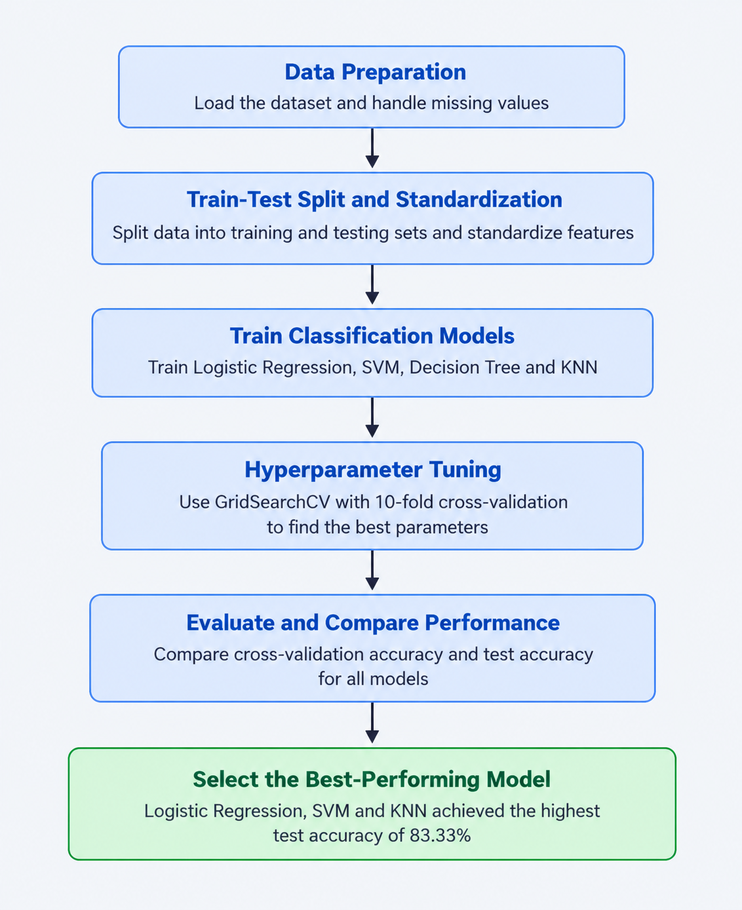
Predictive Analysis (Classification)
Model Development Process
Data Preparation: Split the dataset into training and testing sets and standardized the features.
Model Building: Trained four classification models: Logistic Regression, Support Vector Machine (SVM), Decision Tree, and K-Nearest Neighbors (KNN).
Hyperparameter Tuning: Used GridSearchCV with 10-fold cross-validation to find the best parameters.
Model Evaluation: Compared model accuracy using cross-validation scores and test data scores.
Best Model Selection: Logistic Regression, SVM, and KNN achieved the highest test accuracy of 83.33%, while Decision Tree achieved 61.11%.
Tools Used
Python, Pandas, Scikit-learn, GridSearchCV
GitHub : https://github.com/anatesan-01/Data-Science-Capstone--IBM/blob/main/SpaceX-Machine-Learning-Prediction-Part-5-v1%20(1).ipynb

Slide 16
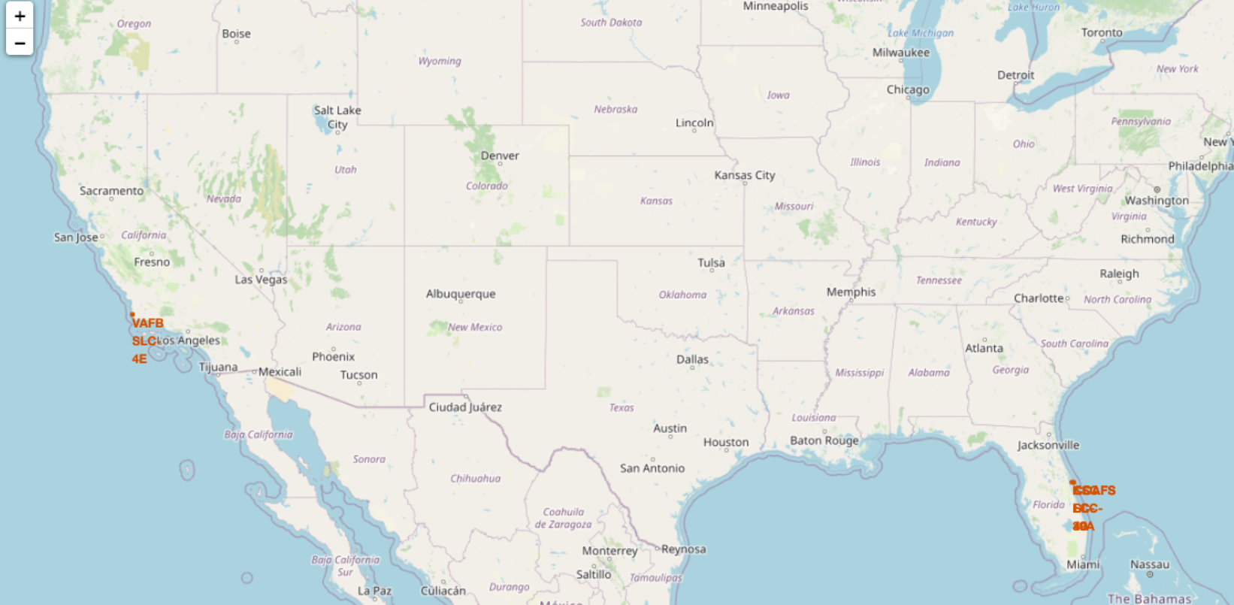
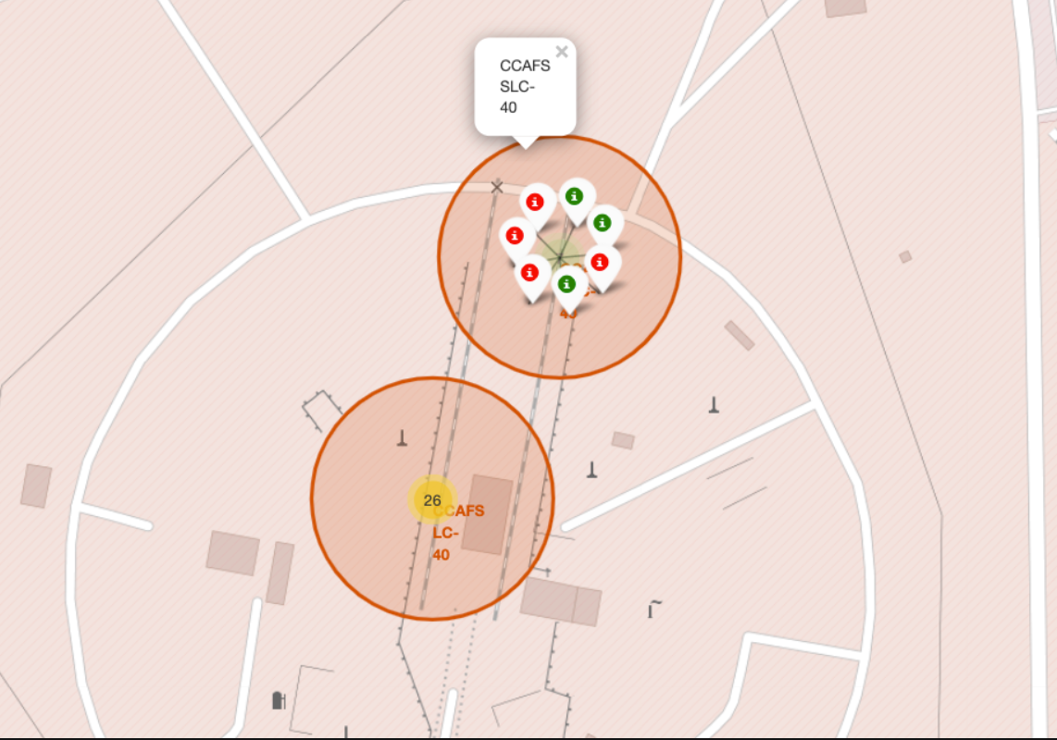
Results
EDA Results
Identified launch success patterns based on payload mass, launch site, orbit type, and flight number.
Observed an overall upward trend in landing success across the years.
Interactive Analytics Results
Created a Folium map to visualize SpaceX launch site locations.
Developed a Plotly Dash dashboard to explore launch performance using interactive charts and filters.
Predictive Analysis Results
Evaluated Logistic Regression, SVM, Decision Tree, and KNN models.
Logistic Regression, SVM, and KNN achieved the highest test accuracy of 83.33%.
Decision Tree achieved a test accuracy of 61.11%.

Slide 17

Section 2

Slide 18
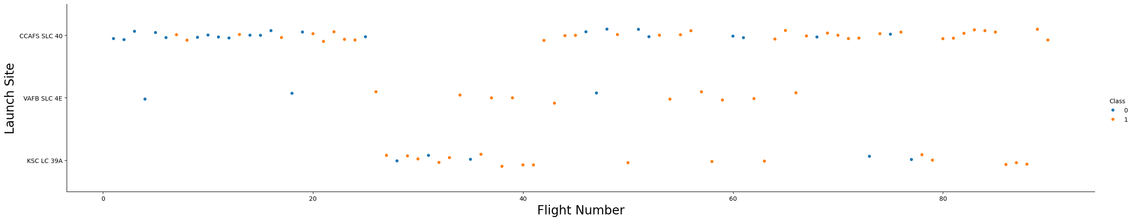
Flight Number vs. Launch Site
Key Observations
CCAFS SLC-40 has the largest number of launches in the plot.
Both successful and unsuccessful landing outcomes occur across different flight numbers and launch sites.
The plot helps compare landing performance across launch sites and identify patterns as flight experience increases.
Scatter Plot Analysis
The scatter plot shows the relationship between flight number and launch site.
Different color represent landing outcomes: Class 0 (unsuccessful landing) and Class 1 (successful landing).
Launch sites include CCAFS SLC-40, VAFB SLC-4E, and KSC LC-39A.
Conclusion: Flight number and launch site help explore patterns in Falcon 9 first-stage landing success.

Slide 19
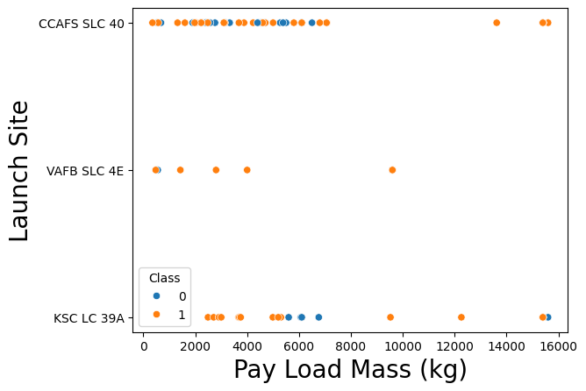
Payload vs. Launch Site
Scatter Plot Analysis
The scatter plot compares payload mass (kg) across different SpaceX launch sites.
It helps examine how payload mass varies between CCAFS SLC-40, VAFB SLC-4E, and KSC LC-39A.
The distribution of data points helps identify differences in payload mass handled by each launch site.
Key Observations
CCAFS SLC-40 has payloads across a wide range, including some of the heaviest payloads.
VAFB SLC-4E has fewer data points than the other launch sites.
KSC LC-39A includes both successful and unsuccessful landing outcomes across different payload masses.
Conclusion: Payload mass and launch site help us explore patterns in Falcon 9 first-stage landing success.

Slide 20
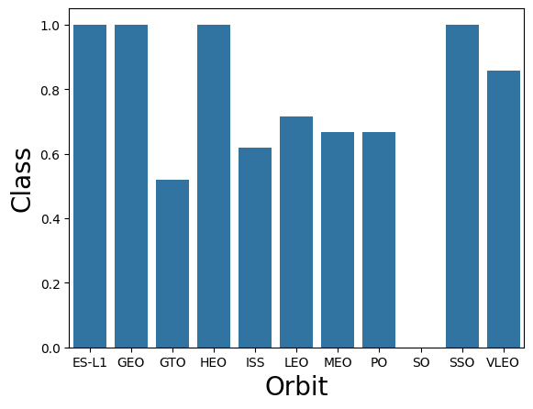
Success Rate vs. Orbit Type
Bar Chart Analysis
The bar chart compares the average landing success (Class) across different orbit types.
A higher bar indicates a higher proportion of successful landings, while a lower bar indicates a lower success rate.
The chart includes orbit types such as ES-L1, GEO, GTO, HEO, ISS, LEO, MEO, PO, SO, SSO, and VLEO.
Key Observations
ES-L1, GEO, HEO, and SSO show a success rate of approximately 100%.
GTO has a lower success rate of around 52%, while ISS is approximately 62%.
LEO, MEO, and PO show moderate success rates.
SO shows no successful landing records in this chart.
Conclusion: Landing success varies by orbit type, suggesting that mission orbit is a useful factor when analyzing Falcon 9 first-stage landing outcomes.

Slide 21
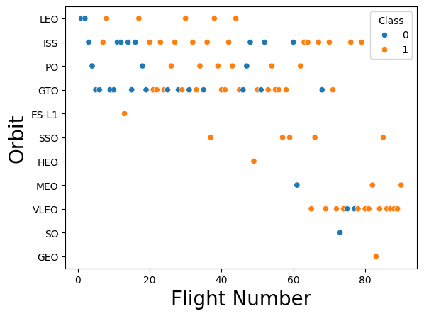
Flight Number vs. Orbit Type
Scatter Plot Analysis
The scatter plot compares flight numbers across different orbit types.
The distribution of points shows how launch outcomes vary across orbits as flight experience increases.
Blue points represent Class 0 (unsuccessful landing), while orange points represent Class 1 (successful landing).
Key Observations
GTO and ISS contain a mix of successful and unsuccessful landing outcomes.
VLEO shows more successful outcomes among the later flight numbers.
LEO, PO, and other orbit types show different patterns in landing outcomes.
Later flights generally show more successful outcomes in several orbit types.
Conclusion: Flight number and orbit type help identify patterns in Falcon 9 first-stage landing success across different missions.

Slide 22
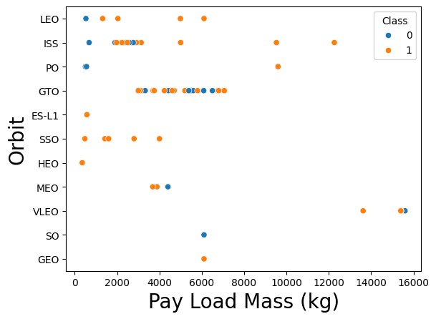
Payload vs. Orbit Type
Scatter Plot Analysis
The scatter plot compares payload mass (kg) across different orbit types.
It helps examine how payload mass varies depending on the target orbit of each Falcon 9 mission.
The colors distinguish successful and unsuccessful first-stage landing outcomes.
Key Observations
GTO missions cover a wide range of payload masses, with both successful and unsuccessful landing outcomes.
ISS missions mostly have payload masses between 2,000 and 3,000 kg, with some heavier payloads.
VLEO includes some of the heaviest payloads, around 15,000–16,000 kg.
Different orbit types show varying landing outcomes across payload masses.
Conclusion: Payload mass and orbit type help reveal patterns in Falcon 9 first-stage landing success across different missions.

Slide 23
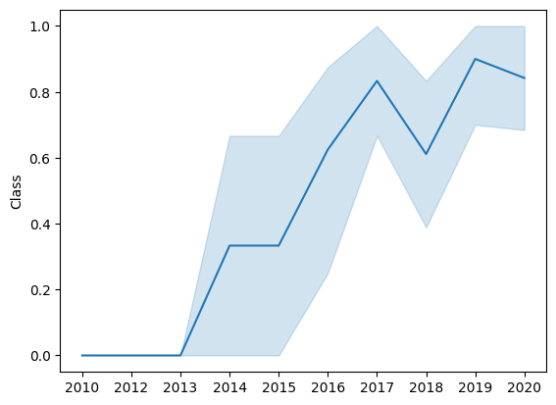
Launch Success Yearly Trend
Line Chart Analysis
The line chart shows the yearly average landing success rate from 2010 to 2020.
It helps identify changes in Falcon 9 first-stage landing performance over time.
The shaded region represents the variation around the plotted trend.
Key Observations
From 2010 to 2013, the average success rate remains at 0.
The success rate begins to increase in 2014 and rises to approximately 0.83 in 2017.
It decreases to around 0.61 in 2018, then reaches approximately 0.90 in 2019.
In 2020, the success rate remains high at around 0.84.
Conclusion: The yearly trend shows an overall improvement in Falcon 9 first-stage landing success, with some fluctuations between years.

Slide 24
All Launch Site Names
Unique Launch Sites
CCAFS LC-40: Cape Canaveral Air Force Station, Space Launch Complex 40.
VAFB SLC-4E: Vandenberg Air Force Base, Space Launch Complex 4 East.
KSC LC-39A: Kennedy Space Center, Launch Complex 39A.
Explanation
Used the SQL SELECT DISTINCT statement to identify unique launch sites in the SpaceX dataset.
Identified three unique launch sites and eliminated duplicate entries.
These launch sites provide the locations for analyzing Falcon 9 launch activities.
Compared launch sites with payload mass, flight number, and landing outcomes to explore patterns in first-stage landing success.
This analysis helps understand the role of launch site information in evaluating Falcon 9 mission performance.

Slide 25
Launch Site Names Begin with 'CCA'
Query Analysis
Used the SQL LIKE 'CCA%' condition to identify launch sites whose names begin with CCA.
Retrieved the first five records using the LIMIT 5 clause.
Key Observations
All five records belong to the CCAFS LC-40 launch site.
The records include launches from 2010 to 2013.
The missions include Dragon demonstration flights and NASA cargo resupply missions.
Conclusion: CCAFS LC-40 is a launch site used for multiple Falcon 9 missions, including early demonstration and cargo resupply flights.

Slide 26
Total Payload Mass
Objective: Calculate the total payload mass carried by SpaceX boosters for NASA (CRS) missions.
SQL Analysis: Used the SUM() function to calculate the combined payload mass of NASA (CRS) missions in the SPACEXTABLE database.
Filtering: Applied the condition WHERE Customer = 'NASA (CRS)' to include only payloads associated with NASA cargo resupply missions.
Query Result: The total payload mass is 45,596 kg.
Key Observation: The result represents the combined mass of payloads recorded for NASA (CRS) missions, rather than the payload mass of a single launch.
Conclusion: This analysis helps quantify the total cargo transported by Falcon 9 boosters for NASA cargo resupply missions and demonstrates how SQL can summarize mission data efficiently.

Slide 27
Average Payload Mass by F9 v1.1
Objective: Calculate the average payload mass carried by the Falcon 9 v1.1 booster version.
SQL Analysis: Used the AVG() function on the PAYLOAD_MASS__KG_ column to calculate the average payload mass for F9 v1.1 launches.
Query Result: The average payload mass is 2,928.4 kg.
Explanation: This value represents the average mass of payloads carried by the F9 v1.1 booster across the launches included in the dataset.
Conclusion: The analysis helps understand the typical payload capacity used in F9 v1.1 missions and compare its payload performance with other Falcon 9 booster versions.

Slide 28
First Successful Ground Landing Date
Objective: Identify the date of the first successful Falcon 9 first-stage landing on a ground pad.
SQL Analysis: Used the MIN() function on the Date column to find the earliest landing date where the Landing Outcome was 'Success (ground pad)'.
Query Result: 22 December 2015 (2015-12-22).
Key Observation: The query identifies the earliest recorded successful ground-pad landing in the dataset.
Conclusion: This result helps determine when SpaceX first achieved a successful ground-pad landing, an important milestone in developing reusable rocket technology.

Slide 29
Successful Drone Ship Landing with Payload between 4000 and 6000
Objective: Identify the booster versions that successfully landed on a drone ship while carrying a payload mass greater than 4,000 kg and less than 6,000 kg.
SQL Analysis: Used the SELECT DISTINCT statement to retrieve unique booster versions from the SPACEXTABLE database.
Filtering Conditions: Selected records with the landing outcome Success (drone ship) and payload mass between 4,000 kg and 6,000 kg.
Query Results: The identified booster versions include:
  F9 FT B1022
  F9 FT B1026
  F9 FT B1021.2
  F9 FT B1031.2
Key Observation: These booster versions meet the specified landing-outcome and payload-mass conditions in the dataset.
Conclusion: This analysis identifies Falcon 9 booster versions that achieved successful drone-ship landings within the selected payload range, helping examine booster recovery performance.

Slide 30
Total Number of Successful and Failure Mission Outcomes
Objective: Calculate the total number of successful and failed missions recorded in the SpaceX dataset.
SQL Analysis: Used the COUNT() function to count mission records and GROUP BY Mission Outcome to organize the results by outcome.
Successful Missions: The dataset records 98 missions with the outcome Success.
Failure Outcomes: The dataset records 1 mission with the outcome Failure (in flight).
Other Outcomes: The results also include 1 mission marked Success (payload status unclear).
Key Observation: Most missions in the displayed results are recorded as successful, while a smaller number have other or uncertain outcomes.
Conclusion: This analysis summarizes mission outcomes and helps evaluate SpaceX mission performance using SQL.

Slide 31
Boosters Carried Maximum Payload
Objective: Identify the booster versions that carried the maximum payload mass in SpaceX missions.
SQL Analysis: Used the MAX() function to determine the highest payload mass and identify the corresponding booster versions.
Query Result: The results list multiple booster versions, including F9 B5 B1048.4, F9 B5 B1049.4, F9 B5 B1051.3, and others.
Explanation: These booster versions are associated with the maximum payload mass recorded in the dataset. The query results help identify boosters used for missions carrying heavy payloads.

Slide 32
2015 Launch Records
Objective: Identify Falcon 9 launches in 2015 that resulted in failed drone-ship landings.
SQL Analysis: Filtered the launch records for the year 2015 and selected the landing outcome, booster version, and launch site.
Query Results: Two failed drone-ship landings were identified:
  January: Booster F9 v1.1 B1012 — CCAFS LC-40.
  April: Booster F9 v1.1 B1015 — CCAFS LC-40.
Explanation: The results show that both failed drone-ship landing attempts in the 2015 dataset occurred at CCAFS LC-40 using F9 v1.1 boosters.

Slide 33
Rank Landing Outcomes Between 2010-06-04 and 2017-03-20
Objective: Calculate the total number of successful and failed mission outcomes using SQL.
SQL Analysis: Grouped the launch records by Mission Outcome and used the COUNT() function to count the missions in each category.
Query Results:
  Success: 30 missions
  Failure (in flight): 1 mission
Explanation: The results show 30 successful missions and one mission classified as Failure (in flight) in the query output. This helps summarize the mission outcomes recorded in the dataset.

Slide 34

Section 3

Slide 35
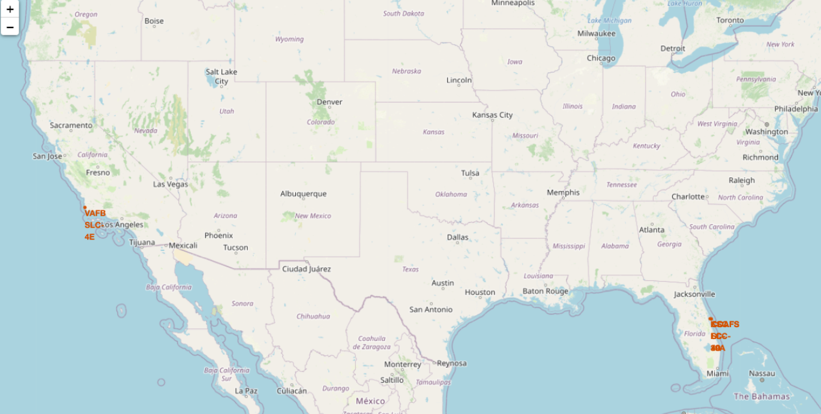
SpaceX Launch Sites: Global Location Map
Key elements on the map
Orange circles mark each launch site (1 km radius)
Text labels give the site names: CCAFS LC-40, CCAFS SLC-40, KSC LC-39A, VAFB SLC-4E
Popups show the name when you click a circle
Findings
Three sites are in Florida, one is in California
All sites are in the southern USA, closer to the Equator
All sit right on the coast, so launches go over water

Slide 36
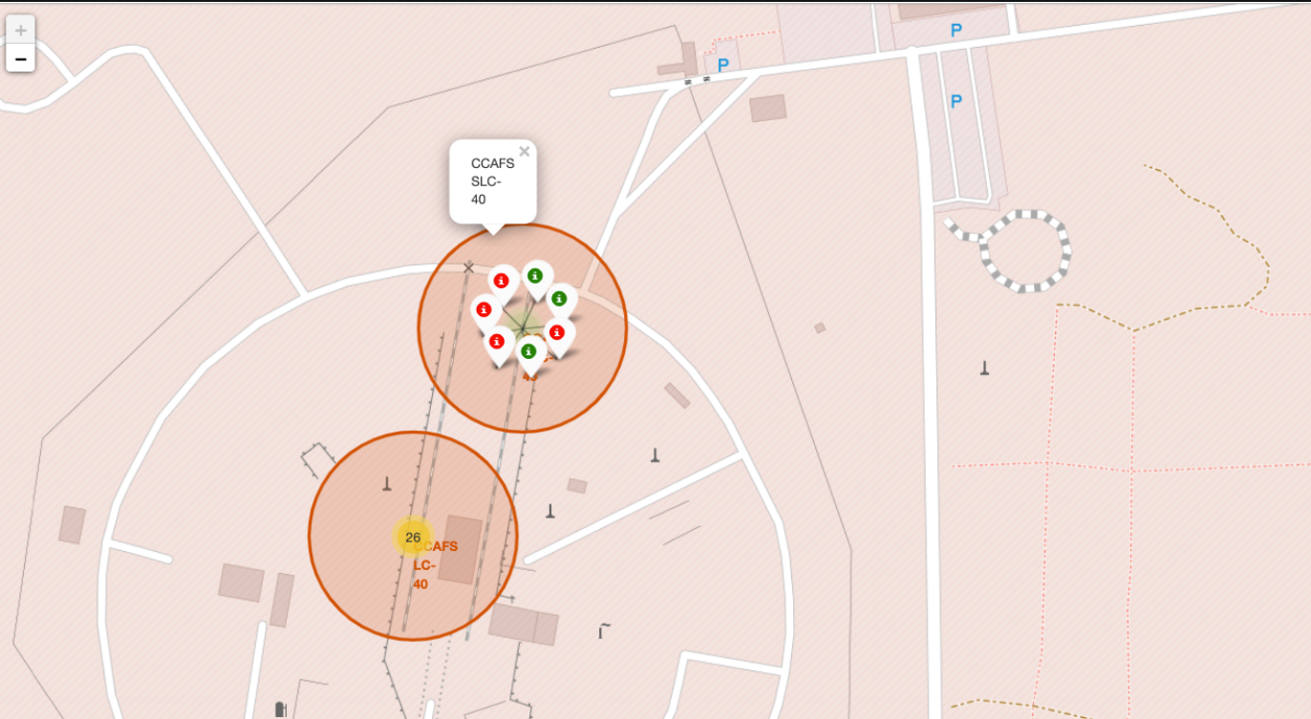
Launch Outcomes by Site
Important elements
Each marker is one launch record, placed at its launch site’s coordinates.
Green marker means a successful landing (class = 1). Red marker means a failed landing (class = 0).
Marker clusters group many markers that share the same coordinate. The number on a cluster is how many launches it holds, and zooming in splits it into single markers.
Findings:
KSC LC-39A has mostly green markers, so it has the highest success rate (roughly 77%).
CCAFS LC-40 has mostly red markers, so it has the lowest success rate (roughly 27%). Many of its launches were early ones, when landings often failed.
CCAFS SLC-40 and VAFB SLC-4E are in the middle, at roughly 40%.
Red markers are mostly the early launches and green markers the later ones, so success improved over time.

Slide 37
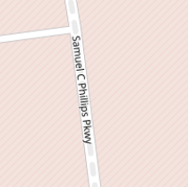


Launch Site Proximities: CCAFS SLC-40
Important elements
The orange circle marks the launch site.
Each thin line joins the launch site to a nearby feature (coastline, railway, highway).
The orange number at the end of each line is the distance in km, calculated with the Haversine formula, which measures distance between two latitude/longitude points on a sphere.
Findings:
Coastline: about 0.5 km, so launches go over water.
Railway (NASA Railroad): about 1.3 km, for moving heavy equipment.
Highway (Samuel C. Phillips Pkwy): under 0.1 km, for crew and supply access.
City (Melbourne): roughly 50 km, which keeps people away from blast, noise and debris.

Slide 38

Section 4

Slide 39
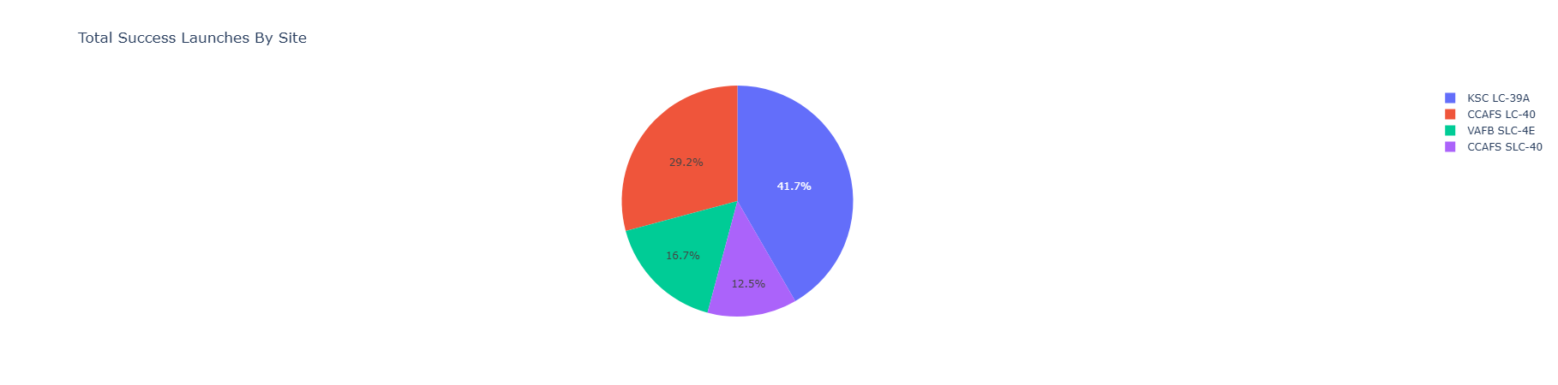
Launch Success Count by Site
Objective: Display the number of successful Falcon 9 launches at each launch site using a pie chart.
KSC LC-39A: Recorded the highest share of successful launches at 41.7%.
CCAFS LC-40: Accounted for 29.2% of successful launches.
VAFB SLC-4E: Contributed 16.7% of successful launches.
CCAFS SLC-40: Represented 12.5% of successful launches.
Key Finding: KSC LC-39A had the largest share of successful launches among the sites displayed.
Interactive Feature: The dashboard includes an All Sites dropdown to filter launch-site data.

Slide 40
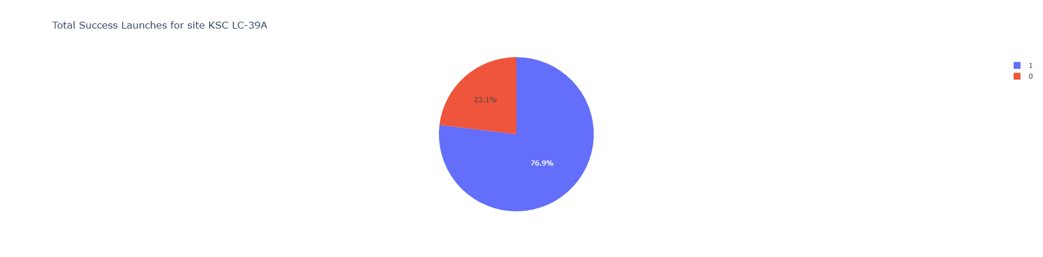
Highest Launch Success Ratio: KSC LC-39A
Key elements on the chart
Title shows the selected site: KSC LC-39A
Blue slice (1) = successful launches, 76.9%
Red slice (0) = failed launches, 23.1%
Legend explains the two classes
Findings
KSC LC-39A has the highest success ratio of all launch sites
Over three in four launches succeeded
This matches the mostly green markers on the Folium map

Slide 41
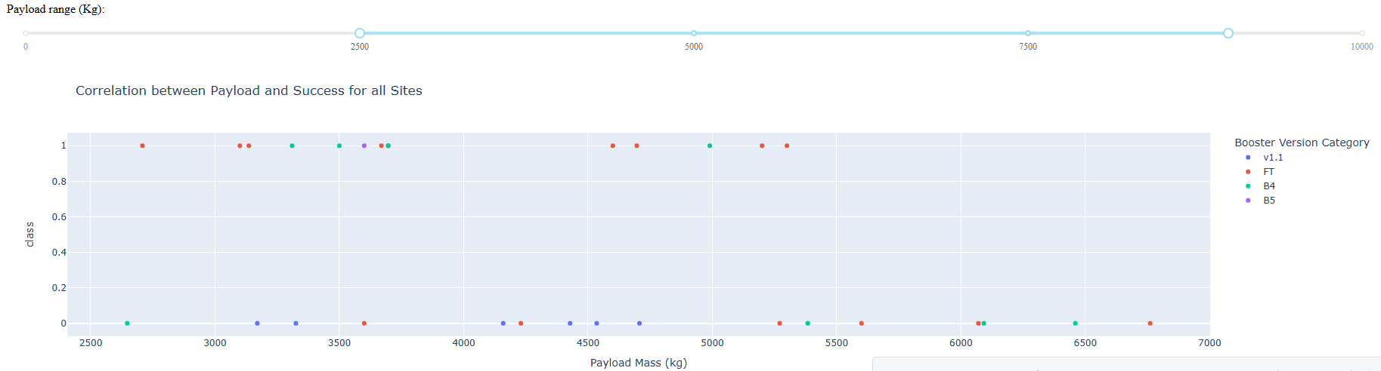
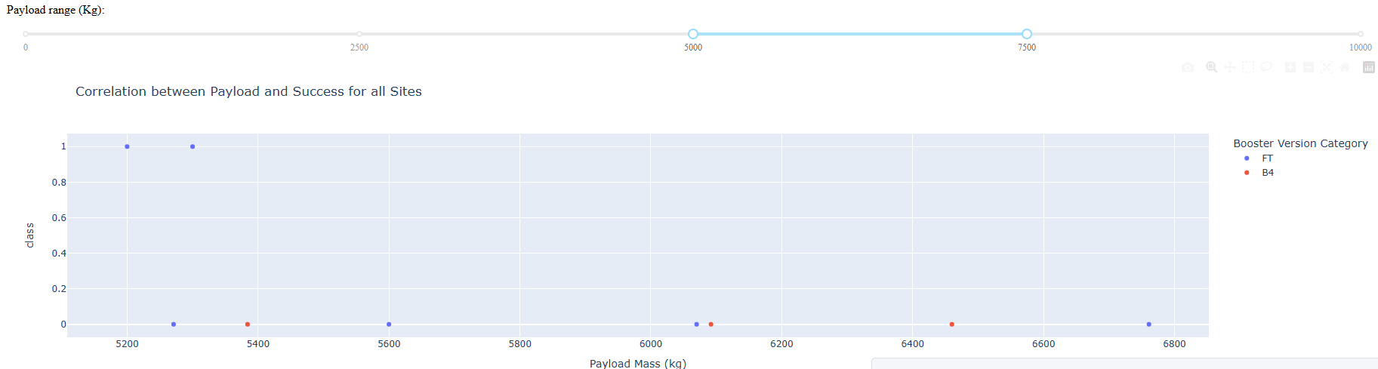
Payload vs. Launch Outcome
Layout : Put the three screenshots on the slide, labeled (a) 0-10,000 kg, (b) 2,500-~8,500 kg and kg.
Narrowest window, 5,000-7,500 kg: only 2 of 9 launches succeed (about 22%). Both successes are FT boosters at about 5,200-5,300 kg.
Booster version matters: v1.0 has only failures, and v1.1 is almost all failures. FT, B4 and B5 account for nearly all successes, so newer boosters are more reliable across payload ranges.
Conclusion: the highest success rate comes from mid-range payloads (about 2,500-4,000 kg) on newer boosters (FT/B4/B5).
What the plot shows: each dot is one launch across all sites. Class 1 is a successful landing, class 0 is a failure, and color shows booster version. The slider filters by payload mass.
Best-performing range, about 2,500-4,000 kg: roughly two-thirds of launches succeed here (about 8 of 12 in screenshot b), mostly with the FT and B4 boosters.
Success falls at higher payloads: at 4,000-5,500 kg it drops to about 40%. Above ~5,500 kg almost every launch fails

Slide 42

Section 5

Slide 43
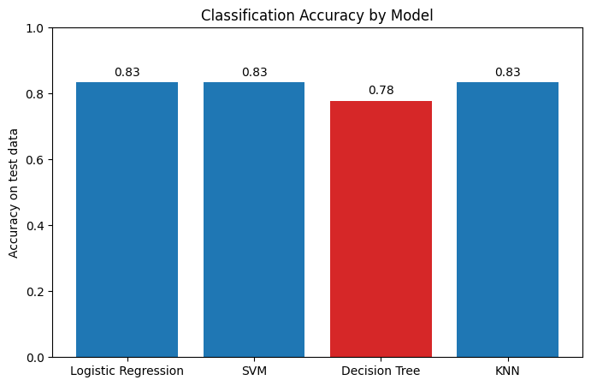
Classification Accuracy
Four classification models were built and tuned with GridSearchCV (10-fold cross-validation): Logistic Regression, SVM, Decision Tree and KNN.
Logistic Regression, SVM and KNN tie for the highest test accuracy at 83.3% (15 of 18 test launches correct).
Decision Tree scored lowest at 77.8% (14 of 18), one launch fewer than the others.
The test set contains only 18 launches, so a single launch changes accuracy by about 5.5 percentage points. The differences between models are not large enough to be conclusive.
Answer: Logistic Regression, SVM and KNN share the highest accuracy. Logistic Regression is reported as the best model because it ties for the top score and is the simplest and easiest to interpret.

Slide 44
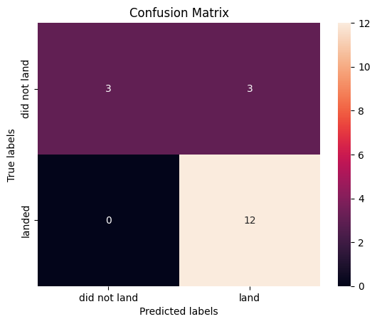
Confusion Matrix
Confusion Matrix: Logistic Regression
The confusion matrix is for Logistic Regression, which ties for the highest test accuracy (83.3%, 15 of 18 launches correct).
12 true positives: successful landings that the model predicted correctly. It did not miss a single real success (0 false negatives).
3 true negatives: failed landings that the model correctly predicted would fail.
3 false positives: launches that failed but were predicted to land. This is the model’s main weakness.
The model is slightly over-optimistic. It rarely misses a real success, but sometimes predicts a landing that does not happen.

Slide 45
Conclusions
Landing success depends on payload and booster version. The dashboard showed the highest success rate at mid-range payloads (about 2,500-4,000 kg) and a sharp drop above about 5,500 kg.
Newer boosters (FT, B4, B5) account for nearly all successful landings. The older v1.0 and v1.1 boosters mostly failed.
Four classification models were tested: Logistic Regression, SVM, KNN and Decision Tree, each tuned with GridSearchCV and 10-fold cross-validation.
Logistic Regression, SVM and KNN tie for the best test accuracy at 83.3% (15 of 18 launches). The Decision Tree is lowest at 77.8%.
Logistic Regression is the selected model. It predicted every successful landing correctly (12 of 12) but wrongly predicted 3 failed landings as successes.
Practical value: predicting whether the first stage will land helps estimate launch cost, which a competing company could use when bidding against SpaceX.
Limitation and next step: only 90 launches are available, with 18 in the test set. More launch data would give a more reliable comparison between models.

Slide 46
Appendix
GitHub repository: https://github.com/anatesan-01/Data-Science-Capstone--IBM
Notebooks and code (all in the repository):
  Data collection (SpaceX API): jupyter-labs-spacex-data-collection-api-v2.ipynb
  Data wrangling: labs-jupyter-spacex-Data wrangling-v2.ipynb
  EDA with data visualization: jupyter-labs-eda-dataviz-v2.ipynb
  EDA with SQL: jupyter-labs-eda-sql-coursera_sqllite.ipynb
  Folium launch-site map: lab-jupyter-launch-site-location-v2.ipynb
  Plotly Dash dashboard: spacex_dash_app.py
  Machine learning prediction: SpaceX-Machine-Learning-Prediction-Part-5 notebook
Datasets: dataset_part_2.csv (cleaned launches with the Class label) and dataset_part_3.csv (one-hot encoded features), both from the IBM course data.
SQL queries run (SQLite): unique launch sites, LIKE 'CCA%', total and average payload, first ground-pad landing, drone-ship landings between 4,000 and 6,000 kg, mission outcome counts, maximum payload boosters, 2015 failed drone-ship landings, and landing outcome ranking.

Slide 47


