Slide 1
Are you Happy?
Click to continue

Slide 2
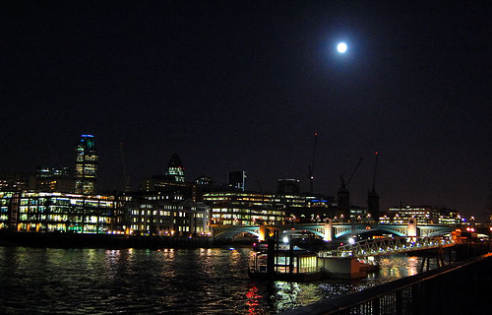
During an elegant welcoming reception
for the new Director of Marketing at an
important London company, the wives
of the other directors wanted to get acquainted with the
new spouse. With some hesitation, they asked her a question.
“Does your spouse make you happy, truly happy?”

Slide 3
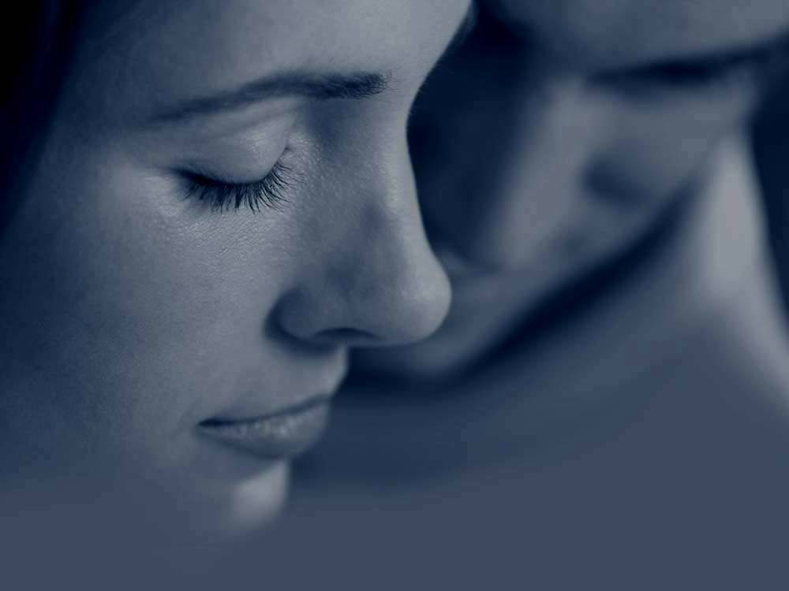
The husband was not at her side but was close enough to hear the question. He was paying attention to the conversation, sitting up slightly, feeling secure, even filling his chest lightly in pride, knowing his spouse would answer affirmatively. She had always been there for him during their marriage.
Nevertheless, to both his and the others’ surprise, she replied simply,
“No, no he doesn’t make me happy.”

Slide 4

The room became uncomfortably silent, as if everyone were listening to the spouse’s response.
The husband was petrified.
He couldn’t believe what his wife was saying,
especially at such an important occasion for him.
To the amazement of her husband and everyone else, she simply enigmatically placed on her head an elegant black silk scarf and continued:
“No, he doesn’t make me happy… I AM HAPPY.
The fact that I am happy or not,
doesn’t depend on him, but on me.”

Slide 5

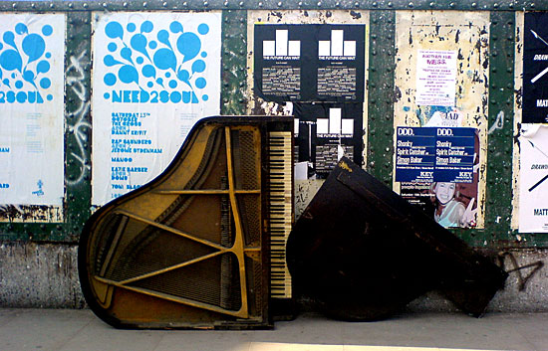
“I am the only person upon which my happiness depends.
I make the choice to be happy in each situation and in each moment of my life.
If my happiness were to depend on other people, on other things or circumstances on the face of this earth, I would be in serious trouble!”
“Everything which exists in this life continually changes:
humans, wealth, my body, the climate, pleasures, etc.
I could enumerate an infinite list.”

Slide 6
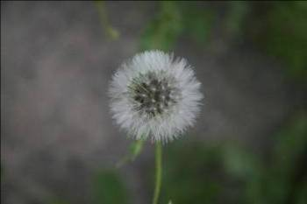
“Over my life I have learned a couple of things:
I decide to be happy and the rest is a matter of
‘experiences or circumstances;’
like helping, understanding,
accepting, listening, or consoling.
I have lived and practiced this
many times with my spouse.”
“Happiness will always be found in
forgiveness and in loving yourself as well as others.”
“It’s not the responsibility of my spouse to make me happy. He also has his ‘experiences or circumstances.’ I love him and he loves me, often in spite of his circumstances and of mine.”

Slide 7

“He changes, I change, the environment changes, everything changes.
Changes can be big or little but they always happen.
Have forgiveness and true love while observing these changes.
We must face them with the love that exists in each one of us.
If the two of us love and forgive each other,
the changes will only be ‘experiences or circumstances’
that enrich us and give us strength.
Otherwise, we would only be “living together.”

Slide 8
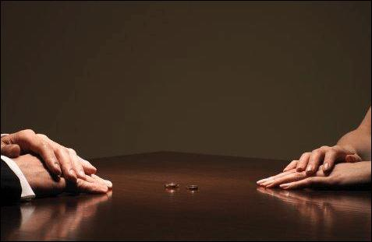
“For some, divorce is the only solution.
In reality it is the easiest.”
“To truly love is difficult.
It is to forgive unconditionally, to live,
to take the ‘experiences or circumstances’ as they are,
facing them together and being happy with conviction.”

Slide 9
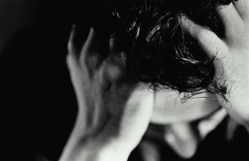
“There are those who say I cannot be happy:
because I am sick,
because I have no money,
because it’s too cold, because they insulted me,
because someone stopped loving me,
because someone didn’t appreciate me!’”

Slide 10
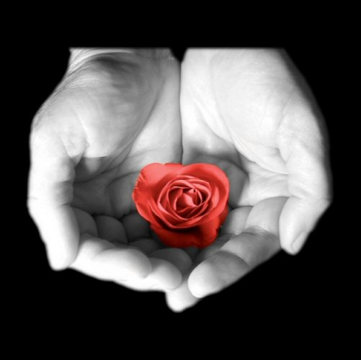
“But what you don’t know is that you can be happy even though you are sick,
it is too hot, you have money or not,
whether someone has insulted you,
someone didn’t love you, or hasn’t valued you.”
“BEING HAPPY
is an attitude about life and each one of us must decide!”
“BEING HAPPY,
depends on you!”

Slide 11
F I N
Diseño original y galería de fotos de libre acceso en internet
Cortesía de Carlos Rangel
Santiago de Querétaro, Mex. Dic. 2007
Carlitosrangel@hotmail.com
Translated into English by
Paul Cushman
gocush@comcast.net

