Slide 1


Service Excellence Through Employee Engagement A Systematic Approach
Ryan Magnon Vice President, Quality The West Paces Hotel Group

Slide 2
The number one responsibility of a leader is to enable their people to achieve excellence.
To do that…the environment, people, and processes must be set up for success!
YOUR PEOPLE ARE A VALUABLE RESOURCE –
MAXIMIZE THEIR POTENTIAL!

Slide 3
Today’s Topics
About The West Paces Hotel Group
The Fundamentals for Excellent Service
Creating a System of Performance Excellence
Results and Recommendations

Slide 4
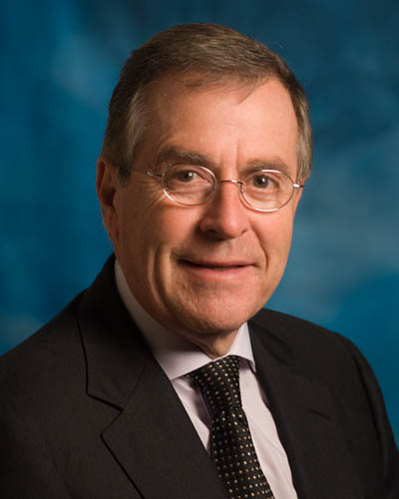
About The West Paces Hotel Group
Horst Schulze, Chairman and CEO
Founded company in 2002 after retiring from Ritz-Carlton.
Same executive team that served at Ritz Carlton 1980’s-1990’s
Two-time Baldrige National Quality Award Winner (92, 99)
Quality Awards 2009 Juran Quality Medal 1999 Baldrige National Quality 1995 Ishikawa Quality Medal 1992 Baldrige National Quality

Slide 5
About The West Paces Hotel Group
Capella Hotels and Resorts - 6
Solis Hotels and Resorts - 2
Independent Hotels and Resorts – 5
West Paces Consulting

Slide 6
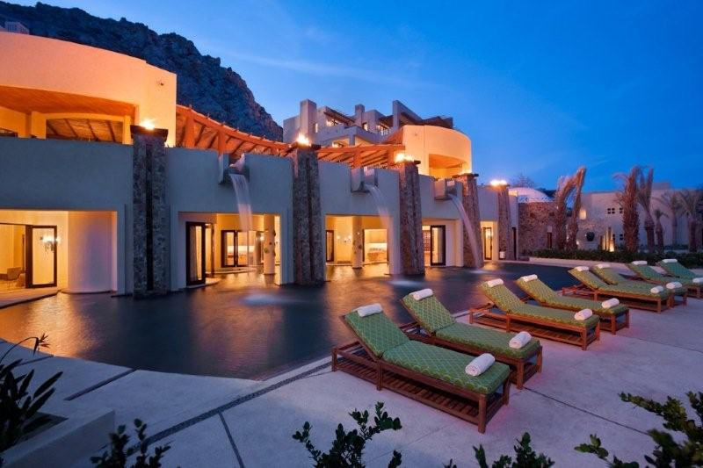
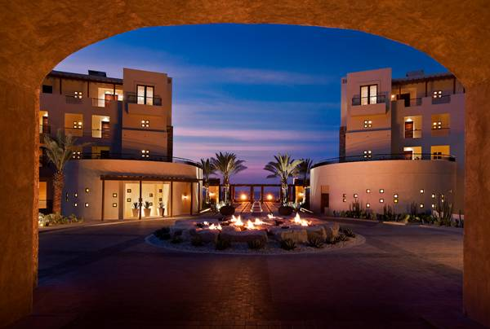
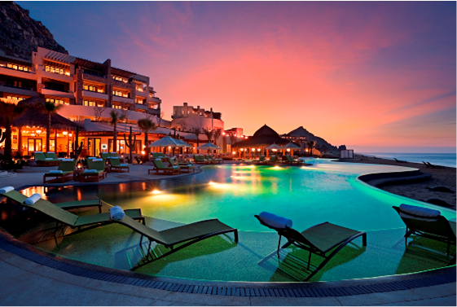

Capella Hotels and Resorts - Cabo Mexico

Slide 7
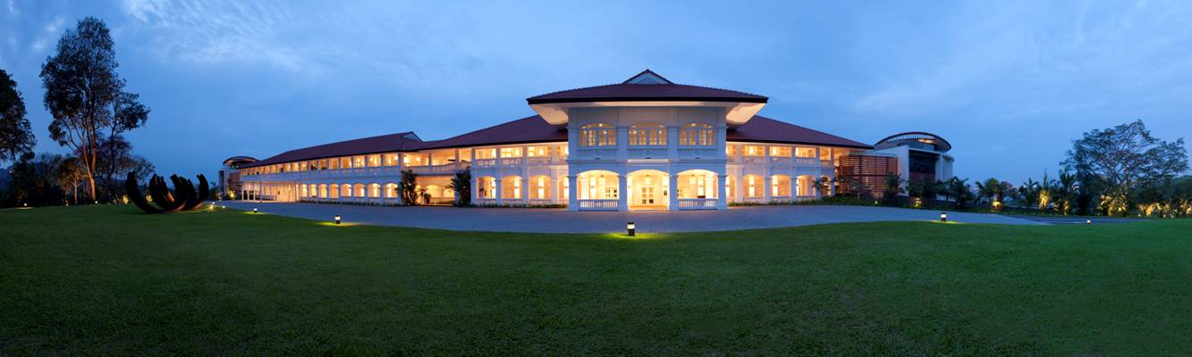
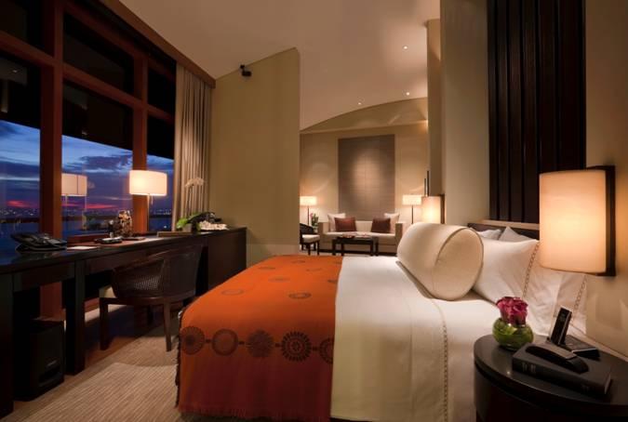
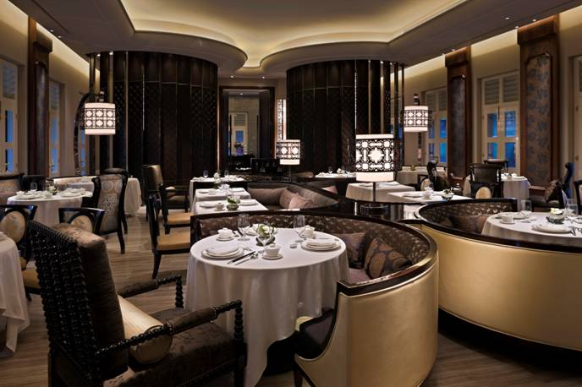
Capella Hotels and Resorts - Singapore

Slide 8
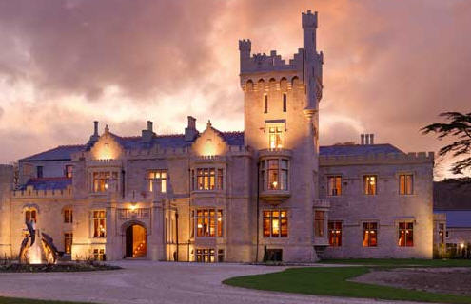

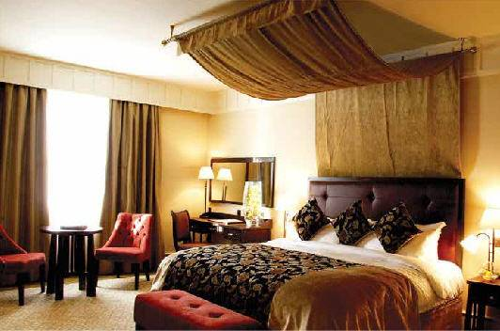
Solis Hotels and Resorts - Ireland

Slide 9
A Framework for Service Excellence
Our Canon Card Who we are, what we do, and why we do it
Zeitgeist “Spirit of the Moment” – how customers want service delivered TODAY
24 Service and Performance Excellence Standards Behavioral Standards and Quality Lessons
Service Process 3-step approach to every customer interaction

Slide 10
Definitions
Employee Engagement When employees have choices and they choose to do things on their own which are in the best interest of the customer and the organization.
Quality Management A business management approach which when implemented effectively results in fewer defects, more efficient processes, and service or product that meets customer expectations.
Reliability The degree to which something is consistent, can be relied on or trusted.
Customer Loyalty The degree to which customers are so enthralled by the product or service “experiences” delivered by an organization that they return continuously and recommend the business to those around them. These are also called “Promoters.”

Slide 11
Key Theme
In order to create loyal customers you must first focus on creating engaged employees. Only then will you be set up to produce world-class results.

Slide 12
The Fundamentals of Service Excellence
Culture – What kind of company are you?
Selection – Do you select your employees wisely?
Quality – Do you have active quality in processes?
To Bake a Great Cake You Need:
Environment, Ingredients, Process - All Three!

Slide 13
Unhappy Employees Produce Unhappy Customers
A 2008 study was conducted of 5,000 American workers:
Overall satisfaction with their work experience is only 45% positive
1987 results were 61% positively satisfied with their work experience
Only 51% now find their jobs “interesting”
In 1987, 70% found their jobs interesting.
Satisfaction
Engagement
Source: Conference Board Research Group
Associated Press Article Jan 5 2010

Slide 14
Daniel Pink - “Drive”
“It’s the intrinsic motivators - what someone naturally wants to do because of their own internal drivers – that proved to be lasting and more impactful on organizational results.
Source: Conference Board Research Group
Associated Press Article Jan 5 2010

Slide 15

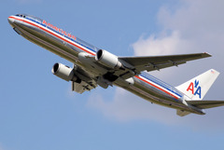
The Airport Experience
Ever felt this way as a customer?

Slide 16
Service Excellence
The Fundamentals

Slide 17
The Fundamentals of Service Excellence - Selection
We use Quality Selection Process based on formula:
(Talent + Fit) x Investment = Growth
Ten employees interviewed to get one hire – the right one!
Employees know their new colleagues are screened as well
80% chance that person will be successful in their role

Slide 18
The Interview
Typical Interview vs Talent-Based
How do you know for sure?
First Impressions, while important, can be misleading
KNOW your candidate from the inside out

Slide 19
The Fundamentals of Service Excellence - Orientation
Employees go through 1-day orientation before working
Connects employees to our vision, mission, values
Opportunity to ask questions
Opportunity to leave!

Slide 20
The Fundamentals of Service Excellence - Training
Three key areas of training:
Technical – Caring - Quality

Slide 21
The Fundamentals of Service Excellence - Training
Training is based on performance “gates” – not time
No one works the floor alone until they pass all their gates
Training continues on via personalized development plans
Tell – Show – Do – Review Methodology
Weekly training is built into every dept schedule

Slide 22
The Fundamentals of Service Excellence - Lineups
Every hotel, every department, every shift
15 minutes to get re-charged, re-connected
Service Standard, Q Standard, Operational Details, WOW stories, Problem Resolution Recovery Stories
Vital to our success!

Slide 23
The Fundamentals of Service Excellence Empowerment
Employees have to BELIEVE they are empowered
Employees don’t call a manager
No spending limit on their decisions
Provided with training on how to handle situations
Problem Resolution and Service Recovery Training

Slide 24
Story of “The Foreman”
“I just feel important here”

Slide 25
Service Excellence
A System to Improve Performance

Slide 26
The Critical Pieces of our Quality System
STRATEGIC PLANNING
DEPT DEFECT ELIMINATION
PROBLEM RESOLUTION & SERVICE RECOVERY
TIGER TEAMS
LINEUPS
FEEDBACK and ALERTS
DEFECT AND GUEST PREFERENCE REPORTS
BALDRIGE QUALITY CRITERIA

Slide 27
Our System of Performance Excellence
It starts with our people
Goal: Create an environment which inspires employees to WANT to do it, and select those who are capable of doing it
Give them the training and support they need for excellence
Give them the data they need to assess their performance
Involve them in improvement teams/efforts

Slide 28
Our System of Performance Excellence – Defects
All employees report defects anytime they see them
Information is shared hotel-wide within hours
Defect reporting is never used as discipline tool
These are viewed as INTERNAL improvement related data

Slide 29
Our System of Performance Excellence – Preferences
Employees gather guest preferences and store them
Preferences are then used to create amazing experiences
All in the effort to create lasting relationships with our guests

Slide 30
Our System of Performance Excellence – Tiger Teams
Employees are involved in formal process improvement teams
6-8 employees cross-functional with one or two leaders
Teams meet for weeks or months and follow process
Tests are piloted in controlled manner
Results are reported

Slide 31
Our System of Performance Excellence – PEP
Develop – Coach – Review - Reward
PEP = Performance Excellence Planning
Tracks top 3 defects in each department for guest
Tracks top 3 defects in each department for employee
Helps leader track training, coaching, development of employees as well as EE sat survey feedback

Slide 32
Our System of Performance Excellence – EE SAT
Employee Satisfaction Feedback System - CultureView
Surveys fielded twice per year
Top drivers of satisfaction identified for each department
Improvement plans are worked over remaining 6 months
Goal: Tie Selection – Satisfaction – Performance together

Slide 33
Our System of Performance Excellence – Guest SAT
Guest Satisfaction Feedback System
Guests Surveyed 24 hours after departure via email
Results available online
“Guest Alerts” triggered for any scores below a 7
GM must follow up with phone call within 24 hours

Slide 34
Critical Elements to Evaluate in Your Organization
Create a culture of excellence!
Select scientifically
Orient them well
Train them intensely
Empower them so that they believe it!
6. Measure performance in relation to requirements – keep score!
7. Listen closely and respond quickly to feedback
8. Improve using Quality
Document lessons learned
Bake it into training

Slide 35
2010 Employee Engagement Results
2010 Overall Satisfaction
% Top Box: 5 on a 5-point scale (Strongly Agree) = 55%
% Positive: 4 and 5 on 5-point scale (Agree and Strongly Agree) = 92%

Slide 36
Capella Hotels and Resorts - Customer Results
Capella 2010: 85% Top Box (9&10)
Overall Satisfaction Mean Score = 93%

Slide 37
West Paces Hotel Group – Story of “Dana”
The impact of one employee…
DO YOUR EMPLOYEES THINK THIS WAY?

Slide 38
What Are Your Customers Saying?
“We were welcomed back by the Hotel Manager and staff and they even remembered to ask if I needed them to increase the temperature of our plunge pool since I had requested that on our previous visit in March. Overall, the staff exceed in service and the resort appears to hire only the best. I can honestly rave about the pool side service, maid service, wait staff at their excellent restaurants, room service staff and front desk.”
What our guests are saying:
“Every day when I woke up I looked forward to my walk across the property hoping to run across one of the delightful staff members who treated me like family. Your staff IS the experience.”
“Laura always takes such good care of us! We come to Auburn often. Laura is always very accommodating to our needs and makes sure that we are VERY well taken care of. She is a GREAT asset to the Hotel. Thank you!”
“Jose Luis, Arturo, Pablo, Marisol, Esteban, Alfonso, Eddie, and others One additional note...the owner took time to speak with both my wife and I on our honeymoon, ask us how we were doing, and the like, and my wife and I were taken aback about how much the staff, and even the owner, care about Capella's guests. A honeymoon to remember, no doubt.”

Slide 39
Service Excellence Through Employee Engagement A Systematic Approach QUESTIONS?
Ryan Magnon Vice President, Quality The West Paces Hotel Group

