Slide 1
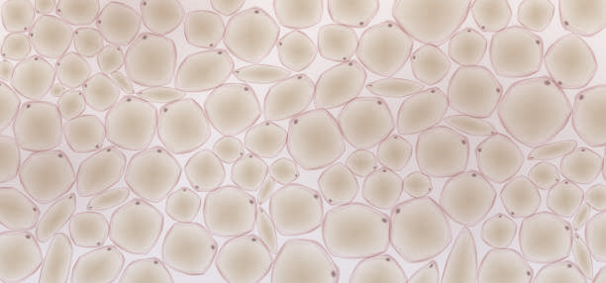
Dichroic mirror
Sensor
SLM 2
Galvo
Brain
SLM 1
Incoming laser beam
laser

