Slide 1
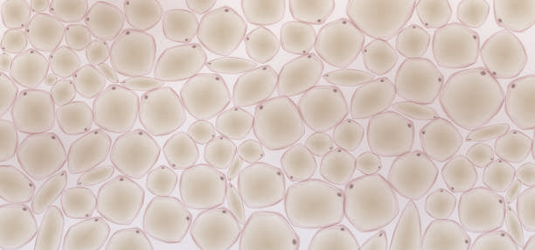
Galvo
SLM 2
SLM 1
Tissue
Dichroic mirror
Detector
SLM 3
(interferometer)
Incoming laser

