Slide 1
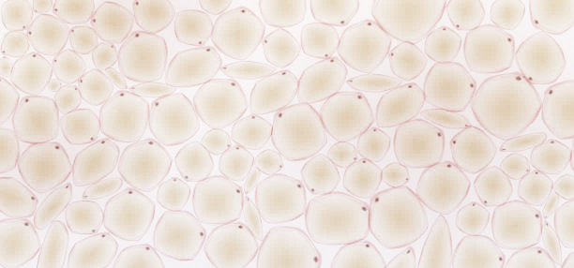







$$z_{o}$$
$$z_{o}$$
$$DOF$$
Focal plane
$$DOF$$
$$ζ$$
$$ζ$$
SLM plane
$d(ζ$)
Galvo plane
$d(ζ$)
(a) Dense correction - small DOF
(b) Sparse correction - large DOF

