Slide 1
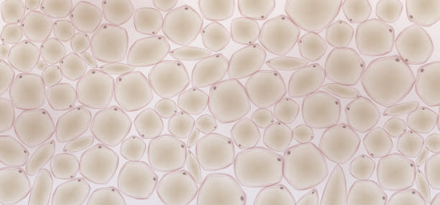
Dichroic mirror
Sensor
SLM 2
Galvo
Tissue
SLM 1
Incoming laser

