Slide 1
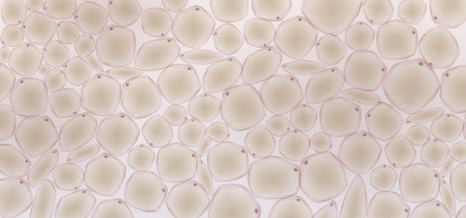
Entrance path
Mirror
Bounce 2
Bounce 3
Bounce 4
Exit Bounce
Path to sensor
Tube lens
Objective
Exit mirror
Entrance mirror
SLM
Sensor
Tissue
(a)

