Slide 1
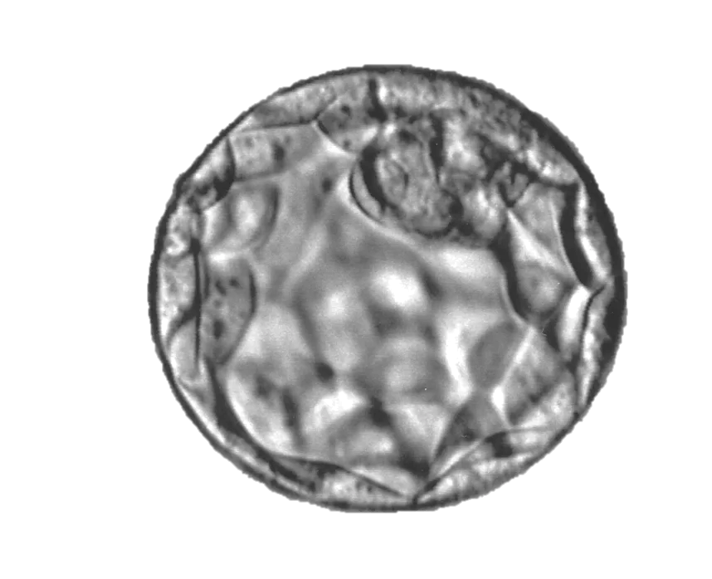
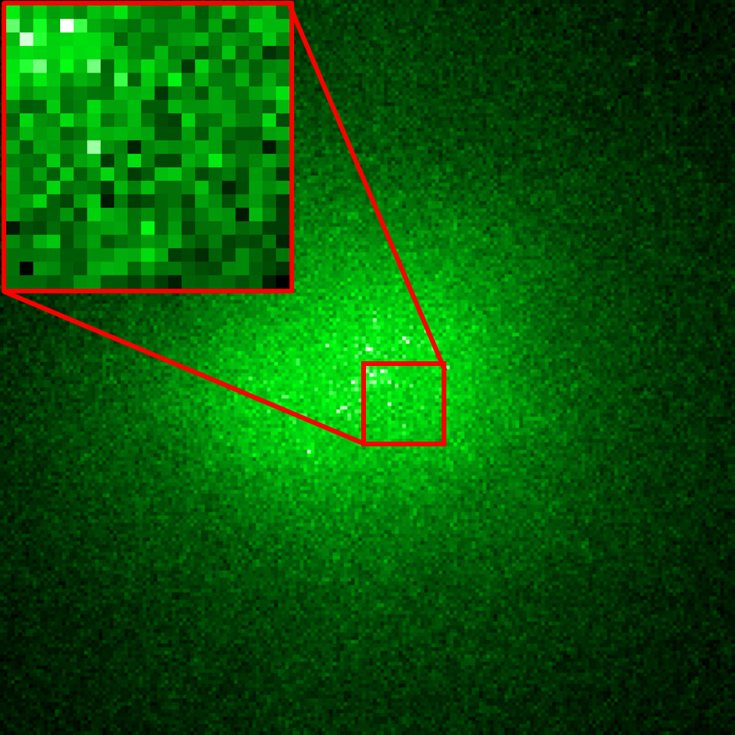
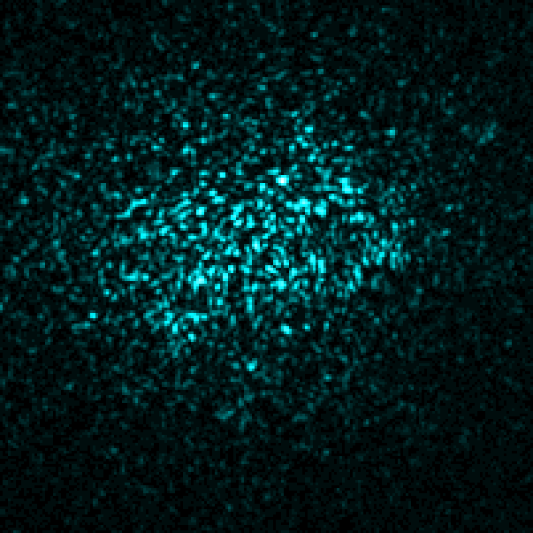
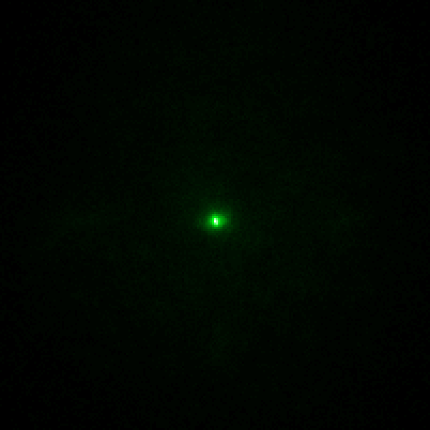
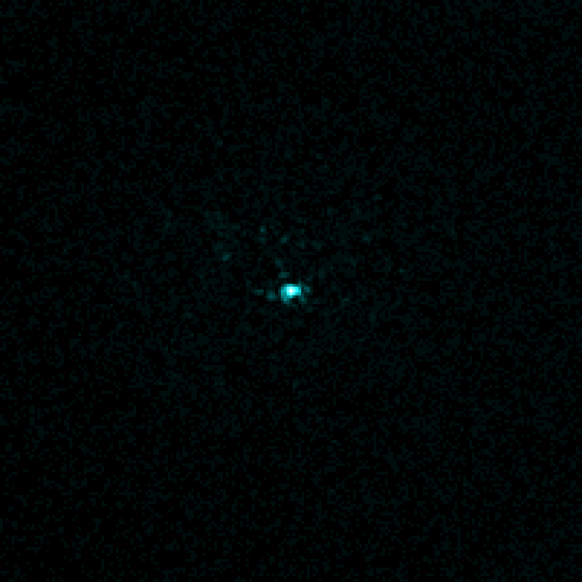
Dichroic filter
Galvo tilt
Beam splitter
Front laser
SLM
sample
Emission
Excitation
unmodulated
unmodulated
Front sensor
Back sensor
modulated
modulated

