Slide 1
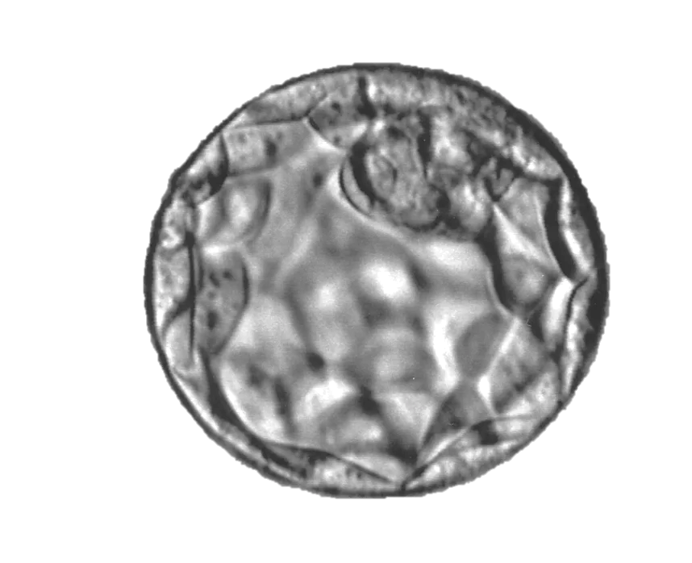
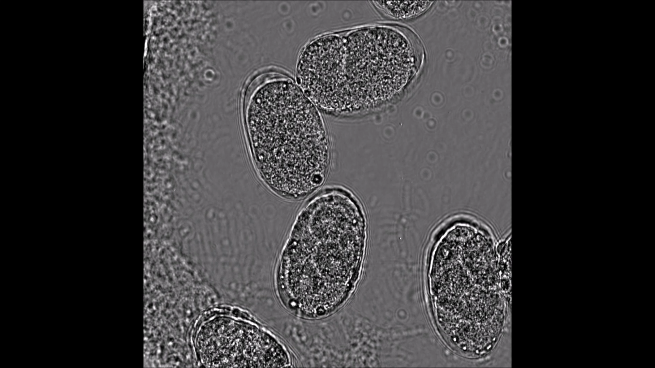
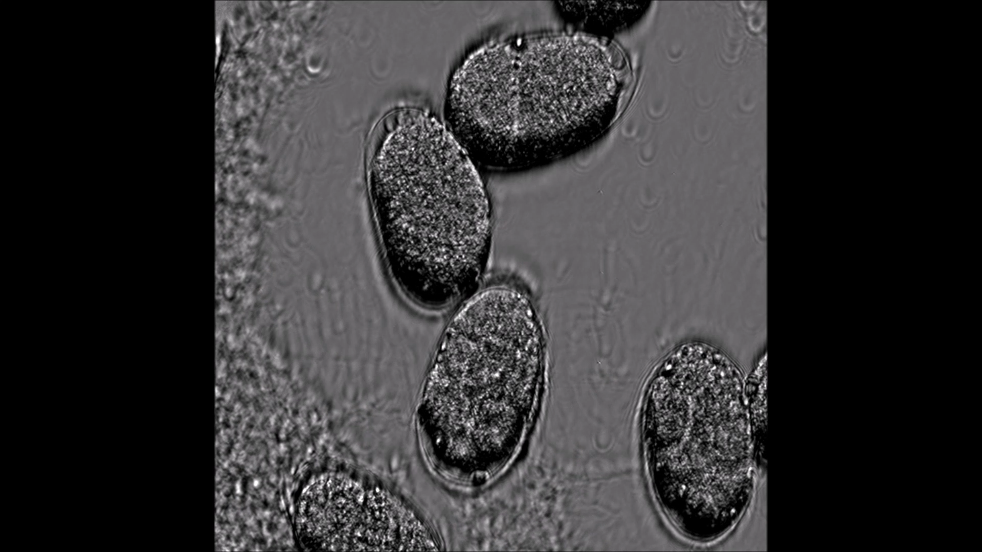
Dichroic filter
Beam splitter
Galvo tilt
Front laser
SLM
sample
Back laser
Front sensor
Back sensor

