Slide 1
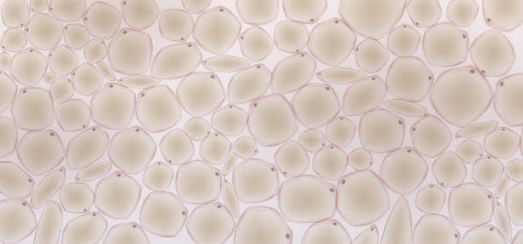






(a)
Tissue
(c)
Order preserving
Order reverting
Order preserving
T-mat error
1
3
5
7
Detector
SLM 3
SLM 1
$$p_{3}$$
$$p_{2}$$
$$p_{1}$$
Layers number
SLM 2
Tissue
(b)
Order reverting
Detector
SLM 1
SLM 2
SLM 3
$$p_{3}$$
$$p_{2}$$
$$p_{1}$$

