Slide 1
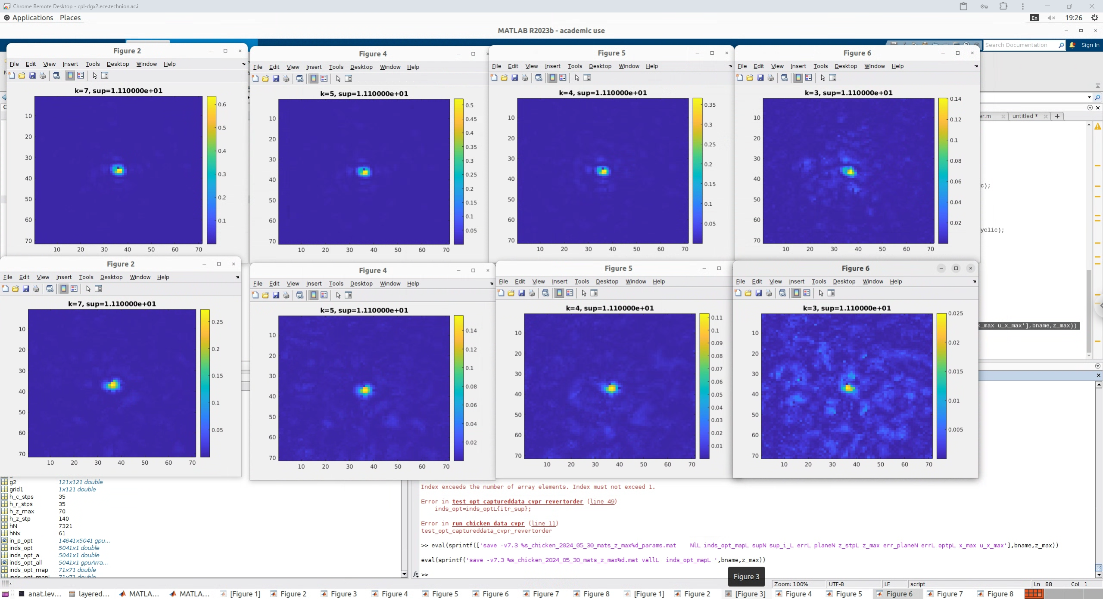
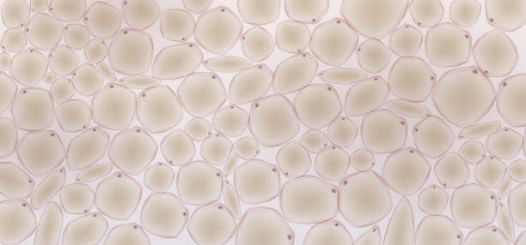






(a)
Tissue
(c)
(d)
Order preserving
Order reverting
3 layers
Order preserving
0.14
0.02
T-mat error
5 layers
1
3
5
7
0.5
0.15
Detector
SLM 3
SLM 1
$$p_{3}$$
$$p_{2}$$
$$p_{1}$$
Layers number
SLM 2
Tissue
(b)
Order reverting
Detector
SLM 1
SLM 2
SLM 3
$$p_{3}$$
$$p_{2}$$
$$p_{1}$$

