Slide 1
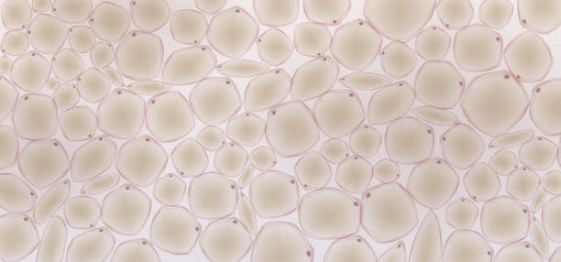







Entrance
Bounce 1
Bounce 2
Bounce 3
Bounce 4
Bounce 5
Exit
$$p_{5}$$
$$p_{4}$$
$$p_{3}$$
$$p_{2}$$
$$p_{1}$$
Exit mirror
Entrance mirror
50$μm$
9.6 mm
15.4mm
250$μm$
SLM
Tissue
(b)

