Slide 1
Using CI / CD technology for web application development
Student:
Anatolii Tregub

Slide 2

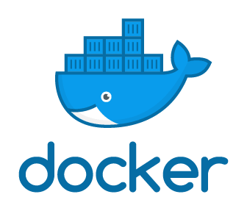




Used tools

Slide 3
Completed steps
1. Install docker.io and docker-compose on the instance .
2. Make jenkins.yml file for installation Jenkins in Docker.
3. Settings Jenkins.
4. Attach repository of GitHub and placed there docker file

Slide 4
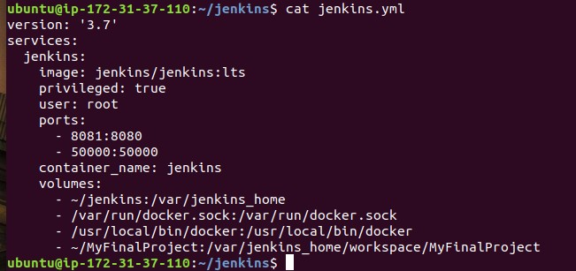
Config compose file

Slide 5
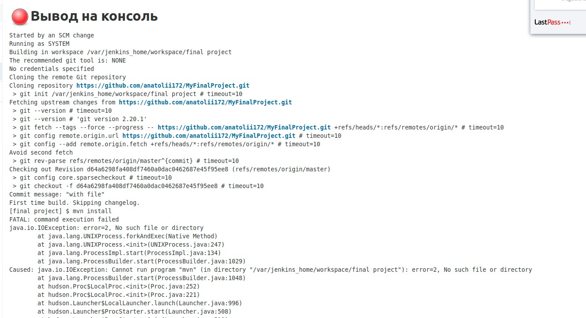
Webhook

Slide 6
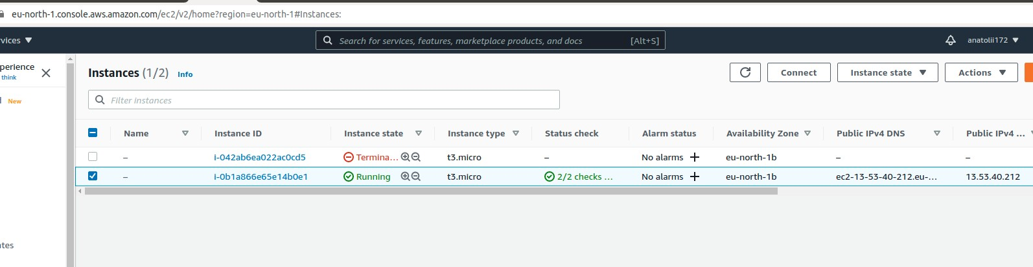
Amazon Web Service

Slide 7
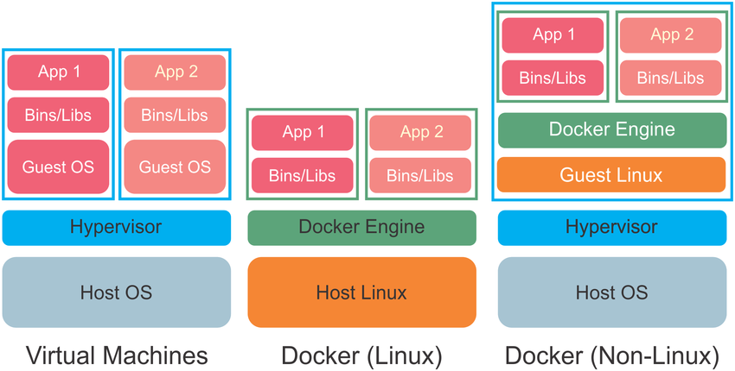
Docker

Slide 8

Result

Slide 9
You have any questions?
Thanks for attention!
Student: Anatolii Tregub
Email: tregubanatolii@gmail.com

