Slide 1
Using CI / CD technology for web application development
Student:
Anatolii Tregub

Slide 2

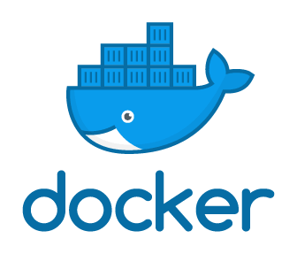

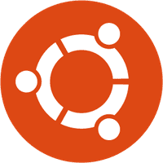
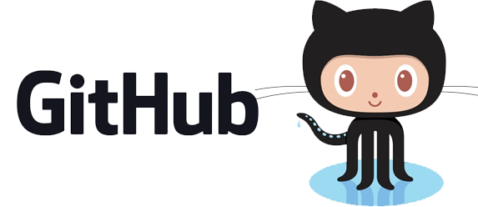
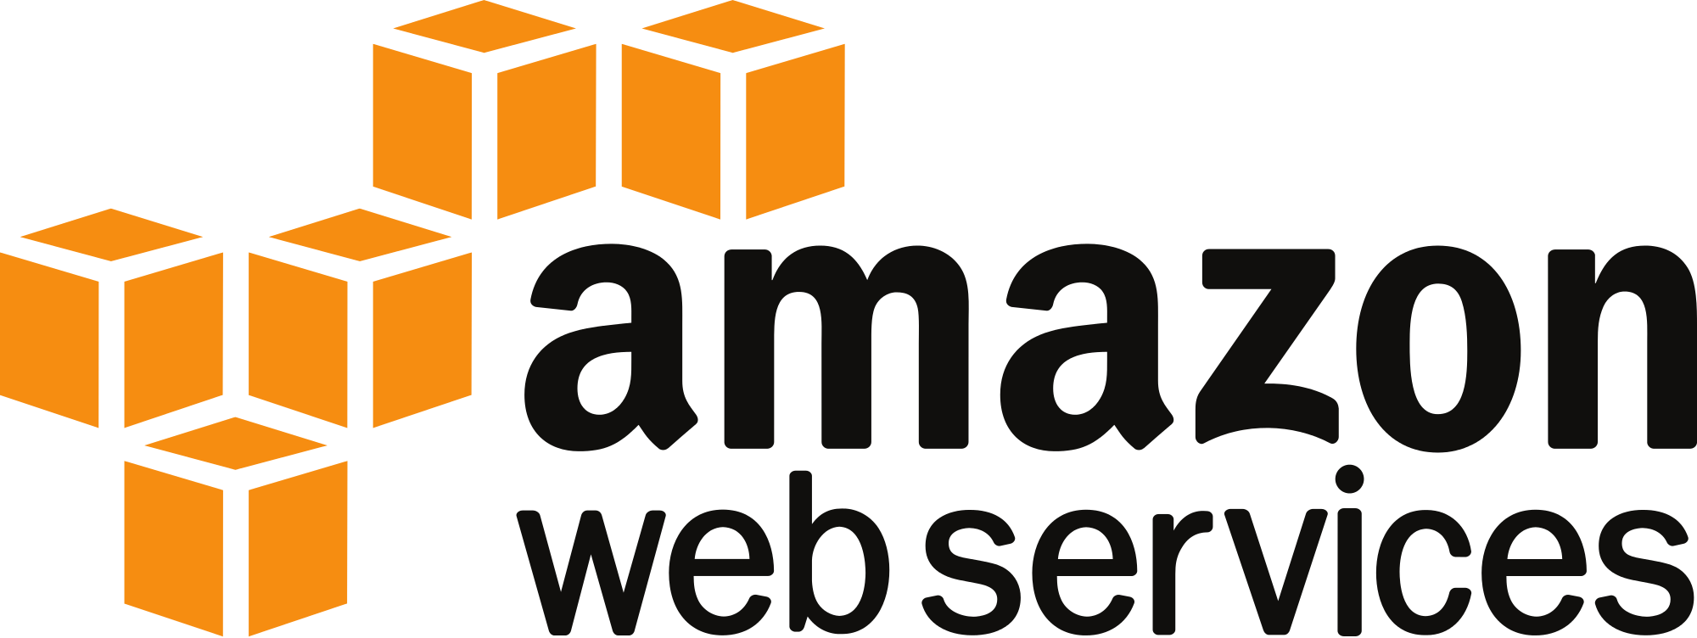
Used tools

Slide 3
Completed steps
1. Install docker.io and docker-compose on the instance .
2. Make jenkins.yml file for installation Jenkins in Docker.
3. Settings Jenkins.
4. Attach repository of GitHub and placed there docker file

Slide 4
Webhook

Slide 5
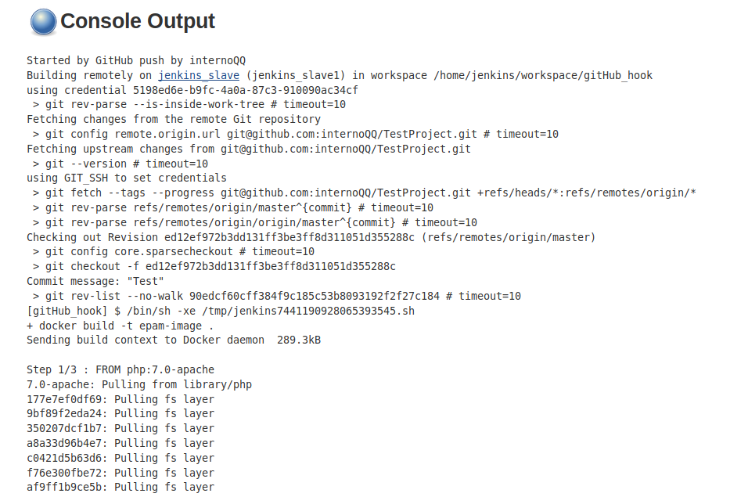
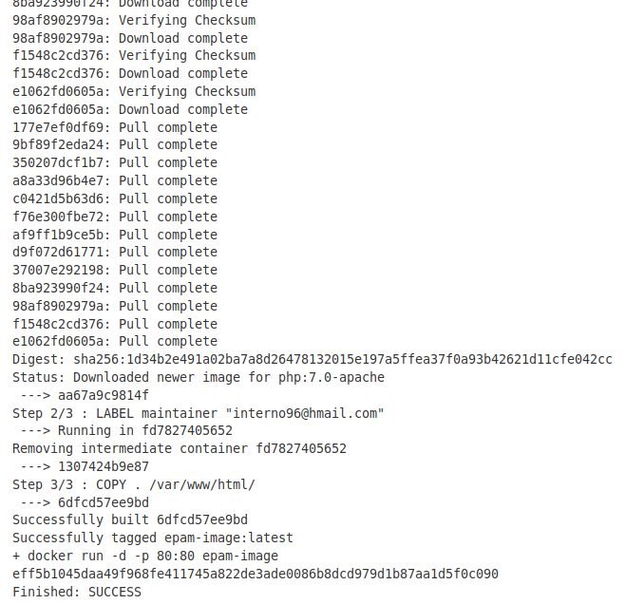
Webhook

Slide 6
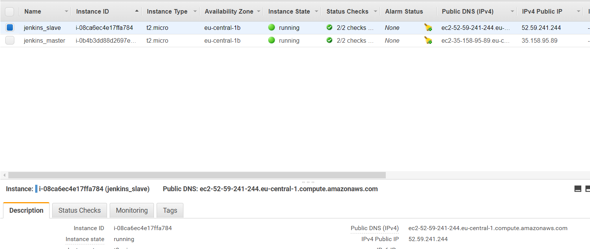
Amazon Web Service

Slide 7
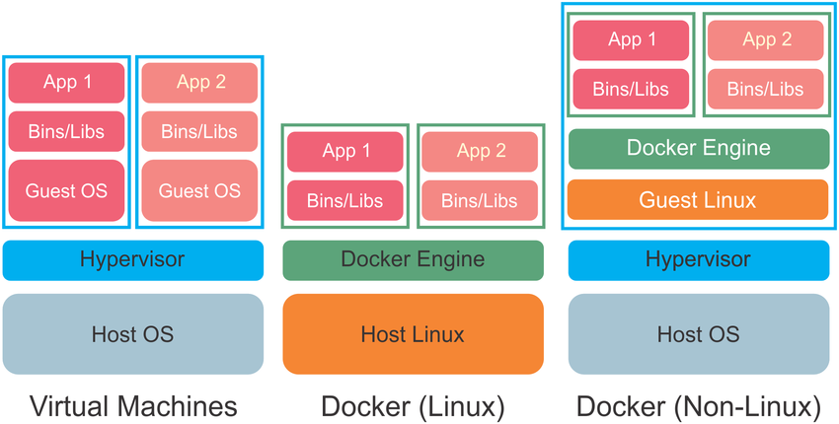
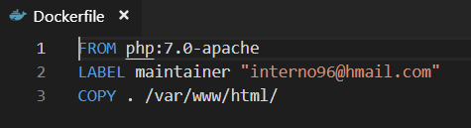
Docker

Slide 8
Terraform (main.tf)
provider "aws" { shared_credentials_file = "~/.aws/credentials" profile = "default" region = "eu-central-1" } data "template_file" "init_jenkins" { template = "${file("${path.module}/template/jenkins.tpl")}" } data "template_file" "init_docker" { template = "${file("${path.module}/template/docker.tpl")}" } resource "aws_instance" "jenkins_master" { ami = "ami-0bdf93799014acdc4" instance_type = "t2.micro" key_name = "virtualBox" user_data = "${data.template_file.init_jenkins.rendered}" security_groups = ["${aws_security_group.sg1.name}"] tags = {Name ="jenkins_master"} } resource "aws_instance" "jenkins_slave" { ami = "ami-0bdf93799014acdc4" instance_type = "t2.micro" key_name = "virtualBox" user_data = "${data.template_file.init_docker.rendered}" security_groups = ["${aws_security_group.sg1.name}"] tags ={Name= "jenkins_slave"} } | resource "aws_security_group" "sg1" { name = "sg_allow_ssh" description = "Allow ssh 22 port" vpc_id = "vpc-87e2e4ec" ingress { # TLS (change to whatever ports you need) from_port = 22 to_port = 22 protocol = "tcp" # Please restrict your ingress to only necessary IPs and ports. # Opening to 0.0.0.0/0 can lead to security vulnerabilities. cidr_blocks = ["0.0.0.0/0"] # add a CIDR block here } egress { from_port = 0 to_port = 0 protocol = "-1" cidr_blocks = ["0.0.0.0/0"] } ingress { from_port = 8080 to_port = 8080 protocol = "tcp" cidr_blocks = ["0.0.0.0/0"] } }

Slide 9
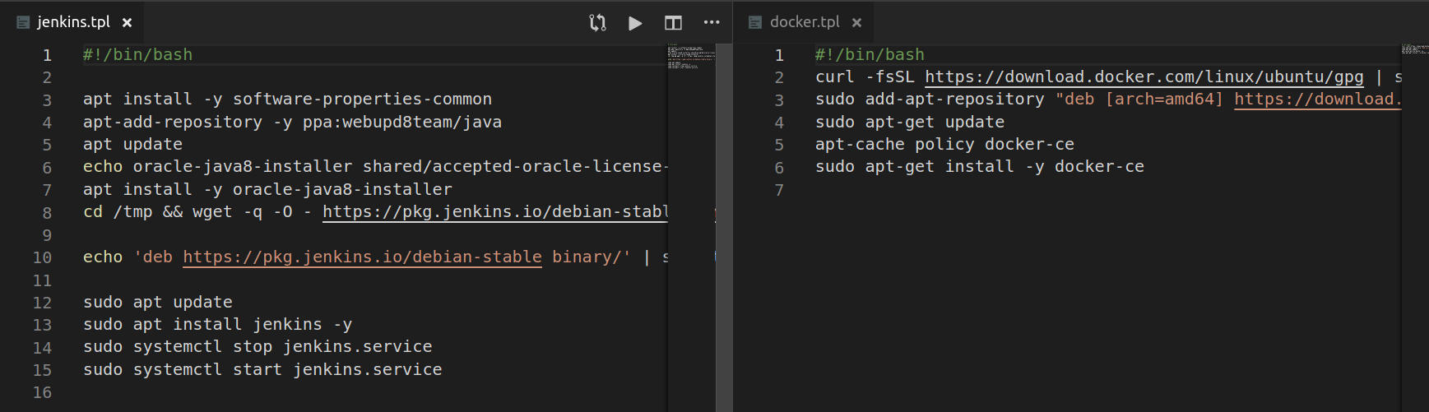
Terraform (template)

Slide 10
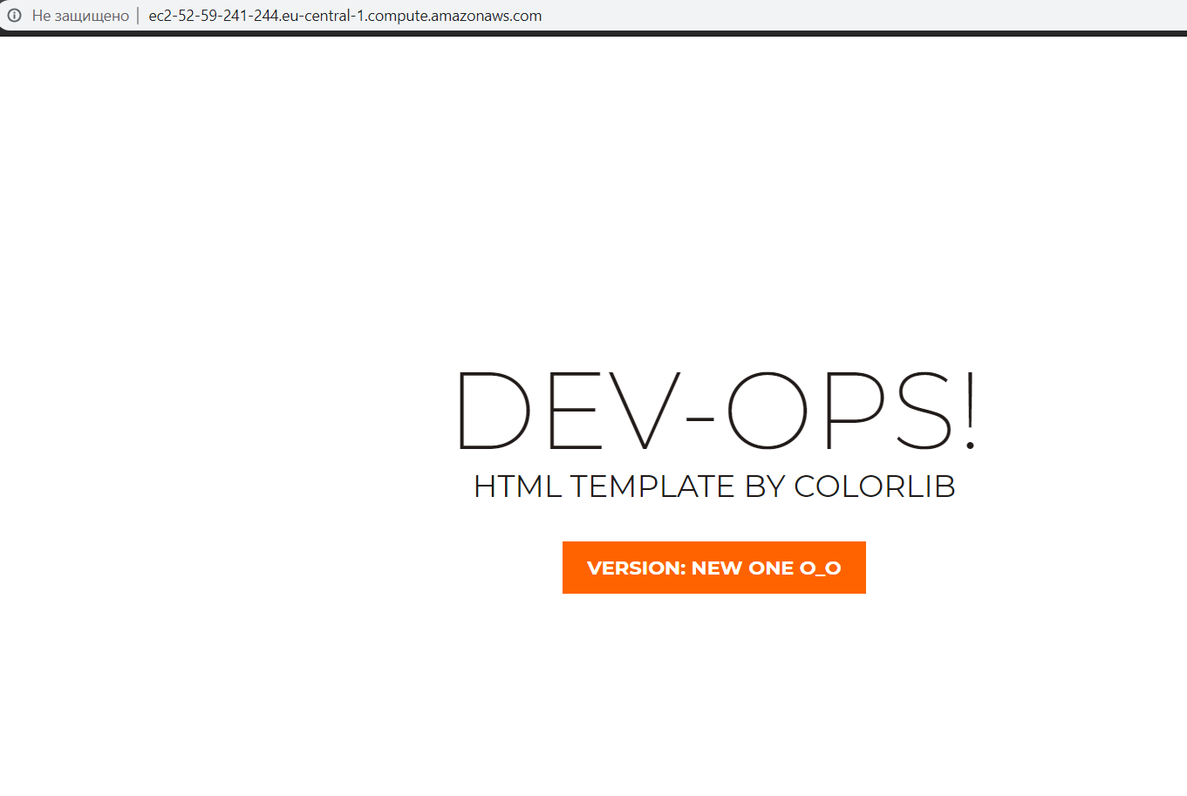
Result

Slide 11
You have any questions?
Thanks for attention!
Student: Voloshin Andrey
Email: interno96@gmail.com

