Slide 1
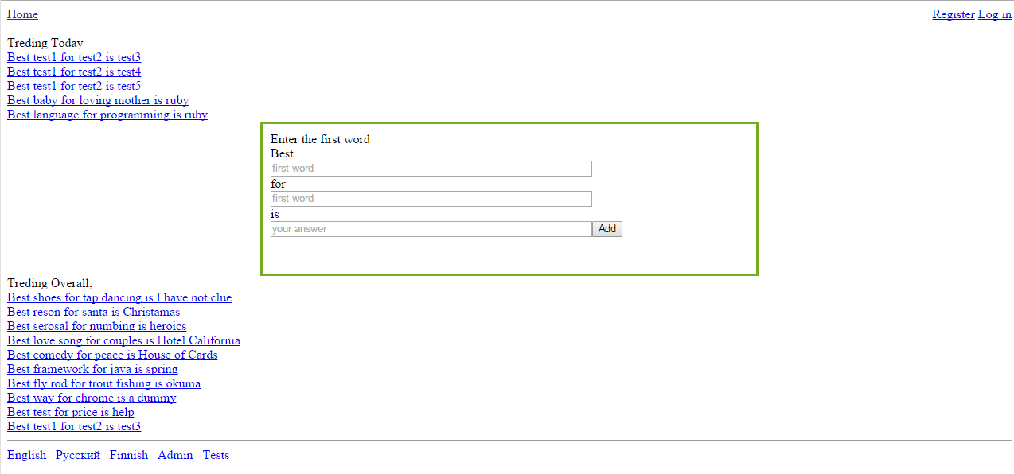
General ideal of the site is products advertising.
User comes to the site feeling like sharing his advice on something with the world.
Example: I think the best fishing rod for trout is okuma MX234 8 foot light
I type “fishing rod” in the first box “trout” in the second box.
Site says “no answers found”
I type “okuma mx12093 blah” -> Add
Answer/opinion is added -> now site has a page that indexes in search engines on the keyword “best fishing rod for trout”.
Site gives ability to add extended description for your answer/opinion
Gives ability to vote for someone else’s answer.
Basic idea is to fill in the content of the site and generate a page/link for each answer that hopefully maps to some product on Amazon.
We will generate link to a product (see slide 4). Link gets indexed in search engines. People come to the page searching on related keywords. Read relevant information on why this product is the best for something
And then go and buy it.

Slide 2
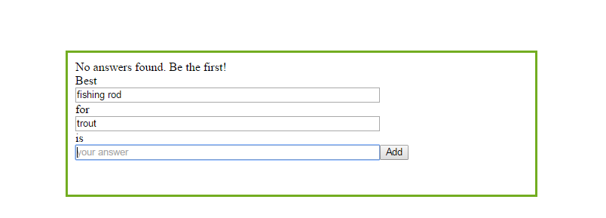

Slide 3
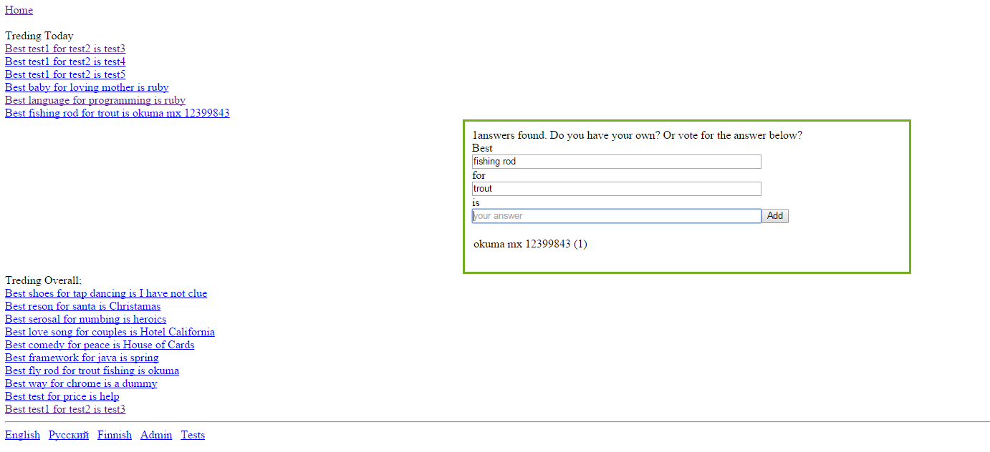

Slide 4
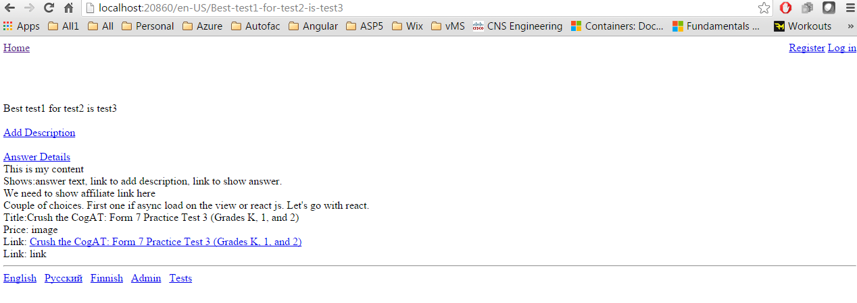
Well indexed link
Page showing answer/opinion, it extended descriptions,
Votes and related products found on amazon
Link to amazon web site where user can buy
Related product.

Slide 5
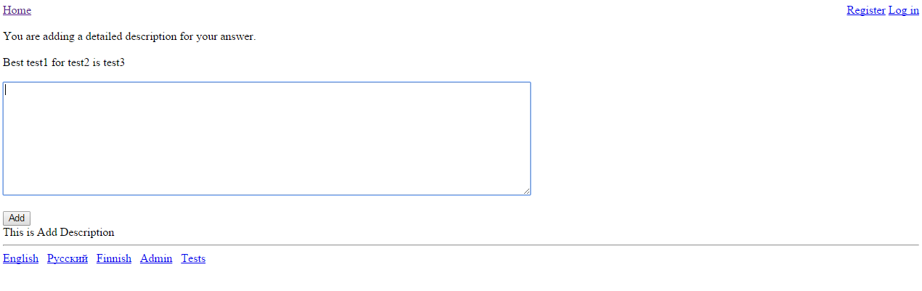
Page where user can add extended reasoning for his answer/opinion.

