Slide 1
Why we need Off Heap memory and how to cook it?

Slide 2
Heap Memory
Tracing garbage collection
Reference counting (used in pooled objects like Netty’s ByteBuff)
Allocate until death (Epsilon GC)

Slide 3
Heap Memory
POJO
(Records are coming
https://openjdk.java.net/jeps/359
but immulable)

Slide 4
Heap Memory
JOL - Java Object Layout
https://openjdk.java.net/projects/code-tools/jol/

Slide 5
Heap Memory
Object Layout
Object header
Fields aligned

Slide 6
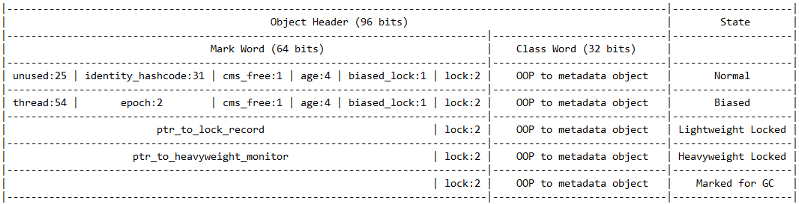
Heap Memory
Object Header
64bit compressed OOPs

Slide 7
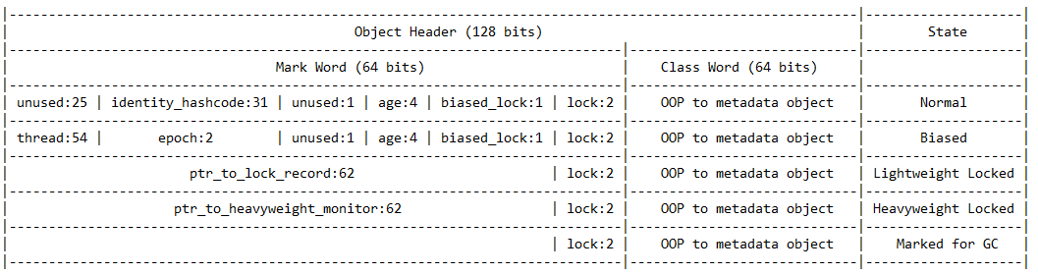
Heap Memory
Object Header
64bit, not compressed OOPs

Slide 8
Heap Memory
Field alignment
Not aligned data:
X86 family – Yes, We Can (not atomically)
ARM - Ooooops

Slide 9
Heap Memory
Heap-related issues:
Memory footprint overhead (direct and indirect (GC structures))
CPU overhead for both allocation and GC, GC pauses/latency
Bad cache locality

Slide 10
Heap Memory
CompressedOops
-XX:+UseCompressedOops enabled by default
https://shipilev.net/jvm/anatomy-quarks/23-compressed-references/

Slide 11
Heap Memory
GC related overhead
GC | Overhead, MB | %
Serial | 7 | 0.3%
Shenandoah | 38 | 1.9%
CMS | 76 | 3.7%
Parallel | 90 | 4.4%
G1 | 166 | 8.1%
Z | 238 | 11.6%
OpenJDK 13, Heap size = 2GB
https://2019.javazone.no/program/f8144167-2595-4e65-97be-45da5d752c09

Slide 12
Off-Heap Memory
DirectByteBuffer/MappedByteBuffer
sun.misc.Unsafe
Custom JNI

Slide 13
Off-Heap Memory
DirectByteBuffer
Pros:
- Standard API for NIO
Cons:
- Not easy to free (Cleaner)
- 2GB limit

Slide 14
Off-Heap Memory
sun.misc.Unsafe
Pros:
- Easy (almost) to use
- No 2GB limitation
- Heap access supported
Cons:
- Internal/not public API
- Malloc’s issues like fragmentation

Slide 15
Off-Heap Memory
Panama Project
https://openjdk.java.net/projects/panama/

Slide 16
Off-Heap Memory
Own JNI
No dependencies on Unfase
Performance penalty

Slide 17
Off-Heap Memory
JNI call cost
Create stack frame
Converting arguments according to ABI
Converting oops to JNI handles (jobject)
Putting addition JNIEnv* and jclass
Lock/release object monitor for synchronized method
Lazy native function linking
Tracing of enter/return into/from the method
Changing thread state from in_Java to in_native and back
Check a safepoint requested
Exception handling

Slide 18
Off-Heap Memory
Secret weapon - JavaCritical
https://bugs.openjdk.java.net/browse/JDK-7013347

Slide 19
Off-Heap Memory
JNIEXPORT jint JNICALL
JavaCritical_compareArrays(jlong address1, jlong address2, jint length) {
return compareWithSIMD(address1, address2, length);
}
Must be static/not synchronized
Primitives and primitive arrays only
Must Not call JNI (no object allocations, no exceptions)
Be as fast as possible (GC blocked)

Slide 20
Off-Heap Memory
Common disadvantage -
no intrinsics available
https://cr.openjdk.java.net/~vlivanov/talks/2017_Vectorization_in_HotSpot_JVM.pdf
Vectorization API in Project Panama

Slide 21
Off-Heap Memory
Async-profiler
https://github.com/jvm-profiling-tools/async-profiler
profiler.sh -d 10 -f ./flamegraph.svg -e mprotect -t $JAVAPID

Slide 22
Off-Heap Memory
Performance testing?
JMH is the answer
https://openjdk.java.net/projects/code-tools/jmh/

