Slide 1
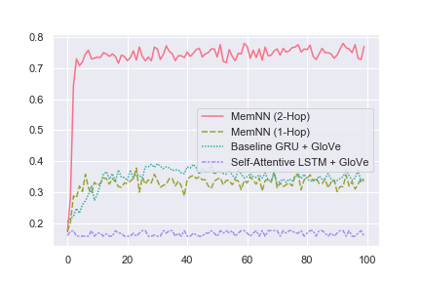


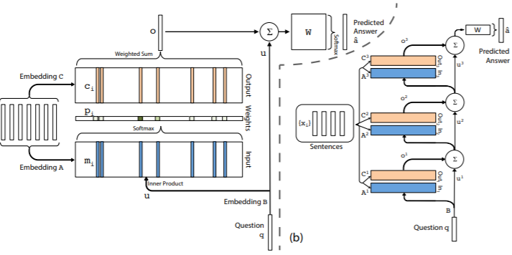

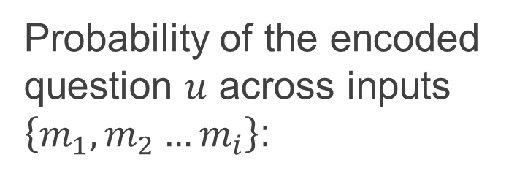
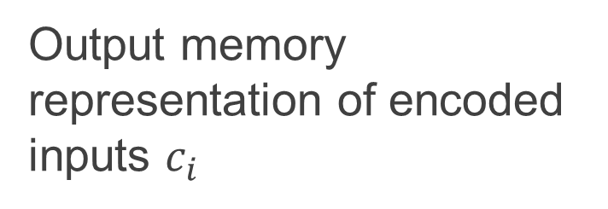
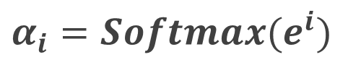
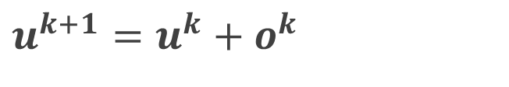
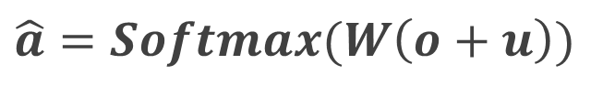
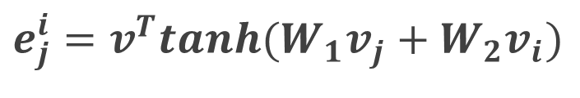
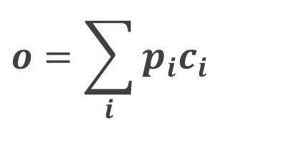
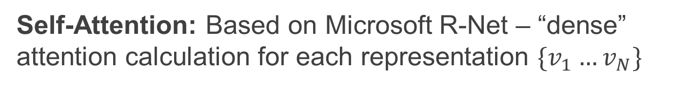
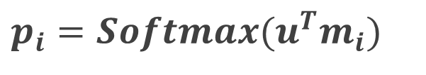
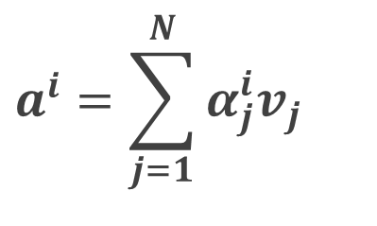
Deep Learning Methods for Reading Comprehension Question Answering
Nick Landy, Anand Natu, Megan Knight
Stanford University
Motivation
Methodology / Model Definition
Results and Analysis
Reading comprehension is a fundamental and multi-faceted problem in AI applied to NLP
Design a deep learning model for context-intelligent question answering, and examine drivers of performance for specific QA tasks
MemNN: A multi-hop memory network replacing the contextual RNN embedding of our baseline with learning from an external-memory representation
1
Probability of the encoded question $u$ across inputs $\left\{m_{1},m_{2}…m_{i}\right\}$:
2
Output memory representation of encoded inputs $c_{i}$
Problem Definition
$$p_{i}=Softmax(u^{T}m_{i})$$
$$o=\sum_{i}{p_{i}c_{i}}$$
QA2 Accuracy (%)
The model reads a passage of text…
…and answers questions about the contents
3
Final prediction and activation:
4
K-stacking of “hops” in the memory network:
$$\hat{a}=Softmax(W\left(o+u\right))$$
$$u^{k+1}=u^{k}+o^{k}$$
Predicted Answer
# Epochs
Passage (Input):
Sandra is in the kitchen. Sandra picked up the football there. Sandra traveled to the hallway. Sandra discarded the football there.
Question (Input):
Where is the football?
Answer (Output):
Hallway
Input Sentences
QA2 accuracies of ~80% reached at convergence with MemNN-2Hop, but single-hop mostly mirrored baseline
RNN vs. external memory exhibit clear pros and cons depending on task (contextual vs. factual intelligence)
QA Challenge | Baseline | LSTM + Self-Attn | MemNN One-Hop | MemNN Two-Hop
QA1 Single Supporting Fact | 42% | 51% | 99% | 99%
QA2 Two Supporting Facts | 33% | 17% | 36% | 75%
QA4 Two Argument Relations | 79% | 70% | 67% | 68%
QA6 Yes/No Questions | 74% | 50% | 50% | 50%
QA7 Counting | 76% | 57% | 80% | 83%
QA8 Lists Sets | 72% | 77% | 86% | 89%
QA9 Simple Negation | 71% | 64% | 90% | 90%
QA10 Indefinite Knowledge | 62% | 44% | 82% | 82%
Dataset and Context
Embedding Layers
Question
Multi-Hop Structure
Dataset: Facebook bAbI
Baseline Model: Attention-based model with pre-trained GloVe word embeddings and bi-directional GRU for context embedding
Evaluation Metrics: Exact Match (EM) accuracy, cross-entropy loss function, Adam optimizer
Self-Attention: Based on Microsoft R-Net – “dense” attention calculation for each representation $\{v_{1}…v_{N}\}$
1
Dot multiplication
2
Activation
$$e_{j}^{i}=v^{T}tanh(W_{1}v_{j}+W_{2}v_{i})$$
$$α_{i}=Softmax(e^{i})$$
Self-attention output
$$a^{i}=\sum_{j=1}^{N}{α_{j}^{i}v_{j}}$$
3

