Slide 1
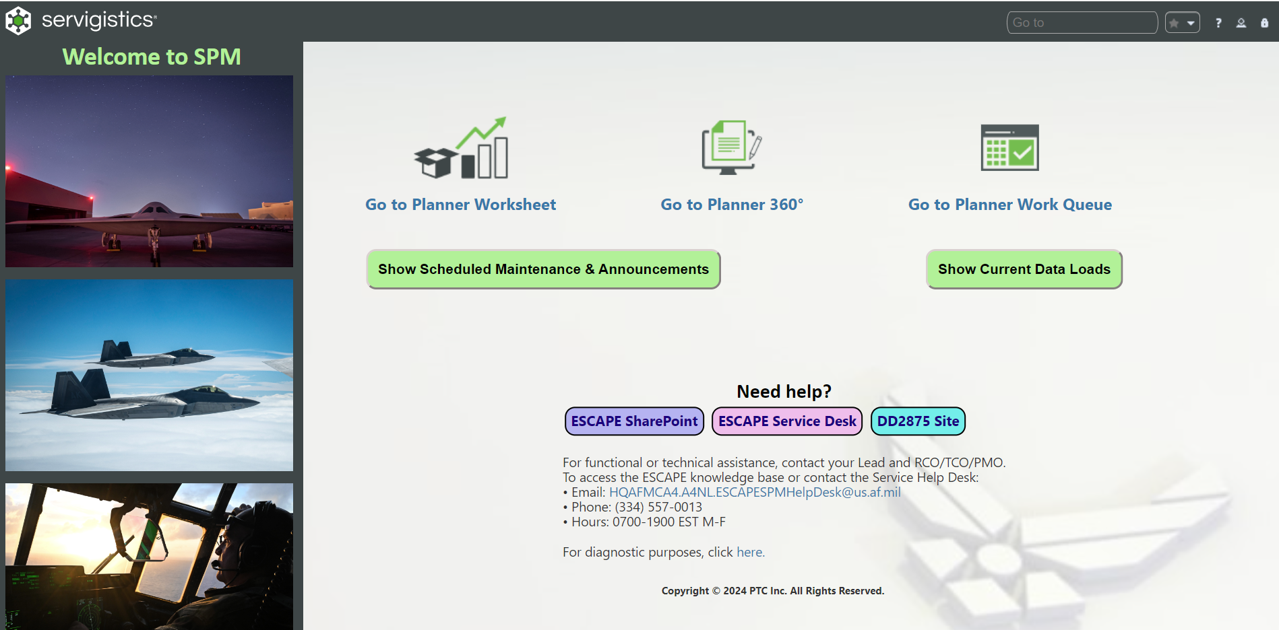
Servigistics SPM Welcome Page
Interactive buttons and removal of Hamburger icon

Slide 2
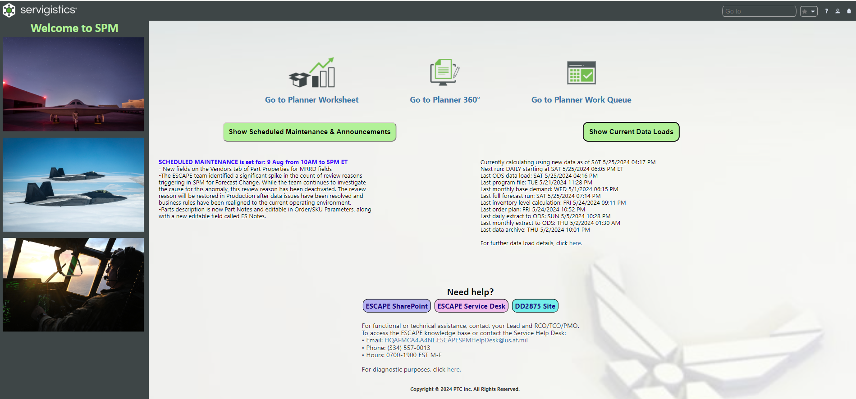
Servigistics SPM Welcome Page (cont.)
Toggles the maintenance and announcements on/off
Toggles the data load details on/off

Slide 3
Servigistics SPM Welcome Page
Your favorites listed here for quick navigation
Redirects to the Planner 360° page
Redirects to the Work Queue page
Redirects to the Planner Worksheet page
Opens Help Desk in new tab
Opens 420th SharePoint in new tab
Opens DD2875 site in new tab
Opens new email to the Help Desk
Opens session properties in new tab

