Slide 1
Advanced A/B Testing
Introduction Elea McDonnell Feit

Slide 2
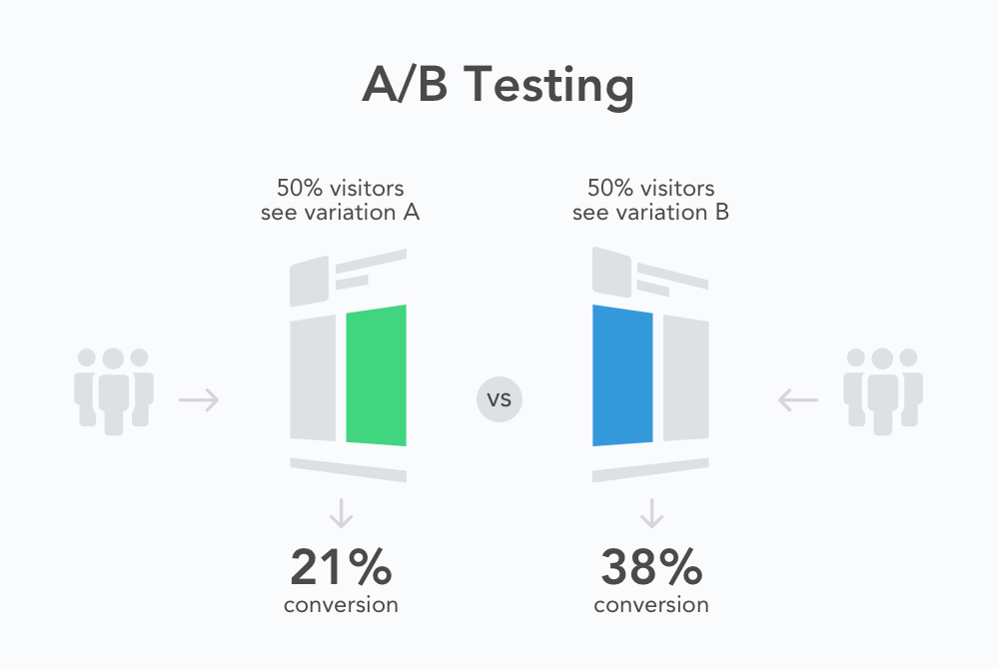

Slide 3
Source: splitmetrics.com

Slide 4
Example A/B test
Randomly assign customers to treatments
Measure response(s)
Compare groups to determine how the treatment changes response
Source: Optimizely Blog

Slide 5
Why A/B tests work
By randomizing over a large number of customers, we create groups that are the same, on average.
Any behavioral differences between these groups is caused by the treatments we randomly assigned.
1, 2, 3. Repeat with me. Randomization will set you free.

Slide 6
Workshop plan
Test Analysis Basics
Randomization checks
Analysis
Sample size planning
When your sample size is big
Slice and dice
Uplift modeling
Causal forests
When your sample size is small
Pre-test matching
Post-stratification
Maximizing profits
Test & roll
Multi-armed bandits
When you can’t randomize (time permitting)

Slide 7
About Elea McDonnell Feit
Professor at Drexel University
Teach data-driven digital marketing and marketing experiments
Develop new marketing analytics tools
Measuring Multi-Channel Advertising Response
Test & Roll: Profit-Maximizing A/B Tests
Make analytics accessible to practitioners
R for Marketing Research and Analytics
Previously
General Motors
The Modellers
Wharton Customer Analytics

Slide 8
Materials
Slides and code at https://eleafeit.github.io/ab_test/.
R Markdown source is at https://github.com/eleafeit/ab_test/.

Slide 9
How to use the materials
We will walk through a set of examples that I created using the R (a statistical programming language).
If you don’t know R, let me drive the R syntax so that you can focus on where we are going. Download the slides and follow along.
If you are learning R, you should also let me drive. I can answer some R syntax questions along the way, but I don’t want to get stuck in the syntatical mud. The code will be there later when you want to review.
If you know R well, download the RMarkdown files and run the code as we go along.
I’m adaptable. Please ask questions so I can calibrate.

Slide 10
Let’s go!

