Slide 1
Advanced AB Testing
Test Analysis Basics

Slide 2
Test data
Example email A/B test
The email A/B test we will analyze was conducted by an online wine store.

Slide 3
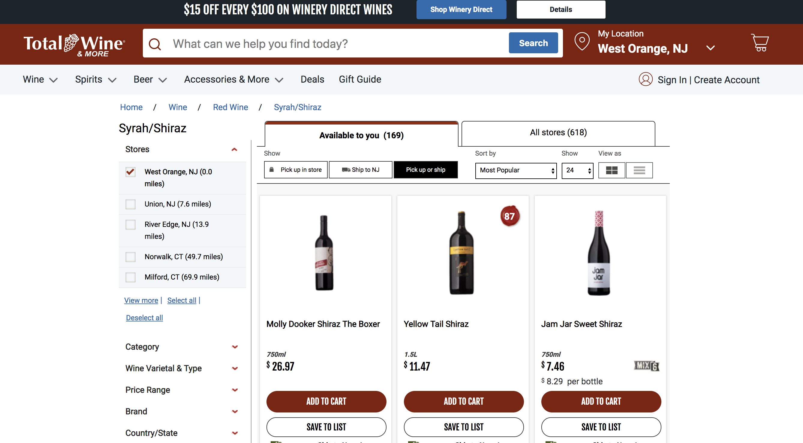

Slide 4
Source: Total Wine & More
Wine retailer email test
Test setting: email to retailer email list
Unit: email address
Treatments: email version A, email version B, holdout
Reponse: open, click and 1-month purchase ($)
Selection: all active customers
Assignment: randomly assigned (1/3 each)
Wine retailer email test data
d <- read.csv("test_data.csv") head(d)
## user_id cpgn_id group email open click purch chard sav_blanc syrah ## 1 1000001 1901Email ctrl FALSE 0 0 0.00 0.00 0.00 33.94 ## 2 1000002 1901Email email_B TRUE 1 0 0.00 0.00 0.00 16.23 ## 3 1000003 1901Email email_A TRUE 1 1 200.51 516.39 0.00 16.63 ## 4 1000004 1901Email email_A TRUE 1 0 0.00 0.00 0.00 0.00 ## 5 1000005 1901Email email_A TRUE 1 1 158.30 426.53 1222.48 0.00 ## 6 1000006 1901Email email_B TRUE 1 0 0.00 0.00 0.00 0.00 ## cab past_purch days_since visits ## 1 0.00 33.94 119 11 ## 2 76.31 92.54 60 3 ## 3 0.00 533.02 9 9 ## 4 41.21 41.21 195 6 ## 5 0.00 1649.01 48 9 ## 6 0.00 0.00 149 6
Types of variables associated with a test
Treatment indicator (x)
Which (randomized) treatment was received
Response (y’s)
Outcome(s) measured for each customer, AKA the dependant variable
Baseline variables (z’s)
Other stuff we know about customers prior to the randomization
Sometimes called “pre-randomization covariates” or “observables”
Everything measured after the randomization that could possibly be affected by the treatment is an outcome.
Treatment indicator (x)
summary(d$group)
## ctrl email_A email_B ## 41330 41329 41329
This is a completely randomized experiment.
Responses (y’s)
open test email (load images)
click test email to visit website
purchases ($) in 30 days after email sent
summary(d[,c("open", "click", "purch")])
## open click purch ## Min. :0.0000 Min. :0.00000 Min. : 0.00 ## 1st Qu.:0.0000 1st Qu.:0.00000 1st Qu.: 0.00 ## Median :0.0000 Median :0.00000 Median : 0.00 ## Mean :0.4567 Mean :0.07503 Mean : 21.30 ## 3rd Qu.:1.0000 3rd Qu.:0.00000 3rd Qu.: 21.86 ## Max. :1.0000 Max. :1.00000 Max. :1607.40
Baseline variables (z)
days since last activity
website visits
total past purchases ($)
summary(d[,c("days_since", "visits", "past_purch")])
## days_since visits past_purch ## Min. : 0.00 Min. : 0.000 Min. : 0.00 ## 1st Qu.: 26.00 1st Qu.: 4.000 1st Qu.: 0.00 ## Median : 63.00 Median : 6.000 Median : 91.22 ## Mean : 89.98 Mean : 5.946 Mean : 188.79 ## 3rd Qu.:125.00 3rd Qu.: 7.000 3rd Qu.: 246.87 ## Max. :992.00 Max. :51.000 Max. :9636.92
More baseline variables
total past purchases by category ($)
summary(d[, c("chard", "sav_blanc", "syrah", "cab")])
## chard sav_blanc syrah cab ## Min. : 0.00 Min. : 0.00 Min. : 0.00 Min. : 0.00 ## 1st Qu.: 0.00 1st Qu.: 0.00 1st Qu.: 0.00 1st Qu.: 0.00 ## Median : 0.00 Median : 0.00 Median : 0.00 Median : 0.00 ## Mean : 73.31 Mean : 72.45 Mean : 26.68 Mean : 16.35 ## 3rd Qu.: 54.06 3rd Qu.: 57.42 3rd Qu.: 20.91 3rd Qu.: 12.96 ## Max. :9636.92 Max. :6609.92 Max. :2880.15 Max. :2365.90
Whoa! That’s a lot of chardonnay for one customer!

Slide 5
Analysis of A/B tests
What is the first question you should ask about an A/B test?
Did the treatment affect the response?
Was the randomization done correctly?
How could we check the randomization with the data?
Randomization checks
Randomization checks confirm that the baseline variables are distributed similarly for the treatment and control groups.
Averages of baseline variables by treatment group
d %>% group_by(group) %>% summarize(mean(days_since), mean(visits), mean(past_purch))
## # A tibble: 3 x 4 ## group `mean(days_since)` `mean(visits)` `mean(past_purch)` ## <fct> <dbl> <dbl> <dbl> ## 1 ctrl 90.0 5.95 188. ## 2 email_A 90.2 5.95 188. ## 3 email_B 89.8 5.94 190.
Group means are are similar between groups.
Randomization checks
Purchase incidence by group is also similar.
## # A tibble: 3 x 2 ## group `mean(past_purch > 0)` ## <fct> <dbl> ## 1 ctrl 0.744 ## 2 email_A 0.741 ## 3 email_B 0.741
About 3/4 of email list has purchased in the past and this is similar across randomized treatments.
Randomization checks
The full distributions of baseline variables should also be the same between treatment groups.

Slide 6
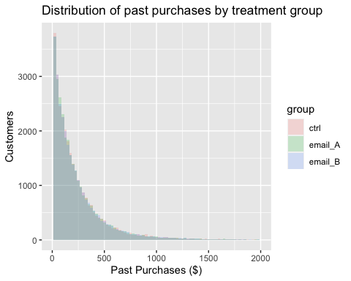

Slide 7
Randomization checks

Slide 8
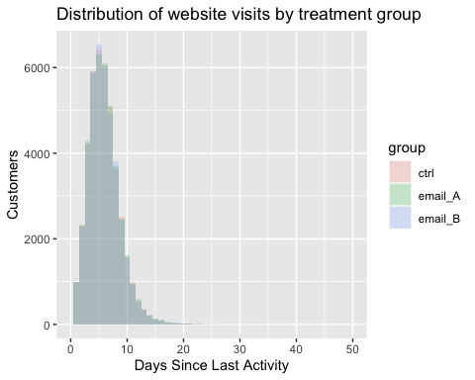

Slide 9
Exercise
Compare the past purchases in each wine category (cab, etc.) to confirm that the randomization produced groups with similar distributions.

Slide 10
Randomization checks out! On to the treatment effects.
Did the treatments affect the responses?
d %>% group_by(group) %>% summarize(mean(open), mean(click), mean(purch))
## # A tibble: 3 x 4 ## group `mean(open)` `mean(click)` `mean(purch)` ## <fct> <dbl> <dbl> <dbl> ## 1 ctrl 0 0 12.4 ## 2 email_A 0.718 0.132 25.6 ## 3 email_B 0.652 0.0934 25.9
Email A looks better for opens and clicks, but maybe not purchases. Both emails seem to generate higher average purchases than the control.
Does email A have higher open rate than B?
Create a new data set with just the customers who received emails.
d_treat <- d[d$group != "ctrl",] d_treat$group <- droplevels(d_treat$group) xtabs(~ group + open, data=d_treat)
## open ## group 0 1 ## email_A 11643 29686 ## email_B 14395 26934
Excluding one treatment group from an experiment is legit.
Confirm significance with proportions test
prop.test(xtabs(~ group + open, data=d_treat)[,2:1])
## ## 2-sample test for equality of proportions with continuity correction ## ## data: xtabs(~group + open, data = d_treat)[, 2:1] ## X-squared = 424.32, df = 1, p-value < 2.2e-16 ## alternative hypothesis: two.sided ## 95 percent confidence interval: ## 0.06024628 0.07292897 ## sample estimates: ## prop 1 prop 2 ## 0.7182850 0.6516974
Visualization: open rates for emails A & B
mosaicplot(xtabs(~ group + open, data=d_treat), main="Wine Retailer Test: Email Opens")

Slide 11
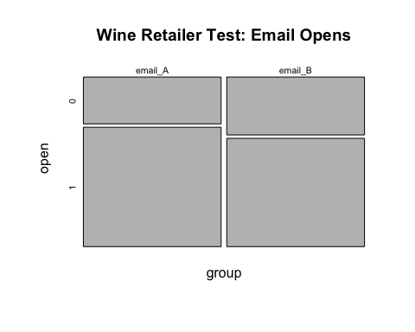

Slide 12
Does email A have a higher click rate than B?
xtabs(~ group + click, data=d_treat)
## click ## group 0 1 ## email_A 35887 5442 ## email_B 37468 3861
Confirm significance with proportions test
prop.test(xtabs(~ group + click, data=d_treat)[,2:1])
## ## 2-sample test for equality of proportions with continuity correction ## ## data: xtabs(~group + click, data = d_treat)[, 2:1] ## X-squared = 302.38, df = 1, p-value < 2.2e-16 ## alternative hypothesis: two.sided ## 95 percent confidence interval: ## 0.03392871 0.04257931 ## sample estimates: ## prop 1 prop 2 ## 0.13167509 0.09342108
Note that we analyze click rate among all who received the email, ignoring whether or not they opened the email. There may be systematic differences in the types of customers who opened email A versus email B.
Visualization: barplot of clicks and opens for emails A & B

Slide 13
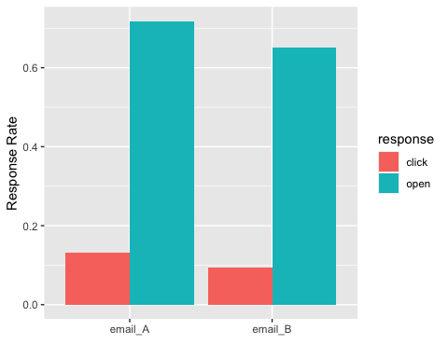

Slide 14
Do any groups have higher average purchases?
Average 30-day purchase amount by group
d %>% group_by(group) %>% summarize(mean(purch))
## # A tibble: 3 x 2 ## group `mean(purch)` ## <fct> <dbl> ## 1 ctrl 12.4 ## 2 email_A 25.6 ## 3 email_B 25.9
Do any groups have higher average purchases?
Visualization: boxplot (old school)
Do any groups have higher average purchases?
Visualization: Violin plots with log scale
Do any groups have higher average purchases?
Visualization: Dotplot with log scale
Test significance with a t-test
t.test(purch ~ group, data=d[d$group != "ctrl",])
## ## Welch Two Sample t-test ## ## data: purch by group ## t = -0.59169, df = 82644, p-value = 0.5541 ## alternative hypothesis: true difference in means is not equal to 0 ## 95 percent confidence interval: ## -1.0498820 0.5629813 ## sample estimates: ## mean in group email_A mean in group email_B ## 25.62284 25.86629
There is not a significant difference in average purchases between email A and email B.
Do emails generate higher purchases?
t.test(purch ~ email, data=d)
## ## Welch Two Sample t-test ## ## data: purch by email ## t = -44.823, df = 107015, p-value < 2.2e-16 ## alternative hypothesis: true difference in means is not equal to 0 ## 95 percent confidence interval: ## -13.90691 -12.74164 ## sample estimates: ## mean in group FALSE mean in group TRUE ## 12.42029 25.74456
Those who received an email have higher average purchases (95% CI = [3.47, 4.42]).
Summary of findings (suitable for texting)
Email A has significantly higher opens and clicks than email B, but purchase are similar for both emails $→$ Send email A!
Both emails generate higher average purchases than the control $→$ Send emails!

Slide 15
Design of A/B tests
Seven key questions
Business question
Test setting (lab v. field)
Unit of analysis (visit, customer, store)
Treatments
Response variable(s)
Selection of units
Assignment to treatments
Sample size
If you can answer these questions, you have a test plan.
Email test
Business questions: Does email work? If so which email is better?
Test setting: email to retailer customers
Unit: email address
Treatments: email version A, email version B, holdout
Reponse: open, click and 30-day purchase ($)
Selection: all active emails on email list (open in last 12 months)
Assignment: randomly assigned (1/3 each)
Sample size: 123,988 emails
Typical website test
Business question: Which version of a webpage?
Test setting: website (field)
Unit of analysis: visitor (cookie-tracked)
Treatments: versions A and B
Response variable: clicks, conversions
Selection of units: all who visit
Assignment to treatments: random (by testing sw)
Sample size: ???
Sample size planning
Significance tests will erroneously detect effects that aren’t there, if you repeatedly test for significance as the data comes in and stop when you get a significant difference.
sig <- rep(0, 1000) for (r in 1:1000) { A <- rnorm(101); B <- rnorm(101) pval <- rep(NA, 100) for (n in 1:100) pval[n] <- t.test(A[1:(n+1)], B[1:(n+1)])$p.value # repeated testing if (min(pval) < 0.05) sig[r] <- 1 # any significance along the way } mean(sig) # bigger than the nominal significance of 5%
## [1] 0.377
Sample size planning {.bigger, .build}
The standard recommendation is to set the sample size in advance and not test for significance until the data comes in.
WTF? Seriously? More on this later.
The recommended sample size is:
$n_{1}=n_{2}≈(z_{1−α/2}+z_{β})^{2}\left(\frac{2s^{2}}{d^{2}}\right)$
Sample size planning: key ideas
My data is noisy, so the group with the higher average in the test not always have the higher long-run response.
There are two mistakes you can make:
Declare the treatments different, when they are the same (Type I)
Declare the treatment the same, when they are different (Type II)
I want a low probability of both of those mistakes ($α$, $β$) given a specific known difference between treatments ($d$) and noise in my response ($s$)
$n_{1}=n_{2}≈(z_{1−α/2}+z_{β})^{2}\left(\frac{2s^{2}}{d^{2}}\right)$
Interpreting the sample size formula
$n_{1}=n_{2}≈(z_{1−α/2}+z_{β})^{2}\left(\frac{2s^{2}}{d^{2}}\right)$
More noise $→$ larger sample size
Smaller difference to detect$→$ larger sample size
Fewer errors $→$ larger sample size
Sample size calculator in R
Sample size to detect at $1 difference in average 30-day purchases:
sd(d$purch)
## [1] 54.82613
#power.t.test(sd=sd(d$purch), delta=1, sig.level=0.95, power=0.80)
We need 2,387 in each group.
Sample size planning
There is a slightly different formula for:
Continous response (eg money, time-on-site)
$n_{1}=n_{2}≈(z_{1−α/2}+z_{β})^{2}\left(\frac{2s^{2}}{d^{2}}\right)$
Binary response (eg conversions)
$n_{1}=n_{2}≈(z_{1−α/2}+z_{β})^{2}\left(\frac{2p(1−p)}{d^{2}}\right)$
Sample size calculator in R
Binary response
power.prop.test(p1=0.07, p2=0.07 + 0.01, sig.level=0.05, power=0.80)
## ## Two-sample comparison of proportions power calculation ## ## n = 10889.14 ## p1 = 0.07 ## p2 = 0.08 ## sig.level = 0.05 ## power = 0.8 ## alternative = two.sided ## ## NOTE: n is number in *each* group
Sample size calculator

Slide 16
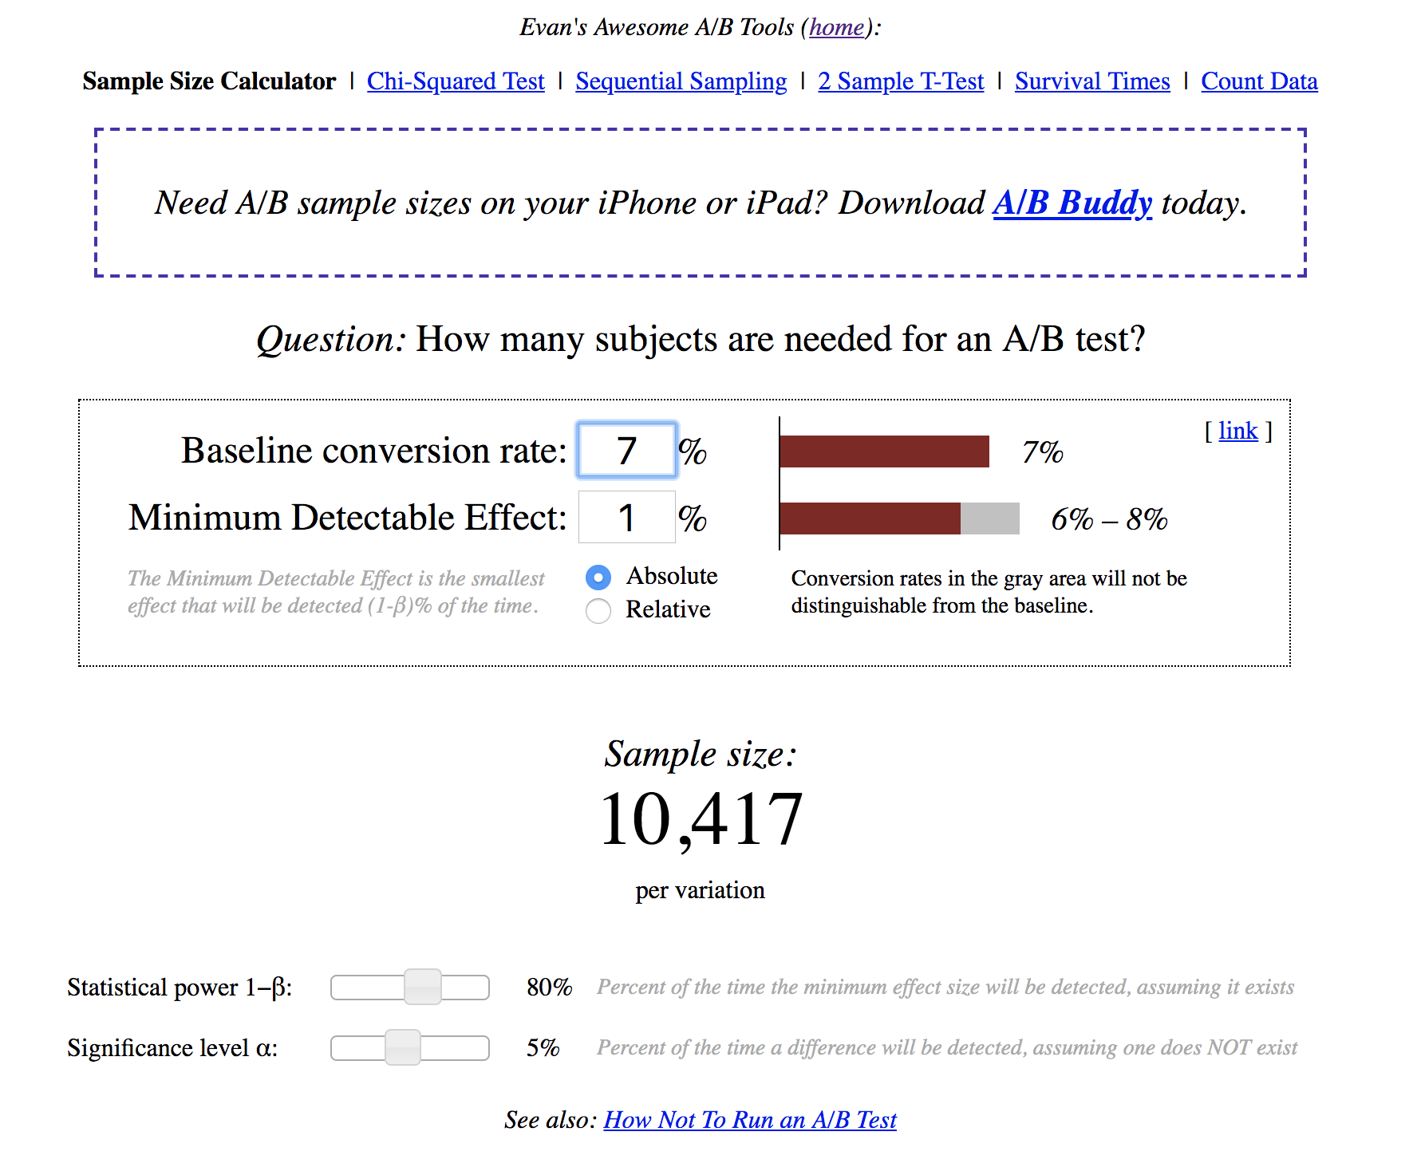

Slide 17
A word of caution about sample size calculators
There are different sample size formulas floating around. These formulas differ on what assumptions they may about what you are trying to do, but it can be very hard to figure out what assumptions are being made (even for experts).
A decent sample size calculation will help you identify whether you are likely to end up with way too much or too little data.
Tips for getting started with A/B testing
Keep it simple
Be prepared to find no effect
Choose “strong” treatments
Run many tests in fast succession
You are searching for a few “golden tickets”

Slide 18


Slide 19
Things you just learned (or reviewed)
Three types of variables in test data
Treatment (x’s)
Response (y’s)
Baseline variables (z’s)
Analyzing tests with binary response
Bar plot or mosaic plot
prop.test() for significance
Analyzing tests with continuous response
Dot plots or violin plots
t.test() for significance
Eight key questions that define a test plan
Sample size calculations
Continous responses
Binary responses

