Slide 1
Advanced A/B Testing
Profit-Maximizing A/B Tests Elea McDonnell Feit

Slide 2
Test & Roll

Slide 3
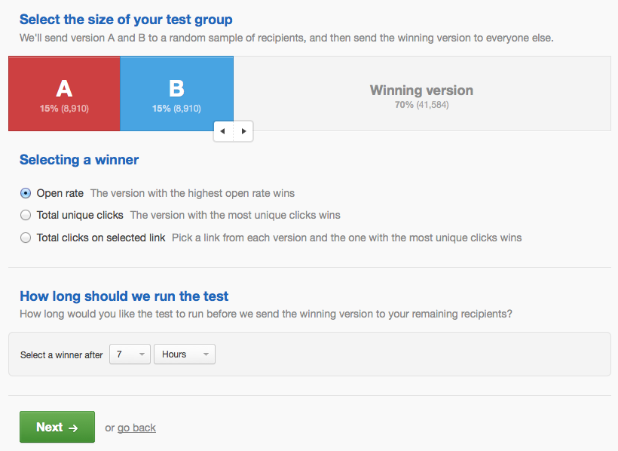
Typical A/B email test setup screen

Slide 4
Hypothesis testing doesn’t quite fit this problem
Hypothesis tests focus on minimizing Type I error
Doesn’t matter when we are deciding which of two equal-cost treatments to deploy
Populations are limited and hypothesis tests don’t recognize this
Sample size formulas will suggest sample sizes larger than the population
When a hypothesis test is insignificant, it doesn’t tell you what to do.
Choose randomly? That doesn’t make sense!
Doesn’t allow for unequal group sizes
But we see these all the time in media holdout testing

Slide 5
A/B tests as a decision problem
Test
Choose $n_{1}^{*}$ and $n_{2}^{*}$ customers to send the treatments. Collect data on response.
Roll
Choose a treatment to deploy to the remaining $N−n_{1}^{*}−n_{2}^{*}$.
Objective
Maximize combined profit for test stage and the roll stage.

Slide 6
Profit-maximizing sample size
For the case where response is normally distributed with variance $s$ and a symmetric normal prior on the mean response ($m_{1},m_{2}∼N(μ,σ)$), the profit maximizing sample size is
$$n_{1}=n_{2}=\sqrt{\frac{N}{4}{\left(\frac{s}{σ}\right)}^{2}+{\left(\frac{3}{4}{\left(\frac{s}{σ}\right)}^{2}\right)}^{2}}−\frac{3}{4}{\left(\frac{s}{σ}\right)}^{2}$$
If the priors are different for each group (eg a holdout test), the optimal sample sizes can be found numerically. This new sample size formula was recently derived by Feit and Berman (2019) Marketing Science.

Slide 7
Test & Roll in math
Response
$$y_{1}∼N(m_{1},s) y_{2}∼N(m_{2},s)$$
Priors
$$m_{1}∼N(μ,σ) m_{2}∼N(μ,σ)$$
Profit-maximizing sample size
$$n_{1}=n_{2}=\sqrt{\frac{N}{4}{\left(\frac{s}{σ}\right)}^{2}+{\left(\frac{3}{4}{\left(\frac{s}{σ}\right)}^{2}\right)}^{2}}−\frac{3}{4}{\left(\frac{s}{σ}\right)}^{2}$$

Slide 8
Interpreting the sample size formula
Bigger population ($N$) $→$ bigger test
More noise in the repsonse ($s$) $→$ bigger test
More prior difference between treatments ($σ$) $→$ smaller test
$$n_{1}=n_{2}=\sqrt{\frac{N}{4}{\left(\frac{s}{σ}\right)}^{2}+{\left(\frac{3}{4}{\left(\frac{s}{σ}\right)}^{2}\right)}^{2}}−\frac{3}{4}{\left(\frac{s}{σ}\right)}^{2}$$

Slide 9
Test & Roll procedure
Come up with priors distributions for each treatment
Use past data, if you’ve got it
Use the priors to compute the optimal sample size
Run the test
Deploy the treatment with the higher posterior to the remainder of the population
Priors are symmetric $→$ pick the treatment with the higher average

Slide 10
Come up with priors
Hierarchical Stan model for past experiments
// Stan code for Lewis and Rao 2015 data // L&R only report the mean and standard deviation for the control group for each experiment data { int<lower=1> nexpt; // number of experiments real<lower=2> nobs[nexpt]; // sample size for control group real ybar[nexpt]; // observed mean for control group real<lower=0> s[nexpt]; // observed standard deviation for experiment (pooled) } parameters { real m[nexpt]; // true mean for control group in experiment real mu; // mean across experiments real<lower=0> sigma; //standard deviation across experiments } model { // priors mu ~ normal(0, 10); sigma ~ normal(0, 3); // likelihood for (i in 1:nexpt) { m[i] ~ normal(mu, sigma); ybar[i] ~ normal(m[i], s[i]/sqrt(nobs[i])); } }

Slide 11
Fit hierarchical model to past experiments
lr <- read.csv("display_LewisRao2015Retail.csv") # data taken from tables 1 and 2 of Lewis and Rao (2015) c <- c(1:3,5:6) # include only advertiser 1 and eliminate exp 4 d1 <- list(nexpt=length(c), nobs=lr$n1[c], ybar=lr$m[c], s=lr$s[c]) m1 <- stan(file="test_roll_model.stan", data=d1, seed=20030601, iter=10000)
## ## SAMPLING FOR MODEL 'test_roll_model' NOW (CHAIN 1). ## Chain 1: ## Chain 1: Gradient evaluation took 1.6e-05 seconds ## Chain 1: 1000 transitions using 10 leapfrog steps per transition would take 0.16 seconds. ## Chain 1: Adjust your expectations accordingly! ## Chain 1: ## Chain 1: ## Chain 1: Iteration: 1 / 10000 [ 0%] (Warmup) ## Chain 1: Iteration: 1000 / 10000 [ 10%] (Warmup) ## Chain 1: Iteration: 2000 / 10000 [ 20%] (Warmup) ## Chain 1: Iteration: 3000 / 10000 [ 30%] (Warmup) ## Chain 1: Iteration: 4000 / 10000 [ 40%] (Warmup) ## Chain 1: Iteration: 5000 / 10000 [ 50%] (Warmup) ## Chain 1: Iteration: 5001 / 10000 [ 50%] (Sampling) ## Chain 1: Iteration: 6000 / 10000 [ 60%] (Sampling) ## Chain 1: Iteration: 7000 / 10000 [ 70%] (Sampling) ## Chain 1: Iteration: 8000 / 10000 [ 80%] (Sampling) ## Chain 1: Iteration: 9000 / 10000 [ 90%] (Sampling) ## Chain 1: Iteration: 10000 / 10000 [100%] (Sampling) ## Chain 1: ## Chain 1: Elapsed Time: 0.157387 seconds (Warm-up) ## Chain 1: 0.166998 seconds (Sampling) ## Chain 1: 0.324385 seconds (Total) ## Chain 1: ## ## SAMPLING FOR MODEL 'test_roll_model' NOW (CHAIN 2). ## Chain 2: ## Chain 2: Gradient evaluation took 1.1e-05 seconds ## Chain 2: 1000 transitions using 10 leapfrog steps per transition would take 0.11 seconds. ## Chain 2: Adjust your expectations accordingly! ## Chain 2: ## Chain 2: ## Chain 2: Iteration: 1 / 10000 [ 0%] (Warmup) ## Chain 2: Iteration: 1000 / 10000 [ 10%] (Warmup) ## Chain 2: Iteration: 2000 / 10000 [ 20%] (Warmup) ## Chain 2: Iteration: 3000 / 10000 [ 30%] (Warmup) ## Chain 2: Iteration: 4000 / 10000 [ 40%] (Warmup) ## Chain 2: Iteration: 5000 / 10000 [ 50%] (Warmup) ## Chain 2: Iteration: 5001 / 10000 [ 50%] (Sampling) ## Chain 2: Iteration: 6000 / 10000 [ 60%] (Sampling) ## Chain 2: Iteration: 7000 / 10000 [ 70%] (Sampling) ## Chain 2: Iteration: 8000 / 10000 [ 80%] (Sampling) ## Chain 2: Iteration: 9000 / 10000 [ 90%] (Sampling) ## Chain 2: Iteration: 10000 / 10000 [100%] (Sampling) ## Chain 2: ## Chain 2: Elapsed Time: 0.180081 seconds (Warm-up) ## Chain 2: 0.177137 seconds (Sampling) ## Chain 2: 0.357218 seconds (Total) ## Chain 2: ## ## SAMPLING FOR MODEL 'test_roll_model' NOW (CHAIN 3). ## Chain 3: ## Chain 3: Gradient evaluation took 8e-06 seconds ## Chain 3: 1000 transitions using 10 leapfrog steps per transition would take 0.08 seconds. ## Chain 3: Adjust your expectations accordingly! ## Chain 3: ## Chain 3: ## Chain 3: Iteration: 1 / 10000 [ 0%] (Warmup) ## Chain 3: Iteration: 1000 / 10000 [ 10%] (Warmup) ## Chain 3: Iteration: 2000 / 10000 [ 20%] (Warmup) ## Chain 3: Iteration: 3000 / 10000 [ 30%] (Warmup) ## Chain 3: Iteration: 4000 / 10000 [ 40%] (Warmup) ## Chain 3: Iteration: 5000 / 10000 [ 50%] (Warmup) ## Chain 3: Iteration: 5001 / 10000 [ 50%] (Sampling) ## Chain 3: Iteration: 6000 / 10000 [ 60%] (Sampling) ## Chain 3: Iteration: 7000 / 10000 [ 70%] (Sampling) ## Chain 3: Iteration: 8000 / 10000 [ 80%] (Sampling) ## Chain 3: Iteration: 9000 / 10000 [ 90%] (Sampling) ## Chain 3: Iteration: 10000 / 10000 [100%] (Sampling) ## Chain 3: ## Chain 3: Elapsed Time: 0.155204 seconds (Warm-up) ## Chain 3: 0.17979 seconds (Sampling) ## Chain 3: 0.334994 seconds (Total) ## Chain 3: ## ## SAMPLING FOR MODEL 'test_roll_model' NOW (CHAIN 4). ## Chain 4: ## Chain 4: Gradient evaluation took 8e-06 seconds ## Chain 4: 1000 transitions using 10 leapfrog steps per transition would take 0.08 seconds. ## Chain 4: Adjust your expectations accordingly! ## Chain 4: ## Chain 4: ## Chain 4: Iteration: 1 / 10000 [ 0%] (Warmup) ## Chain 4: Iteration: 1000 / 10000 [ 10%] (Warmup) ## Chain 4: Iteration: 2000 / 10000 [ 20%] (Warmup) ## Chain 4: Iteration: 3000 / 10000 [ 30%] (Warmup) ## Chain 4: Iteration: 4000 / 10000 [ 40%] (Warmup) ## Chain 4: Iteration: 5000 / 10000 [ 50%] (Warmup) ## Chain 4: Iteration: 5001 / 10000 [ 50%] (Sampling) ## Chain 4: Iteration: 6000 / 10000 [ 60%] (Sampling) ## Chain 4: Iteration: 7000 / 10000 [ 70%] (Sampling) ## Chain 4: Iteration: 8000 / 10000 [ 80%] (Sampling) ## Chain 4: Iteration: 9000 / 10000 [ 90%] (Sampling) ## Chain 4: Iteration: 10000 / 10000 [100%] (Sampling) ## Chain 4: ## Chain 4: Elapsed Time: 0.155448 seconds (Warm-up) ## Chain 4: 0.17147 seconds (Sampling) ## Chain 4: 0.326918 seconds (Total) ## Chain 4:

Slide 12
Fitted model
summary(m1)$summary[,c(1,3,5,8)]
## mean sd 25% 97.5% ## m[1] 9.490377 0.08467993 9.433258 9.655464 ## m[2] 10.500796 0.10008523 10.433861 10.698501 ## m[3] 4.860131 0.06181156 4.818066 4.981305 ## m[4] 11.470157 0.07017636 11.422815 11.609507 ## m[5] 17.615434 0.09047702 17.553716 17.792088 ## mu 10.352358 2.00230021 9.138484 14.169450 ## sigma 4.398852 1.17817514 3.540116 7.193112 ## lp__ -13.182626 1.90558956 -14.218789 -10.511587

Slide 13
Compute optimal sample size
source("nn_functions.R")
## Loading required package: foreach
## Loading required package: iterators
## Loading required package: parallel
(n <- test_size_nn(N=1000000, s=mean(d1$s), mu=10.36044, sigma=4.39646))
## [1] 11390.89 11390.89

Slide 14
Evaluate the test
(eval <- test_eval_nn(n=n, N=1000000, s=mean(d1$s), mu=10.36044, sigma=4.3964))
## n1 n2 profit_per_cust profit profit_test profit_deploy ## 1 11390.89 11390.89 12.72715 12727151 236029.3 12491122 ## profit_rand profit_perfect profit_gain regret error_rate deploy_1_rate ## 1 10360440 12840843 0.9541639 0.008853939 0.06927924 0.5 ## tie_rate ## 1 0

Slide 15
Compare to sample size for hypothesis test
Null hypothesis test size to detect difference between: - display ads that have no effect - display ads that are exactly worth the costs (ROI = 0 versus ROI = -100).
margin <- 0.5 d <- mean(lr$cost[c])/margin (n_nht <- test_size_nht(s=mean(d1$s), d=d))
## [1] 4782433

Slide 16
Sample size for hypothesis test with finite population correction
(n_fpc <- test_size_nht(s=mean(d1$s), d=d, N=1000000))
## [1] 452673.4
(eval_fpc <- test_eval_nn(c(n_fpc, n_fpc), N=1000000, s=mean(d1$s), mu=10.36044, sigma=4.39646))
## n1 n2 profit_per_cust profit profit_test profit_deploy ## 1 452673.4 452673.4 10.59508 10595077 9379790 1215287 ## profit_rand profit_perfect profit_gain regret error_rate deploy_1_rate ## 1 10360440 12840877 0.09459509 0.1748946 0.01116195 0.5 ## tie_rate ## 1 0

Slide 17
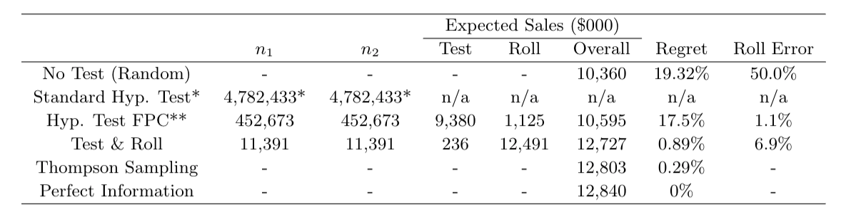
Comparison of display ad tests

Slide 18
Multi-armed bandits

Slide 19
Multi-armed bandits
Multi-armed bandits are a dynamic profit-maximizing approach that is more flexible than a test & roll experiment. They are often referred to as the “machine learning for the A/B testing world.”

Slide 20


Slide 21
Source: personal photo from Ceasar’s Palace, Las Vegas

Slide 22
Multi-armed bandit process/problem
Define treatment probabilities $p_{k}$
Asssign one or a few units to treatments with probability for each treatment $k$
Collect data
Adjust $p_{k}$’s based on the data
Repeat

Slide 23
Thompson sampling
A popular approach multi-armed bandit problems was proposed by Thompson in 1933.
Start with prior distributions on the performance of each treatment
Assign units to treatments based on the probability that the treatment is best
Collect data
Update priors
Repeat
There are other methods that work better in specific contexts, but Thompson sampling is very robust.

Slide 24
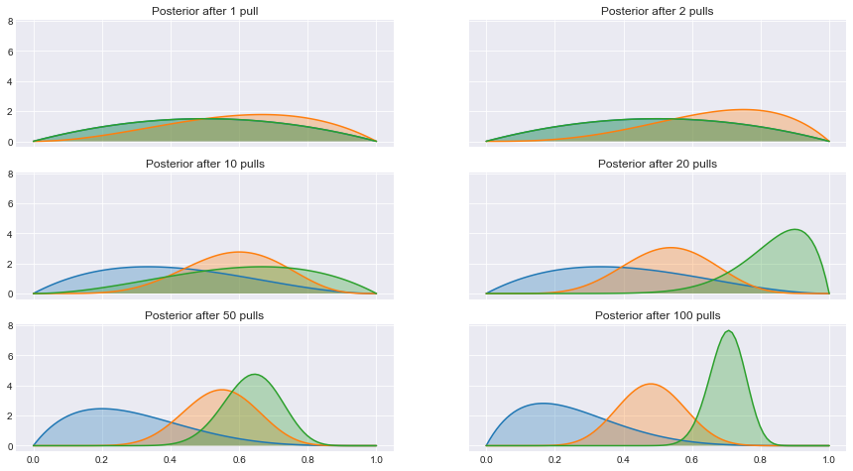
Thompson sampling for 3 treatments

Slide 25
Source: eigenfoo.xyz

Slide 26
How do Thompson sampling and Test & Roll compare?
Both methods are profit-maximizing. We can compare them based on how much profit they generate.
Thompson sampling is less constrained, so will always produce more profit on average.
Statisticans are a pessimistic lot, so we prefer to compute regret for an algorithm, which is the difference between profit with perfect information and profit with the algorithm.

Slide 27
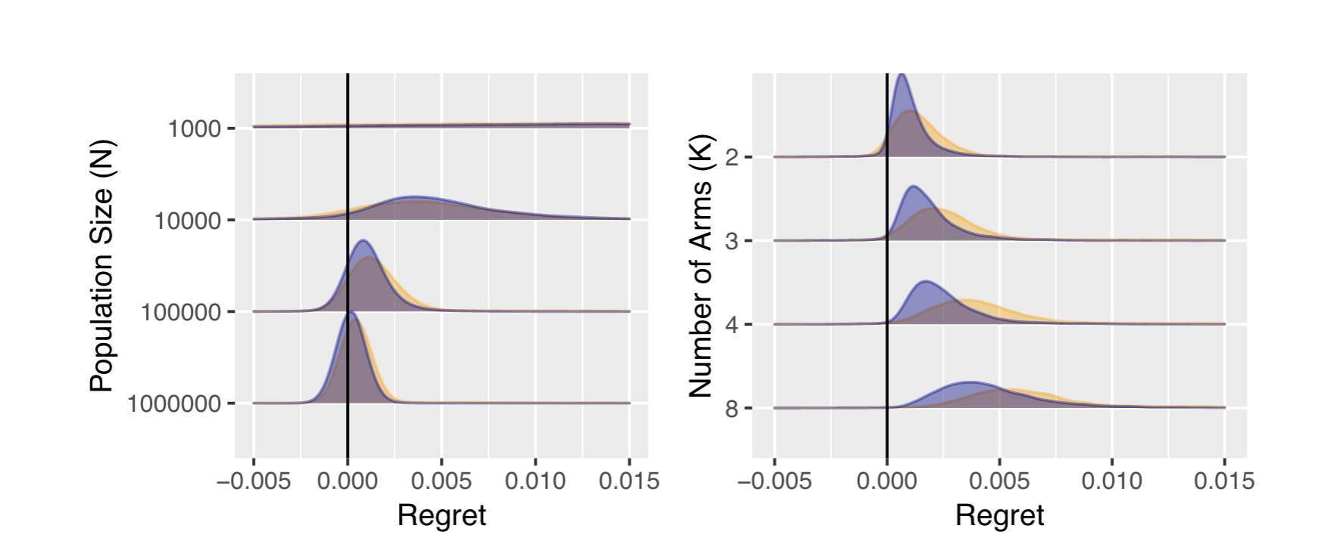
Comparison of regret for Thompson sampling and Test & Roll

Slide 28
Source: Feit and Berman 2019

Slide 29
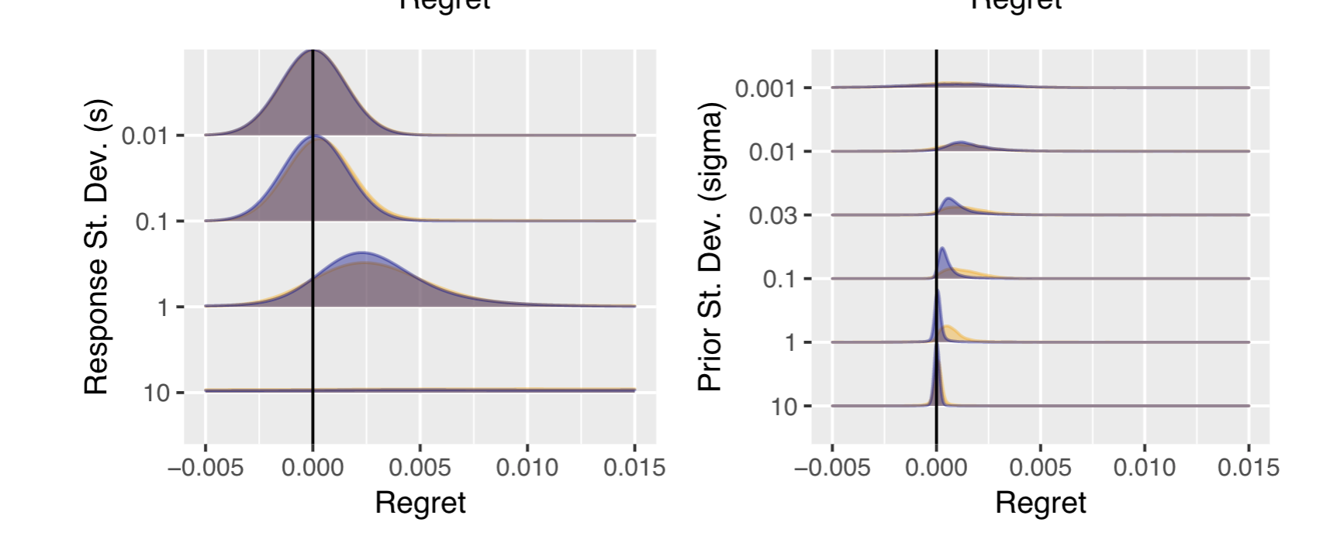
Comparison of Thompson sampling and Test & Roll

Slide 30
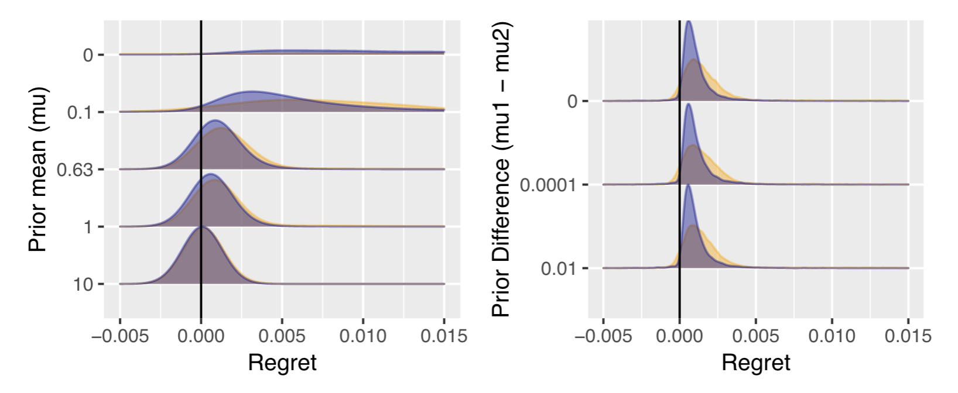
Comparison of Thompson sampling and Test & Roll

Slide 31
Why do Test & Roll?
Works when response takes a long time to measure
Long purchase cycles
Works when iterative allocation would be time-consuming
Email, catalog and direct mail
Reduces complexity for website tests
Don’t need bandit interacting with site
Test & Roll profit-maximizing sample size can be used as a conservative estimate of how long to run a bandit algorithm.

Slide 32
Things you just learned
Test & Roll experiments
Profit-maximizing sample size
Multi-armed bandits
Thompson sampling

