Slide 1

Introduction to Apache Spark Architecture, RDD, DataFrames, SQL & MLlib
Prasanth Kothuri, CERN
IT-Database Group

Slide 2
Outline
What is Apache Spark?
Spark Abstractions
Spark Architecture
Spark Data APIs
RDD
Dataframe
SQL
Spark Mlib

Slide 3
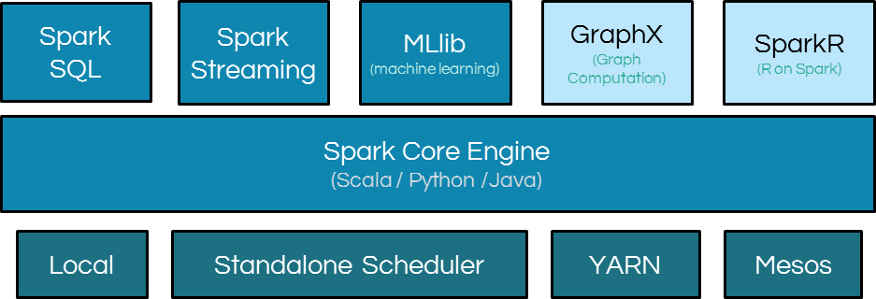
What is Apache Spark?
Apache Spark is an open-source parallel processing framework with expressive development APIs (in multiple languages) that allows for sophisticated analytics, real-time streaming and machine learning on large datasets
Spark ecosystem

Slide 4
Spark Abstractions
Two main abstractions of Spark
RDD – Resilient Distributed Dataset
DAG – Direct Acyclic Graph

Slide 5
RDD
Resilient Distributed Datasets (RDDs) are the primary abstraction in Spark – a immutable distributed collection of records that can be operated on in parallel
There are currently two ways to create them:
parallelized collections – take an existing python/scala collection and run functions on it in parallel
Hadoop datasets – run functions on each record of a file(s) in Hadoop distributed file system

Slide 6
RDD: Example
rdd = sc.parallelize(range(1,25),5)
Partitioned: RDD is partitioned and distributed across worker nodes of the cluster
In-Memory : RDD is stored in memory as much (size) and long (time) as possible
Immutable: does not change once created, can only be transformed into new RDDs
Typed: RDDs have types
Cacheable: hold all the data in a persistent storage like memory (preferrable) or disk
rdd is split into partitions
Partitions on stored in worker’s memory
Worker
[1,2,3,4,5]
DataNode
[6,7,8,9,10]
Worker
[11,12,13,14,15]
DataNode
[16,17,18,19,20]
Worker
DataNode
[21,22,23,24]

Slide 7
RDD: Actions and Transformations
Two types of operations on RDDs:
transformations and actions
transformations – lazy operations that return another RDD
actions – operations that trigger computation and return value
transformations
RDD
action
RDD
result
RDD
RDD

Slide 8
DAG
Direct Acyclic Graph – sequence of computations performed on data
Node – RDD partition
Edge – transformation on top of data
Acyclic – graph cannot return to the older partition
Direct – transformation is an action that transistions data partition state (from X to Y)

Slide 9
DAG
WordCount example
text_file = sc.textFile("hdfs:///user/pkothuri/sparkTraining/LICENSE.txt")
counts = text_file.flatMap(lambda line: line.split(" ")) \
.map(lambda word: (word, 1)) \
.reduceByKey(lambda a, b: a + b)
for x in counts.collect():
print x

Slide 10
DAG
WordCount example
sc.textFile
flatmap
map
reduceByKey
collect
RDD Partitions
HDFS Blocks

Slide 11
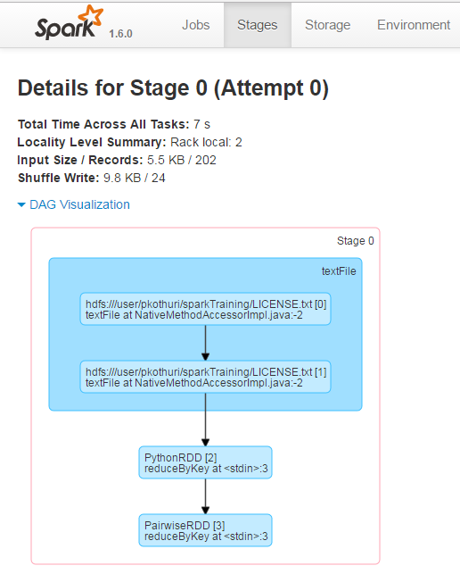
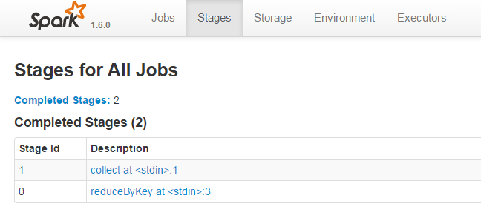
Spark WEB UI
Every SparkContext launches a web UI, by default on port 4040, that displays useful information about the application. This includes:
A list of scheduler stages and tasks
A summary of RDD sizes and memory usage
Environmental information.
Information about the running executors

Slide 12
Spark Architecture
Spark Cluster
DriverNode
driver
Spark Context
WorkerNode
WorkerNode
WorkerNode
executor
executor
executor
executor
executor
executor
Task
Task
Task
Task
Task
Task
Task
Task
Task
Task
Task
Task
Task
Task
Task
Task
Task
Task

Slide 13
Spark Architecture
Driver
Entry point for Spark Shell (Scala, Python)
SparkContext is created here and resides here
Graph is built and submitted to DAGScheduler
DAGScheduler divides it into stages and tasks
Schedules tasks and controls their execution

Slide 14
Spark Architecture
Executor
Reads data from HDFS (or external sources)
Stores the data in cache in JVM heap or on HDDs
Performs all data processing
Writes data to HDFS (or external sources)

Slide 15
Spark Architecture
Application Decomposition
Application
Single instance of SparkContext that stores some data processing logic and can schedule series of jobs, sequentially or in parallel
Job
Complete set of transformations on RDD that finishes with action or data saving, triggered by the driver application

Slide 16
Spark Architecture
Application Decomposition
Stage
Set of transformations that can be pipelined and executed by a single independent worker. Usually it is app the transformations between «read», «shuffle», «action» and «save»
Task
- Execution of the stage on a single data partition. Basic unit of scheduling

Slide 17
DAG scheduler
When an action is called on the RDD, Spark creates DAG and submits to the DAG scheduler
The DAG scheduler divides operators into stages of tasks
The stages are created based on the transformations, the narrow transformations are grouped (pipelined) into a single stage
The DAG scheduler submits the stages to the task scheduler
The number of tasks depend on number of partitions
The number of tasks submitted depends on number of available executors

Slide 18
DAG
WordCount example
sc.textFile
flatmap
map
reduceByKey
collect
RDD Partitions
HDFS Blocks
stage1
stage2

Slide 19

SCHEDULING PROCESS
RDD Objects
DAG Scheduler
Task Scheduler
Executor
Task Scheduler
Task threads
DAG
TaskSet
Task
Block manager
Rdd1.join(rdd2)
.groupBy(…)
.filter(…)
Launches individual tasks
Retry failed or straggling tasks
Split graph into stages of tasks
Stage boundaries are at wide transformations (shuffle)
Submit each stage as ready
Execute tasks
Store and serve blocks
- Build operator DAG

Slide 20
Essential Spark Operations
General
Math / Stats
Set Theory
Data Structure / I/O
map
filter
flatMap
mapPartitions
groupBy
sortBy
flatMapValues
groupByKey
reduceByKey
foldByKey
sortByKey
combineByKey
sample
sampleByKey
randomSplit
union
intersection
subtract
distinct
cartesian
zip
join
fullOuterJoin
leftOuterJoin
rightOuterJoin
keyBy
zipWithIndex
zipWithUniqueID
zipPartitions
coalesce
repartition
repartitionAndSortWithinPartitions
pipe
partitionBy
TRANSFORMATIONS
reduce
collect
aggregate
fold
first
take
forEach
top
treeAggregate
treeReduce
forEachPartition
collectAsMap
keys
values
count
takeSample
max
min
sum
histogram
mean
variance
stdev
sampleVariance
countApprox
countApproxDistinct
takeOrdered
saveAsTextFile
saveAsSequenceFile
saveAsObjectFile
saveAsHadoopDataset
saveAsHadoopFile
saveAsNewAPIHadoopDataset
saveAsNewAPIHadoopFile
ACTIONS

Slide 21
Transformations: map and filter
MAP
FILTER
Return a new RDD that only has elements that pass the filter() function
Return a new RDD by applying a function to each element of this RDD
sourceRDD
[1,2,3,4,5]
x = sc.parallelize([1,2,3,4,5])
y = x.map(lambda z: z * 2)
print(x.collect())
print(y.collect())
x = sc.parallelize([1,2,3,4,5])
z = x.filter(lambda z: z % 2 != 0)
print(x.collect())
print(z.collect())
mapRDD
[2,4,6,8,10]
filterRDD
[1,3,5]

Slide 22
Transformations: map and flatmap
MAP
FLATMAP
Return a new RDD by applying a function to each element of the RDD, and then flattening the results.
Also, function in flapMap can return a list of elements (0 or more)
Return a new RDD by applying a function to each element of this RDD
sourceRDD
[3,4,5]
x = sc.parallelize([3,4,5])
y = x.map(lambda z: [z,z*2])
print(x.collect())
print(y.collect())
x = sc.parallelize([3,4,5])
z = x.flatmap(lambda z: [z,z*2])
print(x.collect())
print(z.collect())
mapRDD
[[3,6],[4,8],[5,10]]
flatMapRDD
[3,6,4,8,5,10]

Slide 23
Transformations: reduceByKey and groupByKey
REDUCEBYKEY
GROUPBYKEY
sourceRDD
Return a new RDD by grouping the values with the same key
Return a new RDD by combining the values with the same key with a given function
[('a',3),('b',4), ('c',5),('a',4),('b',-6)]
reduceRDD
groupRDD
[('a', 7), ('c', 5), ('b', -2)]
[('a', [3, 4]), ('c', [5]), ('b', [-6, 4])]
x = sc.parallelize([('a',3),('b',4), ('c',5),('a',4),('b',-6)])
y = x.reduceByKey(add)
print(x.collect())
print(y.collect())
x = sc.parallelize([('a',3),('b',4), ('c',5),('a',4),('b',-6)])
I = x.groupByKey()
y = I.map(lambda z: (z[0],sum(z[1])))
print(x.collect())
print(y.collect())

Slide 24
Actions
Actions trigger the computations and resulting result must fit in the driver JVM
collect():
count()
countByKey()
first()
take(n)
saveAsTextFile()
getNumPartitions()
returns all the elements of the RDD as an array to the driver, should be done after a filter or other operation
returns the number of elements in the RDD
for pair RDDs returns (K, Int) pairs with the count of each key
returns the first element of the RDD
returns an array with first n elements
writes the elements of the RDD as a text file to HDFS or local filesystem
returns the number of partitions of the RDD

Slide 25
RDD: Demo
Login to lxplus
cd /eos/user/p/pkothuri
git clone https://github.com/prasanthkothuri/sparkTraining.git
Login to SWAN
https://swan.cern.ch/
open sparkTraining->notebooks->Tutorial_RDD_Final.ipynb

Slide 26
Lifecycle of a Spark program
Create some input RDDs from external data or parallelize a collection in your driver program
Lazily transform them to define new RDDs using transformations like filter() or map()
Ask Spark to cache() any intermediate RDDs that will need to be reused
Launch actions such as count() and collect() to kick off a parallel computation, which is then optimized and executed by Spark

Slide 27
Persistence and Cache
Example DAG
persist() is an action which triggers computation and persists a dataset in memory across operations
You can persist with different storage level options (e.g MEMORY_ONLY or MEMORY_AND_DISK)
persist() or cache() is key for iterative algorithms
cache() is same as persist() with MEMORY_ONLY storage option
Input Data
RDD1
persist this RDD
RDD2
RDD3
RDD4
Output Data
Output Data
Job 1
Action 1
Job 2
Action 2

Slide 28
DataFrames
An extension to the existing RDD API
DataFrame is an RDD with schema
DataFrames have numerous optimizations that make them much faster than RDD (predicate pushdown, bloom-filter)
Write less code – solve problems concisely using dataframe functions
Inspired by data frames in Python (pandas) and R

Slide 29
Write Less Code: DataFrame vs RDD
Using RDDs
w_rdd.map(lambda record: (record.NAMELAST, 1) ) \
.reduceByKey(add) \
.map(lambda (x,y):(y,x)) \
.sortByKey(False) \
.collect()
Using DataFrames
w_df.groupBy("NAMELAST") \
.count() \
.orderBy("count")
.show()

Slide 30
Construct a DataFrame
# Create a DataFrame from json file
df = sqlContext.read.json("/tmp/read_my_shiny.json")
# Create a DataFrame by loading a parquet file
df = sqlContext.read.parquet("/tmp/path_to_the_parquet_file")
df = sqlContext.read.format('jdbc') \ .options(driver='oracle.jdbc.driver.OracleDriver',url='jdbc:oracle:thin:username/password@host:port:servicename',dbtable='table_name') \
.load()
# Convert a DataFrame
df = rdd.toDF()

Slide 31
Schema Inference
>>> df.printSchema()
root
|-- LocID: string (nullable = true)
|-- Location: string (nullable = true)
|-- VarID: string (nullable = true)
|-- Variant: string (nullable = true)
|-- Time: string (nullable = true)
|-- MidPeriod: string (nullable = true)
|-- SexID: string (nullable = true)
|-- Sex: string (nullable = true)
|-- AgeGrp: string (nullable = true)
|-- AgeGrpStart: string (nullable = true)
|-- AgeGrpSpan: string (nullable = true)
|-- Value: string (nullable = true)
DataFrames have schemas and can infer the schema from the type of the data being read
A Parquet file has a schema (column names and types) that DataFrames can use.
What if the data doesn’t have schema (e.g csv)
create an RDD of particular type using python namedtuple, dict and convert RDD to DataFrame
You can also specify the column names in .toDF() function

Slide 32
DataFrame: Transformations and Actions
DataFrames are lazy. Transformations contribute to the query plan, but they don't execute anything.
Actions cause the execution of the query.
Execution of the query means:
Spark initiates a distributed read of the data source
The data flows through the transformations
The result of the action is pulled back into the driver JVM.
Transformation examples
Action examples
filter
select
drop
intersect
join
count
collect
show
head
take

Slide 33
Transformations: select(), filter() and show()
filter()
select()
The filter() method allows you to filter out rows from you results
similar to SQL SELECT, allows you to limit the results to specific columns
show()
displays the first n elements in the DataFrame (n defaults to 20)
>>>w_df.filter(w_df.NAMELAST == 'KOTHURI').select(w_df.NAMELAST,w_df.NAMEFIRST,w_df.APPT_START_DATE).show()
+--------+----------------+---------------+
|NAMELAST| NAMEFIRST|APPT_START_DATE|
+--------+----------------+---------------+
| KOTHURI| KRISHNA| 9/27/14 11:30|
| KOTHURI| SARYU| 9/27/14 11:30|
| KOTHURI|VENKATAGOPALARAO| 9/27/14 11:30|
+--------+----------------+---------------+

Slide 34
Transformations: orderBy(), groupBy()
orderBy()
groupBy()
The orderBy() method allows you sort the results
groupBy() groups the elements by a specific column value, often used with count
>>>w_df.groupBy(w_df.NAMELAST) \
.count() \
.orderBy("count",ascending=False) \
.show(10)
+--------+-----+
|NAMELAST|count|
+--------+-----+
| Smith|25908|
| Johnson|21491|
|Williams|18228|
| Brown|16804|
| Jones|16023|
| SMITH|14565|
| Miller|12942|
| Davis|12263|
| JOHNSON|12157|
| Lee|10151|
+--------+-----+
only showing top 10 rows

Slide 35
Transformations: Joins
r_DF – is a DataFrame holding movie ratings [userId,movieId,rating,timestamp]
m_DF – is a DataFrame holding movie information [movieId,title,genres]
These DataFrames can be joined as below to obtain number of reviews per genre
>>>r_DF.join(m_DF,r_DF.movieId == m_DF.movieId) \
.groupBy(m_DF.genres) \
.count() \
.orderBy("count",ascending =False) \
.show(5)
+--------------------+-----+
| genres|count|
+--------------------+-----+
| Drama| 5832|
| Comedy| 5648|
| Comedy|Romance| 3194|
| Drama|Romance| 2649|
|Comedy|Drama|Romance| 2486|
+--------------------+-----+
only showing top 5 rows

Slide 36
Spark SQL and DataFrames
DataFrames and Spark SQL are essentially tied to each other
The DataFrames API provides a programmatic interface for interacting with data
Spark SQL provides a SQL-like interface
Whatever you can do in DataFrames, you can do in Spark SQL and vice versa

Slide 37
Spark SQL contd.
Spark SQL allows you to manipulate distributed data with SQL queries. Currently, two SQL dialects are supported.
If you're using a Spark SQLContext, the only supported dialect is "sql", a rich subset of SQL 92.
If you're using a HiveContext, the default dialect is "hiveql", corresponding to Hive's SQL dialect. "sql" is also available, but "hiveql" is a richer dialect.

Slide 38
Spark SQL contd.
You issue SQL queries through a SQLContext or HiveContext, using the sql() method.
The sql() method returns a DataFrame.
You can mix DataFrame methods and SQL queries in the same code.
To use SQL, you must either:
query a persisted Impala or Hive table, or
make a table alias for a DataFrame, using registerTempTable()

Slide 39
Spark SQL - Example
To issue SQL against an existing DataFrame, create a temporary table, which essentially gives the DataFrame a name that's usable within a query.
>>> df = sqlContext.read.parquet("/tmp/WH_VRecord/part-r-00000-5396c70a-ff5b-4dda-9306-3a5e8bd9167a.gz.parquet")
>>> df.registerTempTable("VistorRecords")
>>> sql_df = sqlContext.sql("SELECT NAMELAST,NAMEFIRST,APPT_START_DATE,APPT_END_DATE FROM VistorRecords")
>>> sql_df.show(5)
+-----------+---------+---------------+-------------+
| NAMELAST|NAMEFIRST|APPT_START_DATE|APPT_END_DATE|
+-----------+---------+---------------+-------------+
|Adamopoulos| Stella| 5/1/15| 5/1/15|
| Brosman| Muriel| 5/1/15| 5/1/15|
| Brumfield| Avery| 5/1/15| 5/1/15|
| Chipman|Catherine| 5/1/15| 5/1/15|
| Chubb| Steven| 5/1/15| 5/1/15|
+-----------+---------+---------------+-------------+
only showing top 5 rows

Slide 40
Catalyst : Spark’s Optimizer
Spark SQL uses catalyst to optimize all the queries written both in spark sql and dataframe dsl
Analysis
phase where attribute references or relations are resolved
e.g: column validity, column type
catalog object tracks the tables in all data sources
DataFrame DSL
Analysis
Logical Plan Optimization
Physical Planning
Cost Model
Code Generation
Unresolved Logical Plan
Logical Plan
Optimized Logical Plan
Physical Plans
Selected Physical Plan
RDDs
SQL Query
Catalog

Slide 41
Catalyst : Spark’s Optimizer
Logical Optimizations
Standard rule-based optimizations
e.g: predicate pushdown, project prunning, null propagation etc
Physical Planning
generated one or more physical plans
cost model is used to select a plan
Code Generation
generate java bytecode to speed up execution
Further Reading
https://databricks.com/blog/2015/04/13/deep-dive-into-spark-sqls-catalyst-optimizer.html

Slide 42
Dataframe and SPARK SQL: Demo
Login to lxplus
cd /eos/user/p/pkothuri
git clone https://github.com/prasanthkothuri/sparkTraining.git
Login to SWAN
https://swan.cern.ch/
open sparkTraining->notebooks->Tutorial_DataFrame_Final.ipynb

Slide 43
Spark MLlib
Why Apache Spark for Machine Learning?
Bigger than memory datasets
Able to train a model on large scale dataset
General Purpose
Apart from the libraries for commonly used algorithms, libs for advanced data preparation, feature engineering etc
Compatibility
Support for multiple languages and integrate well with python libs like pandas, scikit-learn etc

Slide 44
Dataframe and RDD based API
DataFrame-based API (spark.ml)
Easier to construct a machine learning pipeline
Flexible and versatile API compared to spark.mllib
Will reach feature parity with spark.mllib in the next releases
RDD-based (spark.mllib)
Original Machine Learning API
No new features, only bugfixes
Will be removed in Spark 3.0

Slide 45
Spark MLlib – Main Concepts
DataFrame
Same as the Dataframe from Spark SQL / Dataframe API
Used to hold ML dataset
Transformer
Transforms one DataFrame into another DataFrame
Examples
Feature transformer appends new column (features) to DataFrame
Learning model transforms a DataFrame with features into a DataFrame with predictions
Estimator
Abstracts the learning algorithm; accepts a DataFrame and produces a Model
Pipeline
A sequence of transformers and estimators to process and learn from data
Parameter
Specifying parameters for transformers and estimators

Slide 46
Spark MLlib utilities and algorithms
Distributed pre-processing workflow utilities
Feature Engineering
Extraction:- Extracting features from raw data
Word2vec
countvectorizer
Transformations:- modifying, converting or scaling features
Tokenizer
StringIndexer
Standardization
Normalization
VectorAssembler
Selectors:- selecting a subset from a larger set of features
High performant ML algorithms (classification, regression, clustering etc)
Full list - http://spark.apache.org/mllib/

Slide 47
Model Lifecycle
Pipeline
Feature Extraction
Train
Training Data
Model
Testing Data
Feature Extraction
Score
Evaluation

Slide 48
SPARK MLlib: Demo
Login to lxplus
cd /eos/user/p/pkothuri
git clone https://github.com/prasanthkothuri/sparkTraining.git
Login to SWAN
https://swan.cern.ch/
open sparkTraining->notebooks->Tutorial-ML-Final.ipynb

Slide 49
Conclusion
We have covered the spark concepts; abstraction and architecture
Introduced to Spark data APIs – RDD, DataFrame and Spark SQL
Demonstration of using Spark data APIs for exploratory data analysis and data analytics
Introduced to Spark Mllib for scalable machine learning
Understood how spark can aid in distributed computing of VERY large datasets
Several ways to interact with spark – spark-shell, pyspark, spark-submit and jupyter notebooks

Slide 50
Further study
Slides and Notebooks for Hands On
https://github.com/prasanthkothuri/sparkTraining
2016 IT DB Hadoop tutorials
https://github.com/prasanthkothuri/hadoop-tutorials-2016
Coursera course – Big Data Analysis with Scala and Spark
https://www.coursera.org/learn/scala-spark-big-data
CERN Technical Training on Apache Spark in June

