Slide 1
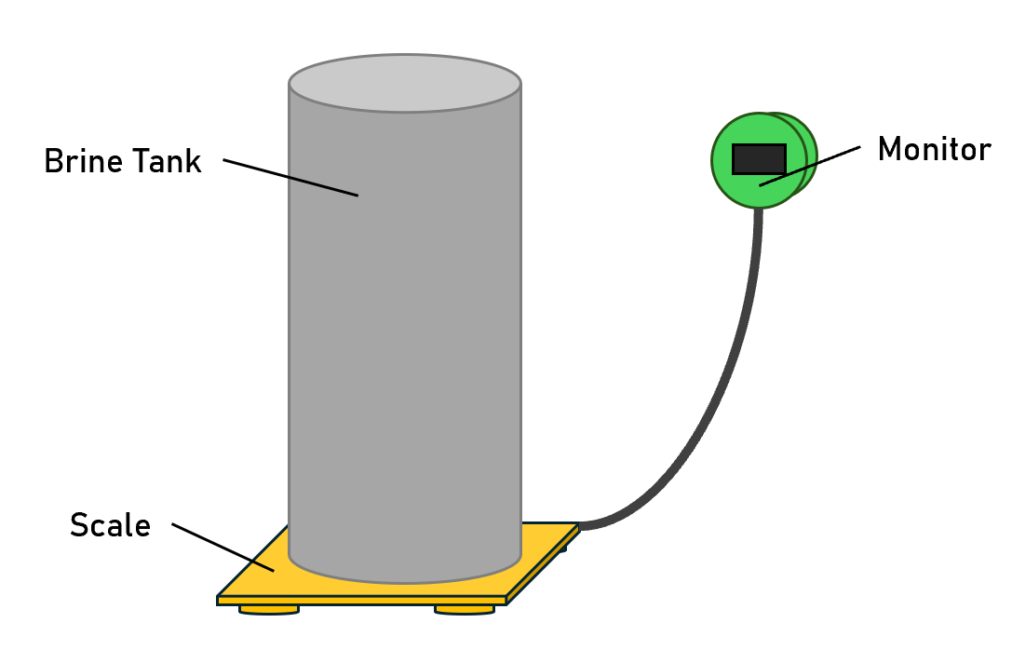

Slide 2
Scale
Monitor
5V Barrel Jack Input
ESP32
5V
HX711
Buzzer
Button
3.3V
Data
Load Cells
OLED
LDR

Slide 3
A+
E+
E+
E-
A-
A+
B-
B+
GND
DT
SCK
VCC
E-
A-

Slide 4
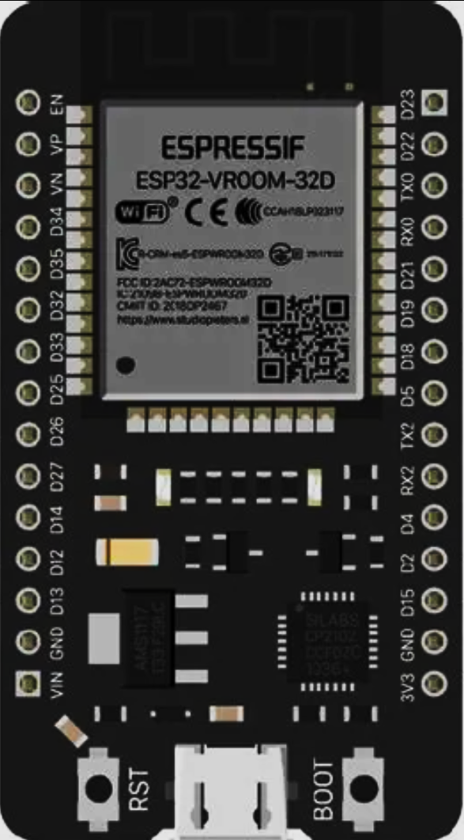
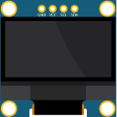
VCC
+
+
AO DO GND
-
HX711 CLK/DO
5V Input
3V3 Output

