Slide 1


Slide 2

Parallel Implementation of an Astronomical
Algorithm for a Hybrid Computing Environment
with OpenACC
Solórzano, A. L. V.; Charão, A. S. (advisor)
Association for Computing Machinery
#GHC19
Notes:
Opening Page/ Tittle Screen

Slide 3
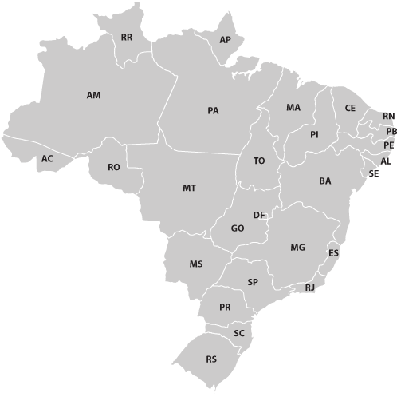

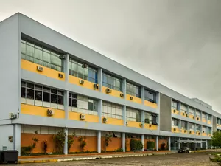
Ana Solórzano
alsolorzano@inf.ufsm.br
Bachelor’s in Computer Science
Graduation on Dec. 2019
Computer Science Education
High Performance Computing
#GHC19
Notes:
This was part of my undergraduate research

Slide 4
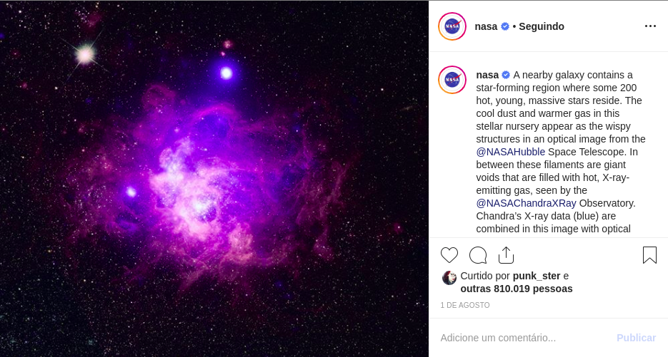
#GHC19
Notes:
There are simulation tools that perform methods to collect this information and sampled it by a list of particles of three-dimensional positions.

Slide 5
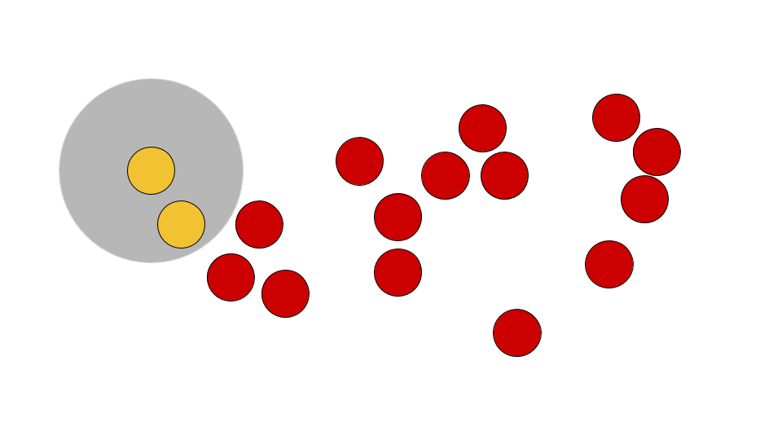
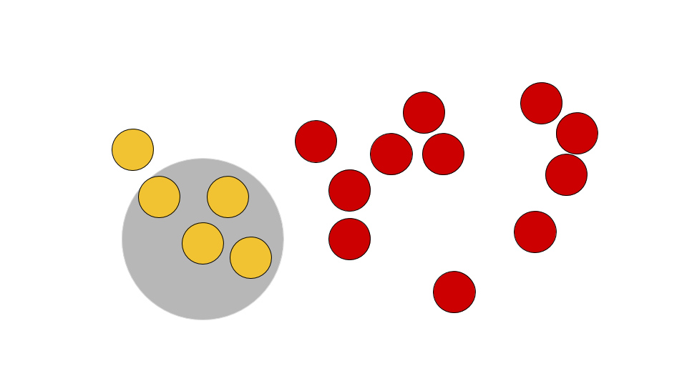
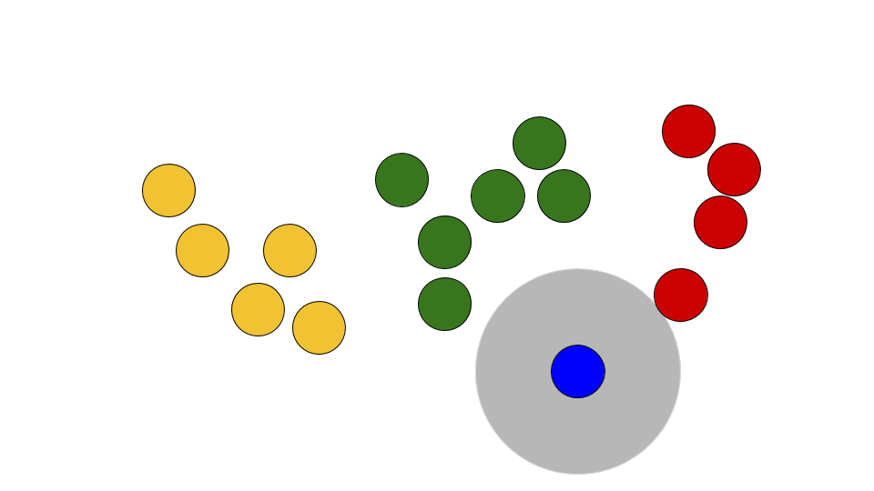
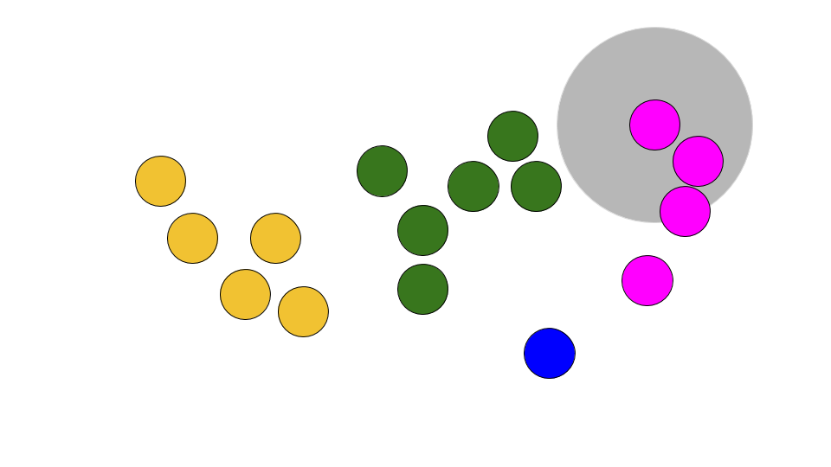
Friends-of-Friends (FoF)
Percolation algorithm
Reference implementation by [Ruiz et. al., 2009]
INPUT
Text file - simulation result
Percolation radius
OUTPUT
Number of groups
Output file
Log file
Execution time
#GHC19
Notes:
FoF is one of the existing algorithms that studies this simulations results.
It is a grouping algorithm to identify structures in the universe according to their physical proximity
We used as reference an FoF implementation by a research that worked with this in our institute.
The idea of the FoF is: Consider a sphere of radius R around each particle. If there are other particles inside this sphere, they will be considered belonging to the same group and will be called friends. The algorithm perform this comparasion between pairs of particles calculating the distance between then.
As output the algorithm shows the number of groups found and other execution information

Slide 6
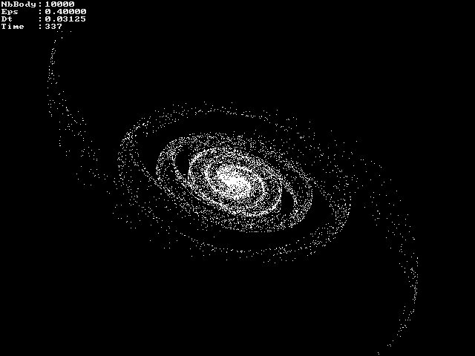
PROBLEM
Computational analysis of Astronomical data
Large datasets!
COMPUTATIONAL SOLUTION
High-performance Computing
Hybrid Computing
Accelerator devices
FPGA, Intel Xeon Phi, GPU
Optimization tools
MPI, OpenMP, CUDA, OpenACC
GOAL
Parallel FoF to run in a
CPU + GPU Environment
#GHC19
Notes:
Perform the same computation in a lot of data

Slide 7
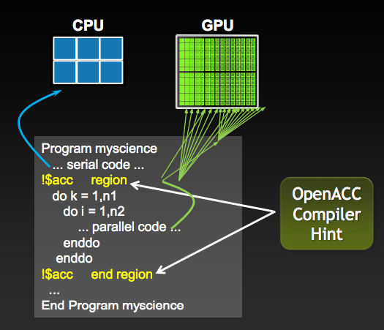
OpenACC
(https://www.openacc.org/)
Standard to parallelize codes using compiling directives
Heterogeneous HPC hardware platforms and architectures
Codes in C/C++/Fortran
List of compilers and profilers
(https://www.openacc.org/tools)
The OpenACC workflow
https://blogs.nvidia.com/blog/2012/06/05/openacc-complier-fast-portable-just-199-from-caps/
#GHC19
Notes:
Talk about data transference
That offers significantly less programming effort than required with a low-level model like CUDA or OpenCL
Talk about parallel programming, that the data is processed at the same time in different GPU kernels

Slide 8
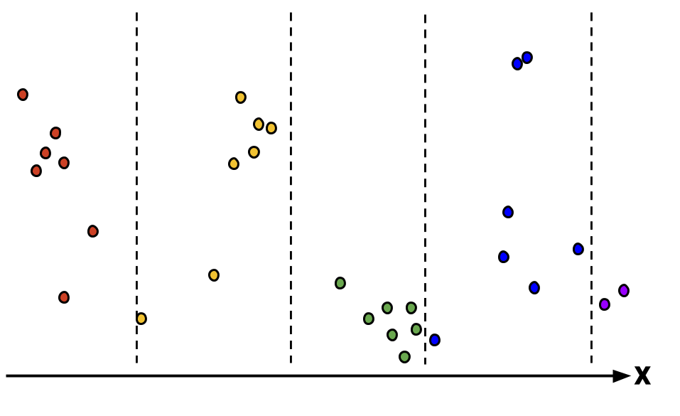
Parallel Approach
Hybrid Environment using
1 CPU and 1 GPU
Partition the input in chunks
Each chunk to a GPU kernel
#GHC19
Notes:
Talk about data transference
Also, why was it parallelized only along 'x'? How about making it into grids and having the cores handle it? Also, data transfer is mentioned and also that it improved; however no further details were provided.

Slide 9
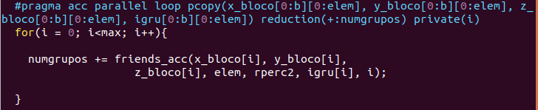
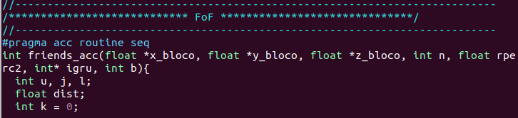
Compiling directives!!
Parallel Approach
#GHC19
Notes:
Talk about data transference
Just insert few lines of code to parallelize it with OpenACC

Slide 10
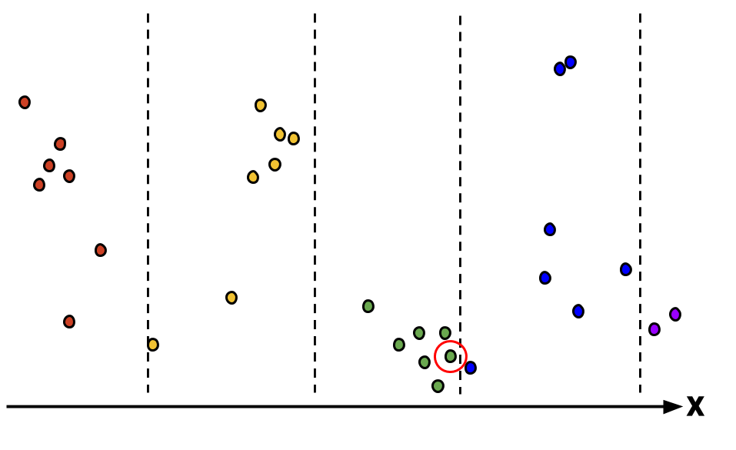
Post-processing
Particles friends classified by
different kernels
Verify the proximity between
particles in the border zones
Parallelization with OpenMP
#GHC19
Notes:
Talk about data transference

Slide 11
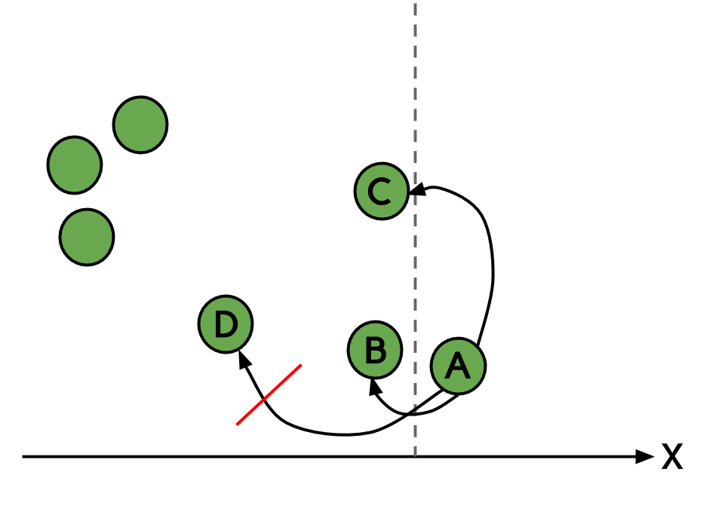
Post-processing
Particles friends classified by
different kernels
Verify the proximity between
particles in the border zones
Parallelization with OpenMP
#GHC19
Notes:
we do not need to compare it to the farther particles.

Slide 12
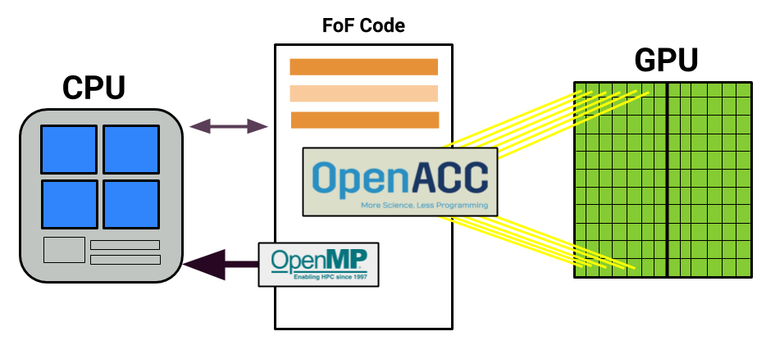
Parallel Approach
1
2
3
#GHC19
Notes:
To summarize here is a representation of the execution workflow.
Provide more details of it means by hybrid. Was the CPU doing some work while the GPU is executing the kernel?

Slide 13


Execution Environment
2 x Intel® Xeon® E5-2650 v3
10 cores and Hyperthreading amounting to 20 cores
128GB RAM
2 x GPUs NVIDIA Tesla K80
4992 CUDA cores
24GB of GDDR5 SDRAM
Compiler
Profiler
Nvprof
v. 18.4-0
#GHC19
Notes:
pgcc -ta=tesla -Minfo=all
MemCpy(HtoD) -- time copying data from host to the device
MemCpy(DtoH) -- time copying data from device to host
target device (ta)

Slide 14
Executions
Different samples!
30 executions
Radius: 1.7
Virgo Consortium Simulations (http://www.mpa-garching.mpg.de/Virgo/data\_download.html)
65,536
174,761
249,420
INPUT 1
200 KERNELS
INPUT 2
300 KERNELS
INPUT 3
600 KERNELS
#GHC19
Notes:
The original, sequential Friends-of-Friends algorithm implemented by
Ruiz et al. has a high computational cost with O(N 2 ) time complexity.
hierarchical tree-based approach

Slide 15
Results
 | Serial Time (seconds) | OpenACC Time (seconds)
INPUT 1 | 45.70 | 1.32
INPUT 2 | 307.06 | 6.28
INPUT 3 | 5,375.83 | 286.63
#GHC19
Notes:
the time decreased

Slide 16
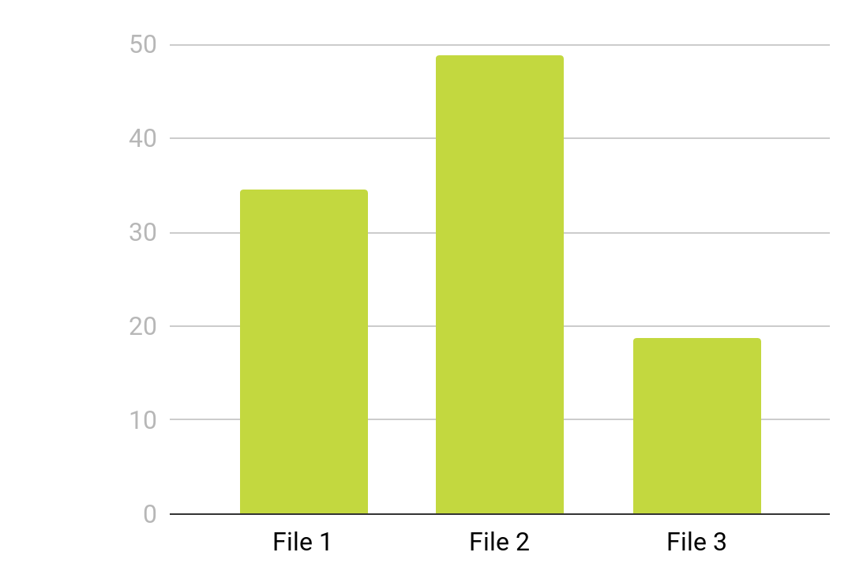
Results
#GHC19
Notes:
The speedup did not increase linearly because the processing varies depending on the particles positions.

Slide 17
In-depth profiling
NVIDIA Nvprof (https://developer.nvidia.com/nvidia-visual-profiler)
Maximum usage of the accelerator
FILE 1: 99.67% (1.79222s)
FILE 2: 99.85% (6.26328s)
FILE 3: 99.96% (61.0618s)
Minimum time with copies Host <-> Device
Limitations for datasets with more than 2.5 million particles
GPU Memory Limitation
#GHC19
Notes:
To investigate the GPU and memory usage we use the NVIDIA’s profiler nvprof. which dynamically analyzes the execution of a program. The tool is executed by command line and presents an overview of the GPU kernels and memory copies used in an application. In the execution option used, it shows the total time and percentage of the total application time for each kernel.
With nvprof we observed a 99.8% of GPU usage for the file with 249,420 particles, spending 0.15% with copies between host and device. However, the algorithm presented errors to process complete datasets, working fine until the number of particles exceeds 2.5 millions. We are currently investigating this issue, with the strongest hypothesis being the memory capacity of the GPU.
Almost all the time in GPU was used to process the FoF since it executed entirely in GPU, taking total advantage of the device.
OpenACC directives: To the second approach, the time was mostly spent in waiting to generate and after to enter the parallel region, with 80.99\% of waiting to the file 1 and 98.38\% to the file 3.

Slide 18

Final remarks
FoF with OpenACC
Future works
Parallelization using a GPU and CPU environment achieving 99% GPU usage and up to 48 of speedup;
Limitations with larger datasets.
More than one GPU;
Parallelize for different nodes
of the cluster.
Implementation break
Available in:
Server issue;
Web Platform for Remote Execution of Algorithms in Astronomy.
/anaveroneze/acmsrc
#GHC19
Notes:
This work explores parallelization approach for using GPUs to improve performance of Friend of Friend algorithm. Using OpenACC directives, the author was able to achieve a 99% GPU usage with minimum time wasted on data transferring.
With the advancement of GPUs and the continuous incorporation of GPUs into HPC clusters, finding efficient ways to port scientific applications to use GPUs is a highly recognized important area of research in the HPC community.

Slide 19
References
Kaehler, R. 2017. Massively parallel computation of accurate densities for N-body dark matter simulations using the phase-space-element method, In Astronomy and Computing, Volume 20, Pages 68-76, ISSN 2213-1337. DOI= https://doi.org/10.1016/j.ascom.2017.05.005​ .
Feng, Y., and Modi, C. 2017. A fast algorithm for identifying Friends-of-Friends halos. In Astronomy and Computing. DOI=​ https://doi.org/10.1016/j.ascom.2017.05.004​ .
Berwian, L., Zancanaro, E. T., Cardoso, D. J., Charão, A. S., da Rocha Ruiz, R. S., e de Campos Velho, H. F. (2017). Comparação de estratégias de paralelização de um algoritmo friends-of-friends com openmp. In Anais da XVII Escola Regional de Alto Desempenho do Estado do Rio Grande do Sul, pages 279 – 252.
Kaehler, R. 2017. Massively parallel computation of accurate densities for N-body dark matter simulations using the phase-space-element method, In Astronomy and Computing, Volume 20, Pages 68-76, ISSN 2213-1337. DOI= https://doi.org/10.1016/j.ascom.2017.05.005​ .
Ruiz, R. S. R., Campos Velho, H. F., e Caretta, C. A. (2009). Parallel algorithm friends-of-friends to identify galaxies and cluster of galaxies for dark matter halos. In Proceedings ... Workshop dos Cursos de Computação Aplicada do INPE, 9. (WORCAP). Instituto Nacional de Pesquisas Espaciais (INPE).
#GHC19
Notes:
This work explores parallelization approach for using GPUs to improve performance of Friend of Friend algorithm. Using OpenACC directives, the author was able to achieve a 99% GPU usage with minimum time wasted on data transferring.
With the advancement of GPUs and the continuous incorporation of GPUs into HPC clusters, finding efficient ways to port scientific applications to use GPUs is a highly recognized important area of research in the HPC community.

Slide 20



Please remember to complete the session survey in the mobile app.
THANK YOU!
/anavs/en
@anaveroneze
www-usr.inf.ufsm.br/~alsolorzano/
#GHC19
Notes:
Opening Page/ Tittle Screen

Slide 21
for i = 0, …, N do
while igru[i] != 0 do
i++;
igru[i] = ++k;
for j = i, …, N do
if igru[j] == k then
for l = i + 1, …, N do
if igru[l] == 0 then
dist = sqrt((x[j] - x[l])*(x[j] - x[l]) + (y[j] - y[l])*(y[j] - y[l])
+ (z[j] - z[l])*(z[j] - z[l]));
if dist <= rperc then
igru[l] = k;
end if
end for
end if
end for
end for
#GHC19

Slide 22
Friends-of-Friends (FoF)
Percolation algorithm
If d(x,y) < R then x and y are friends
If d(y, z) < R then y is friend of z and friend of x
Time complexity O(nlogn)
#GHC19
Notes:
All the particles can belong to the same group

