Slide 1
NYC LANGUAGE MAPPING PROJECT
April 30, 2020 | Multilingual Technologies, Language Diversity | Columbia @Zoom
Anavi Lohia, Cherie Chu, Jennifer Lee

Slide 2
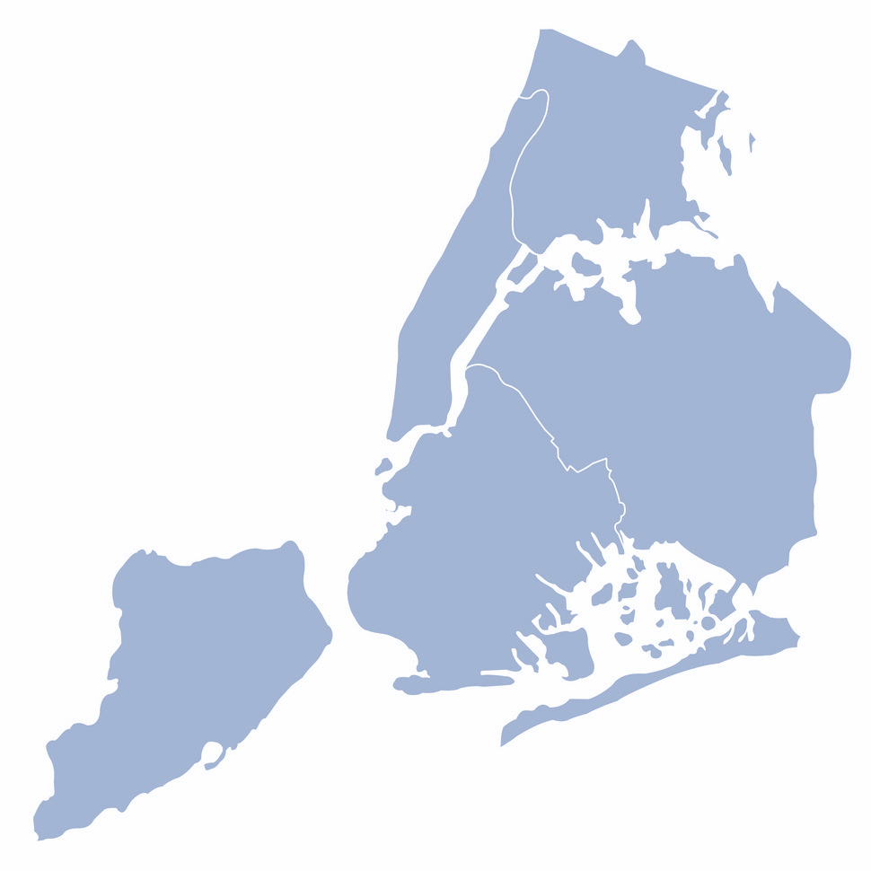

GOALS
LANGUAGE MAPPING NYC
Identify relationships between high-resource and low-resource languages that allow existing technologies for high-resource languages to be better leveraged for use with low-resource languages.
Goal
Language Justice
Related Work
Data
Our Approach
Results
Conclusion
Create a way for laypeople to see, access, and interact with this data, sparking newfound interest in marginalized languages.

Slide 3
“Digital media are transforming the world by turning one of the oldest technologies of world civilization—alphabetic writing—into a new imperial coding system.”
LANGUAGE MAPPING NYC
– Lydia Liu, Scripts in Motion: Writing as Imperial Technology
Goal
Language Justice
Related Work
Data
Our Approach
Results
Conclusion
“DLD [Digital Language Diversity] will not come about of its own accord. […] However, no great technological leaps are required to create a full panoply of resources for any given language. The heavy lifting … that is undertaken for languages at the top of the scale can be applied to other languages at relatively high speed and low cost.”
- Martin Benjamin, Digital Language Diversity: Seeking the Value Proposition

Slide 4
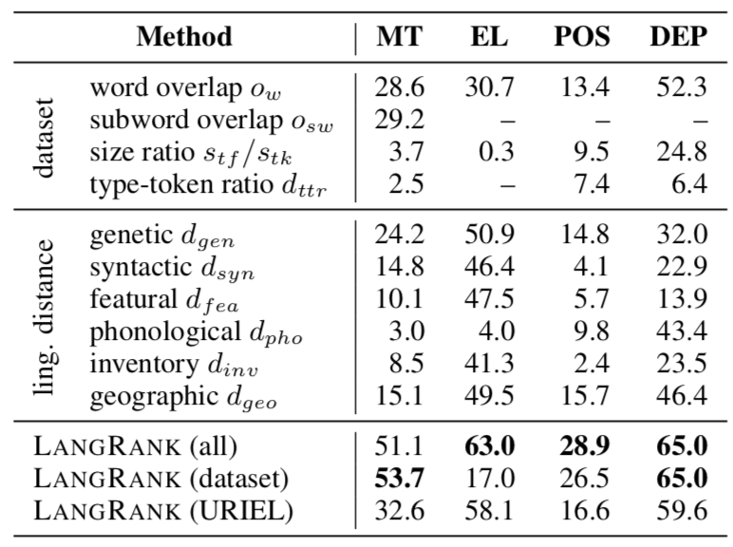
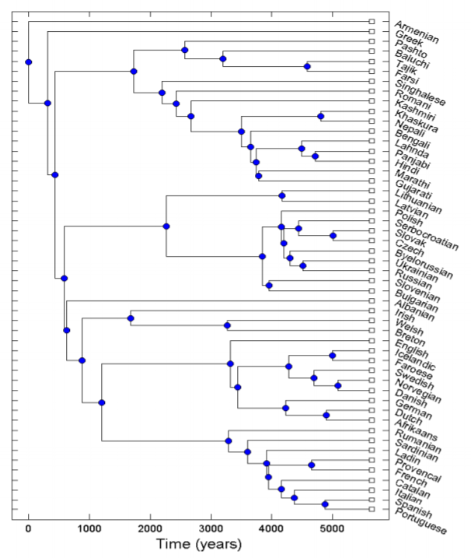
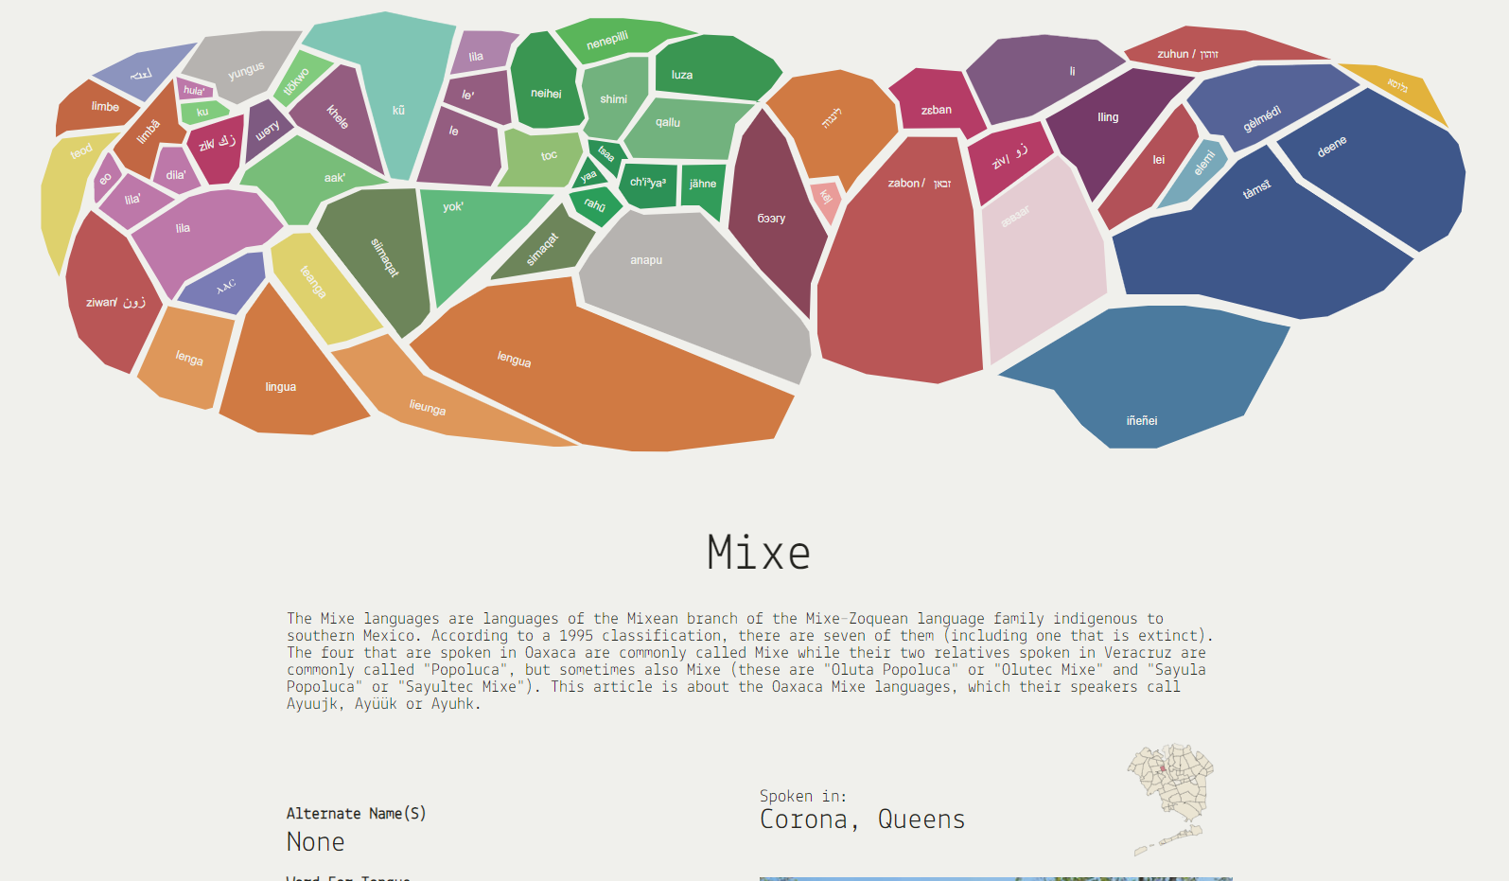
“It is clear that selecting proper pivoting languages and string representations is important; failing to do so can cause performance degradation of as much as 20%”
LANGUAGE MAPPING NYC
–Zhou, Shuyan, et al.
Goal
Language Justice
Related Work
Data
Our Approach
Results
Conclusion
LANGRANK
INDO-EUROPEAN LANGUAGES TREE BY LEVENSHTEIN DISTANCE
THE GARDEN OF FORKED TONGUES

Slide 5
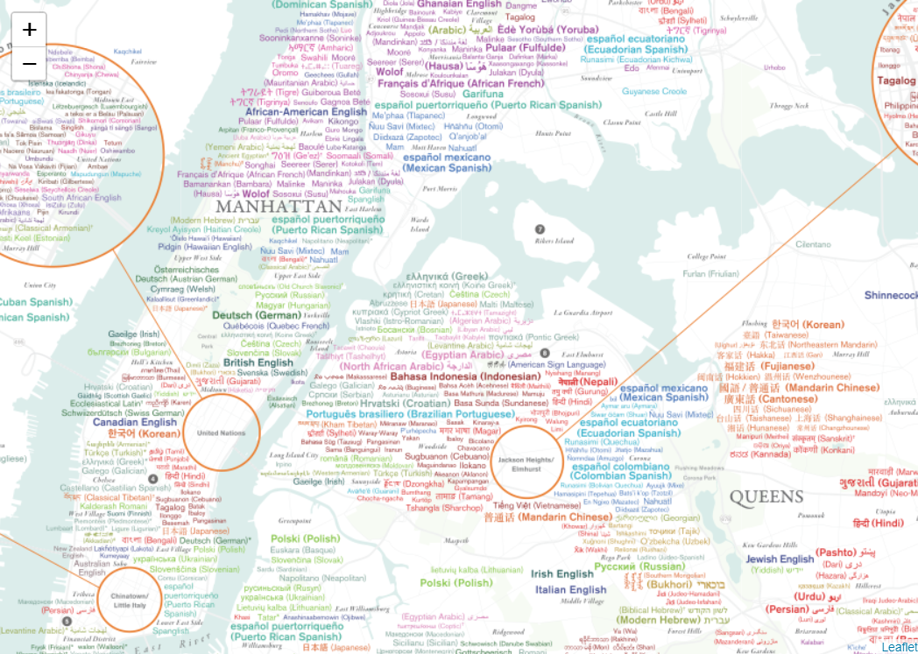
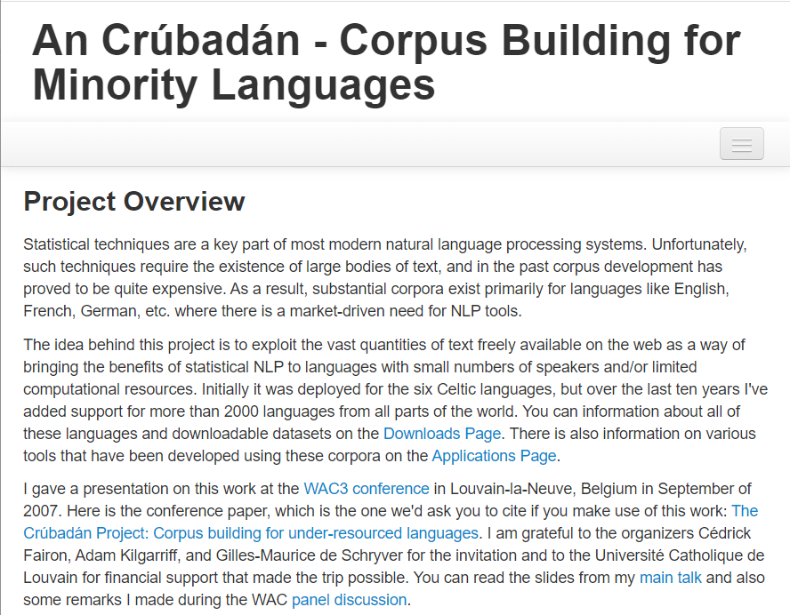
LANGUAGE MAPPING NYC
Goal
Language Justice
Related Work
Data
Our Approach
Results
Conclusion
AN CRÚBADÁN
ENDANGERED LANGUAGE ALLIANCE

Slide 6
LEVENSHTEIN DISTANCE
LANGUAGE MAPPING NYC
 | k | i | t | t | e | n
 | 0 | 1 | 2 | 3 | 4 | 5 | 6
s | 1 | 1 | 2 | 3 | 4 | 5 | 6
i | 2 | 2 | 1 | 2 | 3 | 4 | 5
t | 3 | 3 | 2 | 1 | 2 | 3 | 4
t | 4 | 4 | 3 | 2 | 1 | 2 | 3
i | 5 | 5 | 4 | 3 | 2 | 2 | 3
n | 6 | 6 | 5 | 4 | 3 | 3 | 2
g | 7 | 7 | 6 | 5 | 4 | 4 | 3
 | S | a | t | u | r | d | a | y
 | 0 | 1 | 2 | 3 | 4 | 5 | 6 | 7 | 8
S | 1 | 0 | 1 | 2 | 3 | 4 | 5 | 6 | 7
u | 2 | 1 | 1 | 2 | 2 | 3 | 4 | 5 | 6
n | 3 | 2 | 2 | 2 | 3 | 3 | 4 | 5 | 6
d | 4 | 3 | 3 | 3 | 3 | 4 | 3 | 4 | 5
a | 5 | 4 | 3 | 4 | 4 | 4 | 4 | 3 | 4
y | 6 | 5 | 4 | 4 | 5 | 5 | 5 | 4 | 3
Goal
Language Justice
Related Work
Data
Our Approach
Results
Conclusion
*Example from Wikipedia

Slide 7
LANGUAGE MAPPING NYC
 | RAW RESULTS
 | English (en-US) | Quechua (qu) | Spanish (es-PR) | Tagalog (tl) | Cebuano (ceb) | Uzbek (uz-Latn) | Indonesian (id) | Brazilian Portuguese (pt-BR )
English (en-US) | 5800057454 | 1358782478 | 1308306430 | 4634571488 | 1747033910 | 6395876358 | 8033721888 | 1521680730
Quechua (qu) |  | 263082526 | 300107560 | 973597411 | 376504770 | 1362198719 | 1774238557 | 355008851
Spanish (es-PR) |  |  | 287418368 | 1027990188 | 387665304 | 1420574153 | 1785240968 | 335972233
Tagalog (tl) |  |  |  | 3306331788 | 1267959059 | 4753585015 | 6097091272 | 1206702113
Cebuano (ceb) |  |  |  |  | 477430366 | 1828456776 | 2305310535 | 449317394
Uzbek (uz-Latn) |  |  |  |  |  | 6364980082 | 8542227564 | 1678199223
Indonesian (id) |  |  |  |  |  |  | 10618939790 | 2071489698
Brazilian Portuguese ( pt-BR ) |  |  |  |  |  |  |  | 384199592
Goal
Language Justice
Related Work
Data
Our Approach
Results
Conclusion
 | Similarity Index
 | English (en-US) | Quechua (qu) | Spanish (es-PR) | Tagalog (tl) | Cebuano (ceb) | Uzbek (uz-Latn) | Indonesian (id) | Brazilian Portuguese (pt-BR )
English (en-US) |  | 4.268569508 | 4.433256094 | 1.251476532 | 3.319945549 | 0.906843274 | 0.721963933 | 3.811612607
Quechua (qu) |  |  | 0.876627453 | 0.270216953 | 0.698749517 | 0.193130798 | 0.148279117 | 0.741059062
Spanish (es-PR) |  |  |  | 0.279592521 | 0.741408542 | 0.202325495 | 0.16099696 | 0.855482506
Tagalog (tl) |  |  |  |  | 2.607601377 | 0.695544895 | 0.542280186 | 2.73997348
Cebuano (ceb) |  |  |  |  |  | 0.261111103 | 0.20710024 | 1.062568181
Uzbek (uz-Latn) |  |  |  |  |  |  | 0.745119471 | 3.792744029
Indonesian (id) |  |  |  |  |  |  |  | 5.126233454
Brazilian Portuguese ( pt-BR )

Slide 8
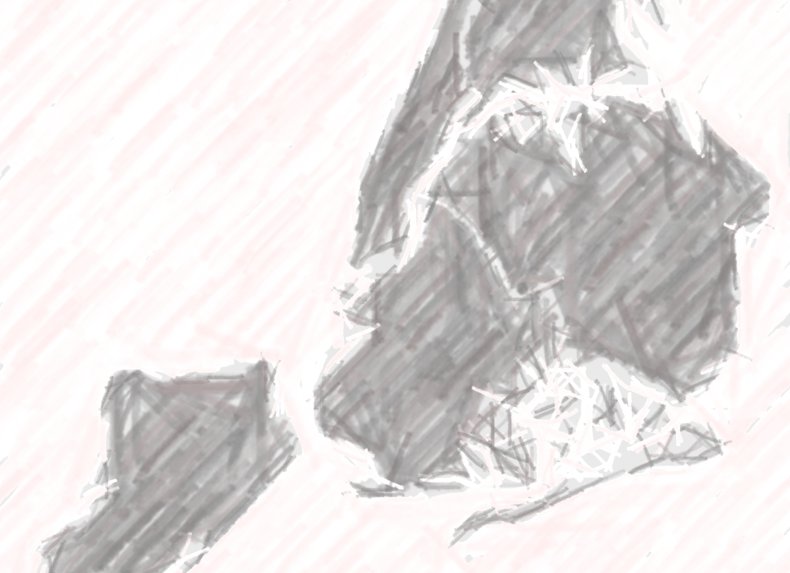
LANGUAGE MAPPING NYC
Goal
Language Justice
Related Work
Data
Our Approach
Results
Conclusion
DEMO

Slide 9
… a LONG way for us to go!
LANGUAGE MAPPING NYC
CHALLENGES
– Original goal was to use Langrank, but could not get our own data into Langrank.
– Ethnologue, An Crúbadán, and ELA use different standards for classifying languages.
– We ended up having to make the corpuses much smaller to be able to run our computations in a reasonable timeframe.
– Getting better data for mapping would help.
Goal
Language Justice
Related Work
Data
Our Approach
Results
Conclusion
FUTURE WORK
– Develop more sophisticated methods of mapping language distance.
– Run this on more languages.
OUR CONTRIBUTIONS
– Calculating Levenshtein distance outside of Indo-European Family Tree.
– Vision for a map that is interactive and shows relationship between languages.
– Emphasis on computational work that is meaningful to the greater public, and for public interest as driver of change.

Slide 10
THANK YOU!

Slide 11
IMAGE/TEXT SOURCES
Language Justice:
Benjamin, Martin. “Digital Language Diversity: Seeking the Value Proposition.” Proceedings of the LREC 2016 Workshop “CCURL 2016 – Towards an Alliance for Digital Language Diversity,” 23 May 2016, pp. 52-58.
Liu, Lydia H. “Scripts in Motion: Writing as Imperial Technology, Past and Present.” Pmla, vol. 130, no. 2, 2015, pp. 375–383., doi:10.1632/pmla.2015.130.2.375.
Related Work:
Ghani, Miriam. “The Garden of Forked Tongues.” Forked Tongue Map, ww.mariamghani.com/forkedtongues/tonguemap/.
Lin, Yu-Hsiang, et al. “Choosing Transfer Languages for Cross-Lingual Learning.” Proceedings of the 57th Annual Meeting of the Association for Computational Linguistics, 2019, pp. 3125–35, doi:10.18653/v1/p19-1301.
Serva, M., and F. Petroni. “Indo-European Languages Tree by Levenshtein Distance.” EPL (Europhysics Letters), vol. 81, no. 6, 2008, p. 68005., doi:10.1209/0295-5075/81/68005.
Zhou, Shuyan, et al. “Improving Candidate Generation for Low-Resource Cross-Lingual Entity Linking.” Transactions of the Association for Computational Linguistics, vol. 8, 2020, pp. 109–24, doi:10.1162/tacl_a_00303.
Data
Scannell, Kevin P. “An Crúbadán -.” An Crúbadán - Corpus Building for Minority Languages, crubadan.org. Accessed 1 May 2020.
“Maps | Endangered Language Alliance.” Endangered Language Alliance, elalliance.org/programs/maps. Accessed 1 May 2020.
Our Approach
Wikipedia contributors. “Levenshtein Distance.” Wikipedia, 21 Apr. 2020, en.wikipedia.org/wiki/Levenshtein_distance.

