Slide 1
* 프로젝트 개발 진행 과정에서 “강지용, 최원형 팀”과 메일 상으로 여러 도움을 주고 받았습니다.
Report on ARP project
(2023년 1학기 인터넷 보안 특강)
서윤형, 송효진
2023.06.19

Slide 2
1. Introduction
2. Related Work
목차
3. Extended ARP Design
4. Implementation
5. Experiment
6. Conclusion

Slide 3



Introduction
ARP protocol
A network protocol to map an IP address (L3, network layer) to a corresponding MAC address (L2, data link layer) on a local network
Security vulnerability on ARP
ARP spoofing attack can be easily done because,
ARP request is sent to all hosts via a broadcast message on a local network.
All hosts update the ARP cache and send the ARP reply without any verification.
The attacker can intercept the network traffic and perform the next attack. (e.g. MITM)
Man In The Middle Attack
Proposed Solution
ARP Request via broadcast
A
B
Let the ARP reply be sent in a secure way.
ARP Reply incl. a certification

Slide 4
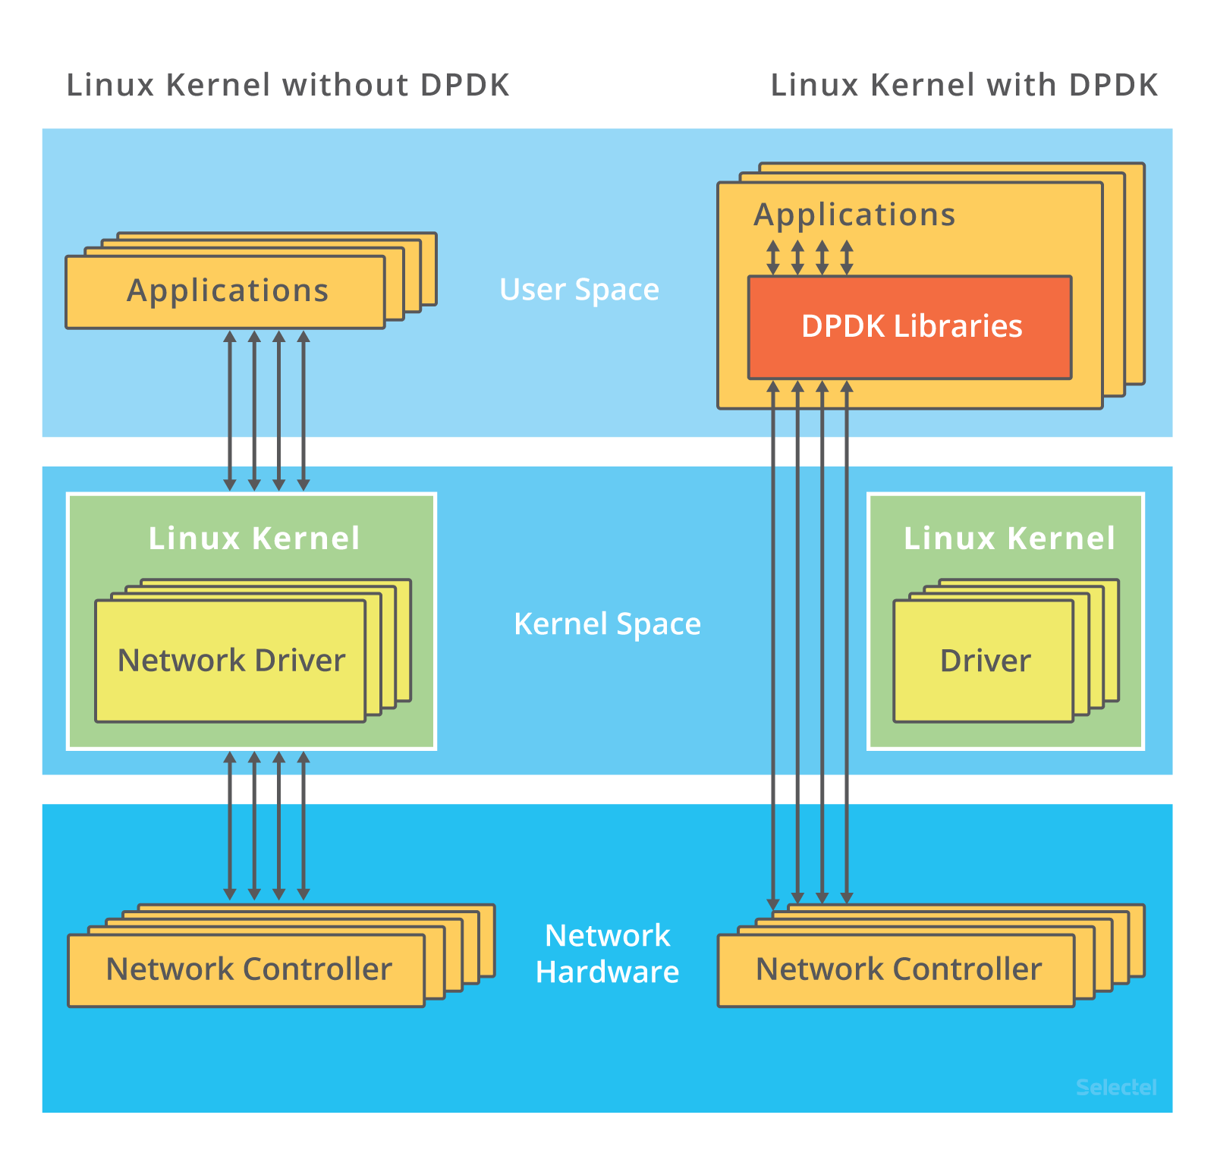
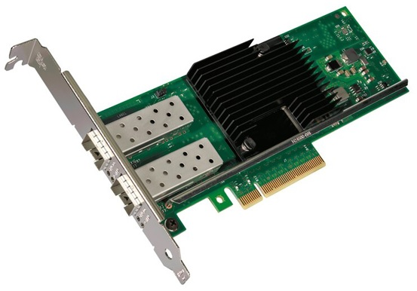
Related Work
VFIO (Virtual Function I/O): A kernel feature for the direct access from the user space to PCI
IOMMU (I/O memory management unit): Provides a security functionality for the memory protection
DPDK (Data Plane Development Kit, https://www.dpdk.org/)
An open source project with data plane libraries and drivers
Make applications directly access to the NIC bypassing the kernel
Can’t use the socket supported by kernel!
Intel X710-DA2 (PDF spec)
VFIO
A DPDK-compatible NIC with two SFP+ ports
Support NIC drivers for both Kernel and DPDK
IOMMU
S-ARP: a Secure Address Resolution Protocol
Propose a signature and key management system for the secure ARP.
https://ieeexplore.ieee.org/document/1254311 (published in 2003)

Slide 5
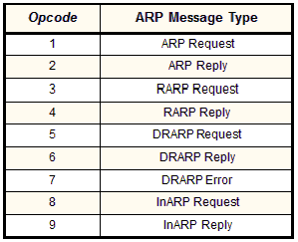

Extended ARP Design
* Opcode for Signed ARP Reply: 0x0012
Major consideration
The additional bytes are inserted at the end of the extended ARP message.
‘Magic’ header is used for identifying the Extended ARP protocol.
‘Type’ header is used for the future extensibility with timestamp. (e.g. Replay attack)
(2 bytes) 16
(4 bytes) 32
(2 bytes) 16
(4 bytes) 32
0
8
24
0
8
24
Hardware Type (Ethernet, 0x0001) |  | Protocol Type (ARP, 0x0806)
Hardware Address Length (0x06) | Protocol Address Length (0x04) | Opcode (Req: 0x0001, Reply: 0x0002)
Sender Hardware Address (MAC, 6 bytes)
 |  | Sender Protocol Address (IP, 4 bytes)
Sender Protocol Address (IP, 4 bytes)
Target Hardware Address (MAC, 6 bytes)
Target Protocol Address (IP, 4 bytes)
Original ARP packet (28 bytes)
Magic (0x1522) | Type (0x0001)
CertDataLen | CertSigLen
Timestamp
Certificate Data
Certificate Signature
Original ARP protocol (28 bytes) (14 bytes for the Ethernet frame header are added.)
Extended ARP packet (28 + 12 + len(cert) bytes)

Slide 6
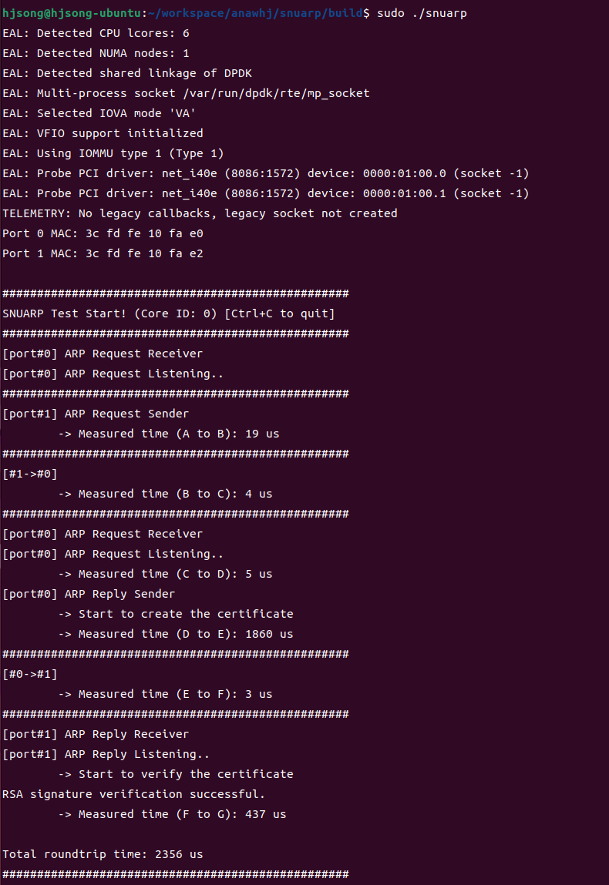
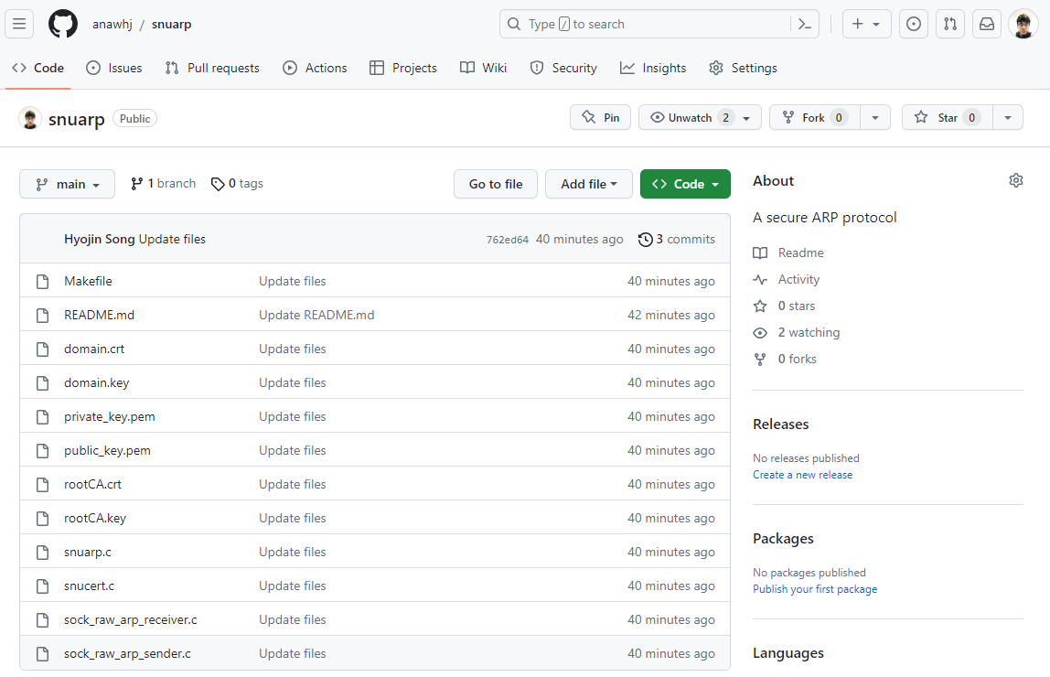
Implementation
Refer to README.md on the following Github repository
https://github.com/anawhj/snuarp

Slide 7
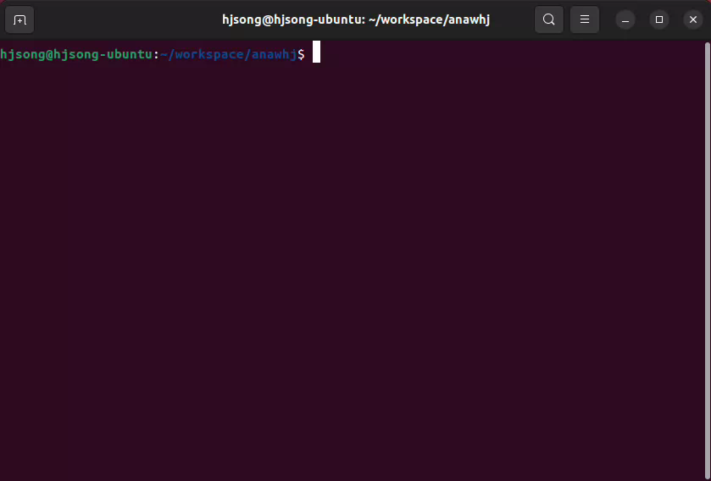
Demo

Slide 8
Experiment (1,000 times average, unit: microsecond)
Roundtrip delay between ARP and E-ARP (Extended ARP)
A: Start to create an ARP Request packet
B: Send an ARP Request Packet
C: Receive an ARP Request Packet
D: Start to create an ARP Reply packet
E: Send an ARP Reply packet
F: Receive an ARP Reply packet
G: Complete to verify the certificate
(Unit: µ secs) | A to B | B to C | C to D | D to E | E to F | F to G | Roundtrip SUM(A:G)
ARP | 6 | 3 | 4 | 2 | 5 | 4 | 25 us
E-ARP | 5 | 2 | 3 | 1927 | 3 | 433 | 2373 us

Slide 9
Experiment (1,000 times average, unit: microsecond)
Roundtrip delay on the E-ARP with 512 and 2048 key lengths
A: Start to create an ARP Request packet
B: Send an ARP Request Packet
C: Receive an ARP Request Packet
D: Start to create an ARP Reply packet
E: Send an ARP Reply packet
F: Receive an ARP Reply packet
G: Complete to verify the certificate
(Unit: µ secs) | A to B | B to C | C to D | D to E | E to F | F to G | Roundtrip SUM(A:G)
E-ARP with 512 | 5 | 3 | 4 | 1156 | 3 | 389 | 1560 us
E-ARP with 2048 | 5 | 2 | 3 | 1927 | 3 | 433 | 2373 us

Slide 10
Conclusion
Alternatives for this project development
Packet Socket for handling L2 packets (https://man7.org/linux/man-pages/man7/packet.7.html)
Smart NIC as a mini PC (https://github.com/Digilent/linux-digilent/blob/master/net/ipv4/arp.c)
Future work (virtual)
How to reduce the computing overhead on ARP reply? (Too many ARP packets in a local network!)
How to deploy and manage the root CA and the key pair? (High complexity makes additional risks.)

