Slide 1
Idea/Approach Details
Ministry/Organization Name: Government of Uttarakhand
Problem Statement: Lack of technological intervention in value addition of agriculture products produced by SHGs /FPGs
Team Name: Hypertext Assassins
Team Leader Name: Bhagyashri Sangtani
College code: 6276

Slide 2
Idea/Approach Details
Main Idea: To eliminate the intermediaries between farmers and consumers by developing an e-commerce platform.
Technological Interventions:
Webapp for the stakeholders, i.e. farmers and consumers
Use of Barcodes for easy logistics
Use of QR codes for food traceability
SMS notifications for the farmer
Marketing Avenues: Television,Radio,Newspaper,Gram Panchayat,NGO’s,School Campaigns.
Technology Stack: HTML, PHP, JavaScript, CSS

Slide 3
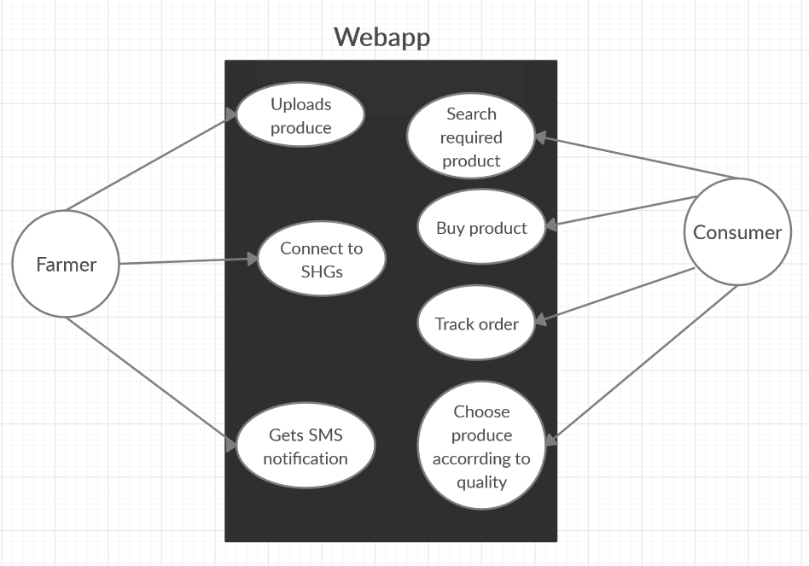
Idea/Approach Details
Use cases
Dependencies
Farmer must upload produce details before any consumer can buy.
Produce should be delivered.
Farmer must receive a message after payment is completed.

Slide 4
Idea/Approach Details
Main Idea: To eliminate the intermediaries between farmers and consumers by developing an e-commerce platform.
Solution:
Value Addition: Production of organic fertilizers/pesticides from farm waste. Hence, converting waste to money.
Direct link between farmers and SHG’s to benefit both.(Diagram)
Providing a platform for FPG formation which in turn provide better value for similar produce.
Technological Interventions: SMS notifications for farmers , audio messages(in local language).
Technology Stack: HTML, CSS, JavaScript, PHP, SQL

