Slide 1

SYNTHETIC WALKTHROUGH
Turn finished agency work into proof a client can approve.
One milestone.
One named reviewer.
One clear decision.
Acceptance-to-invoice evidence for U.S. web agencies.
Closed design-partner beta
Notes:
Open with the workflow problem. The walkthrough uses included synthetic data and creates no retained approval.
[Sources]
- Greenlit internal product screens and company-demo documentation; synthetic walkthrough; July 26, 2026.
[/Sources]

Slide 2
GREENLIT · COMPANY DEMO
02
The work is done. The decision is still scattered.
01
Scope
The promise lives in a SOW.
02
Proof
Screenshots and observations live somewhere else.
03
Decision
Approval gets buried in email or chat.
04
Billing
The invoice handoff loses the evidence trail.
Greenlit’s job is to keep those four moments connected.
Notes:
[Sources]
- Greenlit internal product screens and company-demo documentation; synthetic walkthrough; July 26, 2026.
[/Sources]

Slide 3
GREENLIT · COMPANY DEMO
03
One evidence chain replaces the handoff gap.
1
2
3
4
→
→
→
Confirm
Observe
Decide
Record
Exact SOW language becomes human-confirmed acceptance criteria.
Typed browser checks inspect an authorized staging build.
One named reviewer sees the promise, result, evidence, and deadline.
The decision and invoice-ready context stay attached.
AI drafts. The agency confirms. The browser observes. The client decides.
Notes:
[Sources]
- Greenlit internal product screens and company-demo documentation; synthetic walkthrough; July 26, 2026.
[/Sources]

Slide 4
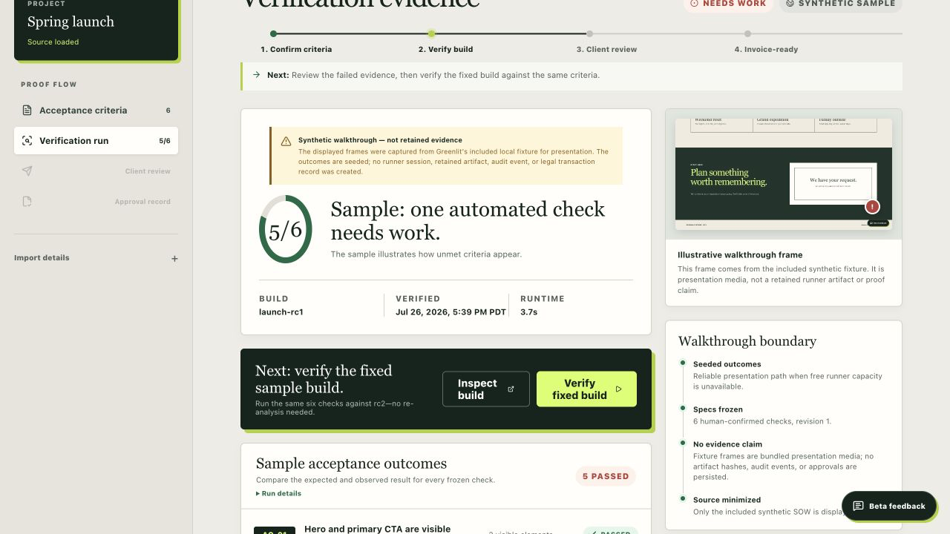
GREENLIT · COMPANY DEMO
04
A polished success message is not proof.
The synthetic release candidate looks successful, while the underlying request fails. Greenlit keeps the observed failure attached to the frozen promise.
AC-04 · NEEDS WORK
Visible confirmation contradicted the HTTP 500 response.
Synthetic fixture · presentation evidence, not a retained runner artifact
Notes:
[Sources]
- Greenlit internal product screens and company-demo documentation; synthetic walkthrough; July 26, 2026.
[/Sources]

Slide 5
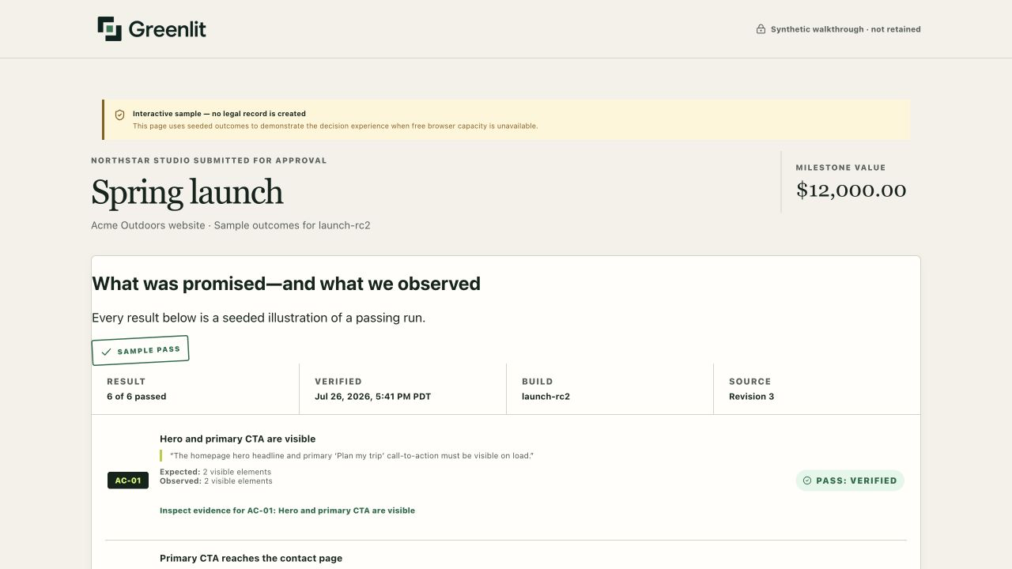
GREENLIT · COMPANY DEMO
05
The client sees the promise—not a test dashboard.
Exact source language
Expected and observed result
Evidence and deadline
Approve or request changes
Notes:
[Sources]
- Greenlit internal product screens and company-demo documentation; synthetic walkthrough; July 26, 2026.
[/Sources]

Slide 6
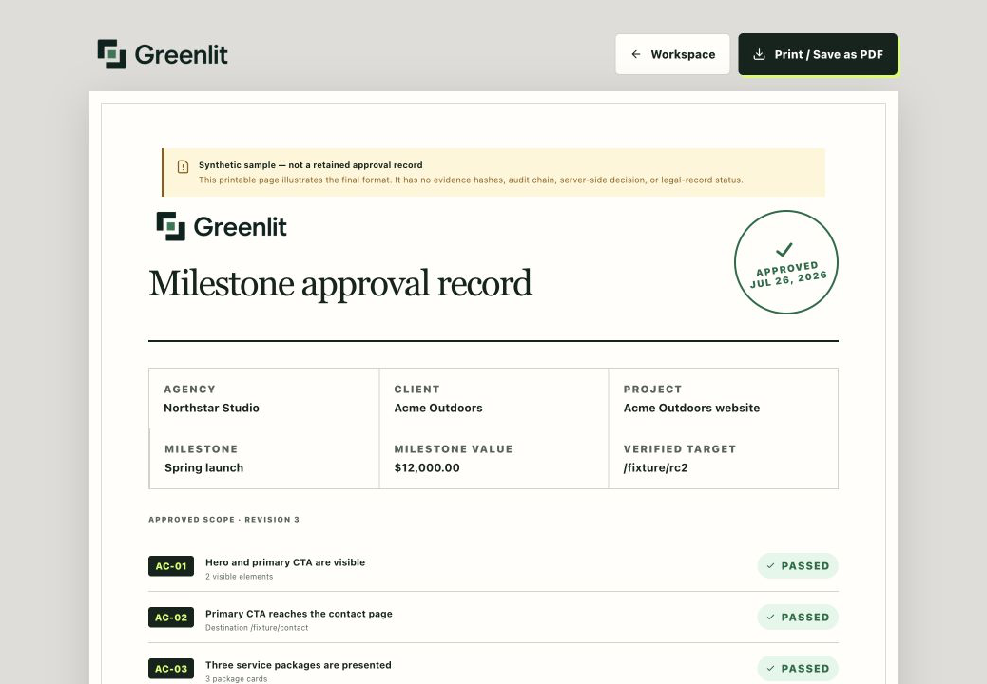
GREENLIT · COMPANY DEMO
06
The decision becomes an invoice-ready record.
One retained view connects the milestone value, frozen revision, observed build, named decision, and print-ready receipt.
What it is
A business approval record and billing handoff.
What it is not
A signature product, certification, ledger, or payment guarantee.
Notes:
[Sources]
- Greenlit internal product screens and company-demo documentation; synthetic walkthrough; July 26, 2026.
[/Sources]

Slide 7
GREENLIT · COMPANY DEMO
07
Start with one bounded milestone.
BEST FIT
BOUNDARIES
2–50-person U.S. web agency
Recurring milestone approvals
Named client reviewer
Authorized public HTTPS staging
No confidential or regulated data
No protected-preview bypasses
No compliance or signature claims
No guaranteed invoice or payment outcome
Recommended research format: 30 days · one milestone at a time · separate permission for any case study
Notes:
[Sources]
- Greenlit internal product screens and company-demo documentation; synthetic walkthrough; July 26, 2026.
[/Sources]

Slide 8
The next useful step is a focused workflow conversation.
Bring
A recurring approval bottleneck and a safe upcoming milestone.
Leave out
Confidential SOWs, credentials, access codes, and client data.
Decide
Whether one bounded design-partner pilot is worth testing.
greenlitproof.vercel.app/request-demo
Trust boundaries:
greenlitproof.vercel.app/trust
Notes:
Close by qualifying the workflow, not by promising a broad rollout.
[Sources]
- Greenlit internal product screens and company-demo documentation; synthetic walkthrough; July 26, 2026.
[/Sources]

