Slide 1

BLUEPRINT HACKATHON
Turn every SOW promise into proof a client can approve.
One Statement of Work (SOW)
Six clear checks
One approval trail
For web agencies that need a clear approval trail.
Notes:
[Sources]
- Internal product narrative: docs/DEVPOST_SUBMISSION.md
- Greenlit logo and visual assets: project-owned source deck.

Slide 2
GREENLIT · BLUEPRINT 2026
02
The work may be finished, but the approval trail is scattered.
01
Scope
The promise starts in the SOW.
02
Proof
Screenshots and test results end up somewhere else.
03
Decision
The approval gets buried in email or chat.
04
Billing
By invoicing time, the evidence trail is gone.
Greenlit keeps the promise, proof, decision, and invoice handoff together.
Notes:
[Sources]
- Product problem and workflow: docs/DEVPOST_SUBMISSION.md.

Slide 3
GREENLIT · BLUEPRINT 2026
03
The same promise stays connected from contract to approval.
1
2
3
4
→
→
→
Confirm
Observe
Decide
Record
Turn the SOW into clear criteria your team approves.
Run typed browser checks against the approved staging build.
Give one reviewer the promise, result, evidence, and deadline.
Keep the decision with the details needed for invoicing.
Your team confirms the criteria, the browser checks the work, and your client makes the call.
Notes:
[Sources]
- Product workflow and trust model: docs/DEVPOST_SUBMISSION.md and docs/ARCHITECTURE.md.

Slide 4
GREENLIT · BLUEPRINT 2026
04
Greenlit starts with agencies that get paid by milestone.
WHO WE START WITH
99,391
Web, product, and creative agencies with 10–50 people
U.S. employer establishments across three adjacent categories
BUYER
68,051 Custom computer programming
15,828 Graphic design
15,512 Advertising agencies
Agency owner, delivery lead, or account lead
PAIN
Proof, approval, and billing live in different tools.
At $200/month: about $239M/year (illustrative)
Market proxy: 2023 U.S. Census County Business Patterns, employer establishments only. Pricing scenario is illustrative.
Notes:
[Sources]
- U.S. Census Bureau, 2023 County Business Patterns national file: https://www2.census.gov/programs-surveys/cbp/datasets/2023/cbp23us.zip
- NAICS categories used: 541511, 541430, and 541810.
- Target-user rationale: README.md and docs/DEVPOST_SUBMISSION.md

Slide 5
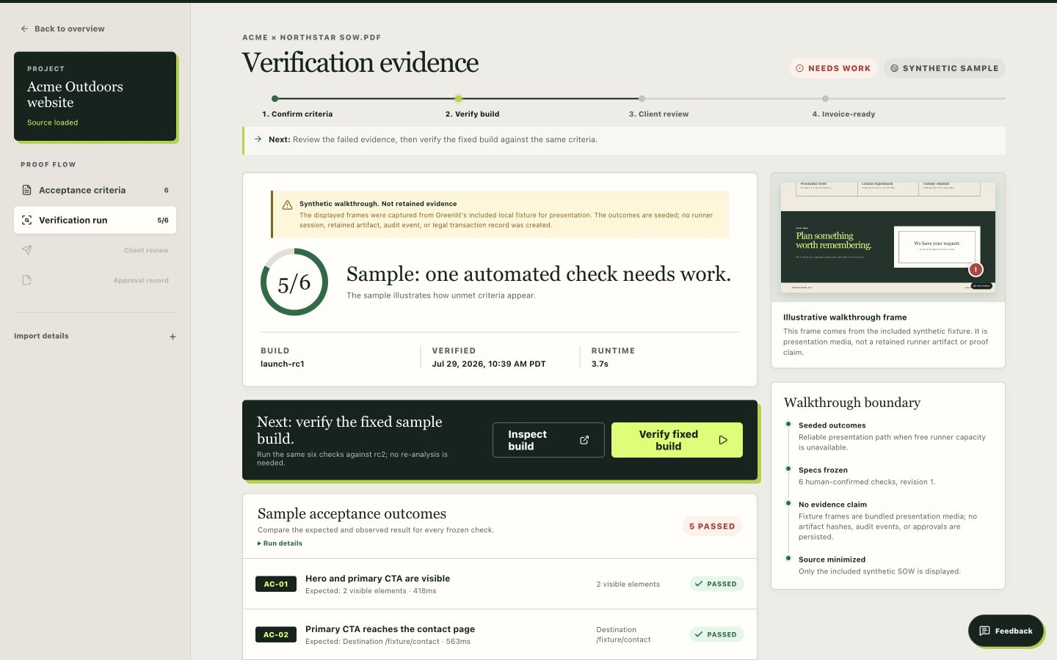
GREENLIT · BLUEPRINT 2026
05
A polished success message is not proof.
The test site says the form worked even though the request returned 500. Greenlit records that failure alongside the exact criterion.
AC-04 · FAILED CHECK
The page showed success, but the server returned HTTP 500.
Synthetic walkthrough evidence; no retained transaction was created.
Notes:
[Sources]
- Synthetic failure scenario and product screenshot: docs/JUDGE_DEMO.md and project-owned Greenlit walkthrough.

Slide 6
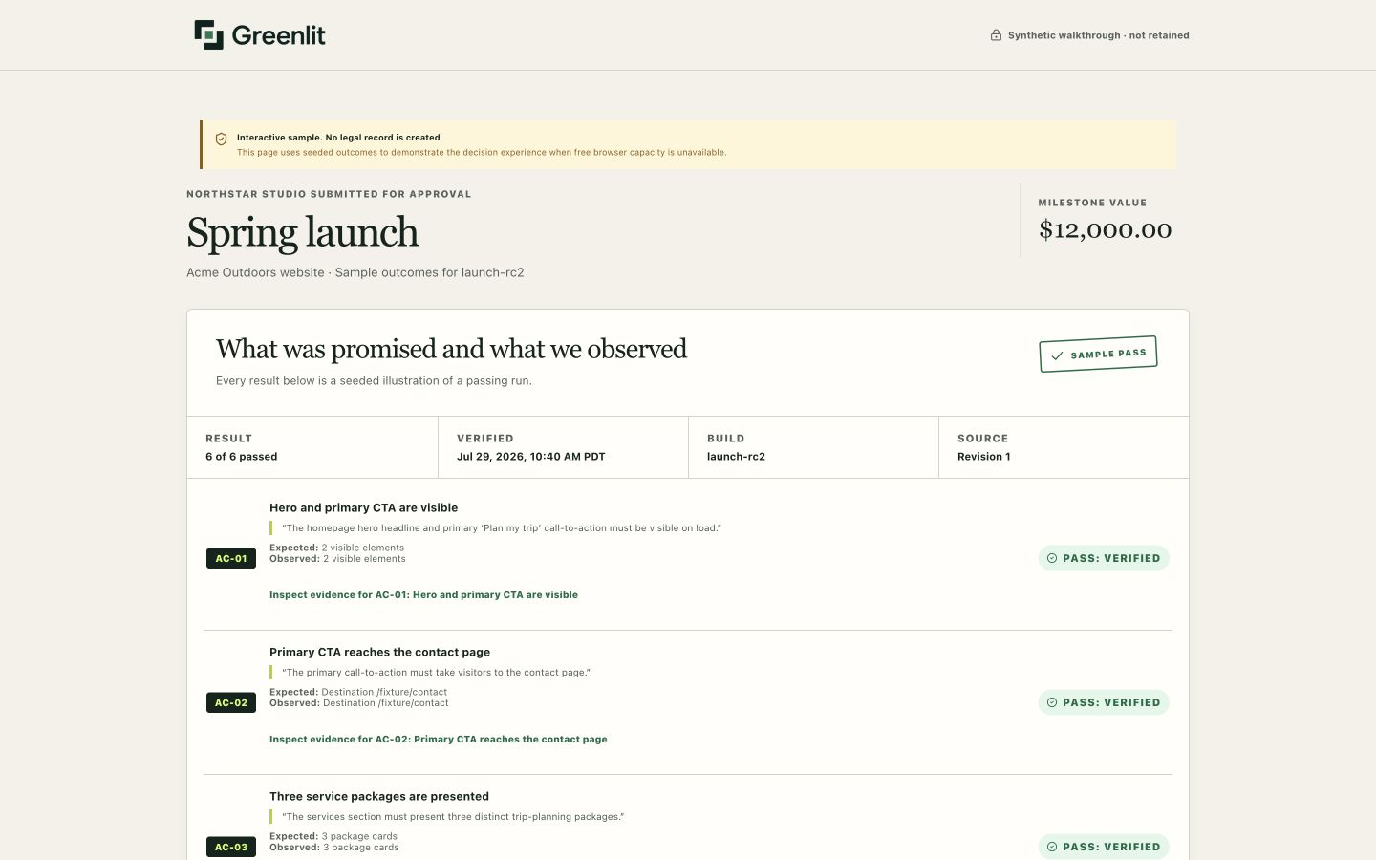
GREENLIT · BLUEPRINT 2026
06
The client sees the promise, not a test dashboard.
The original SOW clause
Expected result and actual result
Evidence and the deadline
Approve or request changes
Notes:
[Sources]
- Synthetic client-review screenshot and workflow: docs/JUDGE_DEMO.md and project-owned Greenlit walkthrough.

Slide 7
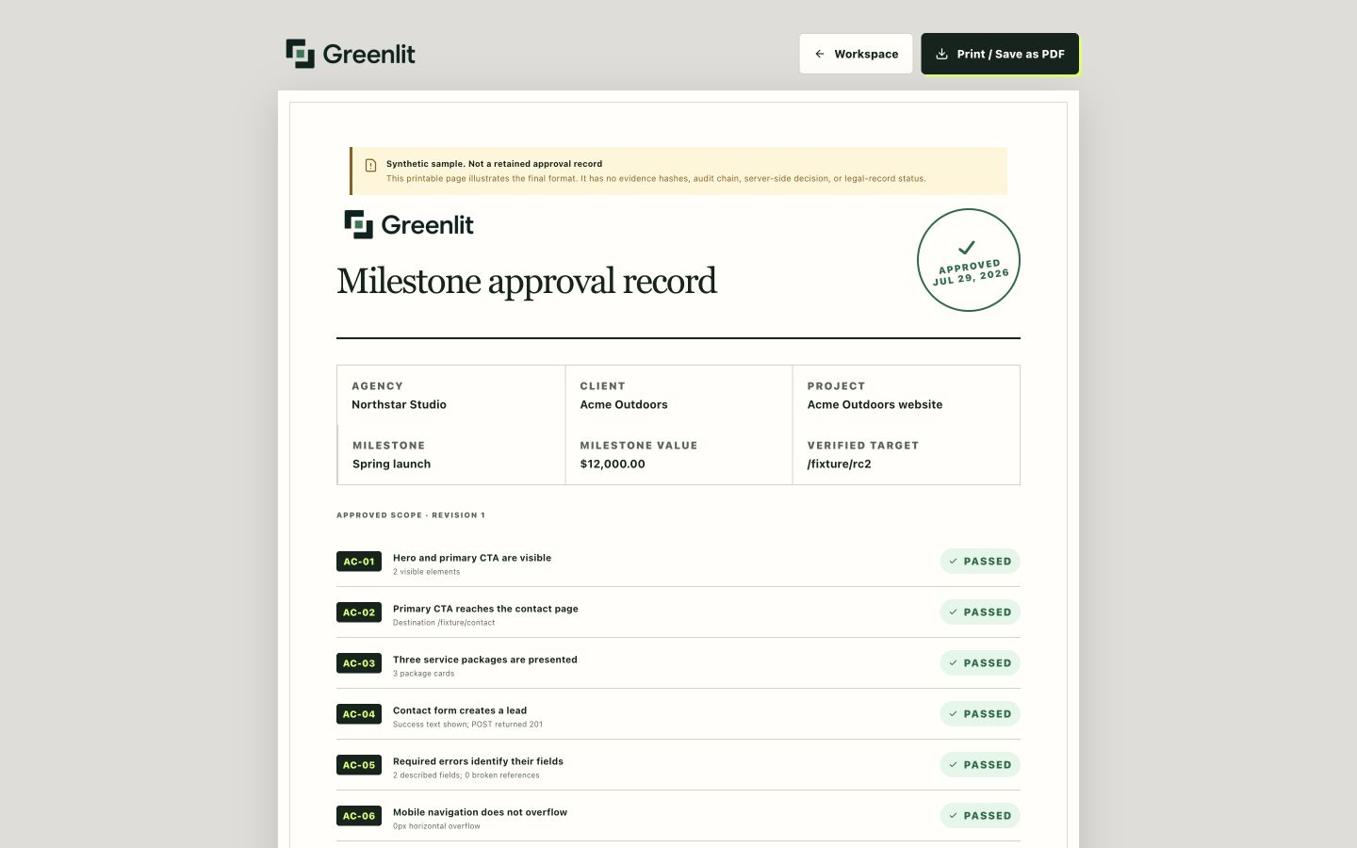
GREENLIT · BLUEPRINT 2026
07
The walkthrough ends in an invoice-ready sample.
The sample receipt keeps the milestone value, revision, observed build, and local-only decision in one place.
What it is
A printable summary of the approval and invoice handoff.
What it is not
A signature, certification, payment record, or guarantee.
Notes:
[Sources]
- Synthetic approval-record screenshot and scope boundaries: docs/DEVPOST_SUBMISSION.md and project-owned Greenlit walkthrough.

Slide 8
GREENLIT · BLUEPRINT 2026
08
The architecture keeps drafting, browser checks, and approval separate.
SOW
NEXT.JS
GEMINI
HUMAN GATE
CLOUDFLARE
TARGET
Agency team
Vercel app
Drafts criteria
Confirms + validates
Queue + browser worker
Verified staging site
SUPABASE
CLIENT
Private evidence
Review + record
Gemini drafts. People confirm. The runner observes. The client decides.
Notes:
[Sources]
- Internal system architecture: docs/ARCHITECTURE.md
- Implementation summary: README.md and docs/DEVPOST_SUBMISSION.md

Slide 9
GREENLIT · BLUEPRINT 2026
09
Four boundaries keep AI in its lane.
Selected text only
Human confirmed
01
02
Gemini sees only the source text needed to draft.
Nothing runs until a person approves the criteria.
Typed and signed
Private evidence
03
04
The runner gets allowlisted checks and a signed job ID.
Results stay in Supabase with expiring access.
AI proposes the criteria. People approve them. Every run stays repeatable.
Notes:
[Sources]
- Trust boundaries and data flow: docs/ARCHITECTURE.md
- Privacy and operational controls: README.md

Slide 10
GREENLIT · BLUEPRINT 2026
10
Built during the hackathon, tested end to end.
Build
Built from scratch during Blueprint 2026 as a full agency-to-client flow.
Verify
Typecheck, lint, tests, build, migrations, and browser flows all passed.
Explore
Try the live walkthrough, then review the source and architecture.
greenlitproof.vercel.app
github.com/
anayagarwalla-ai/greenlit
Notes:
[Sources]
- Commit count and dates: Git history through release commit 4dd64b2.
- Validation counts: current release test and Playwright results executed July 28, 2026.
- Live and source URLs: docs/DEVPOST_SUBMISSION.md.

