Slide 1
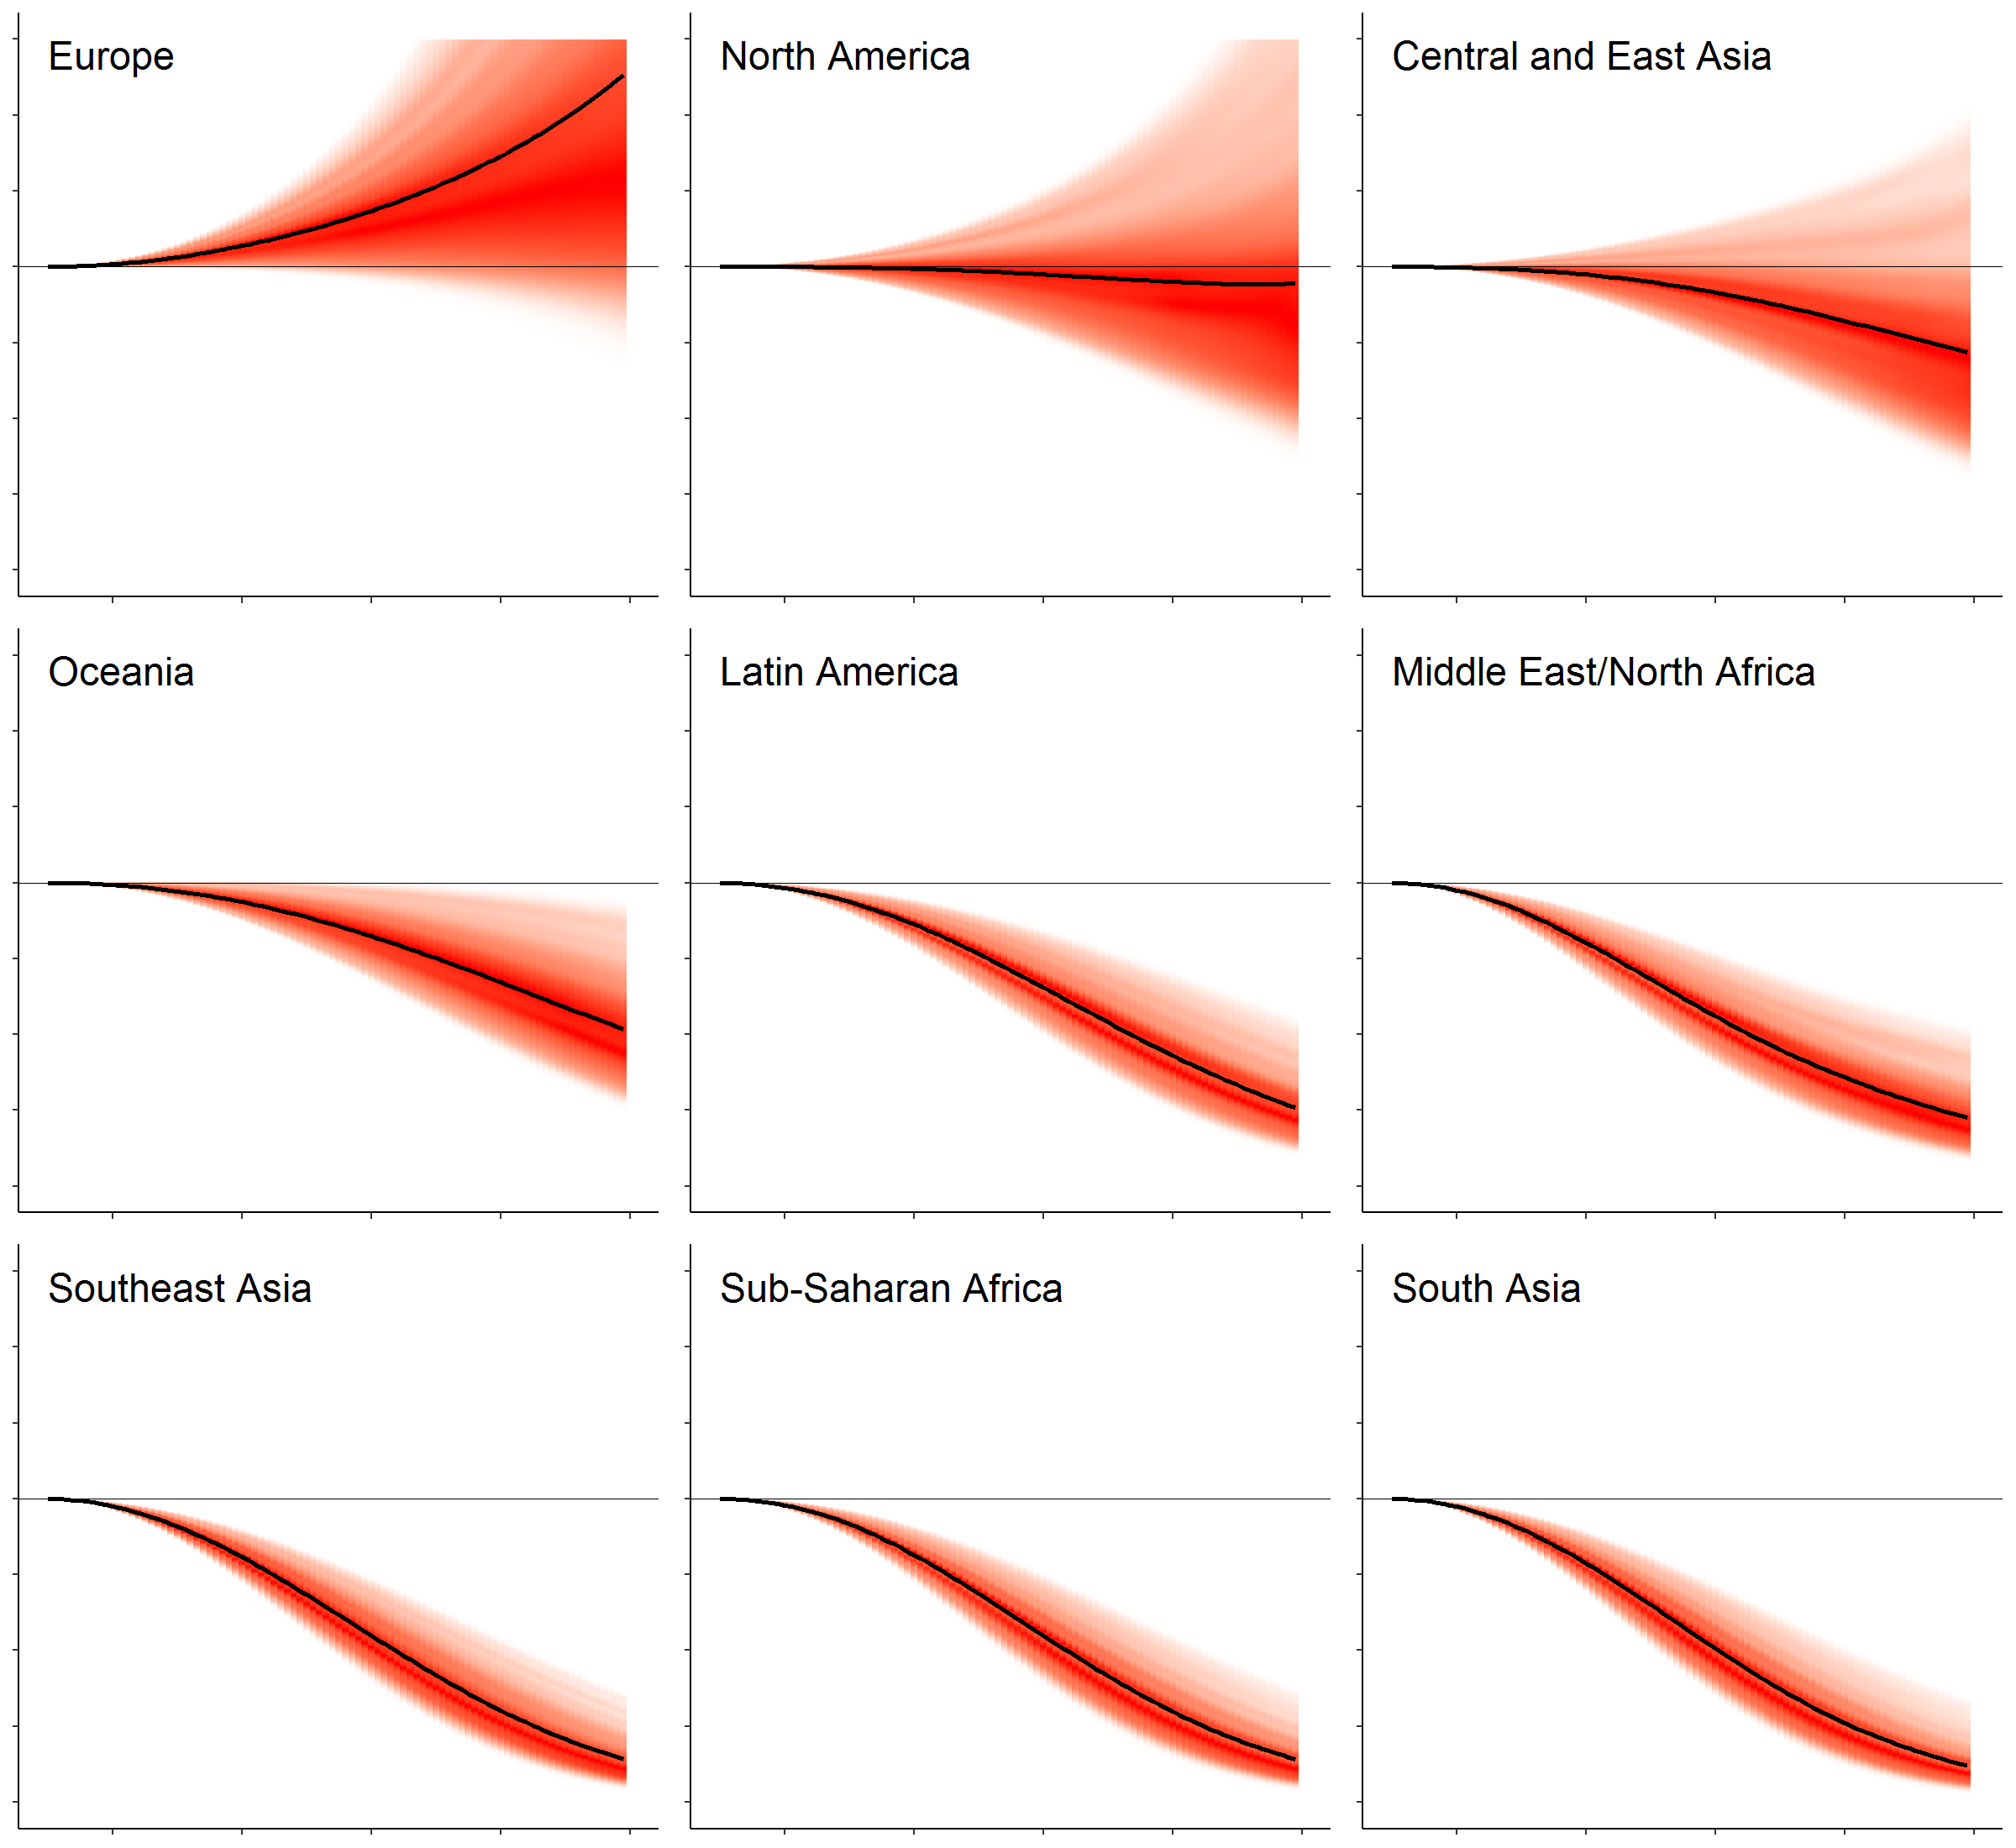
Population-weighted national temperature

Slide 2
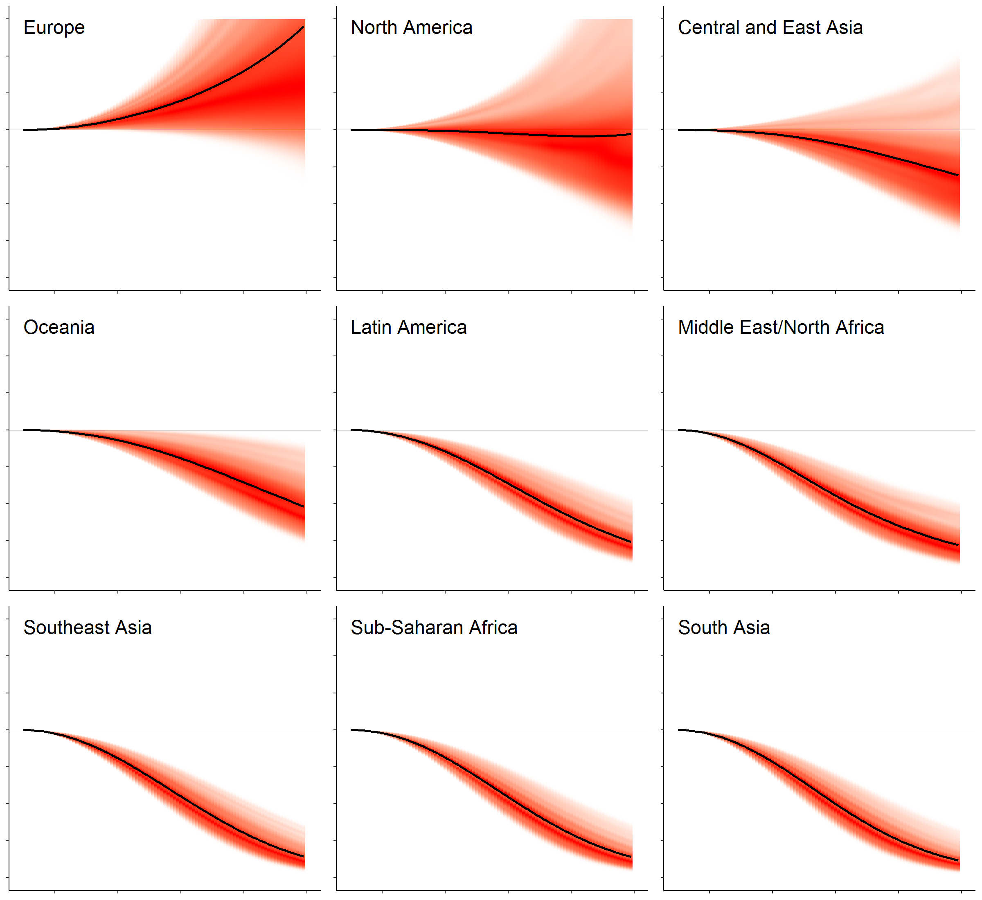
Unweighted national temperature

Slide 3
Population-weighted national temperature

Slide 4
Unweighted national temperature

