Slide 1
North Portico
Tea Room
Ballroom
Francis Bedroom
Upstairs Kitchen
Central Passage
Library
Dining Room
Parlor
First Floor
Front Porch

Slide 2
North Portico
Tea Room
Ballroom
Francis Bedroom
Upstairs Kitchen
Central Passage
Library
Dining Room
Parlor
First Floor
Front Porch

Slide 3
Ritual Room
Old Kitchen
Root Cellar
Wine Cellar
East
Quarters
West
Quarters
Servant’s Passage
Basement

Slide 4
Ritual Room
Old Kitchen
Root Cellar
Wine Cellar
East
Quarters
West
Quarters
Servant’s Passage
Basement

Slide 5
North Balcony
Warr Bedroom
Purple Bedchamber
Linen Closet
Upstairs Hall
Temperance Bedroom
Yellow Room
Second Floor

Slide 6
North Balcony
Warr Bedroom
Purple Bedchamber
Linen Closet
Upstairs Hall
Temperance Bedroom
Yellow Room
Second Floor

Slide 7
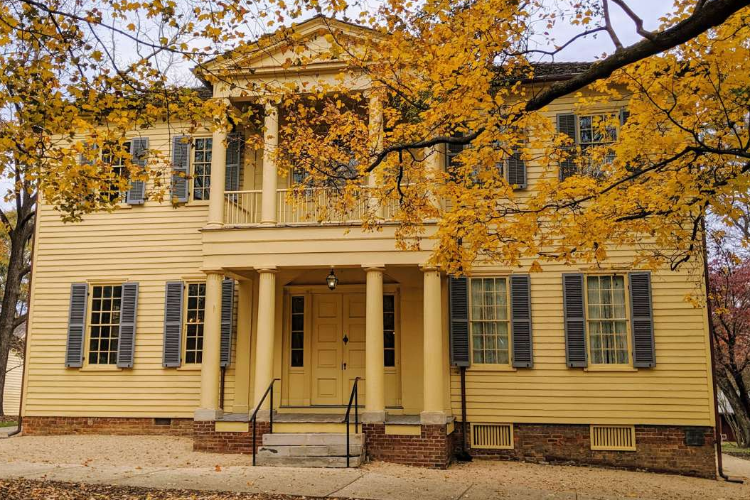
Wash House
West Family Mausoleum
N
Stable-turned Garage
The Grounds

